Slide 1
Object-Oriented programming (OOp) for C++
By Philipp Tiso

Slide 2
A new paradigm
Thus far we have always written procedural programs (runs from top to bottom)
Now we will be looking at a new paradigm which appears similar to procedural programming, but has a few key differences

Slide 3
So what is oop?
OOP is a programming paradigm that subscribes to the notion of using objects
Objects can be created to encapsulate a set of parameters
Before we get started, we need to know a bit about objects
What is an object?
How is it created?

Slide 4
Classes
We have previously (in the predecessor course) looked a bit at what a struct is
But lets just remind ourselves of this before we continue

Slide 5
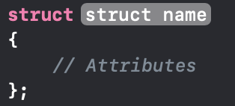
Struct
We can create something called a struct
A struct is defined as follows:

Slide 6
Syntax of a struct
Struct name: This is what we will call our new data-type.
Attributes: This is what our data structure includes.
Let’s create a datatype for a student record

Slide 7
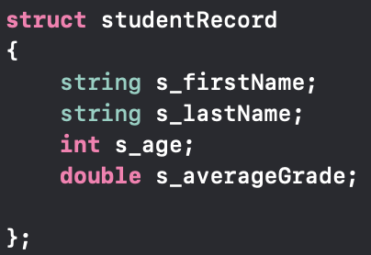
Struct Example: Student record
NOTE: The s_ is just a convention that I use to indicate that this is a member variable of student

Slide 8
Where do we put our struct?
Previously we have always saved our variables on the stack
Now we are getting into the realm of allocating objects onto the heap
But lets first understand the difference between an object and a struct/class

Slide 9

The c++ Class
In C++ we have something called a class
Note: structs are almost identical to classes
We will be using classes going forward
Don’t forget to #include <cstdlib>
We can think of classes like a blueprint for something we want to build
A class will tell us exactly what can be found in an object

Slide 10
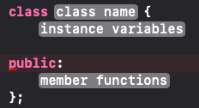
Class syntax
A C++ class can be defined in the following way:
Notice that the class can have both variables and functions

Slide 11
Lets take a break
Try to create some of your own classes while you are waiting
If you did not fully understand the concept of classes up until this point, it should become a lot more clear once we continue

Slide 12


Class Example
Assume we wanted to build a car
A class would serve as a blueprint telling us everything that the car includes
Note that we have NOT actually built the car, we are just saying: “Our car will end up having … once it has been constructed”
Our car will have the following attributes (what the class describes):
A color
2 individual wheels (2D car)
A serial number
An engine
Roof
Chasse

Slide 13
Object
An object is an instance of a class
If the class is a blueprint, then the object is the actual product we get when following the blueprint instructions
This means that we can use one class to build all of our objects which adopt the characteristics of said class

Slide 14



Back to the car example
Before we said that the car class contains the following
Color
2 individual wheels
Serial number
Engine
Roof
Chasse
So we can construct 3 car objects which follow the class building plan, while letting us change things such as color, engine specifications, serial, etc.
Car object 1
Car object 2
Car object 3
Serial: ff-00-20
Engine: V8 turbo
Serial: ab-18-93
Engine: Electric using lION
Serial: af-f4-57
Engine: V12 super charge

Slide 15
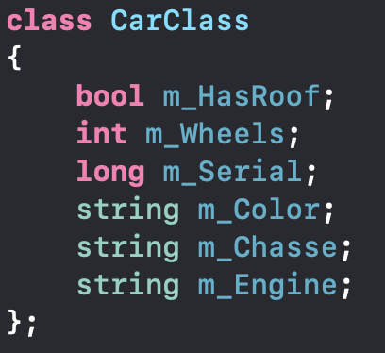
Lets try to create this car class
Take the next 5-10 minutes to create the car class
If you finish early try to create some other classes

Slide 16
Back to The Heap
I previously mentioned that we will be using the heap to store our classes
The heap is a large slice of memory accessible to our program, which stores dynamically created objects
Simply: A section of the programs memory dedicated towards dynamically created objects
We will be using the heap to store all the objects we create from now on

Slide 17
Reserving memory
The heap works differently to the stack, since we need to actually say how much memory we need “we want to allocate n-bytes to this object”
There are 2 ways to do this
Malloc (the hard way)
New (the easy way)
We will use new, since we don’t have a lot of time and malloc has some funny caveats to it

Slide 18
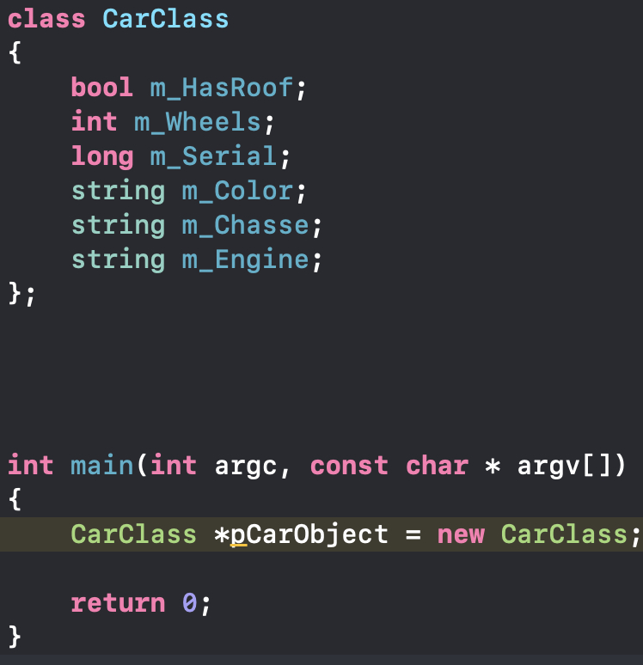
Creating an object
In order to create an object we must first have a class which we can use
So lets use the car class we defined previously

Slide 19

Working with objects
Now that we have a CarClass instance (object) lets try and do something with it
To access member variables of the object, we can use the -> operator similarly to how we used the . operator with structs
Lets try to get the color (m_Color) of our object

Slide 20
Why is it not working?
Xcode keeps going on about “its private”, what does that even mean?
Member variables & functions of a class are private by default
Simply: “The only thing that can access these things are the class and objects who's type is the CarClass class”
So in other words, the class is saying we aren’t allowed to access these instance variables from the main function
Because the main function isn’t of type CarClass

Slide 21
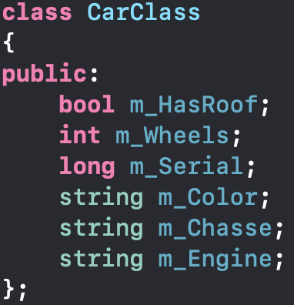
The ”public” key word
In order to make use of these variables we need to set them to public
Simply: Everything is allowed to access members of the class
Everything that comes after public can be accessed by anything

Slide 22
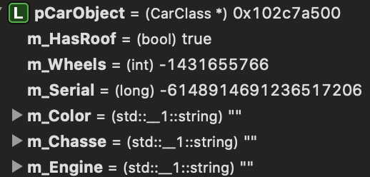
But there is another issue
If we looked at what the values inside the pCarObject object are once it has been created, what would we find?
Because nothing has been initialized, we just get garbage values
How do we fix this?

Slide 23
Class constructors
Wouldn’t it be nice if we could create something that constructs the object according to our specifications, and initializes its instance variables to some default values?
This is what we call a constructor, the constructor is what builds the object
It’s the factory that reads the blueprint and produces the actual car object
So lets write a default constructor
Takes no arguments and is invoked by default when the new keyword is used

Slide 24
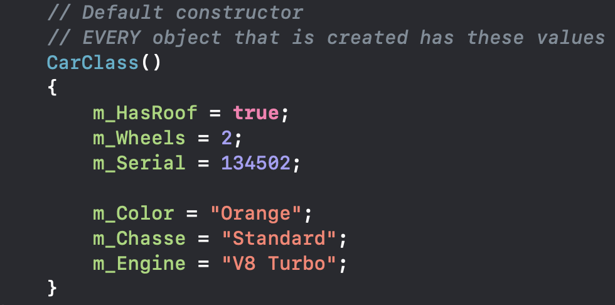
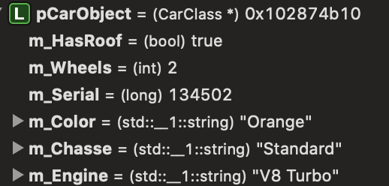
Default constructor
This is what our default constructor looks like inside the class, note that the constructor MUST be public in order for us to use it
This constructor is INSIDE the CarClass class
What would the instance variables of pCarObject be initialized to once we run the code?

Slide 25
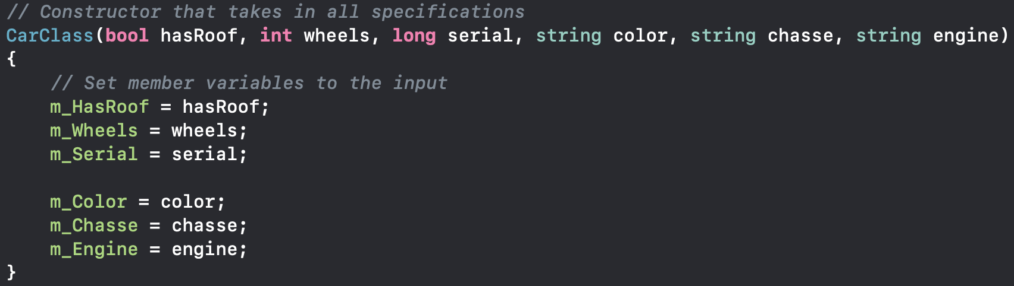
Custom constructor
Lets build a constructor that takes in all the information for the car, and then initializes the values of that object to the input values
Take the next 5 minutes and see if you can figure out how to do this
Why would we want to do this?
Well if we want cars with different attributes, then we should have a constructor that allows us to specify these attributes

Slide 26
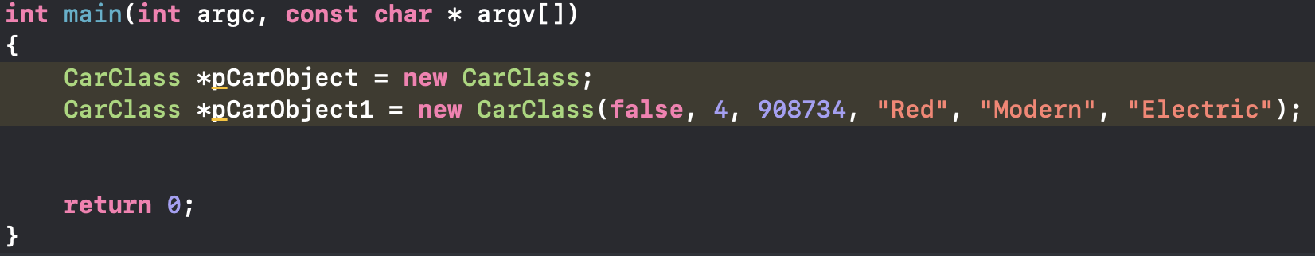
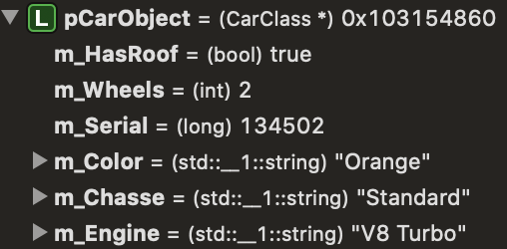
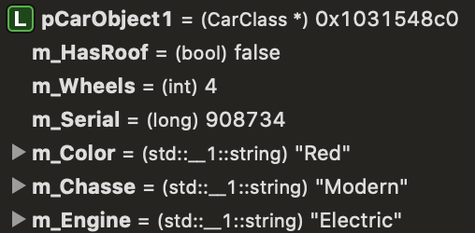
Exercise
What would be the values of instance variables for the two objects constructed in the following piece of code?

Slide 27
But there is still a problem
What if we wanted to just initialize some of the instance variables and leave others at their default value?
We can use an initialization list and actually rewrite the custom constructor from before to replace the default constructor all together
Simply: We will end up with one constructor which can take any number of arguments to initialize said instance variables, while automatically initializing all other member variable to their default values

Slide 28
Default arguments
We can specify what the default values of the member variables should be in the constructer arguments

Slide 29
Initialization list
Instead of doing the assignment inside the constructor, we can follow up with an initialization list
The initialization list is declared by placing the : operator after constructor arguments

Slide 30
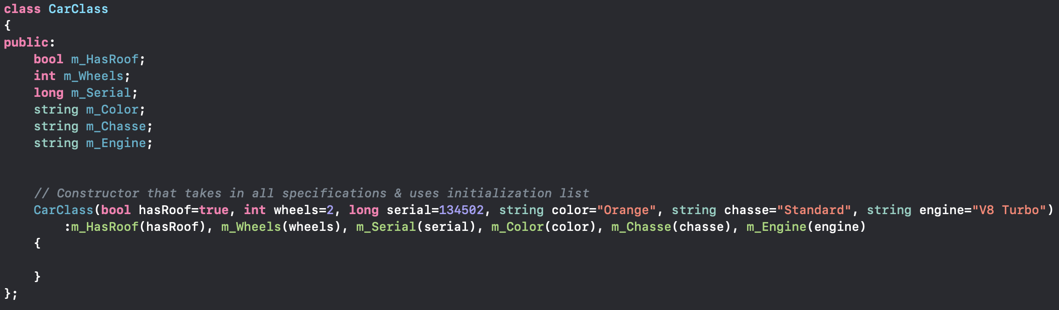
Exercise
Use initialization lists and the default parameters to augment your own constructor
Use the class you have created to construct some new objects & play around with this
This should take no more than 10 minutes

Slide 31
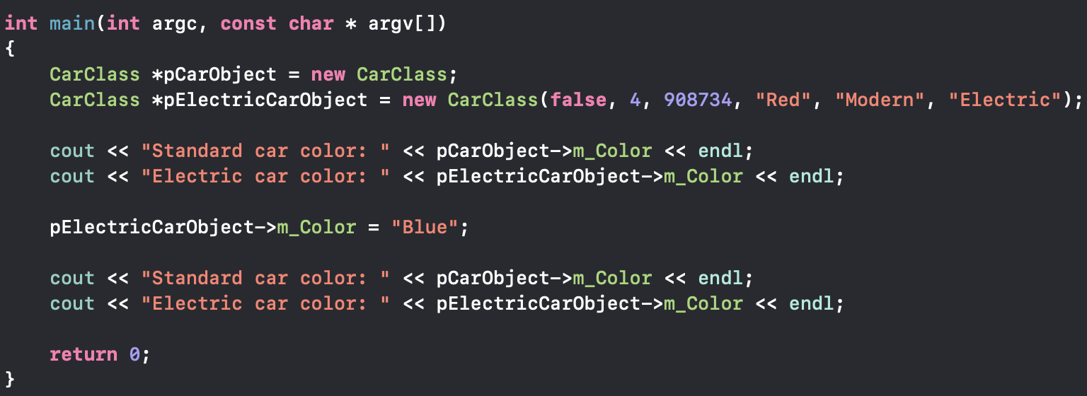
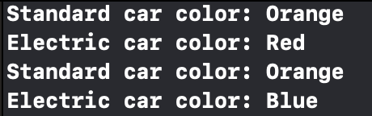
What would the output be?

Slide 32
But once again, there is a problem (a massive one)
What’s the problem now? Everything is working just like we want it to, so what’s going wrong?
If the problem was that bad, surely we would have spotted it by now right?
Any ideas of what it could be?
The error is invisible and you wont know what it is unless you really understand what new is doing and the how the heap should be used

Slide 33


Memory leaks
Every time we use the new keyword, we are allocating memory for an object on the heap, but we never delete the object before the program ends
In other words, we are filling the heap with garbage (objects that we don’t need anymore)
The dangerous thing is, that we can’t actually see these leaks unless we are explicitly looking for them or until its too late and the program crashes

Slide 34
So how do we fix this?
Because C++ gives us so much control, its our responsibility to clean up after ourselves, hence we need to free any memory we have allocated by deleting unused objects
How do we know when there is a memory leak?
There are tools which can help us diagnose this (valgrind, Clnag’s –fsanitize, etc)
But lets try to manually go through and see if we can figure out where this is happening
Notes:
Use breakpoint: /Users/philipp/Desktop/Advanced_Summer_Camp_Course/Advanced_Summer_Course/leaker_script.sh
Illustrate point using malloc instead of new
Run with valgrind:
/Users/philipp/Desktop/XCode_Programs/cppHelloWorld/CPPLectureExamples
valgrind --tool=memcheck --leak-check=yes --show-reachable=yes ./a.out

Slide 35
Deleting objects
Whenever we have used new to allocate some memory, must use delete to free that memory again once we are done using the object
This can be done by simply doing:
delete pCarObject;
delete pElectricCarObject;
The freeing of memory must be done before the program terminates
Otherwise the memory becomes unreachable
For the next 2 minutes, try cleaning up your code using what we just said

Slide 36
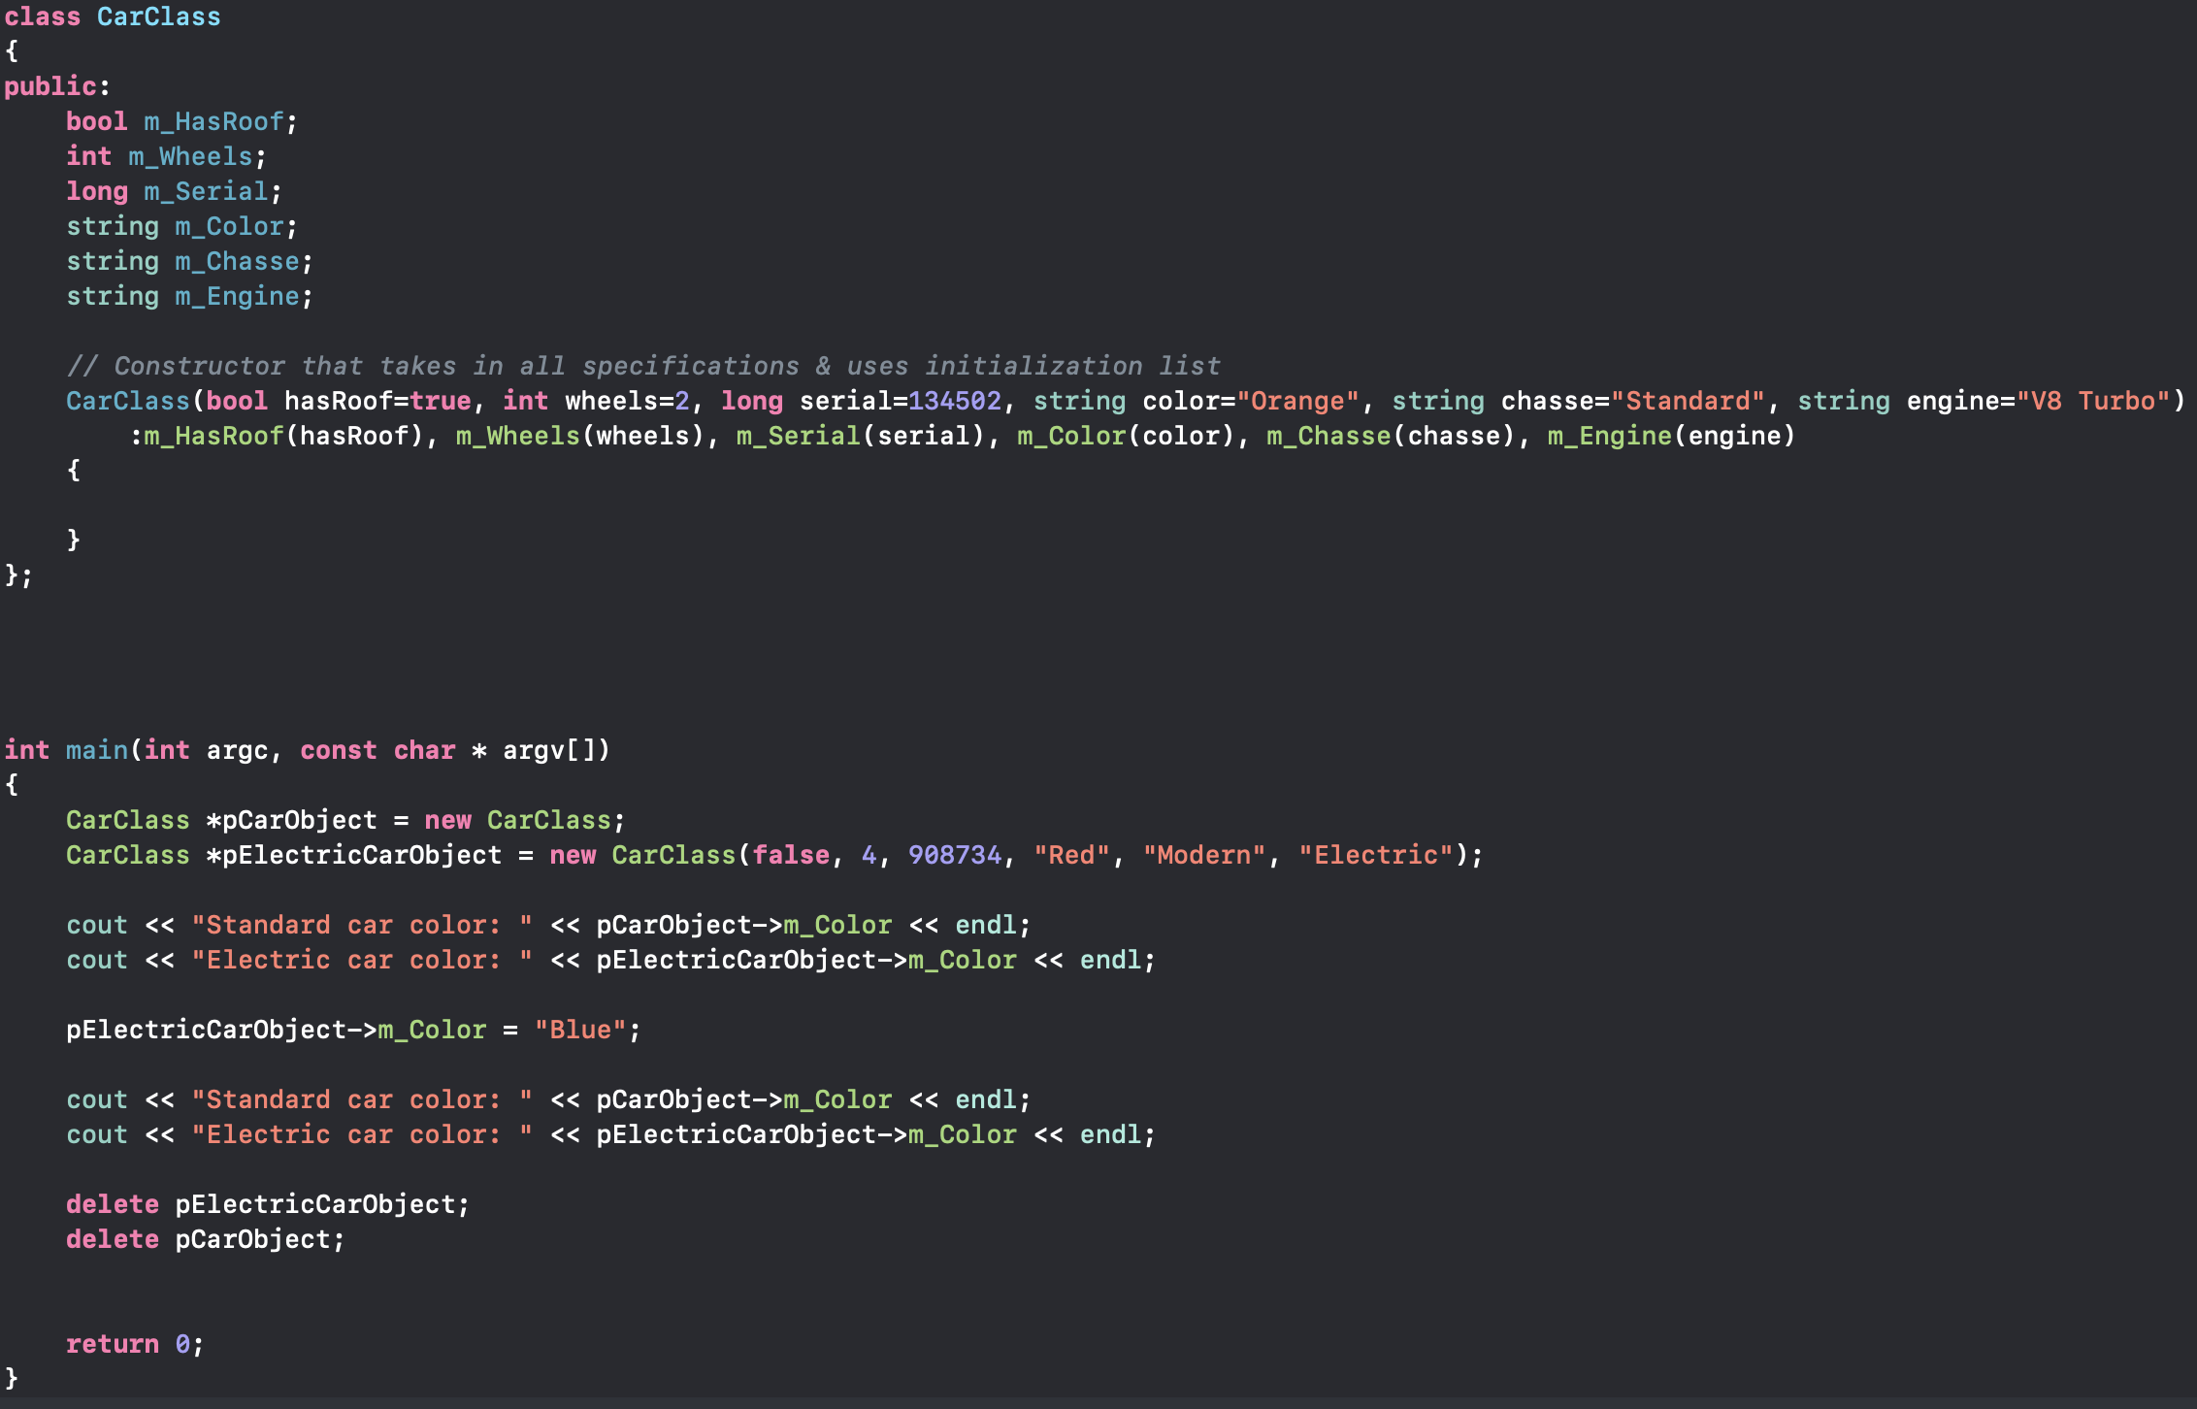
Solution

Slide 37
A short break
We have covered a lot of content so lets just slow down for a few minutes
Now is your chance to ask if you are still confused about anything discussed thus far
The next section mandates that you have understood the following concepts:
Difference between a class and object
How to build a basic constructor
How to access instance variables of an object
Why it was necessary to use the public keyword

Slide 38
Variables are nice, but have you seen functions?
We have been looking at instance variables for classes, but these are not the only members that a class can have
Classes can have member functions which can be invoked via an instantiated class (object)

Slide 39
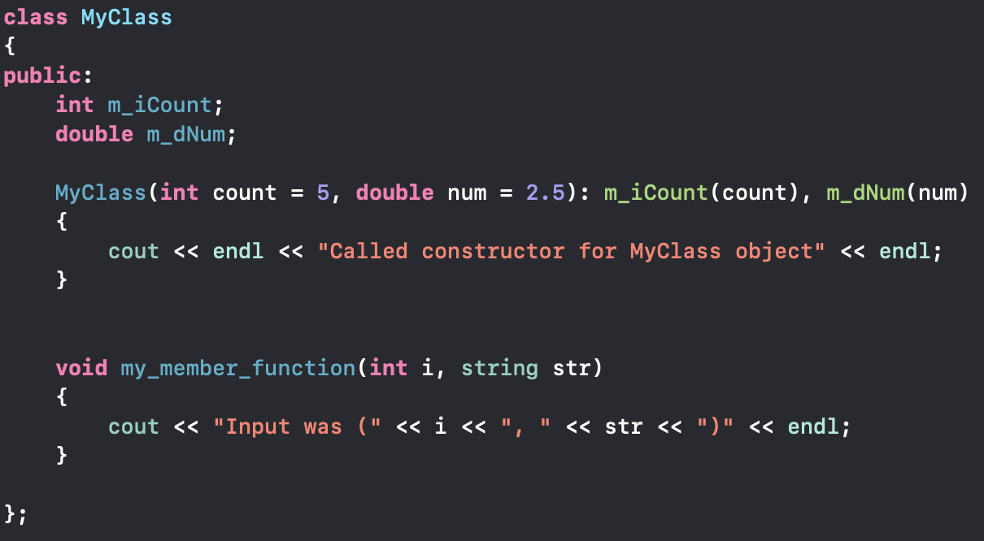
Member functions
Member functions are defined just as any typical function would be
The only difference is that the function is defined inside a class

Slide 40
Exercise
Using what you know about functions and scoping, can you create a simple class which adheres to the following:
All member variables (at least 2) are private (above the public: keyword)
There exists one constructor which takes at least 2 arguments
There are at least 2 member functions in the class
Values of instance variables (variables of objects) can be displayed in the main function
Despite being private
Hint: Look at the 3rd requirement

Slide 41
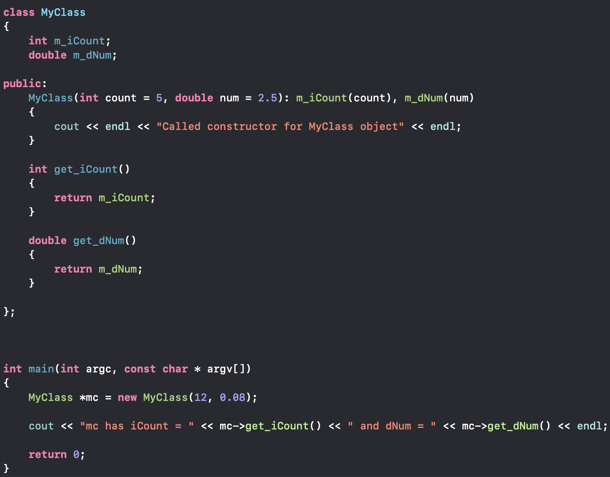
Solution

Slide 42
What now?
You have the remaining time to play around with classes and the various constructs we talked about before
The best way for you to understand what we did, is to try it yourself and experiment around with it

