Slide 1
I/O & Recursion
By Philipp Tiso

Slide 2
Goals for today
I/O
Quick note regarding main()
How does I/O work in C++
The SHELL
Stupid users
The Stack
Function representation (in memory)
RECURSION

Slide 3
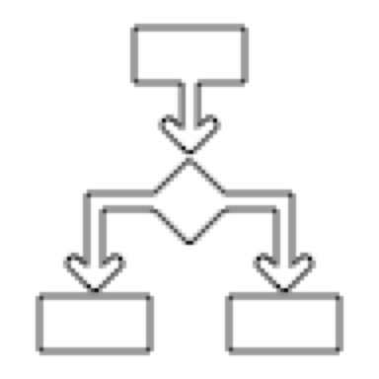

What is I/O?
Its an acronym for “Input/Output”
I/O is what we use to give our program some input to work with
I/O is typically used if we want the user to enter some information

Slide 4
How do we use I/O?
We need to include the library that will allow us to use the I/O methods
This is the <iostream> library
In our case we will be getting input from the command line, which means we will be using a shell

Slide 5
How do we get Input?
We saw the cout function which we used to output data to the screen
cin: This is the function that we can use to get data from the command line
We can use the >> operator to say “ok get me some input an then load it into the variable after the >>”

Slide 6
The cin function
cin is a function that is part of the <iostream> library
cin reads input from the command line
We can use the >> operator with cin to say “from cin, place the input into the variable after the >> operator”

Slide 7
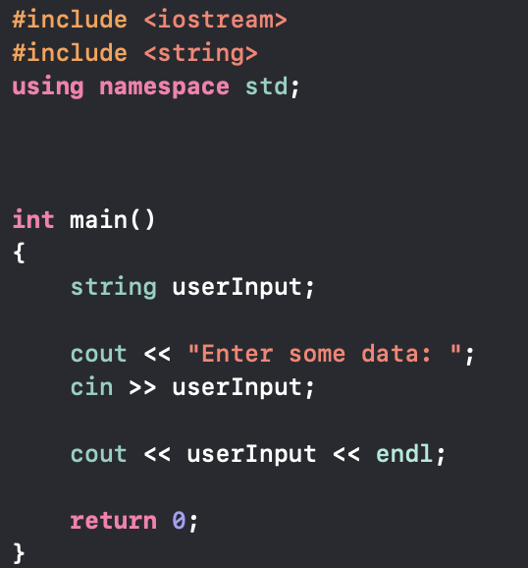
Input Example
We need to save the user input somewhere
We can create a variable to save the user input
The variable must have the appropriate type for the input
If we expect a number, it should be a number data-type etc.

Slide 8
Programming Exercise
Create a program that takes in some user input (you may decide what type)
Then give your program the incorrect input.
What did you notice?
Let’s try it!

Slide 9
Programming Exercise
Create a program that takes 2 string inputs from the command line
You are allowed to use ONLY 1 variable to save these two strings
Your program should then print the strings in the reverse order
:~ string1 string2 → string2 string1

Slide 10
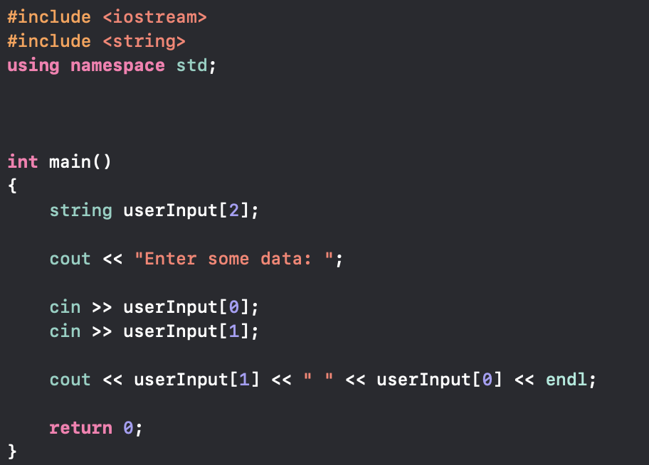

Solution
We can use an array of strings
OUTPUT:
NOTE: The spaces between the two strings is ignored

Slide 11
The main function revisited
The main() function is one that we have seen since the start, but there are things we haven’t told you.
The main() function is somewhat incomplete in the way we have been using it
It is possible to pass arguments to the main function if we tweak its structure

Slide 12
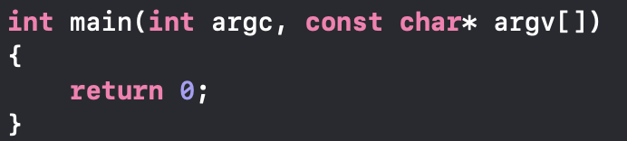
The mains final form!
There are two extra arguments that we have neglected previously
argc and argv respectively

Slide 13
argc
argc is an integer which we can use to select the argument from argv
It is what tells us how many other arguments we have entered
This will make sense once we look at argv
argc will NEVER be less than 1
This is because the first argument is the path of the file we are working on
Just print the first element in argv: cout << argv[0] << endl;

Slide 14
argv
This is an array of strings that our program can use
argv[0] is always the path to our the .cpp file were working in
Arguments are passed before we run our program
This is done on the command line via the shell
argc tells us how many strings argv[] contains

Slide 15
Getting command line args
Command line arguments are given to our program before it runs
This is done by using a shell to provide the required arguments
But what is this “shell” that we keep going on about?

Slide 16
The Shell
The shell is what allows us to interact with the system directly
The shell gives us a complete overview of our computers layout, this includes the file system (how our files are arranged), the processes that are currently running, etc.
Let’s look at how we can run programs from the shell (Don’t worry about this, were just illustrating a point)
Disclaimer: Since I am on a Mac, my shell is somewhat different to the windows shell, so you may not be able to completely reproduce what I do in terms of navigation
Source

Slide 17
Let’s play around with the shell for a bit
This doesn’t work on codeboard.io for some good reasons
In order to add these command line arguments we need access to the shell
Giving people access to your servers shell it typically an awful idea!
Have a think as to why. It’s rather obvious once you think about it
Let’s create some programs that take in input from the shell and then print it to the screen

Slide 18
What are some examples of user input?
Basically every app that you use, Snapchat, WhatsApp, Google Chrome, etc.
User input is anything that requires the user to interact with a program
Enter your name, age, date, etc.

Slide 19

But there is a problem
Have you ever tried to enter a ridiculously large string int a text field?
I know that I have, the only reason for doing so being “well why not?”
Usually those people are called “stupid users”, not the nicest thing to say but let’s move on
So what if we are expecting our user to give us their name, but they give us a random number?
We need to make sure that we can prevent this
In other words, we need to make our application “idiot proof”
Fun fact: Did you know that Microsoft PowerPoint technically violates Apple’s terms and services?
If you are interested as to why, we can look at this during the break

Slide 20
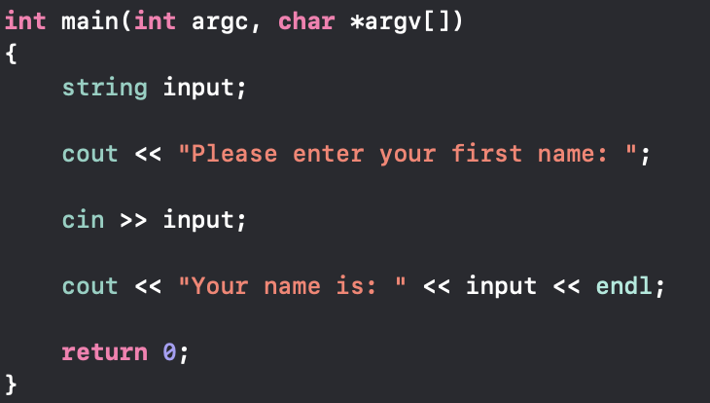

Lets look at the following program
Issues:
User could input an empty string
User can input a number
User can mish & mash strings and numbers

Slide 21

Empty string problem
What does that mean?
It means that our user can just press enter and we get a “empty string” since no input was actually provided
We need to check that our string exists
How do we do that?

Slide 22
Checking that strings are not empty
Let’s think back to what a string actually is
string: “An array of characters”
So if our string is NOT empty what does that imply?
Obviously it means that the array is not empty
This means that there is AT LEAST 1 character in the array

Slide 23
But we are lucky
Fortunately cin is somewhat smart and prevents this by checking this
cin is a more preferable choice over the getchar() which only reads in one char at a time from the command line
But let’s try to do this ourselves for the sake of understanding

Slide 24
5 Minute task
Try to create a method that informs us if a string is empty or not.
You may do this however you choose, but your function MUST have some return type
Hint: Recall that there is a function that gives us the length of the string

Slide 25
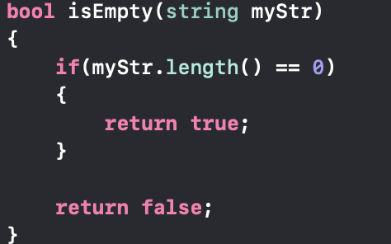
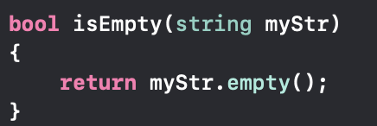
Solution
You may have come up with something like this:
This is perfectly fine, but there is an easier way
In-fact that easy way is just 1 line
Solution:

Slide 26

Prevent Illegal type input
We now know how to prevent empty inputs, but we’re not done yet
What if we expect a string of alphabetic characters and someone gives us a number?
Is it possible to detect if something is a number or not?
Fortunately it is possible to do so using some methods that C++ provides

Slide 27
Let’s take a break
If you are interested, we can look at what the shell actually is
Why is it called SHELL?
Otherwise, go outside (if it’s nice). Think of something else to give your mind a break

Slide 28
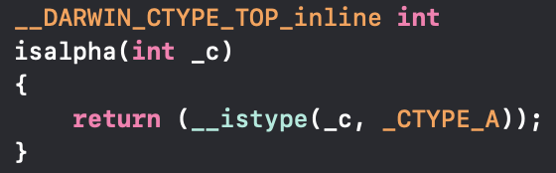
The Isalpha function
The isalpha() function is extremely useful when checking if a variable is an alphabetical character
What do you think the function definition for isalpha() looks like?
I don’t expect that you actually know this detail
Fear not, this is just a fun little extra piece of information
If you value your sanity and don’t want to go crazy then please DON’T MEMORIZE STANDARD LIBRARY FUNCTIONS

Slide 29




5 Minute task
Stop the illegal input!
Construct a function that informs us if a number was an input
You may use any means necessary, but remember what we just talked about
It will help you a lot!

Slide 30
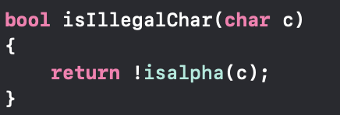


Solution
Your solution may look something like this:
This is not the “end all be all” solution
We return !isalpha(c) because “If c IS alphanumeric, then it is NOT ILLEGAL”

Slide 31
Stopping illegal strings
Before we stopped our user from inputting a SINGLE number into our program
:~ ./a.out 12 would be rejected
But what if we entered something like “iAmN07Astr1ng”?
In short, our program would go “Well this whole thing is not a number, so that’s fine”
Unfortunately this is the furthest that we can get from “fine” (ie. It’s a disaster!)
So what’s the problem?
Simply: We are not checking the entire string for illegal characters

Slide 32
String sanitizing
We need to find a way to look at the entire string and analyze each character
We have the tools to do this so let’s try it!
For the next few minutes, try and come up with a function that informs us if a string is legal or not.

Slide 33
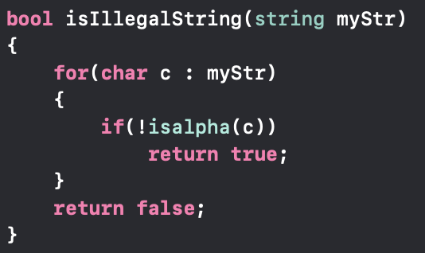
Solution
Your solution may look something like this:
There are many solutions but this is a simple one
WAIT HOLD ON THE IF IS MISSING THE BRACKETS!

Slide 34
A minor detail about the if
Up until now we always enclosed our statement for the if with {}
In C++ it is possible to negate this, SO LONG AS THE STATEMENT IS 1 LINE
This allows us to making our code more readable in some cases
NOTE: This also works for the else statement

Slide 35
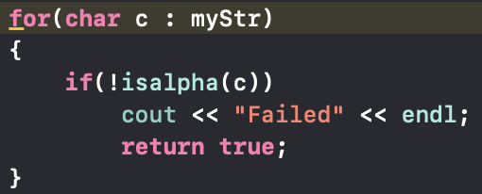
If statement association
Doing the following will result in Xcode yelling (rightfully so)
Xcode will give the following complaint:
Note: Xcode is not all knowing, I am just using it to illustrate a case where it warns us
Xcode is basically saying: “looks like the return true is not part of the if, so the loop will only go once. So why on earth are you using a loop?”

Slide 36
Let’s take a break
If you want to keep working, we can take a look at how memory works and why it’s so important
Alternatively we can take a step back and look at how our code gets translated into machine code
Use hopper to illustrate

Slide 37
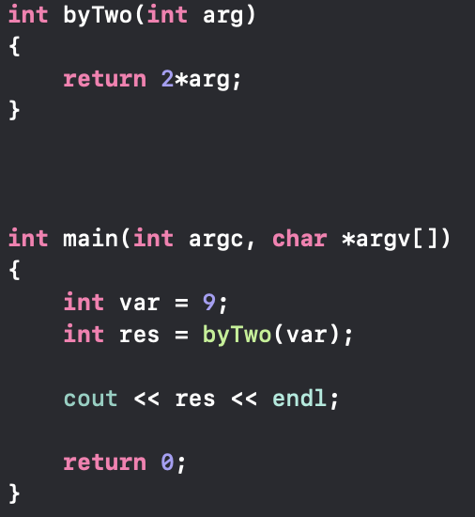
Memory (Revisited)
The last time we looked at memory it was extremely open ended
Now we will narrow in on some aspects
Consider the following piece of code:
Where do you think we use memory?

Slide 38
Where is memory used?
Well isn’t it obvious?
int var and int res
Yes that’s one point where we do use memory, but we missed an important part!
Remember when we talked about functions taking variables “by value” (create a copy)?
Well that copy needs to be stored somewhere, and it just happens to be the computers memory
This is even the case for calling the function. So every function call requires memory
Main point: Every time a function is called, we need memory where we can create a block for the function

Slide 39

The stack
Our computers memory has a pretty complex layout
But there exists a part called the stack
The stack is where all our variables go (this is technically not true, but too in-depth)
When a function is called, the OS says: “Ok looks like I have some space for you on the stack, go here to this memory address”
This “space” that the function allocates when called, is referred to as a “Stack Frame”

Slide 40
Function stack frame
When a function is called, it creates an instance of itself on the stack
The memory used for this instance is called the stack frame
When the function finishes (returns) the stack frame is destroyed
Stack frames are created in the order in which they are called

Slide 41
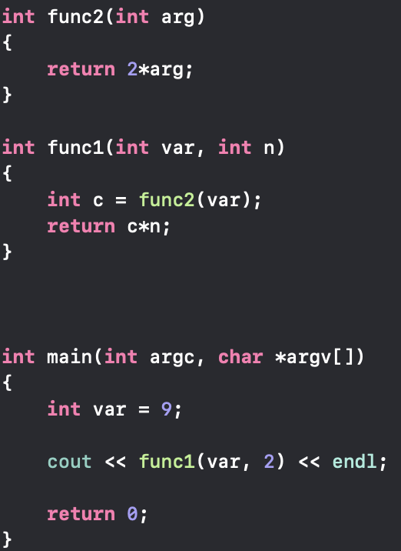
Illustration of the stack frame
CALL STACK

Slide 42
First Call: Main()
CALL STACK
main()
The first function call of our program is the call to the main()

Slide 43
Second Call: func1()
CALL STACK
main()
func1()
The main() calls func1(var, 2)

Slide 44
Third Call: func2()
CALL STACK
main()
func1()
func2()
Before func1() returns, it calls func2()

Slide 45
First unwind: func2()
CALL STACK
main()
func1()
func2()
func2() returns it’s result (18), so it gets removed from the call stack.

Slide 46
Second unwind: func1()
CALL STACK
main()
func1()
func1() returns it’s result (36), so it gets removed from the call stack.

Slide 47
Final unwind: main()
CALL STACK
main()
main() prints out var and returns. The program ends since main() is removed from the call stack
Notice that the function at the bottom of the stack is the one that gets executed. This is something we can use to our advantage.

Slide 48
Warning: The following may be confusing

Slide 49
Recursion
Definition: ”In order to understand recursion you must first understand recursion”
That’s a rather useless definition you may think
But once you understand what recursion is, this joke will make sense
Let’s define recursion in a more simple to understand way!

Slide 50
Simple definition of recursion
Recursion is when we use a function within itself.
Think of it like this: “If I can call a function [func2()] from another function [func1()]. In that case why can’t I call a function [func3()] from itself [func3()]?”
Let’s look at a recursive function and analyze it!

Slide 51
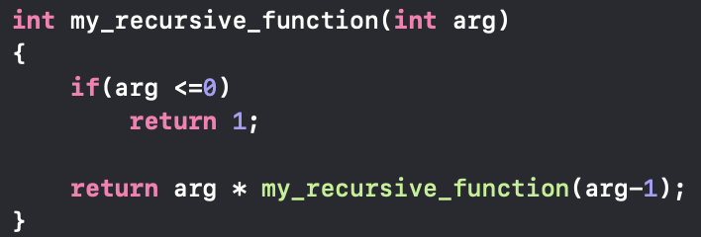
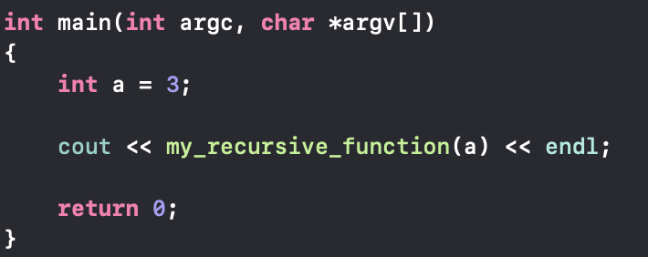
Simple recursive function
This function is recursive since it calls itself
But how does this relate back to the call stack that we just talked about?
Let’s look at how this would work for the following program:

Slide 52
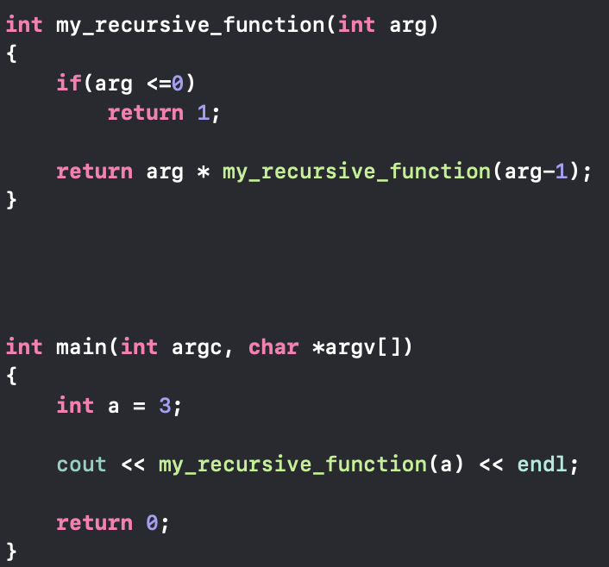
First Call: Main()
CALL STACK
main()
The first function call of our program is the call to the main()

Slide 53
Second Call: my_recursive_function()
CALL STACK
main()
my_recursive_function(3)
main() calls my_recursive_function(3)

Slide 54
First recursive Call:
CALL STACK
main()
my_recursive_function(3)
my_recursive_function(2)
3 was greater than 0, so we call: my_recursive_function(3-1)
which is: my_recursive_function(2)

Slide 55
Second recursive Call:
CALL STACK
main()
my_recursive_function(3)
my_recursive_function(2)
my_recursive_function(1)
2 was greater than 0, so we call: my_recursive_function(2-1)
which is: my_recursive_function(1)

Slide 56
Third recursive Call:
CALL STACK
main()
my_recursive_function(3)
my_recursive_function(2)
my_recursive_function(1)
my_recursive_function(0)
1 was greater than 0, so we call: my_recursive_function(0)

Slide 57
Fourth recursive Call/ First subsequent unwind:
CALL STACK
main()
my_recursive_function(3)
my_recursive_function(2)
my_recursive_function(1)
my_recursive_function(0)
0 was NOT greater than 0, so we return 1

Slide 58
Second Recursive unwind:
CALL STACK
main()
my_recursive_function(3)
my_recursive_function(2)
my_recursive_function(1)
my_recursive_function(0) has finished, my_recursive_function(1) returns as well

Slide 59
Third Recursive unwind:
CALL STACK
main()
my_recursive_function(3)
my_recursive_function(2)
my_recursive_function(1) has finished, my_recursive_function(2) returns as well

Slide 60
Fourth Recursive unwind:
CALL STACK
main()
my_recursive_function(3)
my_recursive_function(2) has finished, my_recursive_function(3) returns as well

Slide 61
Final unwind:
CALL STACK
main()
my_recursive_function(3) has finished so the main() will print the result and returns as well

Slide 62
What if we removed the condition?
DISCLAIMER: You can try this, but I wouldn’t recommend it (you will see why)
The condition is used to define a point when we want our function to stop calling itself
If we removed this condition, we would get infinite recursion!

Slide 63
So what? I have time, I can wait.
Even if you had infinite time, the same can’t be said about the computers memory
Recall that every function will create a new stack frame when it is called
This implies that we would need infinite memory in order to accommodate this
But removing the if isn’t the only way we can cause mayhem on our system

Slide 64
Reasonable function definition
The function we created before was progressing due to how it was called
This refers to how the function is calling itself:
Notice that we are giving arg-1 as the argument and not just arg
This is because we need to have a way to approach our condition
Simply: Whatever we do, it needs to get closer to what we consider “illegal” in our condition
If we didn’t do that, then we may as well remove the condition since we don’t intend to use it
This is a ridiculous proposition, so we will stay well away form it

Slide 65
But what does this actually look like?
Let’s look at this in the Xcode debugger
Show call-stack (in thread Queue)
This will give us a better understanding of what is actually going on in terms of how the functions are called (though it is very similar to what we just did)
Side question: For the mathematicians, does this method resemble an operator that you know?

Slide 66
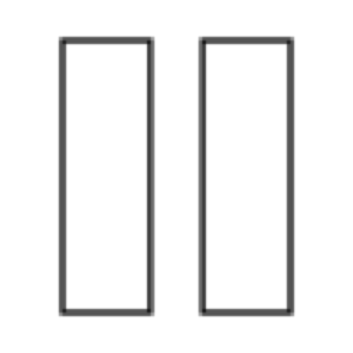
Let’s take a break
This was a lot to take in, so let’s take a break
If there is anything that is still confusing, we can review it!
If you didn’t understand everything don’t worry, recursion is rather complicated at the start

Slide 67
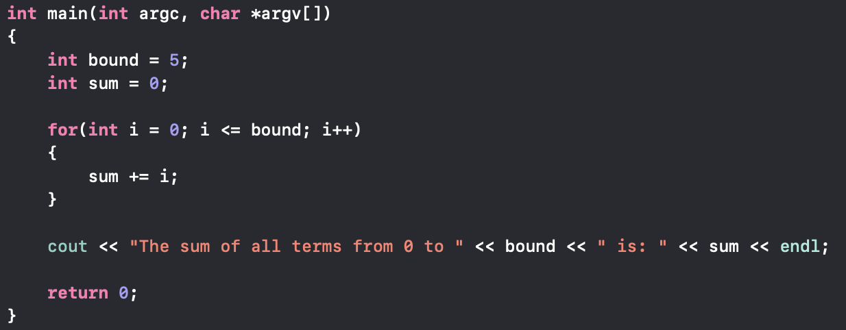
Recursion Exercise
This exercise is NOT trivial. You will need to do some thinking
Convert the for loop into a recursive function:

Slide 68
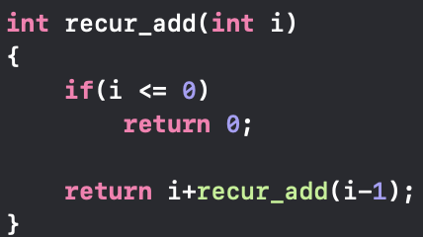
Solution
This is very similar to what we did before. But it requires a fair understanding of what we did to draw that conclusion
Note: bound should be the input to this function

Slide 69
Loops vs Recursion
Question: Does it make sense to always replace loops with recursive methods?
Advantages of recursion:
Recursive methods tend to reduce unneeded function calls (only call what you need)
Recursive methods are usually simpler compared to iterative (for/while) solutions
In this context “simpler” refers to the amount of code needed i.e. readability
Disadvantages of recursion:
Recursive methods have a greater time complexity (longer to execute) than iterative solutions
Recursive methods have a greater space complexity (more memory) than iterative solutions
The larger the problem (number of iterations) the worse space and time complexity get!
Recursive solutions can be rather difficult to understand & debug

Slide 70
Memory (revised)
In C++, a variable name is really just shorthand for a memory address
Up until now we have been passing variables by value to our functions
This can be rather annoying when we want to change our variable
What if we wanted to return 2 values? What do you think we could do?
If we can access the variables in memory directly, we could change them right there
There is a way to do this, but that’s a bit to complicated
Notes:
Start leading into pointers

Slide 71
Pointers
There are things called pointers that we will look at in tomorrows lesson
Be prepared to see the true power that C++ gives us!
Before we get to pointers, we need to get a better understanding of what memory is.

