Slide 1
Conditionals
By Philipp tiso
&
Alexander jaeger

Slide 2
Reminder from yesterday
C++ Function
“A piece of code that we can call repeatedly from anywhere (within acceptable scope)”
Data-types
Numbers : int, float, double
Text: char, string
Logic: bool
Special: void
The main function/ Program flow
Entry point to our program, “where everything starts”
How does the program execute once its compiled

Slide 3
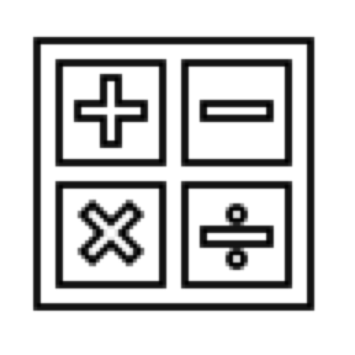
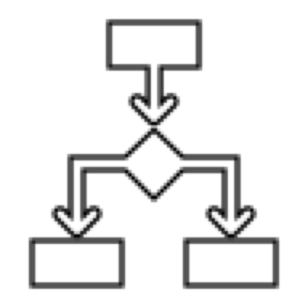






Objectives for today
Arithmetic & Logical operators (introduction)
Conditionals (main focus of the morning)
Functions (review & more in-depth)
Pass by value
Member variables
Arrays (revision & more in-depth)
Array structure in memory (introduction)
Variable scope & lifetime
Local variables
Global variables
$$∀o(o∈∑)$$

Slide 4
What are conditions?
A condition is a statement that must hold true in order for something to occur
Almost everything we do in our daily lives is conditional!
Conditions are usually seen in the form of some term/expression
Let’s look at some examples!

Slide 5
Examples of Conditions (Not C++ syntax)
The integer variable Y is strictly greater than 5
The Boolean variable X has a value of true
The integer variable Y is less than or equal to 10 AND the Boolean variable X is false, OR the Boolean variable I is true

Slide 6
Let’s express the previous expressions using C++ syntax
Y > 5
X == true
(Y <= 10 && X == false) || I == true

Slide 7
Wait, what is this “&&”/ “||” stuff?
These are called logical operators, they are representations of simple operators.
&& : The representation for the AND operator:
Syntax: α && β
Both α and β must be true to satisfy a condition
|| : The representation for the OR operator
Syntax: α || β
Either α or β (both or at least one) must be true to satisfy a condition.

Slide 8
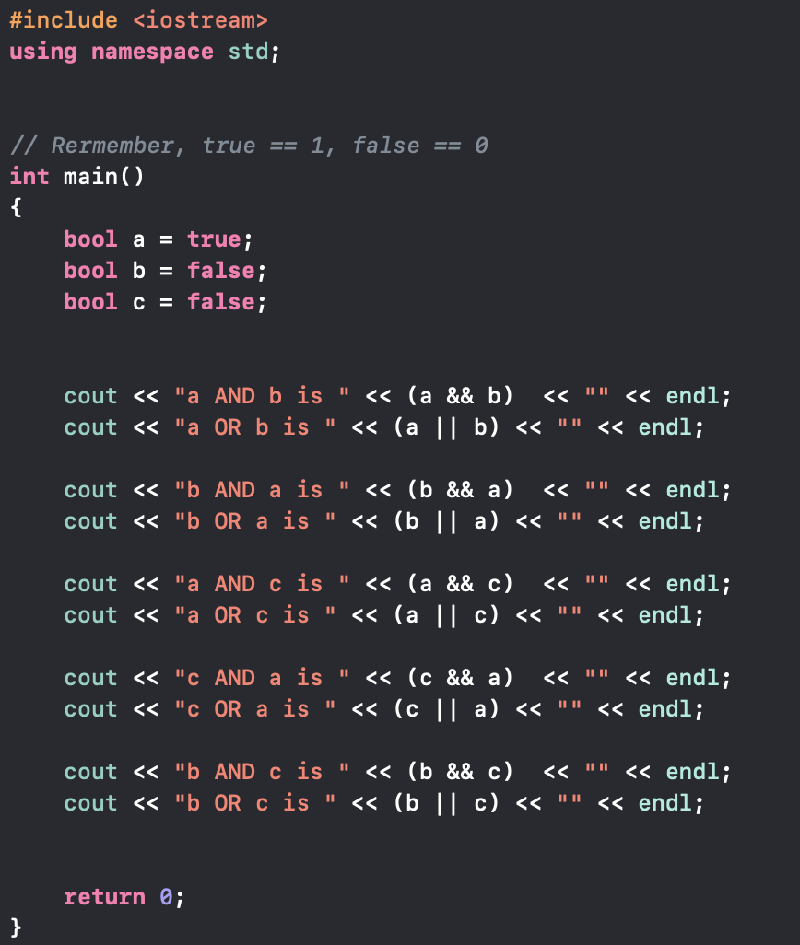
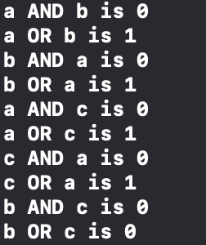
Bool operators Examples
What will the following code print?

Slide 9
The not operator (C++ syntax)
! : The not operator just flips the truth value it gets
Simply: Just evaluate your expression and flip the result
!true == false
!false == true
!(true && false) == true

Slide 10
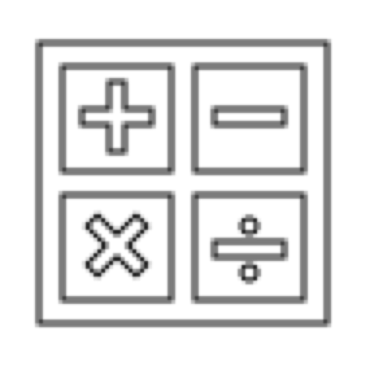
Arithmetic operators
We don’t only have logical operators, we also have arithmetic operators
You have used these before, maybe without knowing (though that would be surprising)
What arithmetic operators do you think we used?
Hint: The answer is in the top right hand corner of the slide

Slide 11
Arithmetic operator list (C++ syntax)
Addition: x + y
Subtraction: x - y
Multiplication: x * y
Division: x / y
Strictly greater than: x > y
Strictly less than: x < y
Greater than or equal: x >= y
Less than or equal: x <= y
Mod: x % y

Slide 12
Quick explanation of the Mod operator
Mod (short for modulo) is like division, the only difference being that it tells us the remainder of the division.
Examples:
2 % 2 = 0 // If we divide 2 by 2, there is nothing left over.
4 % 2 = 0 // 4 can be divided by 2 equally, so there is nothing left over
3 % 2 = 1 // 3 can’t be equally divided by 2 let’s look at this in more detail

Slide 13
3 % 2 example
Container 1
But now we have 1 block that can’t be split.
So we say: “The remainder is 1”, since there is 1 block remaining that can’t be equally split
1
3 =
1
1
Container 2
3 is 3 blocks of 1
Note that the “blocks”
are integers
Dividing by 2 -> split 3 into 2 equal parts

Slide 14
Alternative method (I find this easier)
Let’s solve the following:
15 % 4 = ?
Method: Keep subtracting 4 until you can’t subtract an entire 4 anymore without becoming negative
15 – 4 = 11 → 11 – 4 = 7 → 7 – 4 = 3 → 3 – 4 = “Can’t subtract 4 anymore”
Hence, 15 % 4 = 3

Slide 15
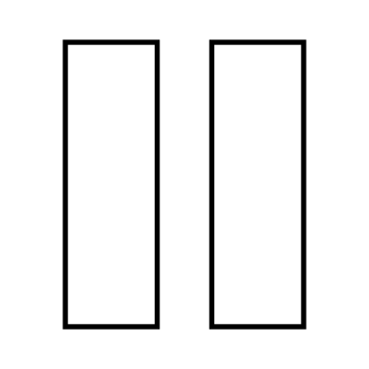
Let’s take a short break
If you have any questions feel free to ask

Slide 16
C++ conditional statements
There are 2 types of conditional statements in C++ (a bit of a lie)
if()
else {}
These go hand in hand (”if this …, else …”)
The if can exist by itself, but the else CAN’T

Slide 17
IF else Definition (C++ syntax)
if ( condition )
{
statement1
}
else
{
statement2
}
If the condition is true, then execute statement1, otherwise execute statement2

Slide 18
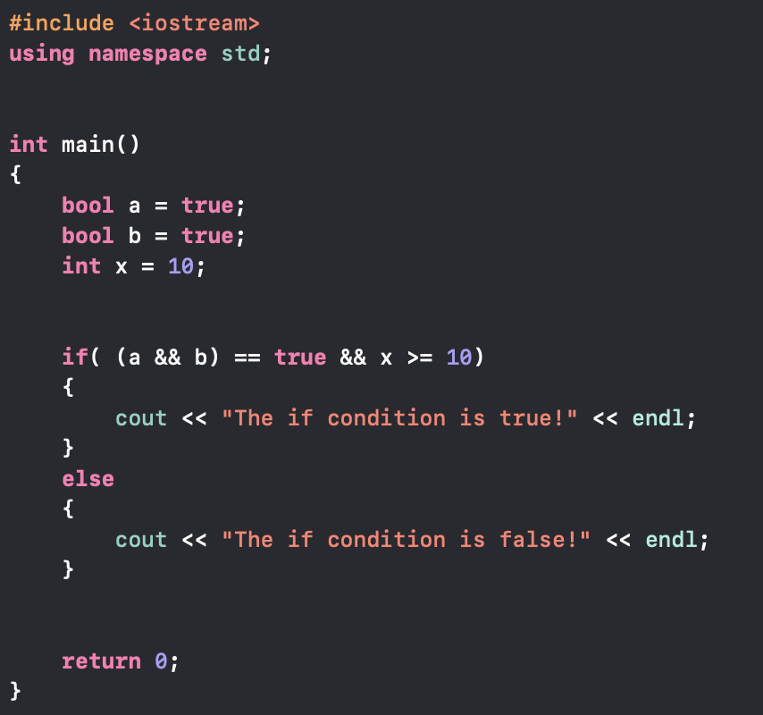
What will the following code print?
OUTPUT:

Slide 19
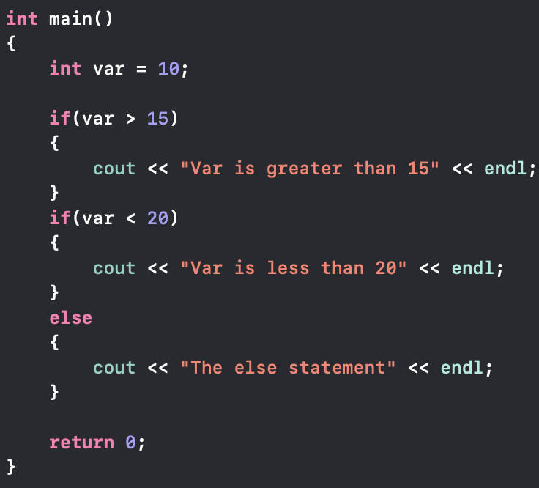

What will the following code print?
OUTPUT:
The else always refers back to the last “else-less if” (the last if statement without an else)

Slide 20
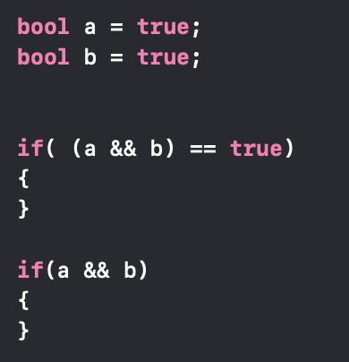
Are these two the same?
Yes, they are.
The reason for this is, that the if statement will only execute if the condition evaluates to true. The top if checks if a && b == true, this is the case so it executes. Since a && b is true, the bottom if will also work.

Slide 21
The else if statement
Let’s say that we need to check something, and depending on what we find we want to execute one specific piece of code. how would we go about doing that?
The else if() statement can be used to “chain” multiple if-else statements
This is great if we are handling multiple input choices

Slide 22
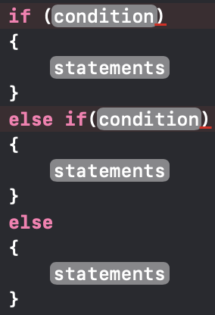
Else if syntax
The final else basically says: “If none of the other specific cases apply, then execute this code”. The else is optional for if statements, the same applies here.
We can have as many else if statements as we want, there is nothing stopping us.

Slide 23
The Switch statement
There is an alternative to the if() statement, this is called a switch case
It works identically to the if statement, the only difference being that it adheres to an explicit cases that we specify
The switch expression CAN’T be used with any floating-point data-type
The case constant CAN’T be used with the bool data-type

Slide 24
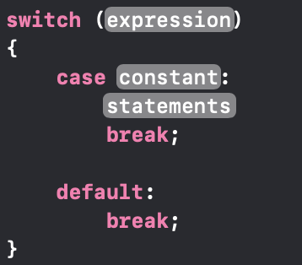
Switch case syntax
switch: switch is what will evaluate the condition that we provide
case: case specifies an instance of the parameter that was passed
expression: The condition that we want to evaluate
constant: The value that the condition evaluates to
statements: The code that we want to execute
default: This is a case that executes if none of the other cases apply
break: Just says, “Ok were done with the switch, we got the case we wanted, move past the switch’s bracket”

Slide 25
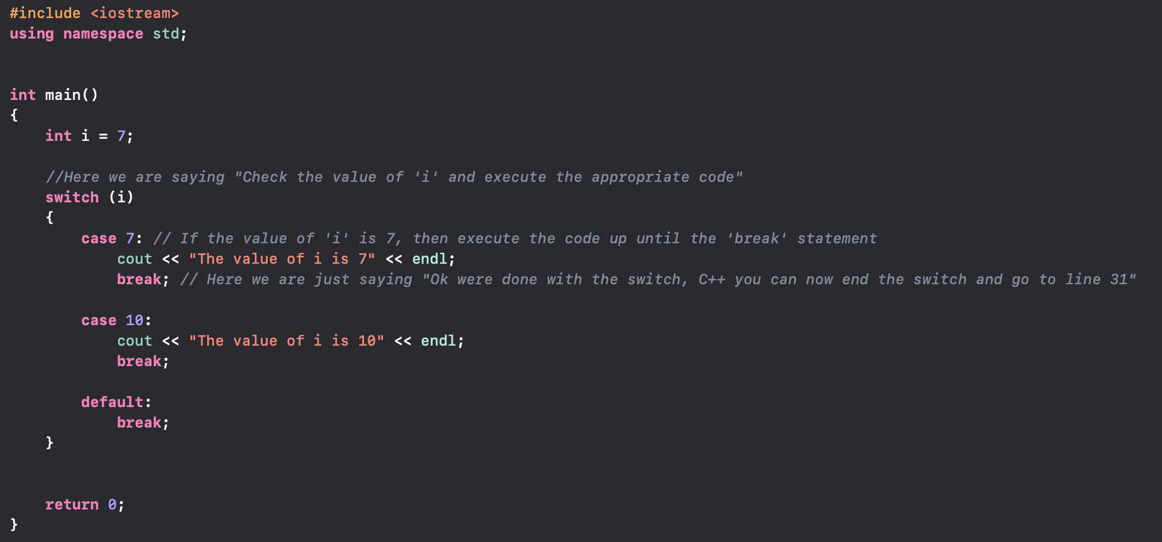
Switch case Example

Slide 26
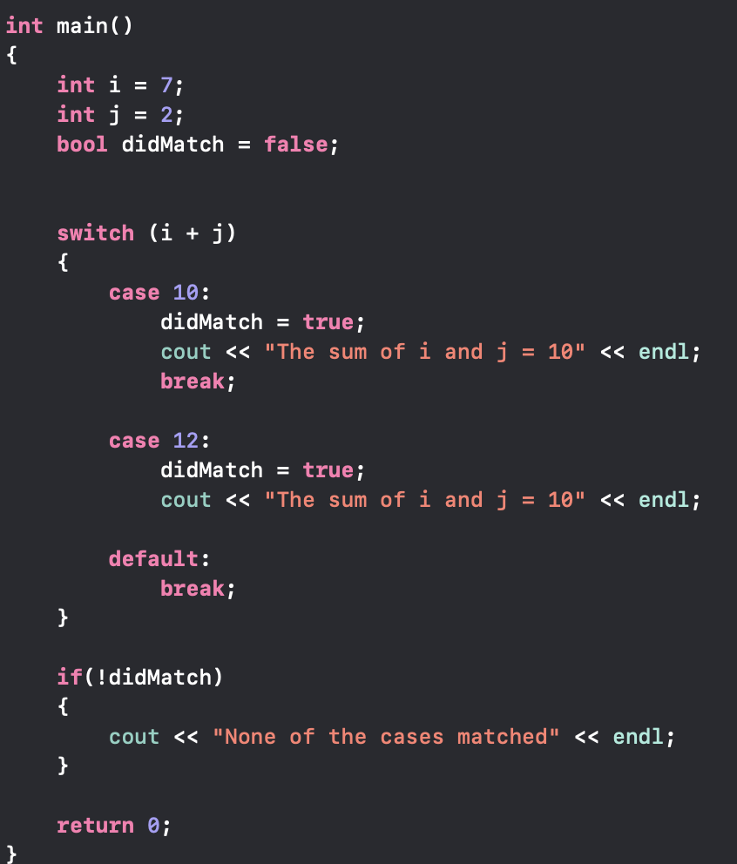
What will the following code print?
This program will print “None of the cases matched”
The reason for this is, because the default case is executed, since it doesn’t execute any code apart form break, the didMatch is never set to true. Hence if(!didMatch) will be true

Slide 27
Programming Exercise
Using the switch and/or the if statements, construct a program that checks if a number is even (divisible by 2 with a zero remainder)
Source

Slide 28
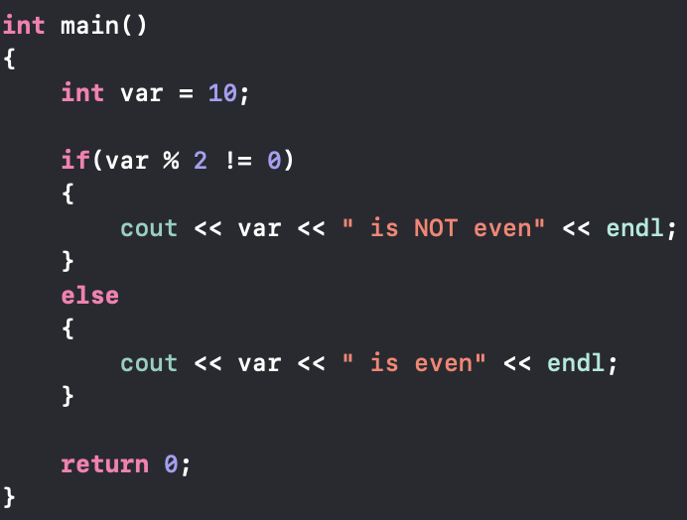
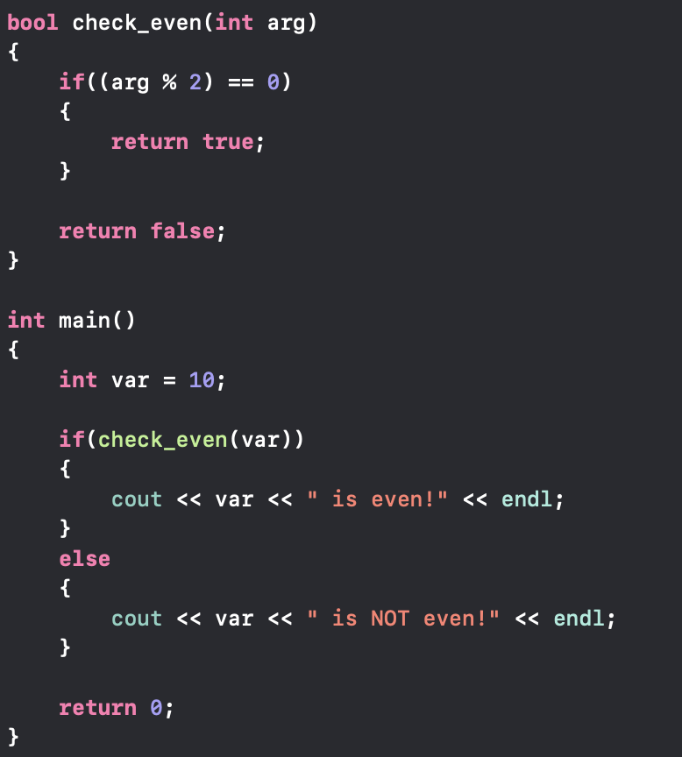
Solution(s)

Slide 29
Functions (An extended look)
Definition: A piece of code that can be called by our program, in order to perform some action for us.
Syntax:
return-type function-name ( data-type argument-name) {}

Slide 30

Return type
The return type is the type of data that our function will give us back once it has finished its task
Reminder: If our function doesn’t need to return any values, we can use the void key word to signify that nothing is returned

Slide 31
What should the following functions have as a return type?
bool
didFail(bool var) { return var; }
int
addInts(int x, int y) { return x + y; }
void
printStr(string str) { cout << str << endl; }

Slide 32
Function-name
The function-name is a name that we give to our method, so that we know what it is called.
The function name can be anything as long as it’s not a number
void 2(bool var) is NOT allowed
void myFunc2(bool var) IS allowed

Slide 33
Function Argument
Function arguments are what gets passed into a function [passed into the brackets of the function].
They can have any name we want, as long as it’s not a number.
Function arguments are proceeded by their type
If var is an integer, then it will have the int type before it

Slide 34
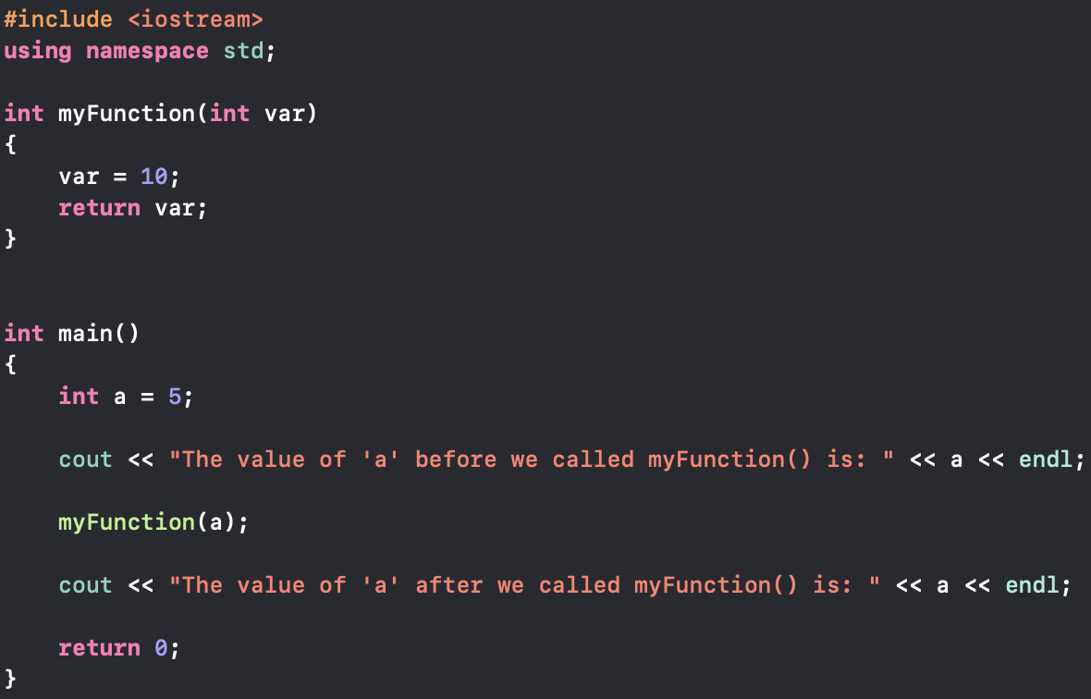
Do functions manipulate the values passed in?
What will this code print?

Slide 35
Wait, didn’t we pass in ‘a’ and set it to 10? Why didn’t it change?
When we pass something into a function, then we are actually creating a copy of the thing we passed in!
NOTE: There are ways to manipulate the actual variable, but this is not in the scope of this course. If you are interested in this we can look at it during the break

Slide 36
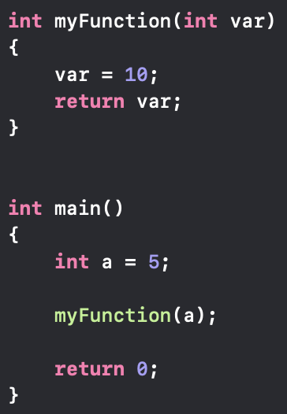
Pass by value example
What happens when this method gets called?
main() calls myFunction with a as the argument
C++ creates a new variable called var, and sets its value to that of a (5)
var is set to 10 and is returned by the function
var gets destroyed, since the function has ended and var was part of it
So we never actually change the a variable from the main
We are only creating a copy of a, which we call var in this case

Slide 37
So why does var get destroyed?
This is because var is a member variable of myFunction!
Member variable: A variable that exists inside (as a member of) a function.
Member variables are created when a function is called
Member variables are destroyed once a function ends (returns)

Slide 38
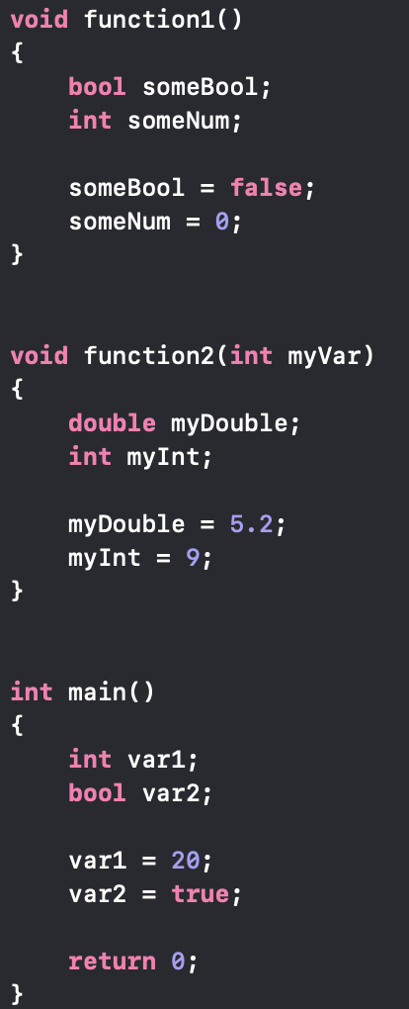
Let’s list the member variables for this code
void function1() | void function2() | int main()
bool someBool | double myDouble | int var1
int someNum | bool myInt | bool var2
Once the respective function ends, it’s variables will be destroyed

Slide 39
Let’s take a 15 minute break
Feel free to ask about anything that is still not clear
If you are interested, then we can look at how we can avid the whole “pass by value” issue.
If you wish to do some programming try the following (you did before):
Create a program (using the switch case) that checks if a number is odd
If the number is odd, print it to the screen
If the number is NOT odd, subtract 20 from it
If the resulting number is < 0, then print “It failed all the checks.” to the screen
All of the prints should appear on a new line.

Slide 40
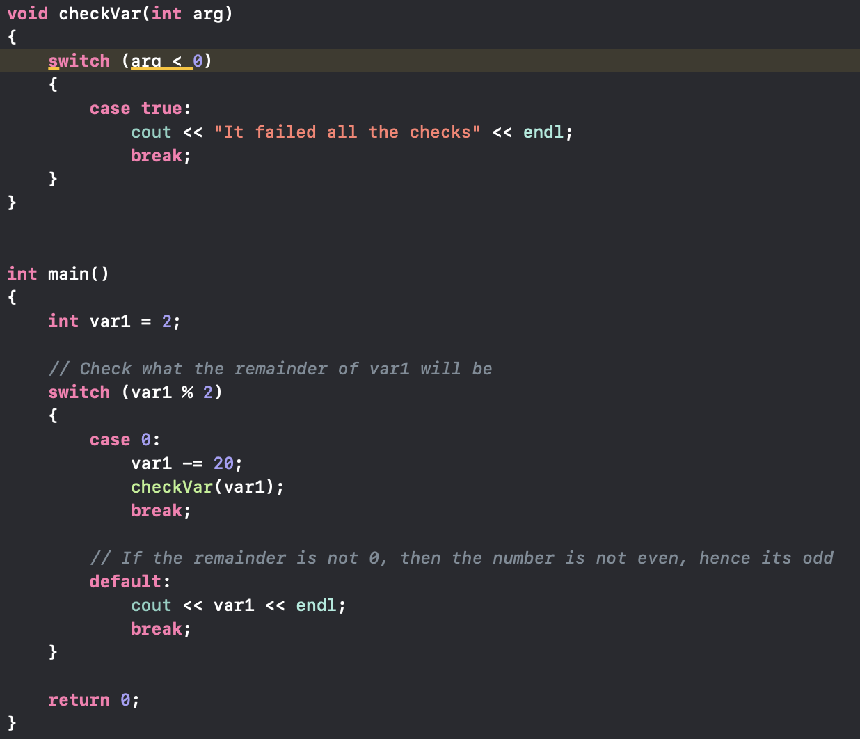
Solution
This is one of many solutions.
BUT WE SHOULD NOT BE ALLOWED TO DO THIS!
Recall that the case statement is not allowed to take bool data-types
So realistically we would need to replace this with an if statement
if(arg < 0)
{
cout << “It failed all the checks” << endl;
}

Slide 41
Arrays Revisited!
Google Definition: A collection of elements of the same type placed in contiguous memory locations that can be individually referenced by using an index to a unique identifier.

Slide 42
What does “Contiguous memory” mean?
Contiguous memory just means “appearing right after each other in memory”
All the elements in an array are direct neighbors regarding their position in memory. Hence arrays are contiguous in memory!
Question: Can our computer access arrays quickly or slowly?
Arrays can be accessed very quickly since we can cache (temporarily save) them without messing up the order.

Slide 43
Let’s visualize this!
If we have an array of chars, then it would have a structure like this in memory
Let’s say that our array is defined as follows: char myArray[] = {‘H’, ‘E’, ‘L’, ‘L’, ‘O’, 0};
Notice that the 0 just indicates where the array ends (include this in for char arrays as a safety measure)
For simplicity we will omit the 0 in the visualization. Just remember that it still exists, we’re just not showing it

Slide 44
Memory layout of the array
Index:
Every block has a size of 1 Byte, since the size of a char is 1 Byte
‘H’
0
myArray[0]
‘E’
1
myArray[1]
‘L’
2
myArray[2]
‘L’
3
myArray[3]
4
‘O’
myArray[4]
This is a contiguous layout since the elements are immediate neighbors.
Note: We can omit the 0 at the end of the array (it still exists though)

Slide 45
This allows us to do something special
We have the ability to address every element in the array individually, and we can manipulate what position we are in (this will be useful when we look at loops later on)
Advanced point: myArray is a “pointer” to the first element in the array, this is a topic that we won’t cover in detail since it goes beyond the scope of this course.

Slide 46
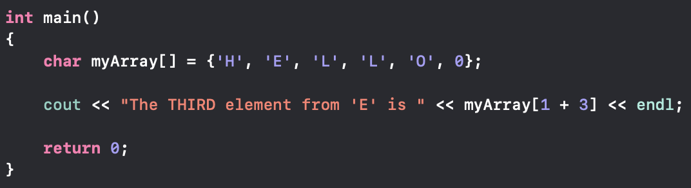
We can traverse the array as follows
myArray[1 + 3] is the key thing here.
This means that if we have some element at a position x, we can find the n^{th} element from x
This will look as follows: someArray[x + n]

Slide 47
Let’s take a 15 minute break
If you are interested in the advanced part (pointers) then we can look at this together during the break
You don’t need to if you’re not interested, but the option is there ☺
Something to think about: Assume there is an array int myArray[] = {1, 2, 5};
What happens if we print myArray[4]?
Why are we getting that result?

Slide 48
Programming Exercise
There is a file on Git describing a programming task called “DrakeEquation.cpp”
We will be here to help guide you and explain anything that’s not clear.
We will NOT write the code for you (if you are really struggling we will get you up to speed so that you can do it independently ☺)
We will be providing a solution for this at the end of the day.
If you finish early then we can take a deeper look into how the CPU and Memory actually works (or anything that you would like to know more about ☺).

Slide 49
Variable scope & lifetime
So far all the variables we have used were member variables of a function.
We may call these types of variables LOCAL variables
There is another type of variable that we may utilize called GLOBAL variables

Slide 50
Local Variable
A variable that is local to a single function. The variable only exists inside a specific function
The variable gets destroyed once its parent function returns.
Methods outside are NOT allowed to access

Slide 51
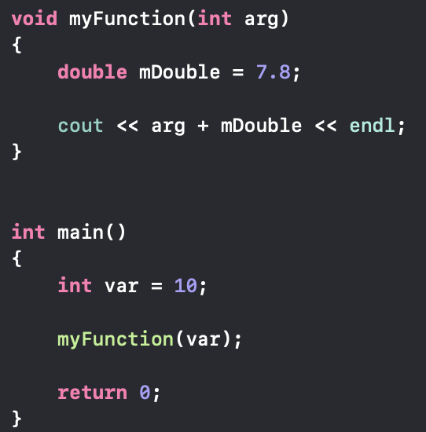
Example of Local variables
int var is a local variable for main()
int arg and double mDouble are local variables for myFunction()

Slide 52
Global variables
Global variables are a bit different, they can be accessed from anywhere.
They are created at the start of our program and are declared & defined OUTSIDE the main()
Global variables are destroyed once the PROGRAM ENDS

Slide 53
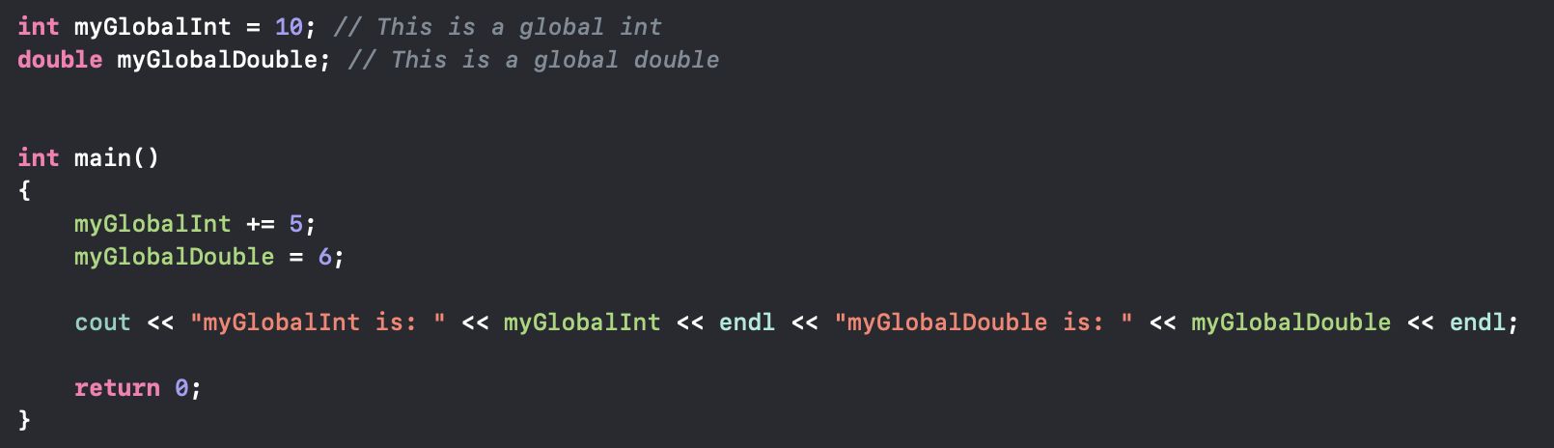

Example of Global variables
Question: What will this print?

Slide 54
The Static keyword
DISCLAIMER: static is one of the most overloaded terms in C++
This means that depending on context static will change how it operates
Let’s say we create a function that contains a variable who's value we want to keep, even after the function ends

Slide 55
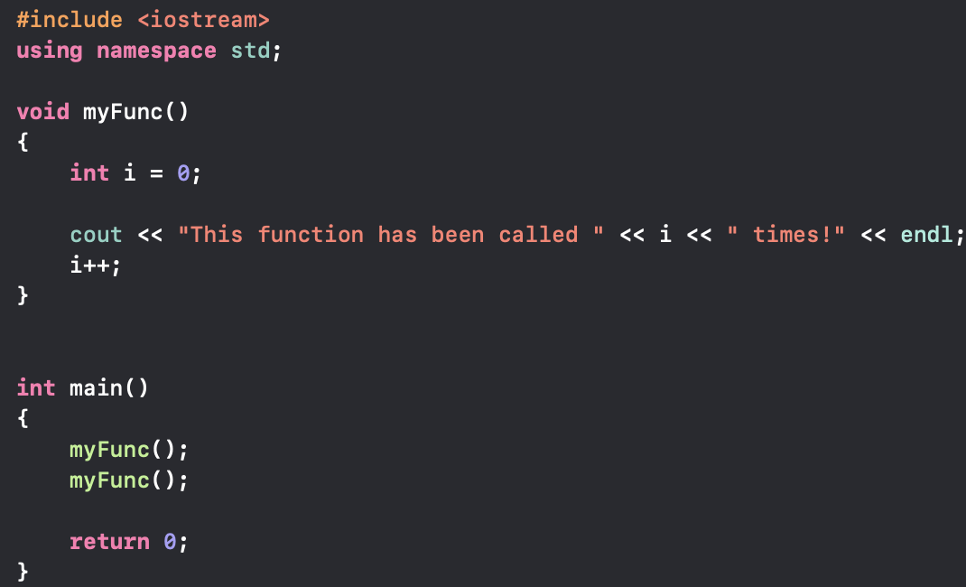

Sample Code
What will the following code print?
OUTPUT:

Slide 56

WELL THAT’S not helpful.
We called the function twice, why didn’t it work?!
We even incremented i!
Task: You have 5 ($±$2) minutes to come up with a solution to this problem
Problem recap: “we want to have a variable that keeps track of the number of times we called a function”

Slide 57
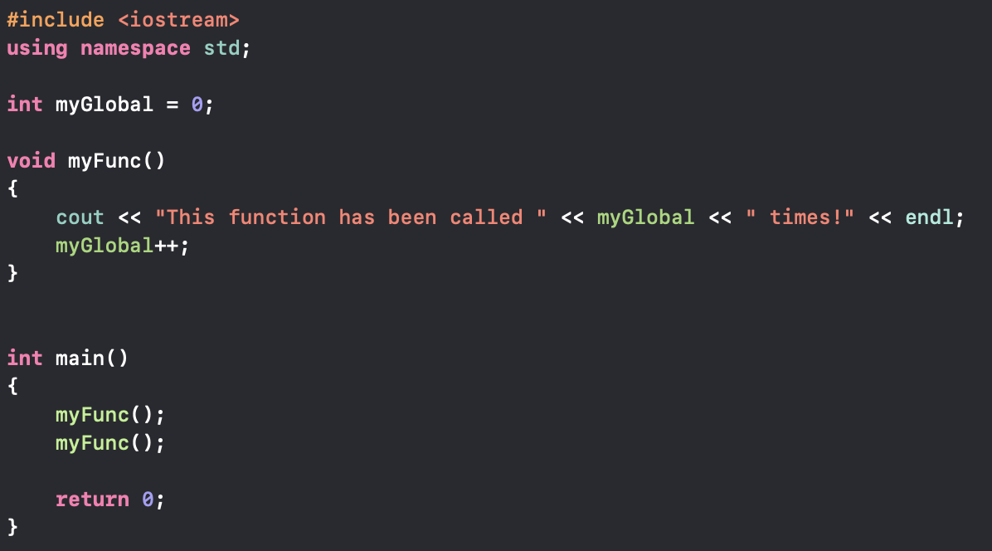
Possible solution
You may have come up with something like this:
OUTPUT:
NOTE: This output is acceptable since we are indexing from 0
BUT THERE IS ANOTHER WAY

Slide 58
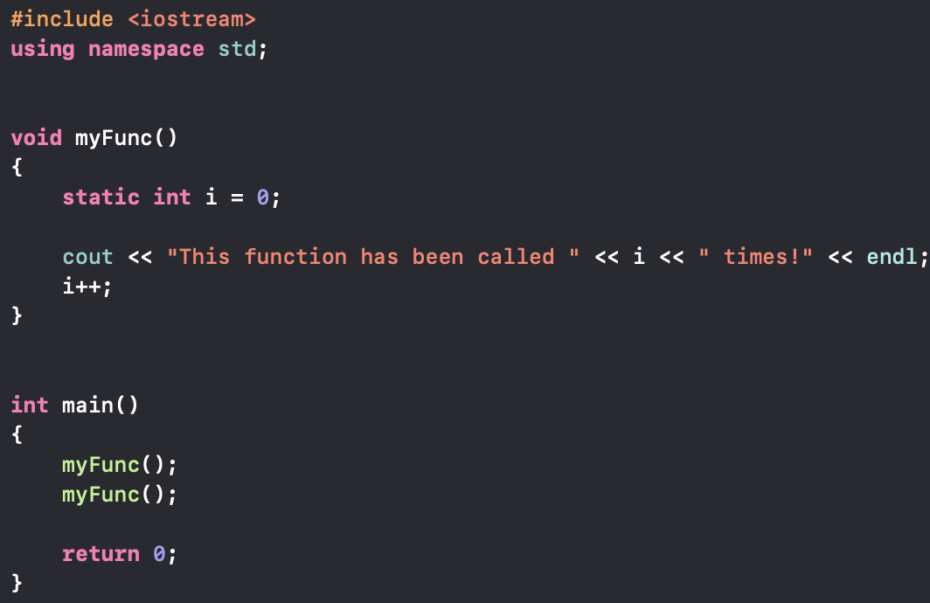
Using static local variables
We can use something called a static local variable
The code will look as follows:

Slide 59
What does a static local variable do?
Simply: “So I want to be part of this function, but I don’t want to be deleted when the function ends. OS can you place me somewhere were I can be safe? Thanks.”
Static local variables are initialized ONCE, which is when they are created
After that they don’t need to be reinitialized (since they exist until the end of the program)
Question: Why do you think this works?
This is for those of you who are interested, you are not required to answer this

Slide 60
Programming Exercise

