Slide 1

Loops
By Philipp Tiso

Slide 2




Goals for today
Loop definitions (what are they, how do we use them)
Loop equivalence
Loop nesting
Operator review (some neat tricks)
Increments

Slide 3
What is a loop?
A loop is something that can repeat itself over and over again until some termination criteria is reached
A loop will do the same thing until it is told to stop by satisfying some condition
source

Slide 4

2 fundamental types of loop
Finite: A finite loop is a loop that is guaranteed to terminate
An example would be: “count down from 10 to 0”.
No matter how much you want to keep going, you WILL reach 0
Infinite: An infinite loop is a loop that is not guaranteed to terminate
An example would be: ”Until I say stop, walk forward.”
It doesn’t matter how much you trust me, I may (conditional) never say stop!

Slide 5
But why do we want Loops?
Programs are sometimes (not always) used for repetitive tasks
So they will do things that keep repeating over and over again
A good indicator for using a loop is If you have to keep copying & pasting code.
We may want our program to do something a set number of times until we decide otherwise
Maybe we want our program to check something repeatedly and inform us if something specific happens

Slide 6




Real world examples?
Your Phone trying to connect to wifi
There is typically a program (or part of a program) that will keep checking if your phone can connect to wifi
Airplane altitude
The pilot probably wants to know the airplanes elevation, otherwise we might have a serious problem.
Connecting to an online game
The server hosting the game will probably have a loop checking if players want to join
Once there are enough players that loop stops since no more players are required

Slide 7

What sort of loops are there?
While-Loop: This one is probably the easiest one to find examples
“While the time is not 12:00, do some programming”
“While the sun is out, don’t sleep”
For-Loop: This is like counting down. We could say something like:
“For the next 5 times that I say ”hello”, give me a random name.”
“For the first 10 elements in an array, tell me what the elements value is”
Those are basically all the loops we will see in this course.
But there are subtypes of these loops that we will look at

Slide 8
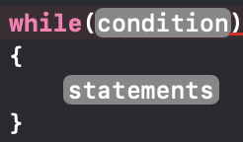
While Loop
The while loop is probably the easiest to understand
All it really says is: “while something is true, I’ll execute this code”
The structure is as follows:
There are 2 parts to the while loop
condition
statements

Slide 9

Condition
The condition MUST evaluate to true in order for the statements to execute
This basically says: “If this condition is true, then you can execute the contents in the while loop. Otherwise you are not allowed to execute the while loop.”

Slide 10


Statements
The statements are just some code that we want to execute.
This can be ANYTHING we want. Function calls, create variables, etc.
We can choose how long to make this, it can be 100,000 lines or it can be 0 lines
The latter is pretty useless and the former seems a bit excessive

Slide 11
Let’s create a simple while loop
First let’s come up with something that we want to do repeatedly
For the sake of simplicity let’s just say: “We want to print all positive numbers that are strictly less than 5”
By doing this we actually have the 2 parts that we want
Condition: Our number must be less than 5
Statement: Print that number (the one that is less than 5)

Slide 12
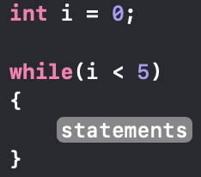

Let’s come up with the code: Condition
We have created a variable i that we use to check if it’s less than 5
i is initialized to 0 since we want all POSSITIVE numbers less than 5
Here we say: “Check if the value of i is less than 5”
That’s the condition that we wanted to check.
“i is a positive number strictly less than 5”
This looks like a good start. But we still need to write the statement.

Slide 13
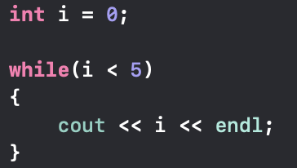
Let’s come up with the code: Statement
Our statement was: “Print the number that’s less than 5”
This is nothing more than a print statement, so let’s just add that!
Well that seemed pretty easy!
So were basically done right?

Slide 14
NO!!
source

Slide 15

But why not?!!
The loop we just create will run INFINITELY!
We may know that we want all positive numbers less than 5, but all we told the loop was: “Oh yeah check if i is less than 5.”
i was initialized to 0, at no point do we actually change the value of i, so the condition is ALWAYS TRUE

Slide 16


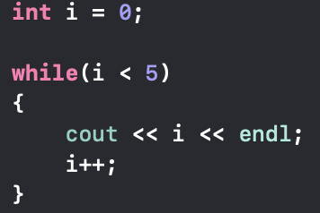
So let’s fix this!
Now we are actually INCREMENTING i
This way our loop will print the correct thing and won’t make us wait for all eternity
Show debug step through

Slide 17
The “do while” loop
do while is basically the same a the while loop with 1 major difference
What do you think the difference could be?
The difference is that do while will ALWAYS EXECUTE ATLEAST ONCE

Slide 18
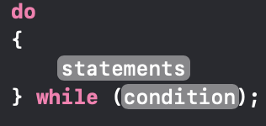
Structure of “do while”
The statements & condition are the EXACT SAME as the what we just saw before for the while loop
The only difference is that now there is a do in front of the while

Slide 19
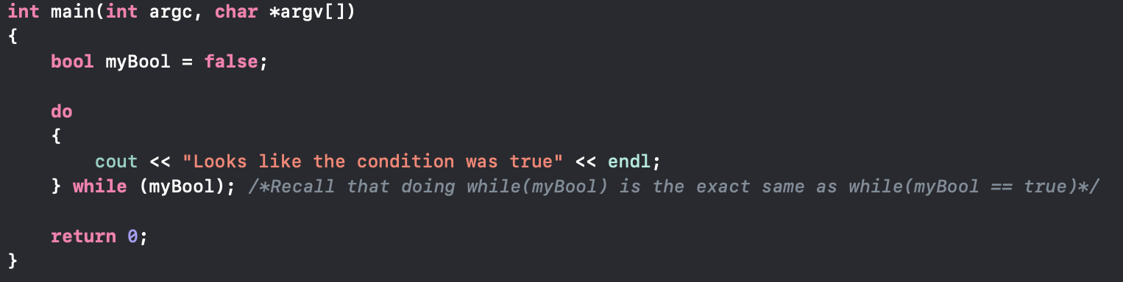
What will the following code output?
OUTPUT:
This is an absolute lie!
Be careful when using this loop, you may get unanticipated results.
Typically we use this if we need something to happen AT LEAST ONCE regardless of the condition.

Slide 20
The for loop
The for loop is basically a more elaborate while loop
This isn’t necessarily a bad thing
Instead of declaring and initializing variables outside the loop (like with the while), we can do this in the loop structure!

Slide 21
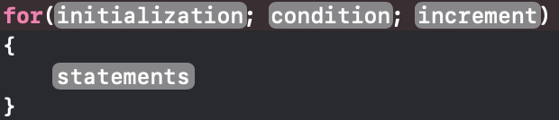
For Loop (C++ syntax)
This is what the structure of the for loop looks like.
There are 4 main parts:
Initialization – some variable we use for counting
Condition – something that must be true about the variable at every iteration
Increment – what we do to the variable we created in the initialization
Statements – the operation our loop will be doing repeatedly

Slide 22
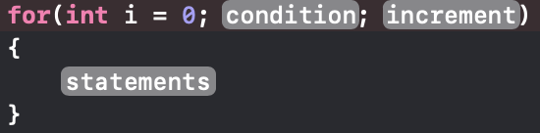
Initialization
Here we create a variable that we want to work with.
This will usually be an int since we want a counting number
This will also be the variable that we use in the increment part
We can initialize as many variables as we want
Initialization ONLY HAPPENS ONCE
When the loop is called for the first time the initialization happens.
After that it gets skipped, otherwise we would keep resetting our variables
i is set to 0

Slide 23
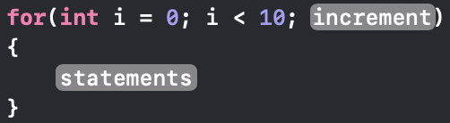
Condition
The condition tells the loop “as long as this is true you can execute, otherwise you’re done”
The condition can be anything we want, but usually it related to the variables that we initialized.
i must be less than 10

Slide 24
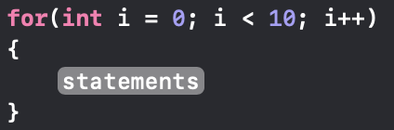
increment
This is the part where we say “Ok you did the thing we wanted, now move on to the next iteration”
This usually involves incrementing (or decrementing) the variable we created
Increment i by 1 every time, until i is no longer smaller than 10

Slide 25
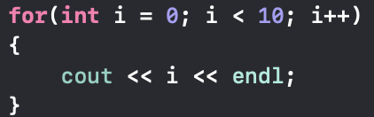
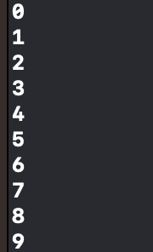
statement
The statement is what the loop executes
This is completely up to us. We can tell the loop to do whatever we want
What will the output of this loop be?

Slide 26
Logic of the for loop
The for loop will execute in the following way:
Initialize all the variables (I will only do this once)
Check if the condition is true
If the condition is true execute the statement
If the condition is NOT true, then don’t execute the statement terminate
Go do the increment and go back to step 2

Slide 27
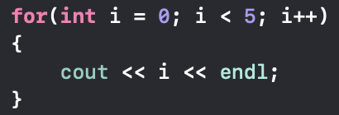
Let’s step through an easy loop

Slide 28
Step 1(Initialize)
Ok it looks like there is a variable called i that is set to 0
Let’s create this variable in memory and give it a value of 0
This is the ONLY time that we create i

Slide 29
Step 2 (condition)
Now let’s check if the condition holds
Is i greater than 10?
Well we know that i was just set to 0
Clearly 0 is less than 10 (if someone tells you otherwise they’re probably lying)
Since (i < 10) == true we can execute the statement

Slide 30


Step 2.1
Since the condition evaluated to true, we can execute the statement in our loop
So we just print the value of i to the screen
Wow do we need to do this for all iterations?
Because I’m getting a bit tired.

Slide 31
Step 3
We can now increment the variable (i) that we created
So i will now be 1
This seems like something that can become a bit annoying when writing/debugging an actual program.
Stepping through this stuff manually is rather time consuming.
There must be a better way!

Slide 32
Let’s continue to step through this loop
Recall that we are using an IDE. They can’t JUST be fancy text editors, they need to have something else going for them right?
Instead of using slides (manually stepping through), let’s actually look what our program is doing
We can do this using a debugging tool (debugger)
Most IDEs have this built in to make our lives a lot easier
codeboard.io is not one of those

Slide 33
For loop variable scope
Let’s say our for loop finished and we want to reuse a variable created in the initialization
Can we do that?
NO! This is not possible!

Slide 34

Why does this not work?
This has to do with the variable scope that exists within the for loop
A variable that is created in the for loop will ”die” with the for loop
This means that a variable created in the initialization is a local variable of the for loop

Slide 35
Equivalence between loops
Is it possible to use a while loop instead of a for loop for something? What do you think?
ANSWER: YES, this is absolutely possible! We could even prove this mathematically.
I’ll spare you the mathematical proof since it’s not relevant here.
A for loop can be expressed as a while loop and vice-versa

Slide 36
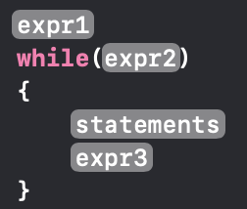
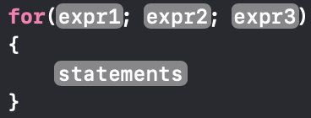

Equivalence between loops
$$⇔$$
These two loops will do the EXACT SAME THING

Slide 37
The “for each” loop
The for each loop is a special case of the for loop
It basically says: “Ok for each sub-type of this super-type, I will do something”
This may sound strange but let’s look at a trivial example

Slide 38
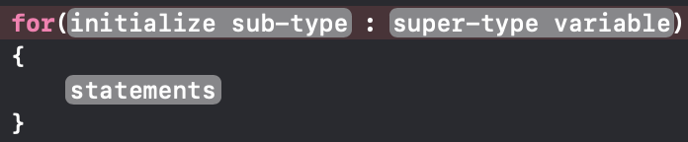
Syntax of the “for each” loop
Initialize sub-type: Here we initialize a temporary variable that is a subtype of the super-type variable
super-type variable: A variable that is a super-type of our temporary variable
Statements: This is still the exact same as it was before (some code that we want executed)

Slide 39
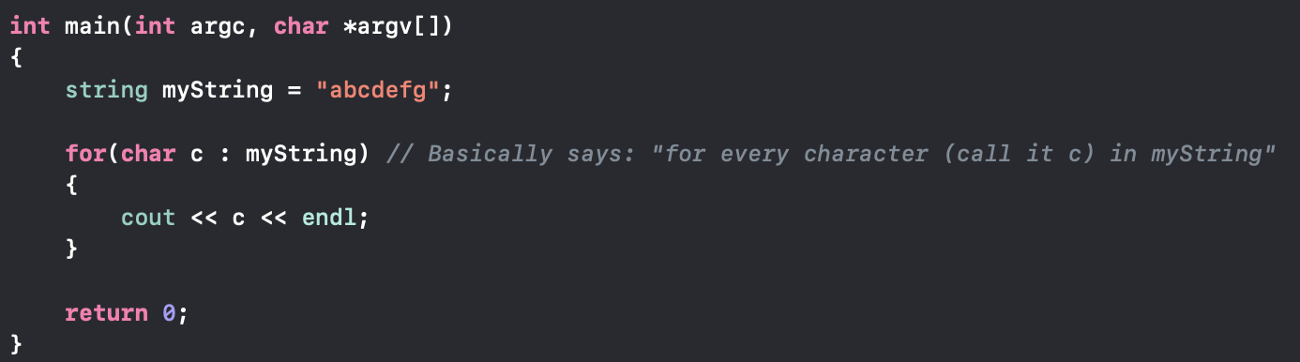
Example of “for each”
Note: char c can have ANY name, this is just a variable that we will use in the loop
Try to guess what this prints. If you don’t know, write the code and see

Slide 40
To summarize
The super-type variable in this case was the string, this is because our variable (myString) was of type string
The sub-type of a string is char. This is because a string is composed of chars, so it makes sense to say ”for every char in the string…”

Slide 41
Simple Exercise
Write a loop that will print all the contents of the following:
This should not take longer than 5 mins.
If you are stuck or need help, I’ll be walking around

Slide 42
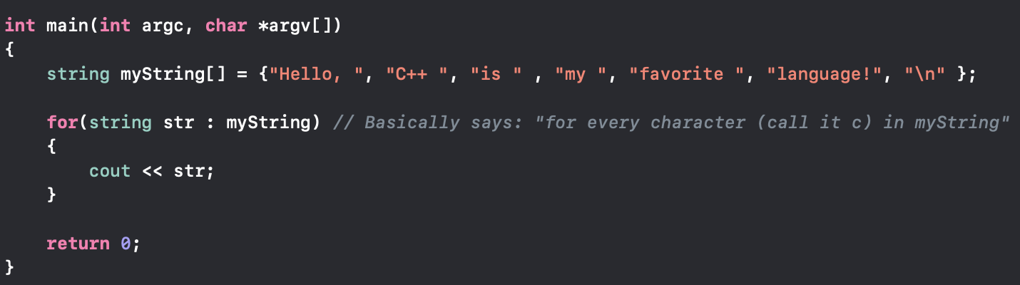
Simplest Solution
Is there another way we could do this using the for loop?
Let’s try it out!

Slide 43
Git Programming exercise
On git there is an exercise called “99_Bottles.cpp”
if(!codeboard.io)
Download and open the file in your IDE
else
Download the file
Copy and paste the contents of the file into a new project
Follow the instructions provided in the source.
If you have any questions feel free to ask

Slide 44
Nested Loops
So far we have looked at loops that exist by themselves
But we can do some more interesting things with loops, ergo we can nest them
What is nesting?
Nesting simply means: “Put things inside something bigger”
In the context of loops this just means “a loop inside a loop”

Slide 45
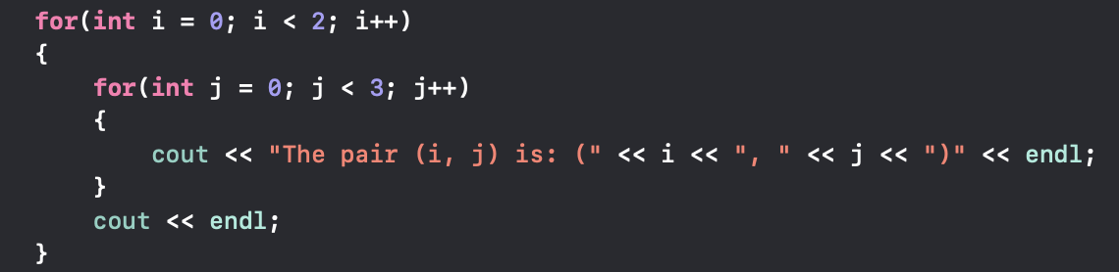
Example of a nested loop
Note: The nested loops can be of different types. Here they just happen to be for loops

Slide 46
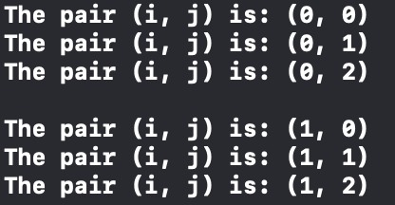
What will this code print?
Show debug

Slide 47
Logic behind nested loops
There is a very straight forward rule for nested loops which is as follows:
The inner most loop gets executed first, then the loop outside that and so on.
Simply: “Just complete the inner loop before moving to the outer loop”

Slide 48
Let’s experiment
For the next 10-15 or so minutes let’s come up with some loops that you would want to see, and we can analyze them in the Xcode debugger

Slide 49
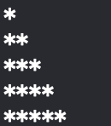
Git programming Exercise
On git there is an exercise file called “Pyramide_drawing.cpp”
if(!codeboard.io)
Download and open the file in your IDE
else
Download the file
Copy and paste the contents of the file into a new project
Follow the instructions provided in the source.
If you have any questions feel free to ask
If you complete this early, create a new function that will print a pyramid that looks as follows:

Slide 50
Operators revised
We have been using operators like ++, ==, etc. but lets look at some nice things we can do with them to make our code less cluttered
Lets say we have a loop where we keep adding a variable to itself

Slide 51
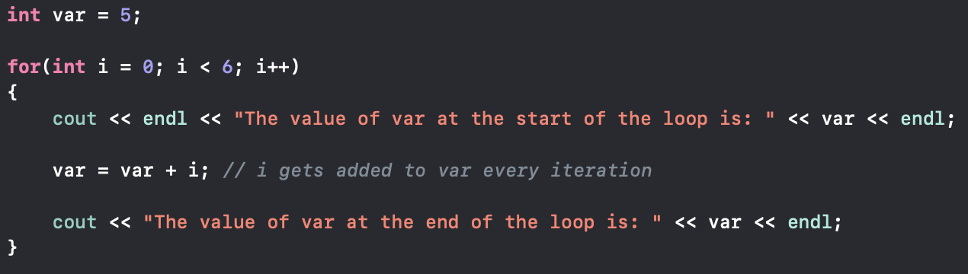
Example loop
The annoying part is the var = var + i expression.
Writing out the same variable over and over again can become rather frustrating.
Surely there is an easier way to do this!

Slide 52


$$⨂=$$
$⨂$ is short for “any other operator (+, -, /, etc.)”, aka N-ary operator
We can remove the second instance of var completely by using this.
Syntax: $n ⨂{=} x$
$n$ is any variable that can have arithmetic operations performed on it
$⨂$ is (like we said before) ANY OPERATOR
$x$ is some number or variable of our choosing

Slide 53

What does the expression actually mean?
$n ⨂{=} x$ basically says: $n=n ⨂{ x}$
This may seem a bit confusing but lets look at some easy examples
$n+=1$ is the same as $n=n+1$
$n−=7$ is the same as $n=n −7$
$n∗=23$ is the same as $n=n∗23$
All of these expressions say “$n$ is equal to the current value of $n ⨂{ }$some value”

Slide 54
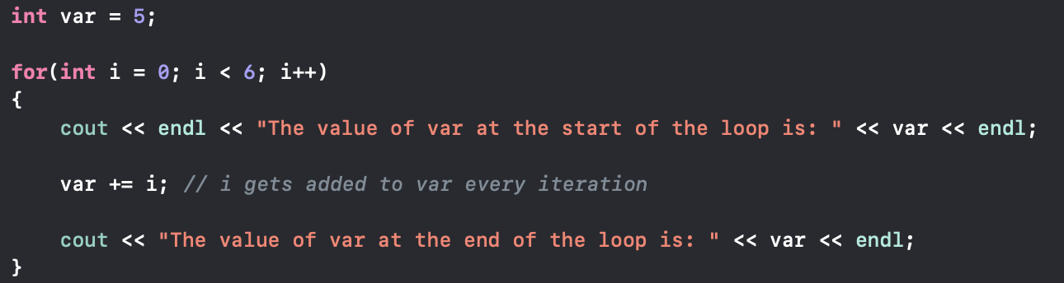
Let’s clean up that expression
You may think that this was rather pointless, but once we start using function return types and more complex equations, doing this will give us a speed boost compared to the first method

Slide 55
For loop increment
What about the increment that we are doing in the for loop? How does that work?
We always so something that looked like i++,we came to accept that this increments the value of i, but let’s look at this

Slide 56
Post-increment
The post increment is seen as i++
This is almost the same as saying i += 1
Let’s see what happens if we assign a post increment to some other variable
Note: The same also applies to i--

Slide 57
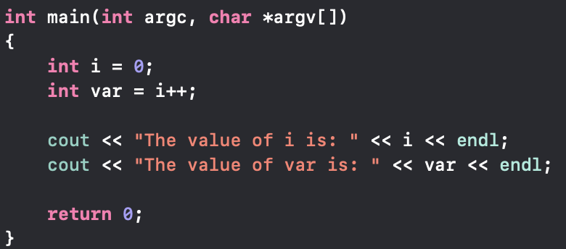

Example Code
OUTPUT:

Slide 58
Post-increment logic
Simply: The-post increment on a variable basically says: “if someone asks, I’ll give them my current value, after that I’ll increment my own value”
We are basically holding off on doing the increment

Slide 59
Pre-increment
The pre-increment is usually seen as ++i
The pre-increment simply says: “Increment i immediately”

Slide 60
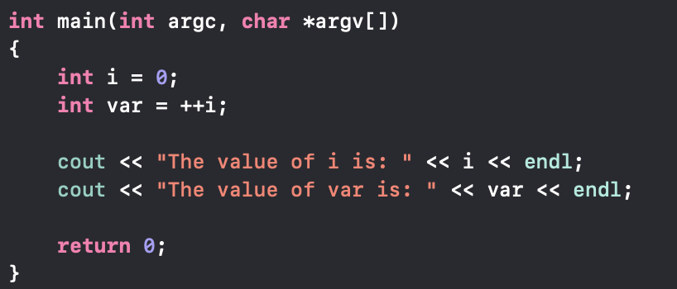

Example code
Output:

Slide 61
Git Programming exercise
On git there is a file called “Reverse_String.cpp”
I will be here to help if you get stuck or if anything is unclear
If you are done early we can take a deep dive into some concepts of your choosing

Slide 62
The “Break” keyword
Sometimes we want to get out of a loop before it actually finishes
We could use return, but doing so will end the function that our loop is in which we may not want
We can use the break keyword to say: “Ok we’re done with the loop even though it could keep going”

Slide 63
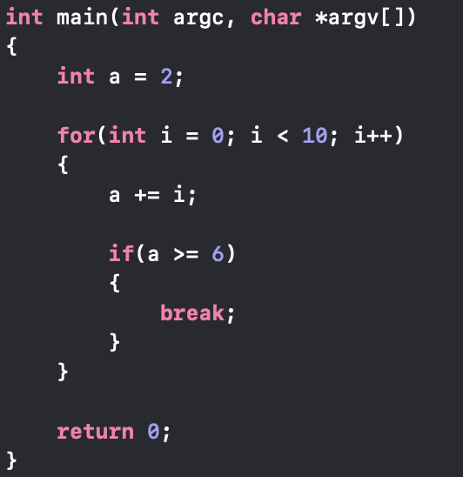
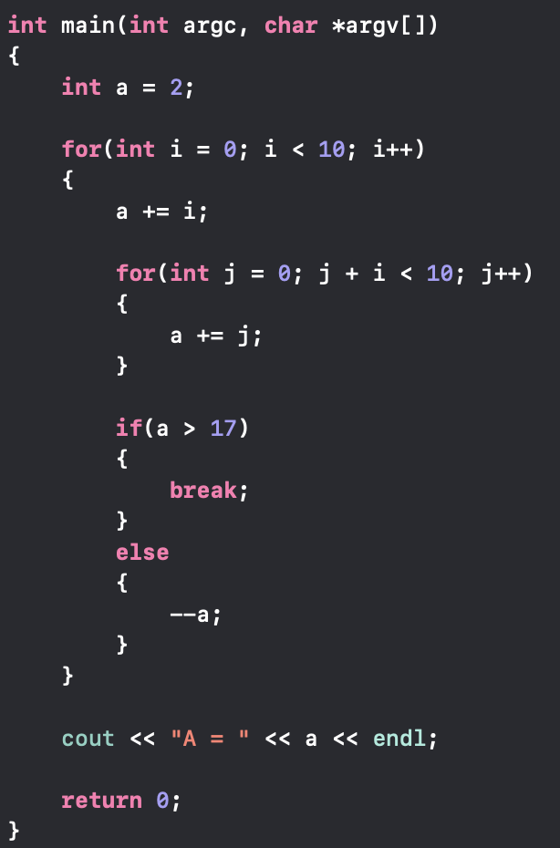
Let’s come up with some examples
These are two simple examples for illustration purposes

Slide 64
Let’s stop for a moment
Most of the programs that we have written so far are purely math based
So let’s look at something more graphical. I have prepared a little script that will hopefully be a bit more interesting that calculating the 5th factorial!
rocketShip script

Slide 65



That was pretty cool right!
2 things probably stood out to you (these are most likely 2 function calls)
DISCLAIMER: I will be referring to something called “the SHELL” for the few next slide. We will look at what the SHELL is next lesson, so don’t worry if you don’t understand everything.

Slide 66


System()
WARNING: Be EXTEMELY careful when using this function
The system() function can directly invoke shell commands. i.e. IF YOU DON’T KNOW WHAT YOU’RE DOING, DON’T ENTER RANDOM STUFF!!!!
Xcode may sandbox you for now, but that will NOT be the case if you run this from the shell
The system() command allows us to make calls like the shell (more on this tomorrow)
In our program before, we used it to clear the screen, giving the illusion that the rocket was just one thing, and not multiple print statement

Slide 67


Sleep()
Like in real life, the worst thing that can happen if you sleep, is that you do it for too long, or not long enough.
sleep() is a rather harmless function for what we are using it for
sleep() is in the <unistd.h> library
The sleep() function takes an unsigned int argument, to specify how long the program “sleeps”
On macOS the argument represents seconds
Other POSIX compliant operating systems will usually use milliseconds

Slide 68
Your task
Knowing what we have just looked at, and using the rocketShip.cpp as a reference (should you need to), create your own animation
The animation can be WHATEVER YOU WANT!
You will then demo this to the class so that everyone gets the chance to present their work

