Slide 1
Pointers
By Philipp Tiso

Slide 2
Goals for today
Memory revision
How does memory work in terms of saving variables?
What are variable names in the context of memory?
Multidimensional arrays
What is a multidimensional array?
Structs
What are structs?
An introduction to pointers
What is a pointer?
Why are pointers so useful?
Revision of previous topics
Manipulating variables
Nested loops
Variable scope

Slide 3
Memory revision
Memory: The location in which our program gets stored.
Our program gets put into memory before it is run.
The memory is one of the most important things that we need to understand

Slide 4
Variable names
In the context of memory, what is a variable name?
A variable name is nothing more than A NAME FOR A MEMORY ADDRESS
Variable names exist so that we can easily identify what variable we are working with

Slide 5
Variable location
We could say that a variable name references an address
At that address the actual value of our variable is stored
Every variable that is in memory has 2 parts
An address (where it is in memory)
The value that the variable actually contains

Slide 6
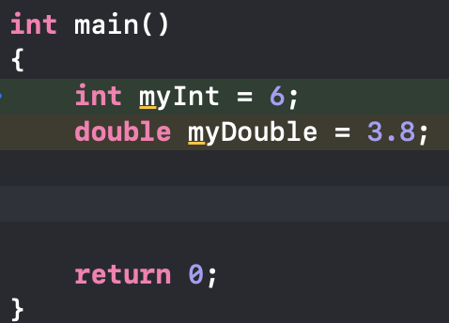
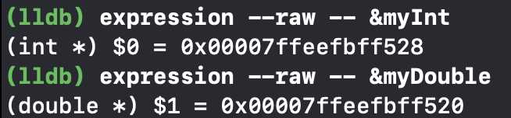
Example of memory addresses
Let’s look at the addressed of the following variables, myInt and myDouble respectively

Slide 7
How would we imagine this?
Think of memory as a series of blocks or as a table that lists all the variables that our program is currently using.
This table has 3 columns
Address
Name
value

Slide 8
Example utilizing this “table”
ADDRESS (actual memory) | NAME (variable name) | VALUE (value of variable)
0x00007ffeefbff528 | myInt | 6
0x00007ffeefbff520 | myDouble | 3.8
This is the simplest way that we can think of the memory without having to get into too many details.

Slide 9
Major question
Does the memory address of our variable change every time we run our program, or is it consistent?
When we check the debugger it seems like it is!
Does that mean that we can keep using the same address for the variable?

Slide 10
NO!!
source

Slide 11
This is done intentionally
The address that our debugger displays does NOT reflect the ACTUAL address of the variable
This has to do with how the program is run in memory
Going into this is TO COMPLICATED, for the sake of argument, just respect the fact that a variables TRUE location in memory WILL CHANGE every time the program is run!

Slide 12

Multidimensional arrays
Up until now we have been using one dimensional arrays
What does this mean?
All it means is, that we only use one index to identify an element
Simply: Our array is just a single row of elements
Think of an Excel spread sheet that is ONLY 1 line

Slide 13
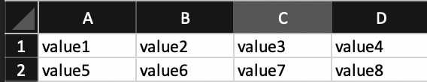
So what is a multidimensional array?
A multidimensional array that uses MULTIPLE indexes to identify a variable
Again, think of it as an Excel table with multiple columns and rows
How many dimensions does the following array have?

Slide 14
Syntax of multidimensional arrays
This is how we DECLARE a multidimensional array:
This says: The 2 dimensional array has 3 rows, and 2 columns
Think of this like an Excel spread sheet, or a coordinate system if you wish

Slide 15
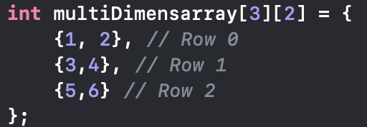
2D array initialization
NOTICE: Each row contains 2 elements (2 columns). There are 3 rows in total

Slide 16
Accessing elements of this 2D array
How do you think we could go through and access the variables?
It’s done exactly like we would do it with a 1D array, the only difference is that we must specify 2 indices
Getting the first and second element looks as follows:

Slide 17
10 minute Exercise
Create some multi dimensional arrays of your choosing
Create a loop construct that will iterate through the 2D array
Hint: I showed you nested loops for a reason
If you finish early, try playing around with the loops and the multidimensional arrays

Slide 18

N-Dimensional arrays
We are not restricted to 2 dimensions, we can create an array of the $n^{th}$dimension
Doing something like this is perfectly possible, but it can get VERY CONFUSING when we try to use it.

Slide 19
Data-types
So far we have been using simple data-types
But we probably want to do a bit more than just use numbers and text types
What if you wanted to create a datatype for a student?
For the next 10-15 minutes, try and come up with a program that allows you to fill in a student record

Slide 20
That was tedious and confusing
There has to be a better way to go about and do this right?
Wouldn’t it be great if we could create our own data structure?
Luckily this is actually possible!

Slide 21
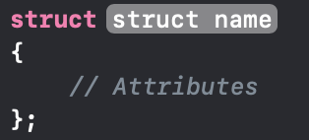
Struct
We can create something called a struct
A struct is defined as follows:

Slide 22
Syntax of a struct
Struct name: This is what will call our new data-type.
Attributes: This is what our data structure includes.
Let’s create a datatype for a student record

Slide 23
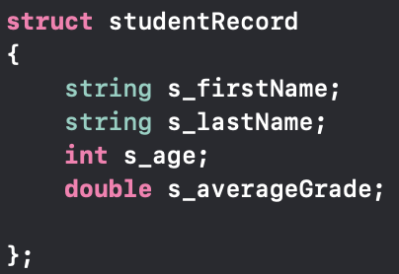
Struct Example: Student record
NOTE: The s_ is just a convention that I use to indicate that this is a member variable of student

Slide 24
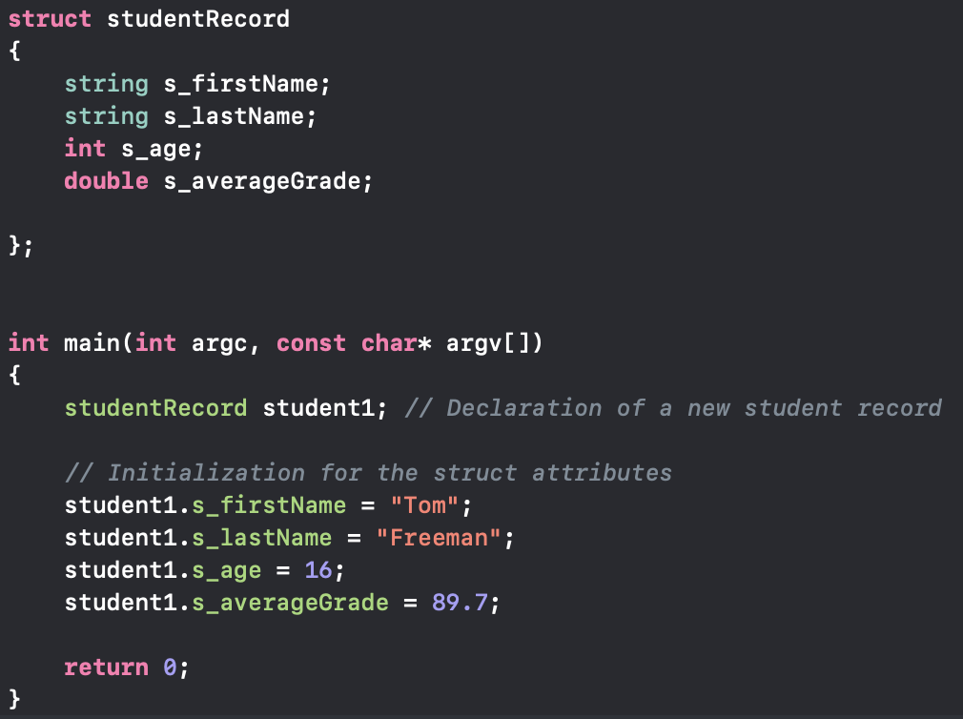
Let’s use our data structure

Slide 25
another way to initialize the struct
This is almost identical to how we initialize arrays
What do you think this looks like?

Slide 26
Struct exercise
Create your own struct and use it for something
You may experiment around with this for the next 10-15 minutes
Note: The dot (.) operator is what lets you access an attribute of your struct

Slide 27


Segfaults
WARNING: Be EXTEMELY careful when using pointers
A pointer can DIRECTLY manipulate memory (so it can change things that shouldn’t be changed)
Your IDE should stop you from doing very stupid things, but you can still create an event known as a “segmentation fault”
Segfaults WILL crash your program
It’s NOT the end of the world, but it is by far one of the worst ways your program can fail
They occur if you try to point to an illegal memory locations
Moving out of bound in an array is a access violation and can spawn a segfault
DISCLAIMER: We this is NOT an extensive look at pointers, doing so is not in the scope of this course

Slide 28
POINTERS
Up until now we have been using something called “pass by value”
When we pass an argument to a function, we are creating a temporary copy
We never actually change the value of our actual variable
We just discussed the fact that a variables true address changes every time we run the program
So trying to remember the address is useless
Pointers will solve BOTH of these issues

Slide 29
What is a pointer?
Simply: A pointer is a variable, who's value is the memory address of another variable.
In other words: “A pointer points to another variable”
Let’s look at how we actually create a pointer.

Slide 30

Pointer syntax

Slide 31

What does * and & mean?
The former is what tells us: “This is a pointer”
The latter expresses: “We want to get the address of what follows &”
So what’s the meaning of

Slide 32
Pointer types
A pointer points to a variable that is the same type as the pointer!
So what type of variable does int *ptr; point to?
This is a pointer to an int
Let’s play around with this for a bit, and see what sorts of pointers we can come up with

Slide 33
Dereferencing pointers
If we want to actually see what the value of the variable which we are pointing to, then we need to do something called dereferencing
This just means: “Instead of giving me the address of i, give me its value”
Let’s look at how we can actually do this.

Slide 34
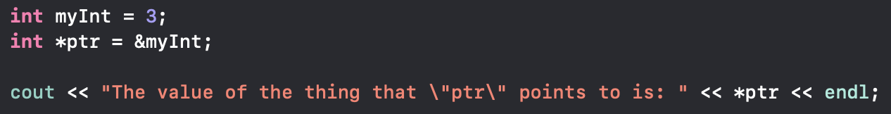

Dereferencing pointers
The key thing is: in the cout

Slide 35
Pointer Exercise
Play around with pointers to different variables
See what happens if you have a int pointer that points to a char variable
In other words: “Try to deliberately do use the wrong type of pointer”
Once you have assigned the pointer, dereference it and see what you get

Slide 36

VOID Pointer

Slide 37
What is a void pointer?
A VOID POINTER is a pointer that can point to ANY TYPE
This is why void is so powerful
In order to see what the actual type was we can do something called a cast
A cast is a way of changing the type of pointer

Slide 38

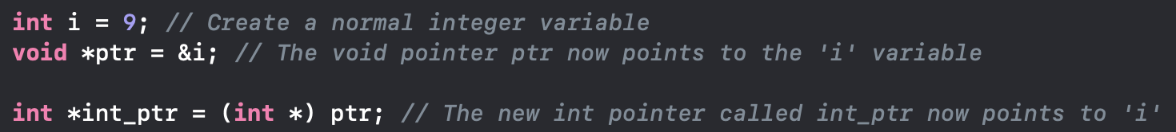
Cast syntax
This here is saying: “From the void pointer called ptr, return a temporary int pointer ”
QUESTION: What would happen if we printed int_ptr?
Let’s play around with this

Slide 39
remainder of the lesson
From what I saw, people were struggling with the following:
Assignment vs comparison
Nested loops (Day_3)
Variable scope (Day_2)
Variable reassignment
Let’s go through this and do some revision
This will mostly consist of you coding and experimenting with these principles

