Slide 1
I/O
By Philipp Tiso
&
Alexander Jaeger

Slide 2


What is I/O?
Its an acronym for “Input/Output”
I/O is what we use to give our program some input to work with
I/O is typically used if we want the user to enter some information

Slide 3
How do we use I/O?
We need to include the library that will allow us to use the I/O methods
This is the <iostream> library
In our case we will be getting input from the command line

Slide 4
How do we get Input?
We saw the cout function which we used to output data to the screen
cin: This is the function that we can use to get data from the command line
We can use the >> operator to say “ok get me some input an then load it into the variable after the >>”

Slide 5
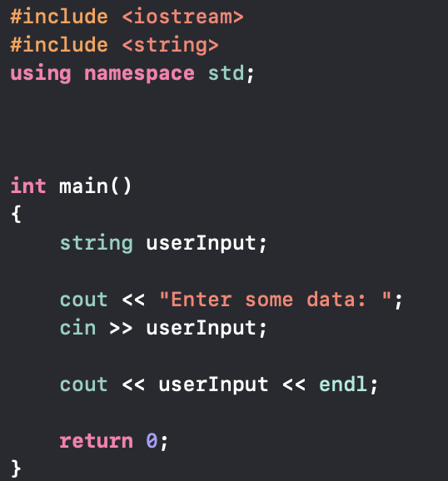
Input Example
We need to save the user input somewhere
We can create a variable to save the user input
The variable must have the appropriate type for the input
If we expect a number, it should be a number data-type etc.

Slide 6
Programming Exercise
Create a program that takes in some user input (you may decide what type)
Then give your program the incorrect input.
What did you notice?
Let’s try it!

Slide 7
Programming Exercise
Create a program that takes 2 string inputs
You are allowed to use ONLY 1 variable
Your program should then print the words in the reverse order
:~ string1 string2 → string2 string1

Slide 8
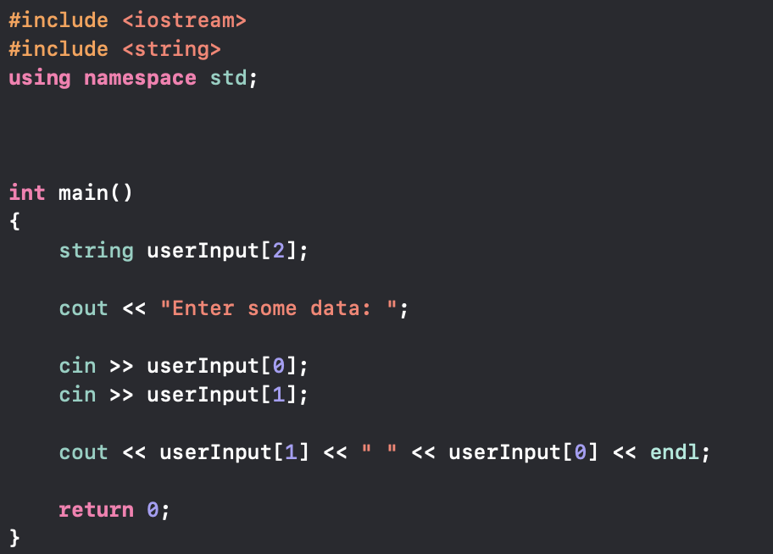

Solution
We can use an array of strings
OUTPUT:
NOTE: The spaces between the two strings is ignored

Slide 9
The main function revisited
The main function is one that we have seen since the start, but there are things we haven’t told you.
The main function is somewhat incomplete in the way we have been using it
It is possible to pass arguments to the main function if we tweak its structure

Slide 10
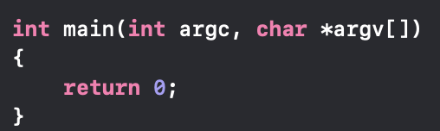
The mains final form!
There are two extra arguments that we have neglected before
argc and argv respectively

Slide 11
argc
argc is an integer which we can use to select the argument from argv
It is what tells us how many other arguments we have entered
This will make sense once we look at argv
argc will NEVER be less than
This is because the first argument is the path of the file we are working on
Just print the first element in argv: cout << argv[0] << endl;

Slide 12
argv
This is an array of strings that our program can use
argv[0] is always the path to our the .cpp file were working in
Arguments are passed before we run our program
This is done on the command line
argc tells us how many strings argv[] contains

