Slide 1


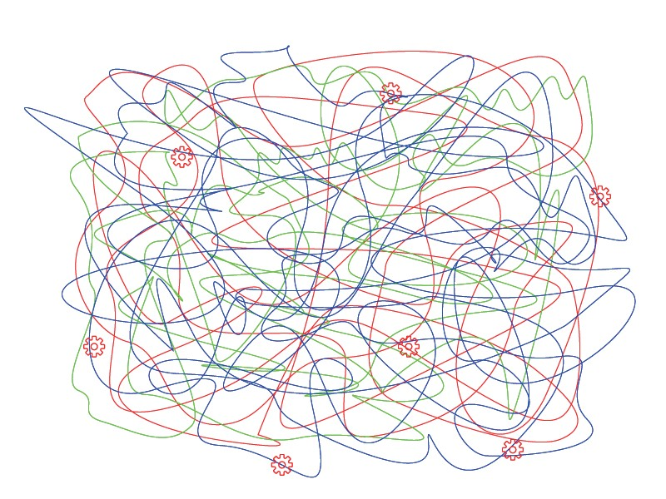
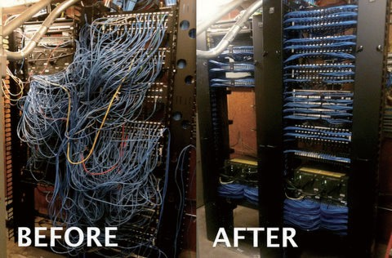
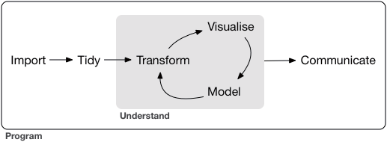




psyphr.read: wrangle and tidy psychophysiological data in R
Kathleen E. Wendt [1], Siqi Zhang, Mallory J. Feldman [2], G. Brooke Anderson [1], & J. Douglas Coatsworth [1]
[1] Colorado State University; [2] University of North Carolina at Chapel Hill
1 a burgeoning field 2 workflow concerns 3 tidy data
Physiological measures are increasingly popular in social, behavioral, and psychological research but yield unwieldy amounts of data and bring their own challenges [1].
To date, few tools have been developed [2] to support reproducibility, efficiency, and accuracy [3-5] in psychophysiological data processing and management.
Output files from proprietary software are often compiled or aligned by hand (e.g., copy-paste). Manual processes introduce opportunities for bias and error. Error-ridden data produces error- driven inferences.
Lack of standardization obstructs shareability and reproducibility.
CURRENT
A main principle of computational reproducibility is tidy data [7].
IDEAL
Each column as a variable
Each row as an observation
Each table as a measure
Our work extends the tidy principles to physiological data.
[6] https://r4ds.had.co.nz/introduction.html
https://advwireonline.com/cable-management.html
my study
Subject Activity
Subject Activity
1
2
=>
1
2
=>
measure A
,
measure B
,
subject 1
activity 1
+
subject 1
activity 2
+
subject 1
activity 3
+
subject n activity m
+ ...
summary
my_study <- psyphr.read::MW_study("D:/my_study"
, ...
)
4 psyphr.read package 5 psyphr suite; future directions
psyphr.read is the first in our suite of free, open source R packages.
With one line of code, the user combines and organizes the entire study (see above illustration). In this tidy form, the user can quickly and easily generate summary statistics and exploratory plots. psyphr.read includes simple data validation techniques to catch errors or problems early.
=>
=>
=>
=>
psyphr.read
+ psyphr.check
+ psyphr.plot
+ psyphr.model +
psyphr.bids
compatibility with Brain Imaging Data Structure (BIDS) [8]
wrangle and tidy
physiological data
sophisticated data validation schemes
publication-grade plots and graphics
common statistical models in area
The full psyphr suite will help researchers spend less time on data management and more time “doing science.”
This work will provide the foundation of open science practices for psychophysiological research and
promote computational reproducibility in fields with increasingly large and complex datasets.
Watch our progress and contribute on github.com/psyphr-dev.
references & poster copy
KEW supported by
National Science Foundation
Graduate Research Fellowship Program
Grant No. 006784-00002

