Slide 1
Decision Tree Classification
Credit Card Fraud Prediciton

Slide 2
Decision Tree Steps(don’t have prunning)
01
Feature Selection
04
Recursing on Subset
Select the best feature that results in the most effective split
Repeating the split for each subset until stop criteria meets
02
Determing the Split
Stop Criteria
05
Find the optimal threshold for spltting the data
The decision tree stops under certain conditions
03
Creating a Node
06
Create Leaf Node
The node is created after split with the decision rule
The leaf node predicts the class that has the majority in the subset

Slide 3
Feature Selection
Artificial Intelligence
Machine learning
Merchant:The merchant involved in the transaction.
Category Transaction type (e.g., personal, childcare).
Amt: Transaction amount.
Gender: Cardholder’s gender
Lat and Long: Latitude and Longitude of cardholder’s location
Unix_time: Transaction timestamp (Unix format).
Merch_lat and Merch_long: Merchant’s location
Is_fraud:Fraudulent transaction indicator (1 = fraud, 0 = legitimate). Target variable
Trans_date_trans_time: Timestamp of the transaction (date and time) They act according to environment
Cc_num: Unique customer identification number.
Name: Cardholder’s name
Address: Cardholder’s address
City_Pop: population of the cardhold’s city
Job: Cardholder’s job title
Dob: Cardholder’s date of birth
Trans_num: Unique transaction identifier
Vs

Slide 4
The Best Split
Left
Right
The condition should not be defined by us!

Slide 5
Decision Tree Type
01
02
ID3
C4.5
Entropy
Better ID3
Algorithm
03
04
C5.0
CART
Faster C4.5
Gini Impurity

Slide 6



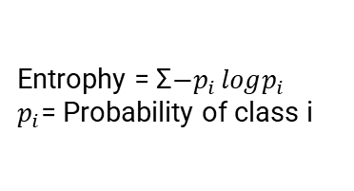






Information Gain and Entrophy
$−0.5log0.5−0.5$ $log0.5$
$$1$$
Entrophy = Σ$−p_{i }logp_{i}$
$p_{i}$= Probability of class i
IG= $E−$ Σ$w_{i }E({child}_{i })$
$$0.99$$
$$0.91$$
IG₁= $1−\frac{14}{20}∗0.99−\frac{6}{20}∗0.91=0.034$
$$0$$
$$0.95$$
IG₂= $1−\frac{4}{20}∗0−\frac{16}{20}∗0.95=0.24$

Slide 7

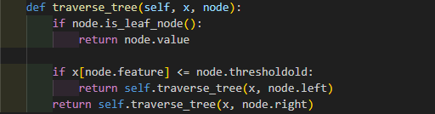
Creating a Node and Recursing on Subset

Slide 8
Stop Criteria
Maximum Depth
01
The tree has reached the predefined maximum depth (number of layers).
Minmum Samples at Nodes
02
A node has fewer samples than the predefined threshold, which is set to prevent further splitting.
All Samples are of One Class
03
There is no point in further splitting because all data points belong to the same category.
No Impurity Improvement
04
Further splits do not significantly improve the purity of the node.

Slide 9

Creating Leaf Node
Stop Criteria
Leaf Node

Slide 10
What Else?
01
Cost Complexity Prunning
A subtree is replaced with a leaf node if it causes the least increase in the error rate.
Pruning
(Optional)
02
Reduce Error Prunning
Simplifying the tree by testing changes against a validation set

Slide 11
Train, Fit, Predict, Result
1. Training Accuracy: 0.9985597996242955
2. Testing Accuracy: 0.9925
3. Training Precision: 0.9972520609542843
4. Testing Precision: 0.16666666666666666
5. Training Recall: 0.9998747651847214
6. Testing Recall: 0.2857142857142857
7. Classification report:
8. precision recall f1-score support
10. 0 1.00 0.99 1.00 1993
11. 1 0.17 0.29 0.21 7
13. accuracy 0.99 2000
14. macro avg 0.58 0.64 0.60 2000
15. weighted avg 0.99 0.99 0.99 2000
1. accuracy for self-built tree: 0.9925
2. accuracy for sklearn built-in tree: 0.997
ML for Credit Card Fraud

Slide 12
How to Improve?
01
02
03
Better Dataset
Feature Engineering
Pruning
Balanced dataset
Better feature selection and transformation
Reduce overfitting and improve model’s generalization
04
05
Optimizing Tree Parameter
Better Algorithm
Random Forest
Max Depth, Max Feature, Min Sample Split, etc…

Slide 13
Conclusion
Decision Trees provide a robust method for both classification tasks in various sectors.
They are favored for their transparency and ease of interpretation, aiding in decision-making processes.
Key techniques to enhance performance include pruning to avoid overfitting, and ensemble methods like Random Forests for greater accuracy.
Future Outlook
Ongoing research is likely to refine decision tree algorithms further, enhancing their efficiency and reducing biases.
Integration with other machine learning frameworks and big data technologies is expected to increase.

Slide 14
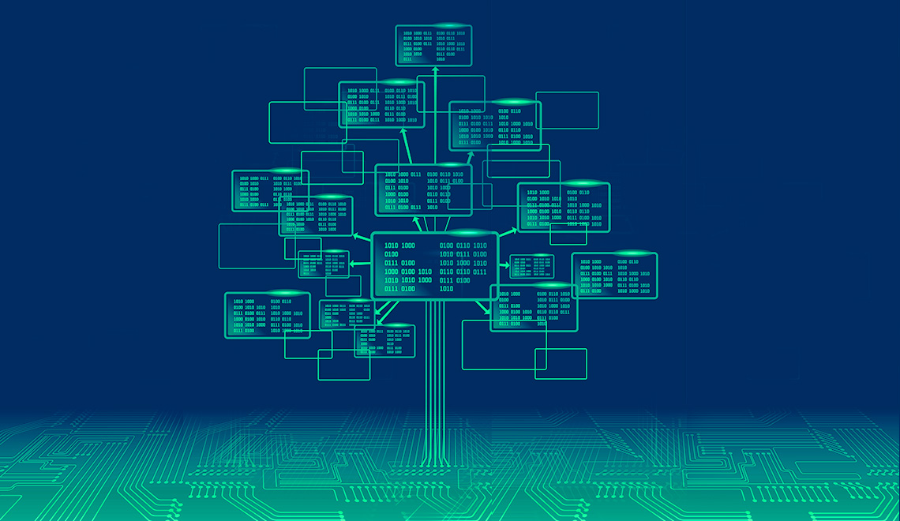
Thank You

