Slide 1
Markov decision process
Reinforcement Learning
鄢忻媛
Jan 30th, 2021
xinyuanyan2016@gmail.com

Slide 2
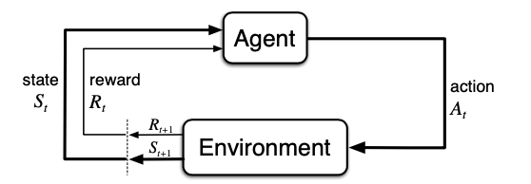
RL? RL is life!
Sutton and Barto, 2018

Slide 3
RL? RL is life!
https://gym.openai.com/

Slide 4

Some websites you should know
https://gym.openai.com/

Slide 5

Some websites you should know
https://deepmind.com/

Slide 6
Learning by Doing, in Python!
gym https://gym.openai.com
tensorflow https://www.tensorflow.org/
pytorch https://pytorch.org/

Slide 7
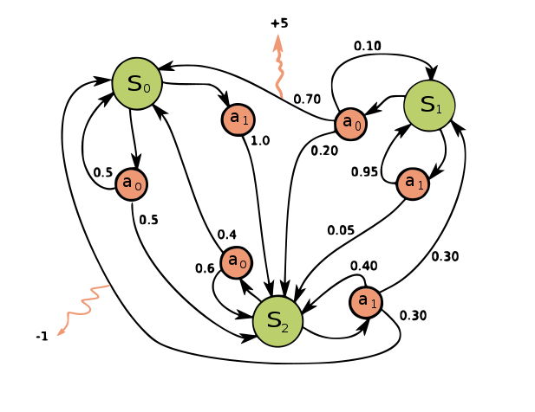
Markov chain and Markov process
Figure from wikipedia

Slide 8
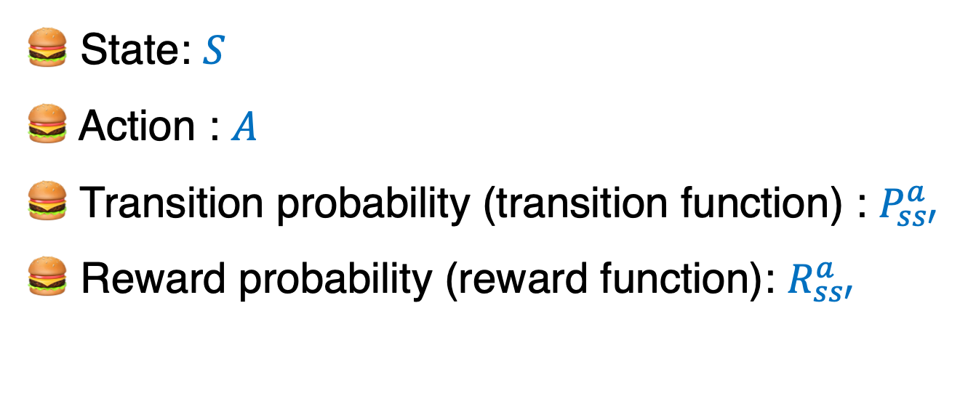
Markov chain and Markov process
🍔 State: $S$
🍔 Action : $A$
🍔 Transition probability (transition function) : $P_{ss′}^{a}$
🍔 Reward probability (reward function): $R_{ss′}^{a}$
🍔 🍔 🍔 Core concept 🍔 🍔 🍔
Future depends only on the present and not on the past

Slide 9
Markov Decision Process
🍊 MDP is an extension of the Markov chain
🍊 Most of RL problems can be modeled by MDP

Slide 10
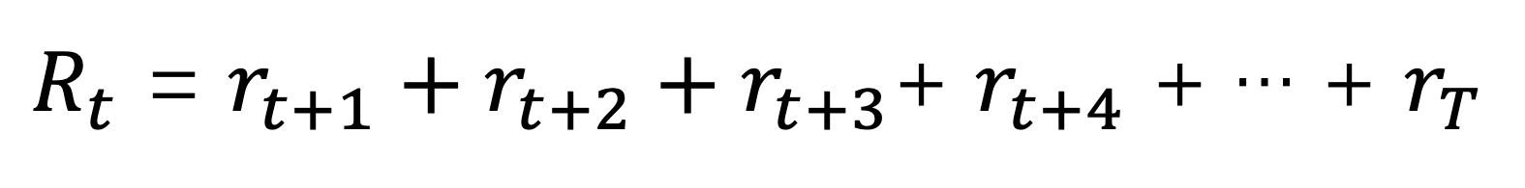
Markov Decision Process
Reward (cumulative vs. immediate)
$R_{t}$ = $r_{t+1}+r_{t+2}+r_{t+3}$+ $r_{t+4}$ + … + $r_{T}$
To maximize the total amount of rewards (cumulative rewards) from the environment
Instead of immediate rewards.

Slide 11

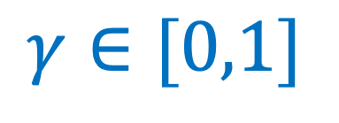
Markov Decision Process
Reward & discount factor $γ$
$$γ∈[0,1]$$
$R_{t}$ = $r_{t+1}+{γr}_{t+2}+{γ^{2}r}_{t+3}$+ $γ^{3} r_{t+4}$ + … + $γ^{k} r_{t+k+1}$
$γ decides how much importance we give to the future rewards and immediate rewards$

Slide 12
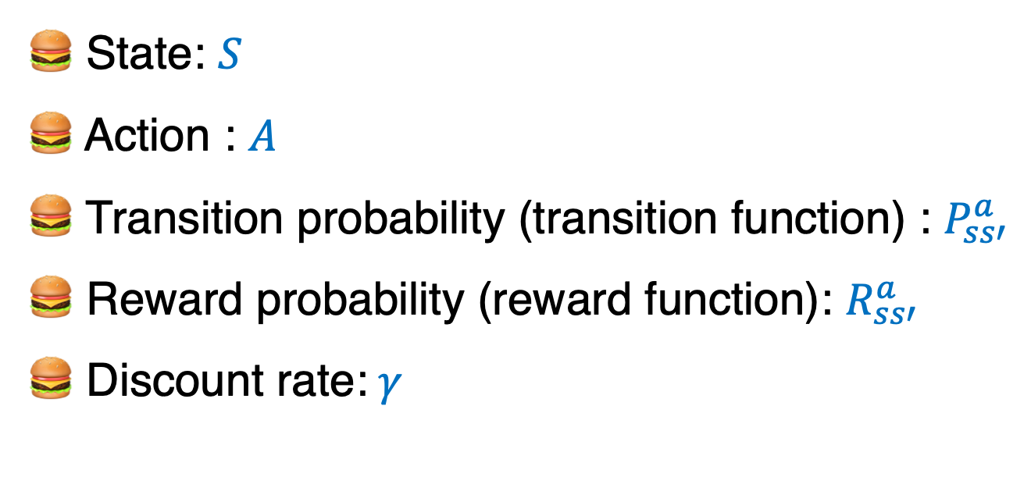
Markov Decision Process
🍔 State: $S$
🍔 Action : $A$
🍔 Transition probability (transition function) : $P_{ss′}^{a}$
🍔 Reward probability (reward function): $R_{ss′}^{a}$
🍔 Discount rate:$γ$

Slide 13
Markov Decision Process
Why introduce the discount factor in MDP?
Reason 1: For infinite horizon problem, including discount factor ($γ∈[0,1]$) help to find optimal solution(converge)
Reason 2: To describe the ‘urgency’ in RL framework

Slide 14
Policy and value function
see OneNote

Slide 15

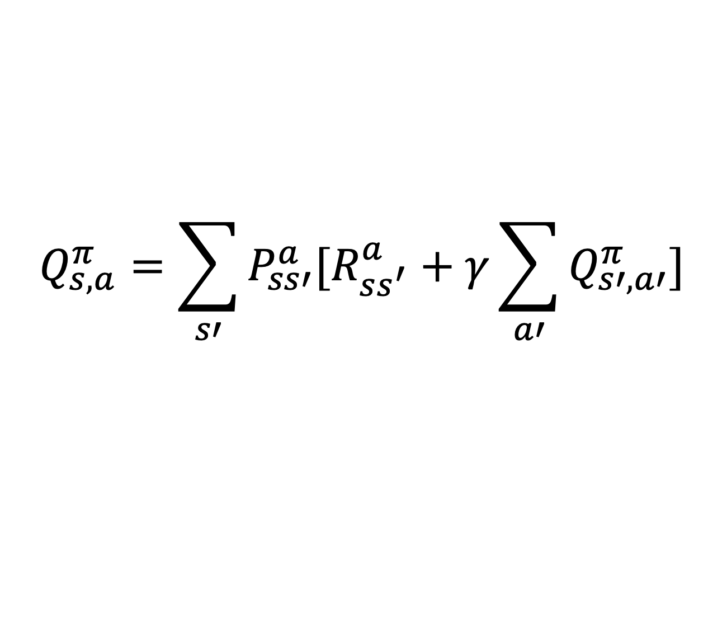
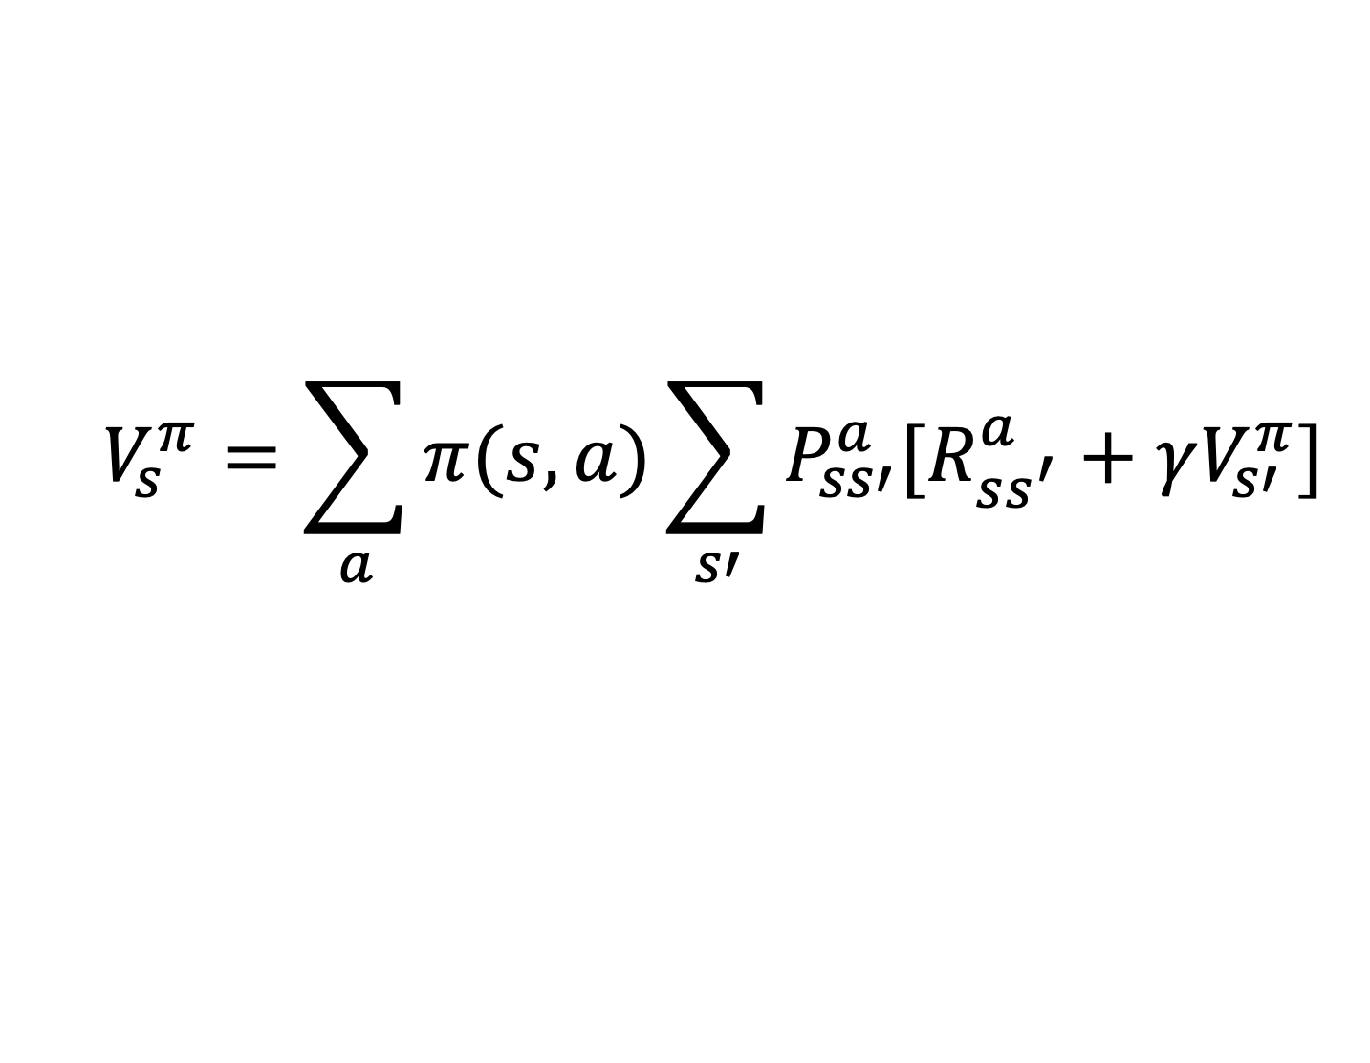

Bellman equation
$$Bellman equation for value function:$$
$$V_{s}^{π}=\sum_{a}{π(s,a)}\sum_{s′}{P_{ss′}^{a}[R_{ss^{′}}^{a}+γV_{s′}^{π}]}$$
$$Bellman equation for Q function:$$
$$Q_{s,a}^{π}=\sum_{s′}{P_{ss′}^{a}[R_{ss^{′}}^{a}+γ\sum_{a′}{Q_{s′,a′}^{π}}]}$$

Slide 16
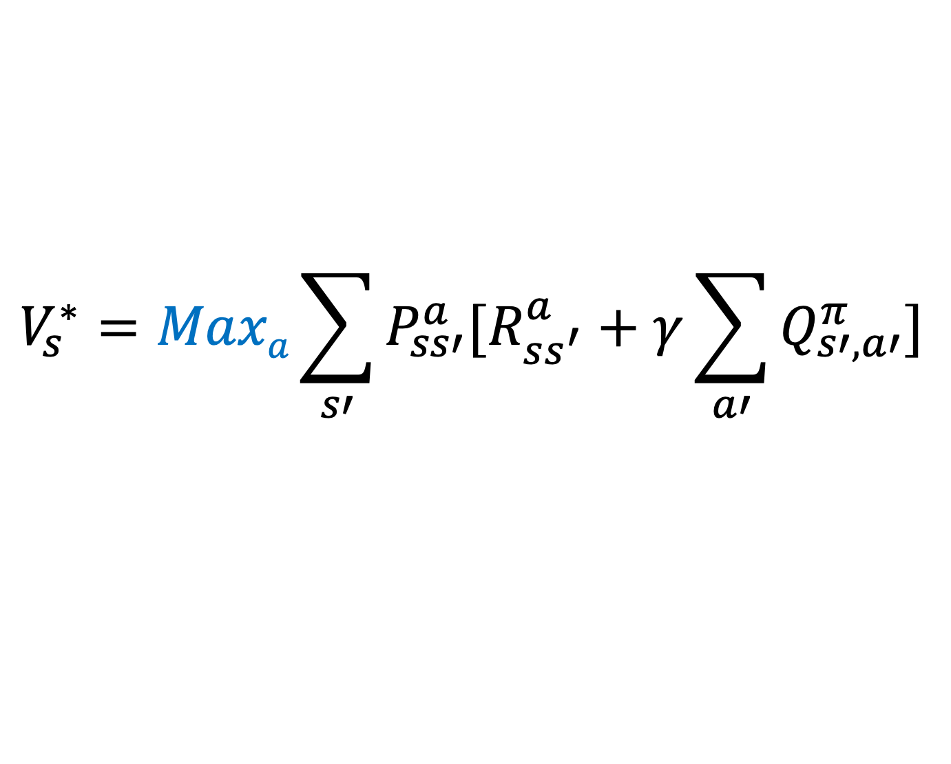
Bellman optimality equation
$$V_{s}^{∗}={MaxaQ}_{s,a}^{π}$$
$$V_{s}^{∗}=Maxa\sum_{s′}{P_{ss′}^{a}[R_{ss^{′}}^{a}+γ\sum_{a′}{Q_{s′,a′}^{π}}]}$$

Slide 17
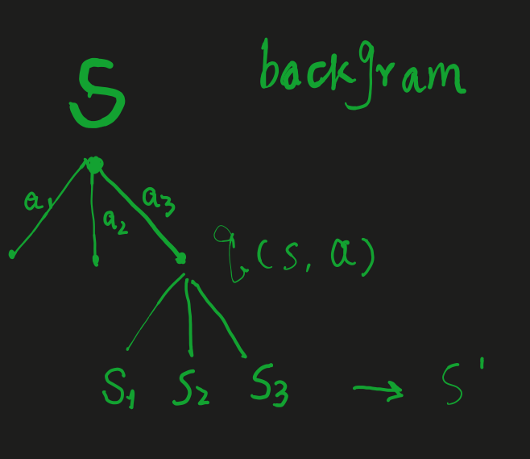
Deriving Bellman Equation
see OneNote

Slide 18
Deriving Bellman Equation
In brief
Q(s,a) = Transition probability * ( Reward probability + gamma * value_{next state})

Slide 19

Dynamic programming: solving bellman optimality equation
0
B
C
D
E
3
1
A
H
G
F
🍔
2

Slide 20
Dynamic programming: solving bellman optimality equation
State | Action | Next state | Transition Prob | Reward Prob
A | 0 | A | 0.3 | 0.3
A | 0 | B | 0.7 | 1
A | 0 | C | 0 | 0
A | 0 | D | 0 | 0
A | 0 | E | 0 | 0
A | 0 | F | 0 | 0
A | 0 | G | 0 | 0
A | 0 | H | 0 | 0
A | 1 | A | 0.3 | 0.3
A | 1 | B | 0 | 0
A | 1 | C | 0 | 0
A | 1 | D | 0 | 0
A | 1 | E | 0 | 0
A | 1 | F | 0 | 0
A | 1 | G | 0 | 0
A | 1 | H | 0.7 | -1

Slide 21
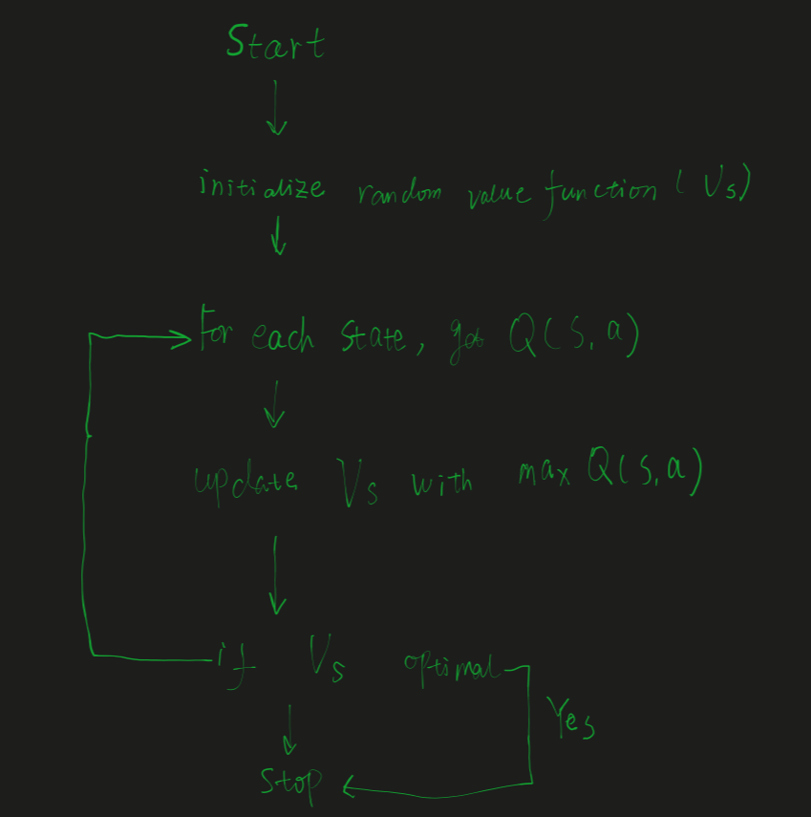
Dynamic programming: solving bellman optimality equation
Value iteration
0
B
C
D
E
3
1
A
H
G
F
2

Slide 22
Dynamic programming: solving bellman optimality equation
Iteration#2
Iteration#55
 | -0.4 | -0.3
 | -0.5 | -0.6
0.3
0.15
0.5
0.45
0.5
0.35
0.63
0.74
0.2
0.71
0.3
0.82
Iteration#N
 | -0.51 | -0.62
0.4
0.45
0.64
0.75
Converge and find the optimal policy!
0.4
0.83

Slide 23
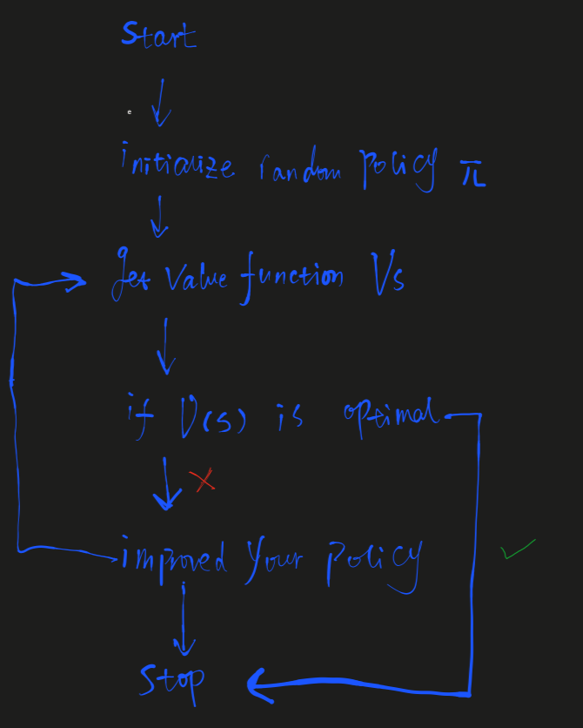
Dynamic programming: solving bellman optimality equation
Policy iteration
0
B
C
D
E
3
1
A
H
G
F
2
Policy example:
A-> 0
B-> 1
C-> 2
D-> 3
…

Slide 24
Thanks!
Discussion!

