Slide 1
Project 3 Proposal & Wireframes
Campus Connect — Student Events SPA
Student Name: Sailesh Mohapatra
Course Title: WEB 803
Task 1 & 2 submission deck with embedded PNG wireframes
Notes:
[Sources] - Project3-Task12.pdf, pages 4-5 (Task 1 deliverables and proposal sections) - Project3.pdf, page 1 (Project 3 objective and required technologies) [/Sources] [Sources] - Project3-Task12.pdf, pages 7-21 (wireframe purpose, standard elements, grayscale guidance, and PNG export instructions) - Project3.pdf, page 1 (app requirements: authentication, validated posting form, responsive use, and live deployment) [/Sources]

Slide 2
Introduction
Client + project overview
Campus Connect is a proposed single-page application for a university Student Life office that wants one modern place for campus events, club announcements, and student updates.
1
2
3
Current information is scattered across email, social posts, and flyers, which makes updates hard to track.
Students need a faster way to discover events, while organizers need secure tools to add, edit, and manage posts.
The proposed app focuses on React JS for the front end and MongoDB / Express for the back end.
Discover
Sign in
Post & Manage
Project summary
Campus Connect lets students browse events and lets authorized organizers securely create, update, and manage event posts from any device.
Task 1 proposal
Notes:
[Sources] - Project3-Task12.pdf, pages 4-5 (Task 1 deliverables and proposal sections) - Project3.pdf, page 1 (Project 3 objective and required technologies) [/Sources]

Slide 3
Goals & Objectives
What the project should accomplish
Centralize information
Secure content management
Replace scattered communication channels with one searchable event feed and announcement hub.
Support signup, login, logout, authorization, sessions, and cookies for protected actions.
Improve data accuracy
Work across devices
Use validated forms so organizers can publish consistent titles, dates, locations, and descriptions.
Deliver a responsive SPA and PWA experience that works on desktop, tablet, and mobile.
Measure of Success: students can find relevant events quickly, and organizers can publish or update information without needing staff to manually edit every post.
Aligned to project objectives
Notes:
[Sources] - Project3-Task12.pdf, pages 4-5 (Task 1 deliverables and proposal sections) - Project3.pdf, page 1 (Project 3 objective and required technologies) [/Sources]

Slide 4
Target Audience
Primary and secondary users
The app serves three connected user groups, each with a different task focus but a shared need for quick mobile-friendly access.
S
C
S
Students
Club leaders
Staff / moderators
Age 18–35
Mobile-first campus users
Need: discover events, search by category, save favorites
Age 20–40
Student organizers and faculty advisors
Need: sign in, create posts, edit details, manage drafts
Age 25–50
Administrative support users
Need: review content, manage accounts, support announcements
Primary user group
Support / creator role
Support / creator role
Notes:
[Sources] - Project3-Task12.pdf, pages 4-5 (Task 1 deliverables and proposal sections) - Project3.pdf, page 1 (Project 3 objective and required technologies) [/Sources]

Slide 5
Key Features
Core experience for the SPA
Search + filters
Secure authentication
Create / edit forms
Browse events by keyword, club, date, or category from the home screen.
Signup, login, logout, and authorization for organizer-only actions.
Validated forms for adding or updating event details and announcements.
Dashboard
Responsive PWA
Session handling
A personal workspace to manage published posts, drafts, and saved items.
A mobile-friendly interface that can be installed for quick return visits.
Protected routes with sessions, cookies, and HTTPS / SSL awareness.
These features directly support add/update actions on the view, authentication, validated posting, and multi-device access.
Notes:
[Sources] - Project3-Task12.pdf, pages 4-5 (Task 1 deliverables and proposal sections) - Project3.pdf, page 1 (Project 3 objective and required technologies) [/Sources]

Slide 6
Technology Requirements
Planned stack for implementation
The proposed stack follows the Project 3 brief and keeps the app modular enough for later team development.
Front end
React JS • React Router • Bootstrap 5 • SASS / LESS • JSON / AJAX
Back end
Node.js • Express • REST API routes
Data + security
MongoDB • Mongoose • Authentication / Authorization • Sessions & Cookies • SSL / HTTPS
Delivery
PWA support • GitHub repository • Live server deployment
Notes:
[Sources] - Project3-Task12.pdf, pages 4-5 (Task 1 deliverables and proposal sections) - Project3.pdf, page 1 (Project 3 objective and required technologies) [/Sources]

Slide 7
Collaboration-ready Structure
Simple split for working with a partner later
A clean module split, consistent naming, and feature branches make it easier to extend this project with a group partner.
client/
src/
components/
pages/
services/
server/
routes/
models/
middleware/
docs/
wireframes/
backlog/
Partner A
Interface + shared layout
Partner B
Auth + data features
Home page and browse flow
Reusable Header / Footer / EventCard
Responsive styling and PWA shell
Signup / login / logout flow
Create-edit form and validation
Dashboard + event API routes
Shared working rules
Use matching page names: Home, Auth, CreateEvent, Dashboard.
Keep design tokens and reusable components in shared folders.
Use feature branches (feature/home, feature/auth, feature/dashboard) and merge to dev before main.
Track work against the same wireframe IDs used below: WF-01 to WF-04.
Notes:
[Sources] - Project3-Task12.pdf, pages 4-5 (Task 1 deliverables and proposal sections) - Project3.pdf, page 1 (Project 3 objective and required technologies) [/Sources]

Slide 8
Project 3 • Task 2
Task 2 — Wireframes
PNG exports inserted into the same presentation as requested
Notes:
[Sources] - Project3-Task12.pdf, pages 7-21 (wireframe purpose, standard elements, grayscale guidance, and PNG export instructions) - Project3.pdf, page 1 (app requirements: authentication, validated posting form, responsive use, and live deployment) [/Sources]

Slide 9
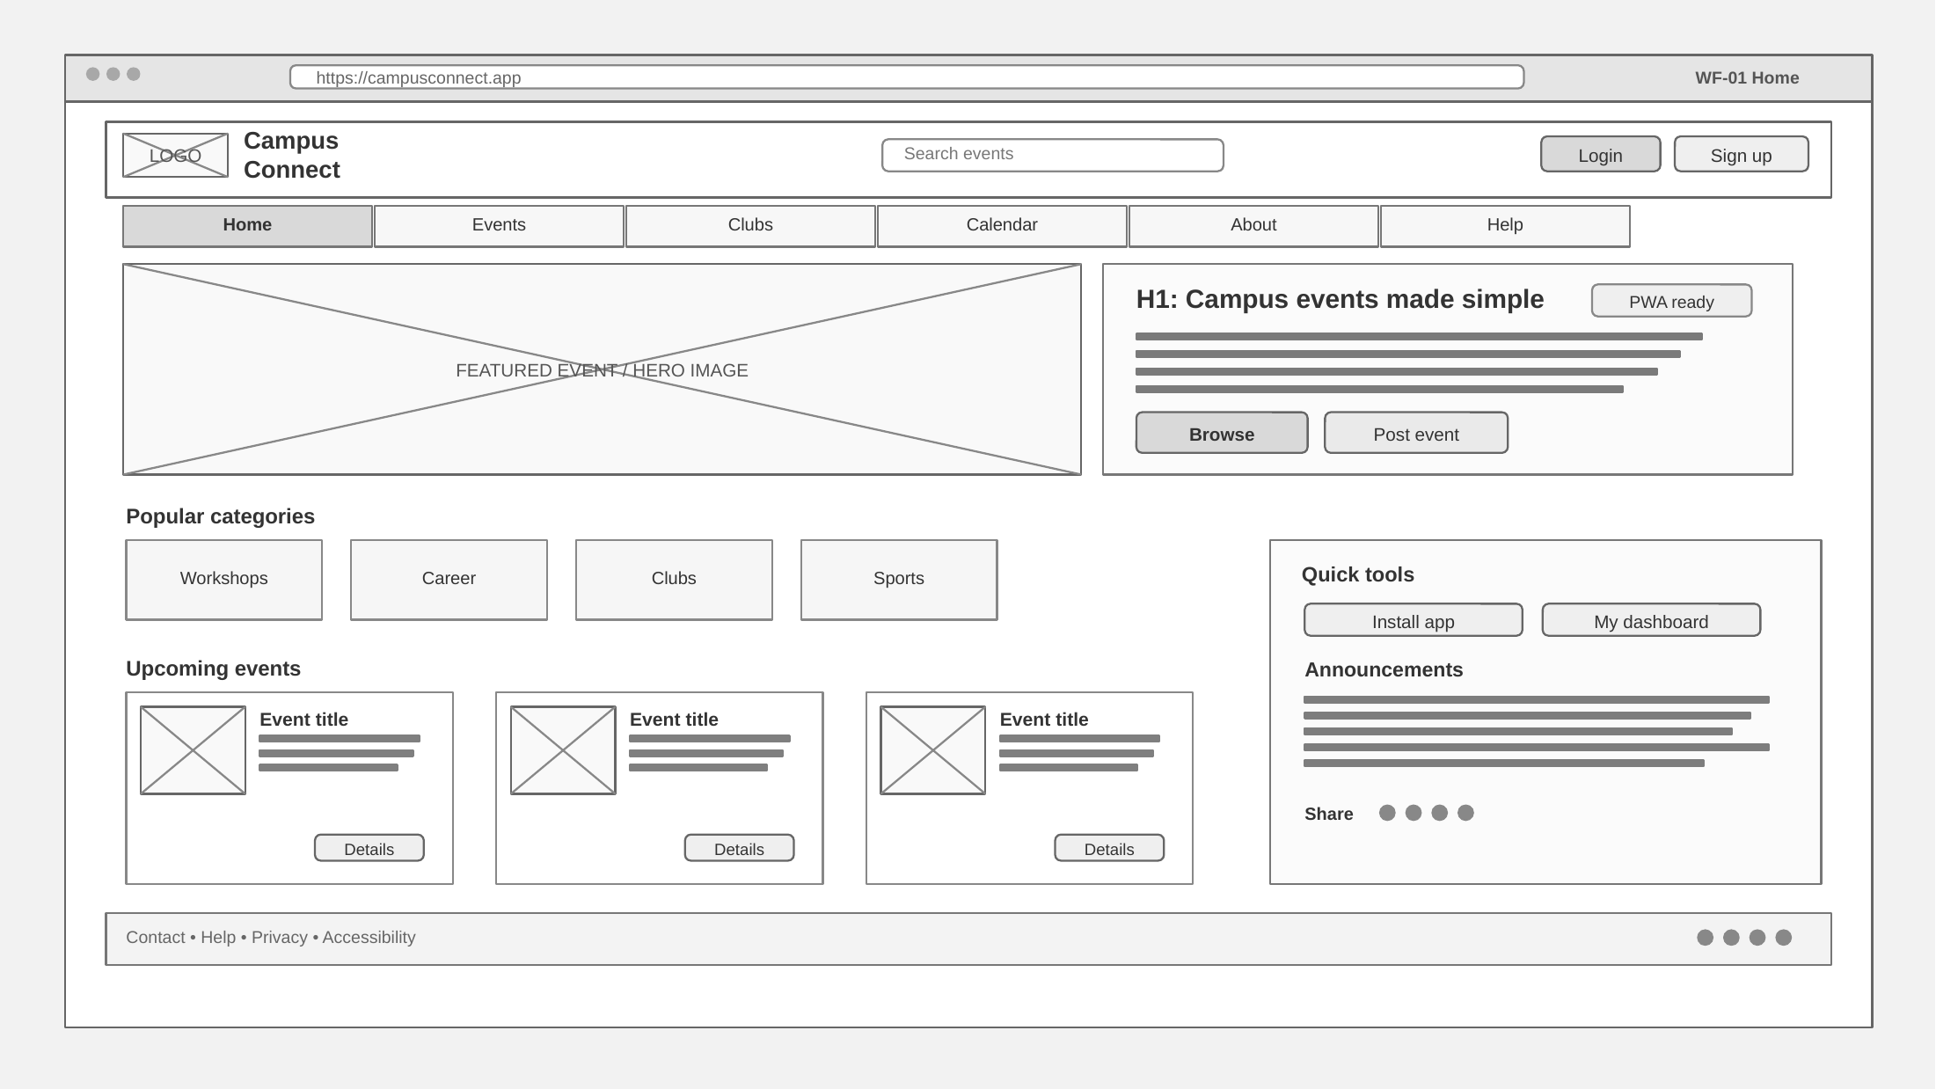
Wireframe 1 — Home Screen
Task 2 PNG
Browse events, search, explore categories, and move into the sign-in or posting flow.
PNG exported
Notes:
[Sources] - Project3-Task12.pdf, pages 7-21 (wireframe purpose, standard elements, grayscale guidance, and PNG export instructions) - Project3.pdf, page 1 (app requirements: authentication, validated posting form, responsive use, and live deployment) [/Sources]

Slide 10
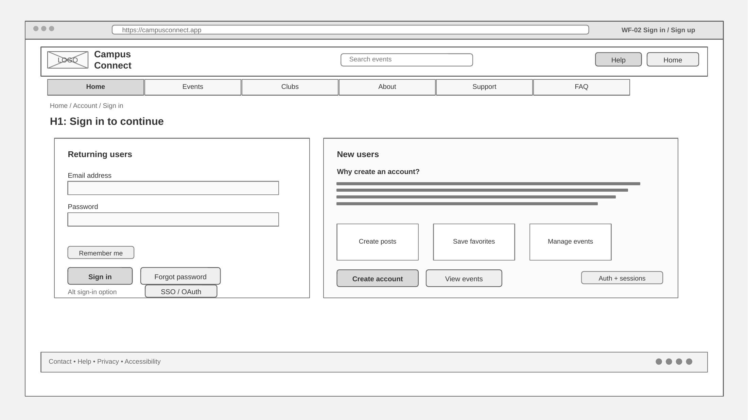
Wireframe 2 — Sign In / Sign Up
Task 2 PNG
Secure entry point for returning users plus account creation for new organizers and students.
PNG exported
Notes:
[Sources] - Project3-Task12.pdf, pages 7-21 (wireframe purpose, standard elements, grayscale guidance, and PNG export instructions) - Project3.pdf, page 1 (app requirements: authentication, validated posting form, responsive use, and live deployment) [/Sources]

Slide 11
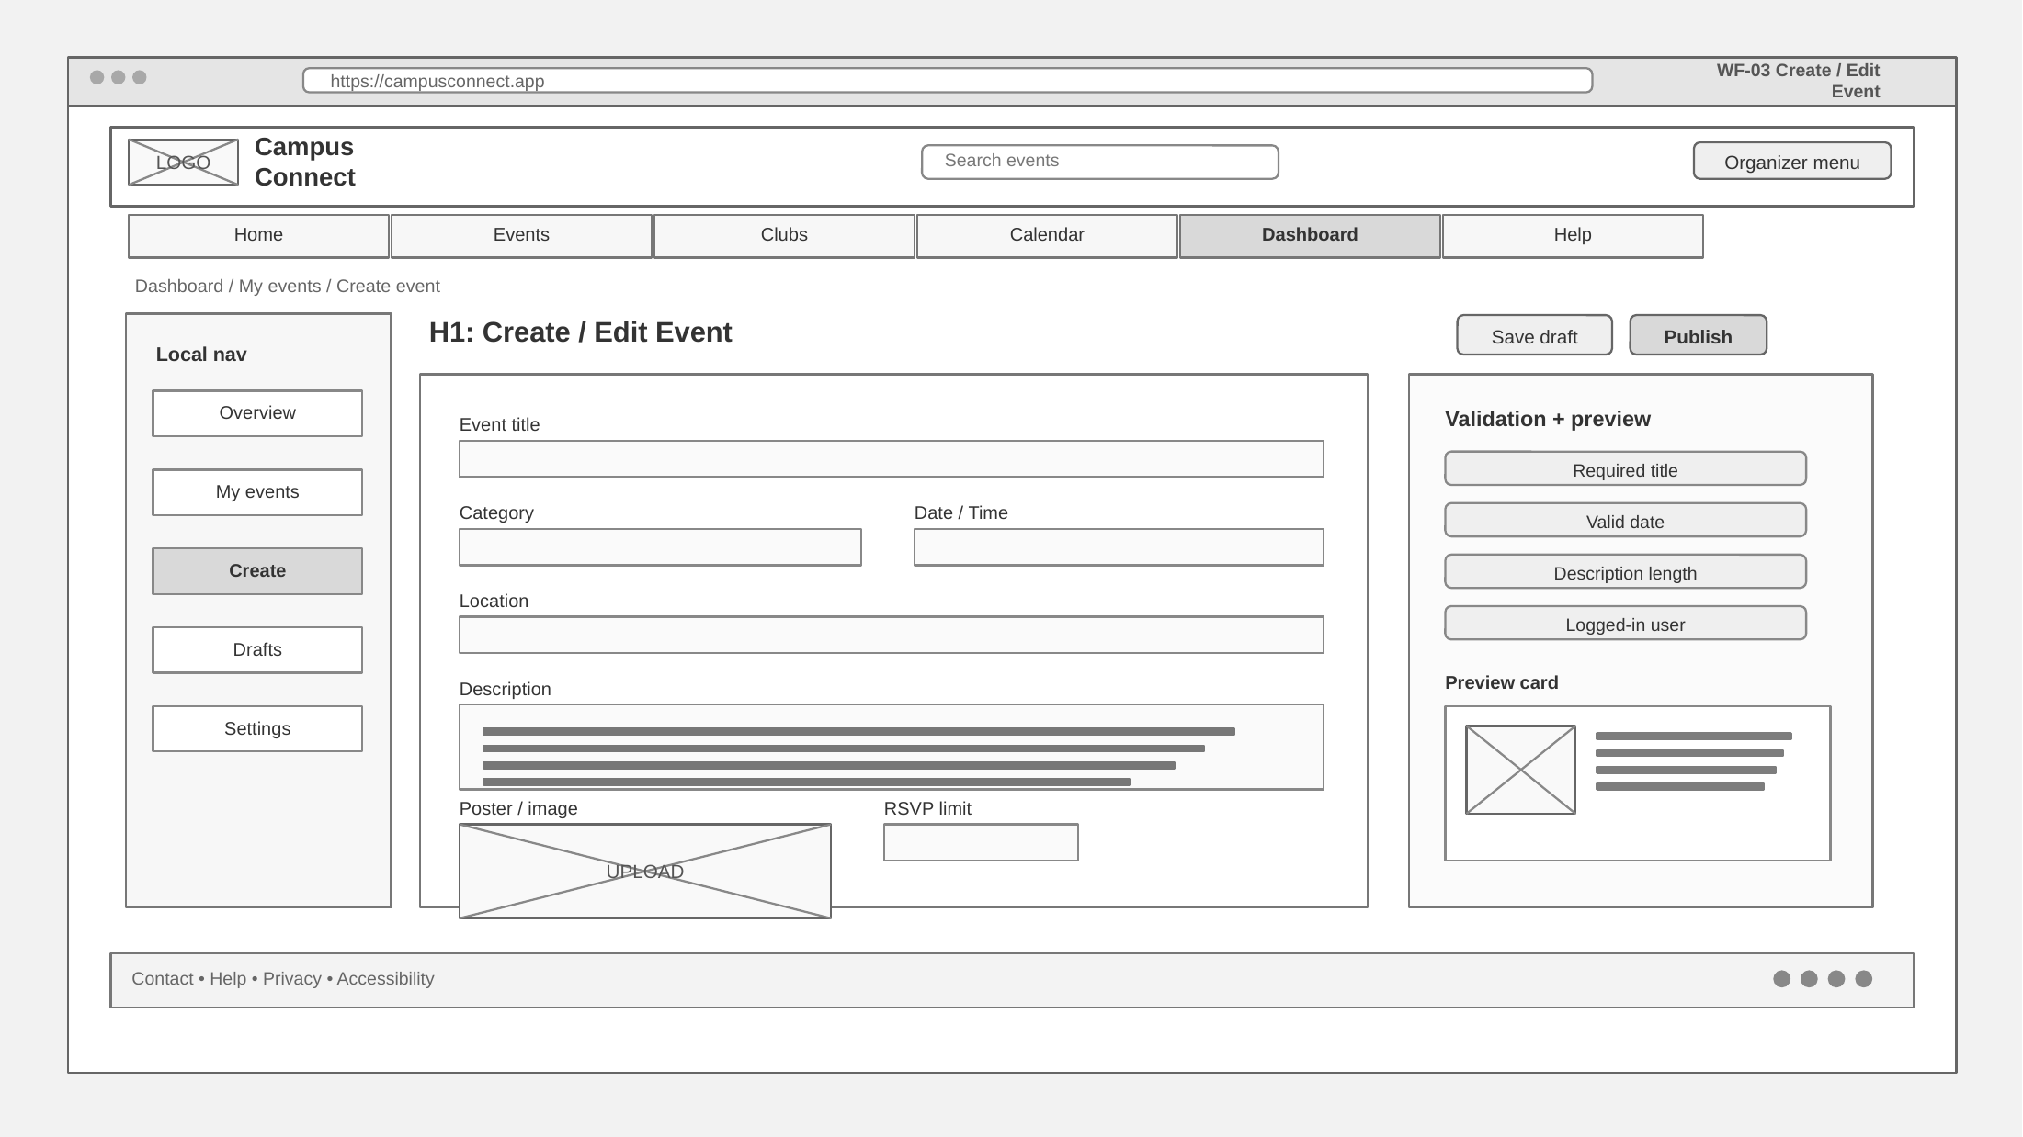
Wireframe 3 — Create / Edit Event
Task 2 PNG
Validated form for posting or updating event information inside the dashboard.
PNG exported
Notes:
[Sources] - Project3-Task12.pdf, pages 7-21 (wireframe purpose, standard elements, grayscale guidance, and PNG export instructions) - Project3.pdf, page 1 (app requirements: authentication, validated posting form, responsive use, and live deployment) [/Sources]

Slide 12
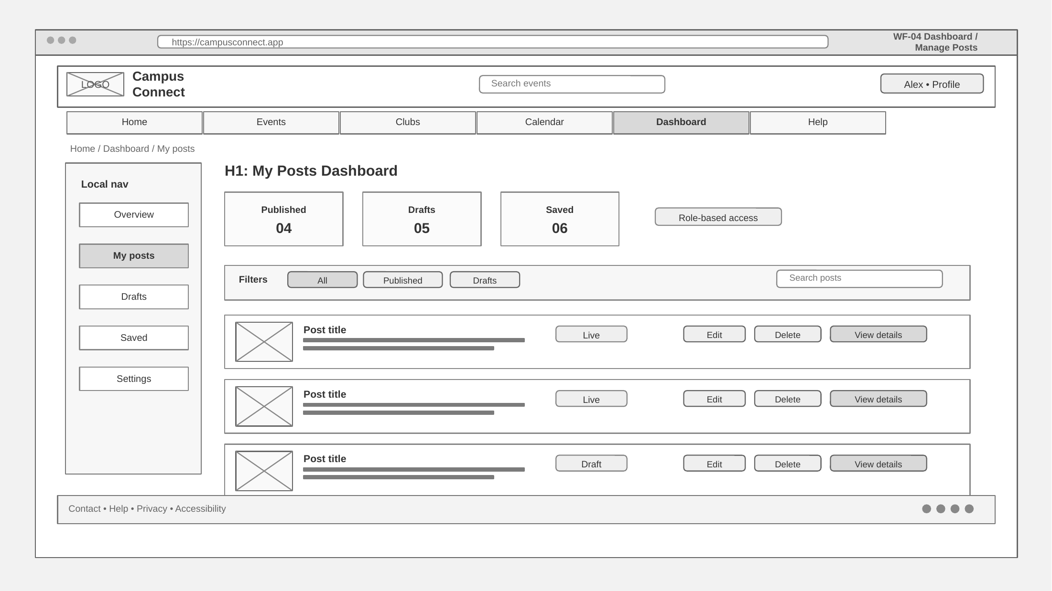
Wireframe 4 — Dashboard / Manage Posts
Task 2 PNG
Organizer workspace for monitoring posts, drafts, and edit actions.
PNG exported
Notes:
[Sources] - Project3-Task12.pdf, pages 7-21 (wireframe purpose, standard elements, grayscale guidance, and PNG export instructions) - Project3.pdf, page 1 (app requirements: authentication, validated posting form, responsive use, and live deployment) [/Sources]

