Slide 1
Your first steps with Julia
Przemysław Szufel, PhD
Assistant Professor – SGH Warsaw School of Economics
https://szufel.pl/

Slide 2
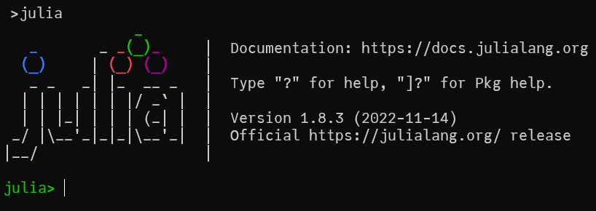


Julia Command Line (REPL)
pressing ] changes REPL to package installation mode
pressing ; changes REPL to package installation mode
pressing ? changes REPL to help mode
to go back to normal mode press BACKSPACE

Slide 3
Adding Julia packages
Start Julia REPL
Press ] to start the Julia package manager (prompt (v1.10) pkg> will be seen)
Sample package installation command
(v1.10) pkg> add PyPlot DataFrames Distributions
to go back to normal mode press BACKSPACE

Slide 4
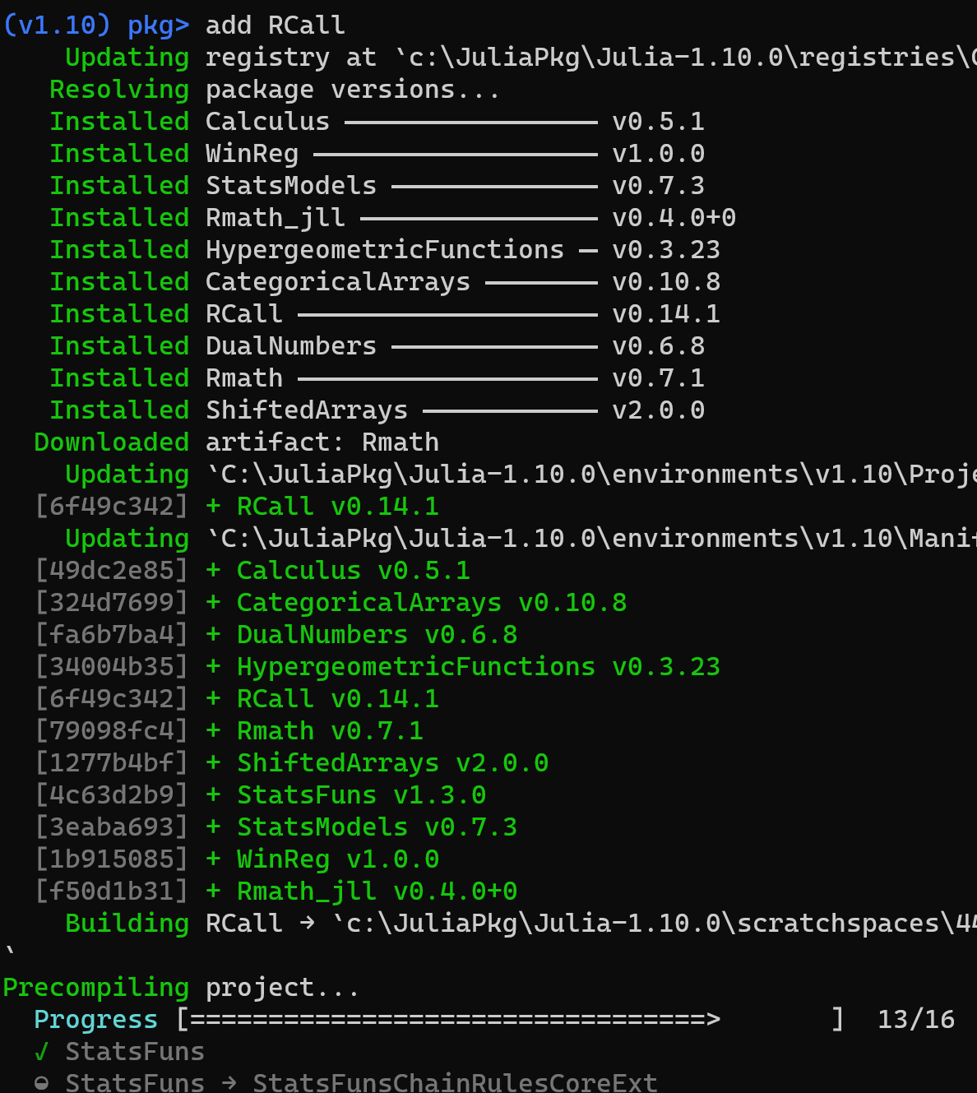
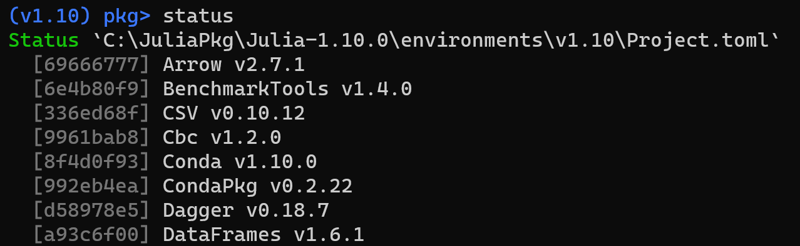
Managing packages (press ] for the package management REPL mode)

Slide 5
Julia installation and virtual environment
JULIA_HOME (system environment variable)
Julia binaries
julia.exe
julia system image
JULIA_DEPOT_PATH (system env variable)
(defaults to ~/.julia)
packages (multiple versions)
precompiled files (multiple versions)
artifacts (multiple versions)
default virtual environment
package1
v1.2.0
v1.4.0
Virtual environment is just a folder!
Pkg.activate("") # default in-built
Pkg.activate("/some/path/")
Pkg.status()
Manifest.toml (file)
Links to defined versions of packages
Resolved dependencies
Use to exactly replicate venv
Project.toml (file)
List of packages
Ranges of package versions

Slide 6
Creating a package with a testset
using Pkg
pkg"generate TestPkg"
; (press “;”) for the command line mode
cd TestPkg/
mkdir test
nano test/runtests.jl
pkg"activate test"
pkg"add Test"
pkg"activate ."
pkg"test"
using TestPkg
using Test
x = 10
@testset "Test 001" begin
@test 1+1 == 2
@test 2+x > 4
end

