Slide 1

Solving optimization problems
Przemysław Szufel
https://szufel.pl/
Preparation of this workshop has been supported by the Polish National Agency for Academic Exchange under the Strategic Partnerships programme, grant number BPI/PST/2021/1/00069/U/00001.

Slide 2
Basics…

Slide 3
Linear optimization
using JuMP, HiGHS
m = Model(optimizer_with_attributes(HiGHS.Optimizer))
@variable(m, x₁ >= 0)
@variable(m, x₂ >= 0)
@objective(m, Min, 50x₁ + 70x₂)
@constraint(m, 200x₁ + 2000x₂ >= 9000 )
@constraint(m, 100x₁ + 30x₂ >= 300 )
@constraint(m, 9x₁ + 11x₂ >= 60 )
optimize!(m)
JuMP.value.([x₁,x₂])

Slide 4
Note – how to type indexes in Julia
julia> x
julia> x\_
julia> x\_1
julia> x\_1<TAB>
julia> x₁

Slide 5
... and Integer programming
using JuMP, HiGHS
m = Model(optimizer_with_attributes(HiGHS.Optimizer))
@variable(m, x₁ >= 0, Int)
@variable(m, x₂ >= 0)
@objective(m, Min, 50x₁ + 70x₂)
@constraint(m, 200x₁ + 2000x₂ >= 9000)
@constraint(m, 100x₁ + 30x₂ >= 300)
@constraint(m, 9x₁ + 11x₂ >= 60)
optimize!(m)

Slide 6
Some of JuMP Solvers (a total of 50 as of today)
Solver | Julia Package | License | LP | SOCP | MILP | NLP | MINLP | SDP
Artelys Knitro | KNITRO.jl | Comm. |  |  |  | X | X
BARON | BARON.jl | Comm. |  |  |  | X | X
Bonmin | AmplNLWriter.jl | EPL | X |  | X | X | X
 | CoinOptServices.jl
Cbc | Cbc.jl | EPL |  |  | X
CPLEX | CPLEX.jl | Comm. | X | X | X
ECOS | ECOS.jl | GPL | X | X
FICO Xpress | Xpress.jl | Comm. | X | X | X
HiGHS | HiGHSMathProgInterface | GPL | X |  | X
Gurobi | Gurobi.jl | Comm. | X | X | X
Ipopt | Ipopt.jl | EPL | X |  |  | X
MOSEK | Mosek.jl | Comm. | X | X | X | X |  | X
NLopt | NLopt.jl | LGPL |  |  |  | X
SCS | SCS.jl | MIT | X | X |  |  |  | X
Full list: https://jump.dev/JuMP.jl/stable/installation/

Slide 7
JuMP Transportation of good among branches

Slide 8
Use case scenario
The Subway restaurant chain in Las Vegas has a total of 118 restaurants in different parts of the city.
18 restaurants have adjacent huge product warehouses that keep ingredients cool and fresh, moreover fresh vegetables are delivered only to those warehouses (rather than to every restaurant) daily at 3am.
Subway has signed a contract with a transportation agency and is billed by the multiple of the weight of transported goods and the distance.
Knowing the amount of available stock at each warehouse and the expected demand at each restaurant (measured in kg), the company needs to decide how the goods should be distributed among warehouses.

Slide 9
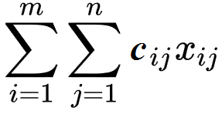
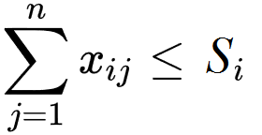
Transportation problem statement
Variables
x_{ij} – number of units transported for i-th supplier to j-th requester
c_{ij} – unit transportation cost between i-th supplier to j-th requester
Cost function C
C =
Constraints: suppliers have maximum capacity S_{i} demand D_{j} must be met

Slide 10
Implementation in JuMP
m = Model(optimizer_with_attributes(HiGHS.Optimizer));
@variable(m, x[i=1:S, j=1:D])
@objective(m, Min, sum( x[i, j]*distance_mx[i, j] for i=1:S, j=1:D))
@constraint(m, x .>= 0)
for j=1:D
@constraint(m, sum( x[i, j] for i=1:S) >= demand[j] )
end
for i=1:S
@constraint(m, sum( x[i, j] for j=1:D) <= supply[i] )
end
optimize!(m)
termination_status(m)

Slide 11
JuMP Travelling salesman problem

Slide 12
Use case scenario
A tourist in San Francisco and plans to visit all McDonald’s restaurant in one day
Let’s help her or him!

Slide 13
Spatial data OpenStreetMap - https://www.openstreetmap.org
Open project – “Wikipedia for maps”
Lots, lots of data
Roads, Buildings, trees, …
Transportation systems
Point-of-interests (POIs) – businesses, restaurants, schools, universities…
Formats: XML, PBF
Multilayered structure
Nodes (points) ⬅ <tag/>
Ways (lines, shapes) ⬅ <tag/>
Relations (wider concepts) ⬅ <tag/>

Slide 14
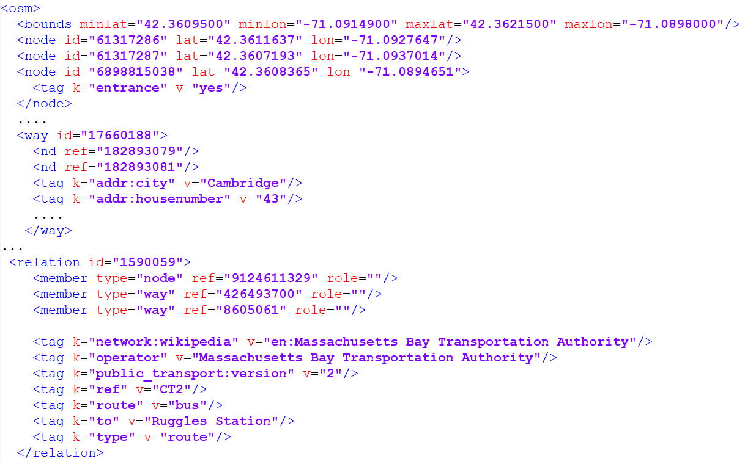
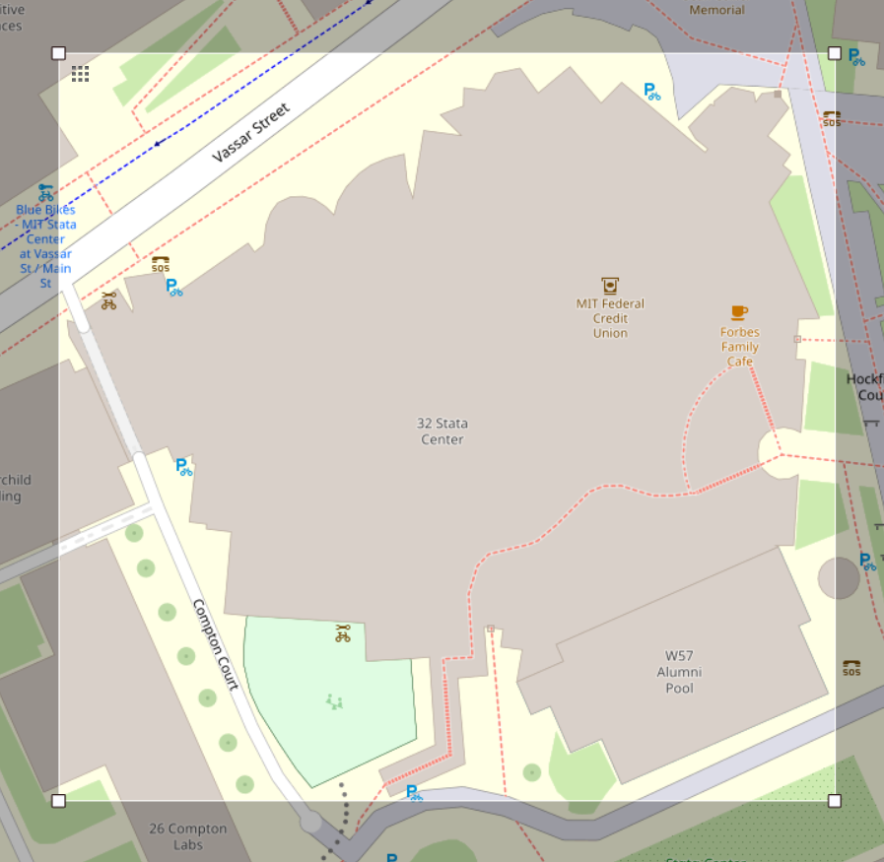


Slide 15
Libraries for OSM data
OpenStreetMapX.jl – mainly oriented on road system
Road system extracted as a directed graph (Graphs.jl) along with separate metadata
Supports routing, road classes, vehicle speeds etc.
Spatial algebra (ENU, LLA, ECEF), overlap with Geodesy.jl
OpenStreetMapXPlots.jl
Plotting maps with Plots.jl and PyPlot.jl .
OSMtoolset.jl – https://github.com/pszufe/OSMToolset.jl
Spatial indexes on maps
Mass extraction of points-of-interests (POIs) from maps
Tools for slicing/tiling large OSM *.xml files
(developed under grant National Science Centre, Poland 2021/41/B/HS4/03349)

Slide 16
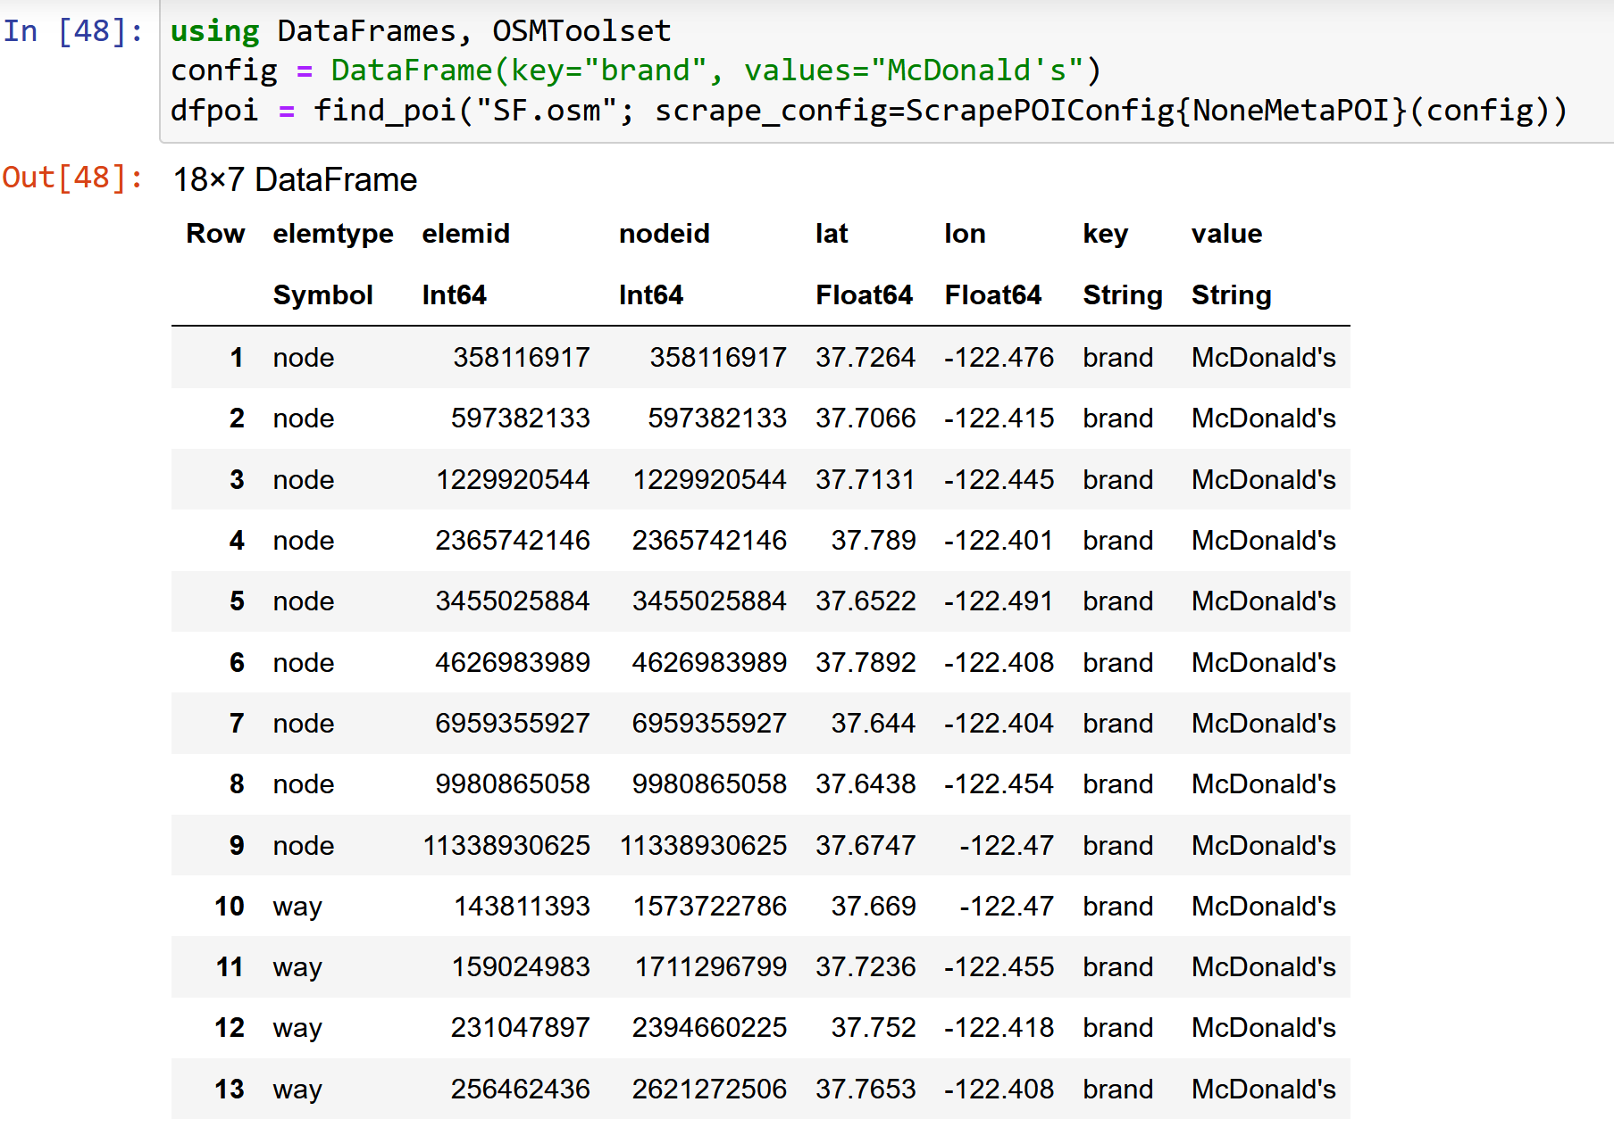
McDonald’s in SF

Slide 17

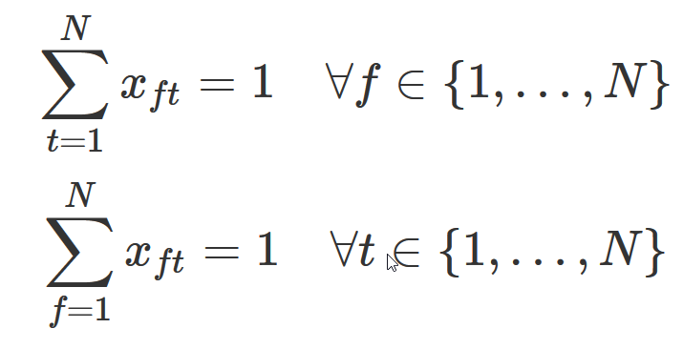
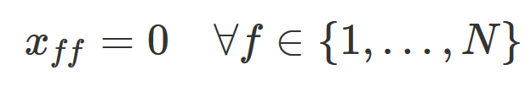

TSP
Variables:
c_{ft} – cost of travel from “f ” to “t ”
x_{ft} – binary variable indicating 1 when agent travels from “f ” to “t ”
Each restaurant visited once
Restaurant cannot visit itself
Avoid two-restaurant
cycles
Other cycles:
/dynamically add a constraint whenever a cycle occurs/
For more details see: http://opensourc.es/blog/mip-tsp

Slide 18
JuMP implementation
m = Model(optimizer_with_attributes(HiGHS.Optimizer));
@variable(m, x[f=1:N, t=1:N], Bin)
@objective(m, Min, sum( x[i, j]*distance_mx[i,j] for i=1:N,j=1:N))
@constraint(m, notself[i=1:N], x[i, i] == 0)
@constraint(m, oneout[i=1:N], sum(x[i, 1:N]) == 1)
@constraint(m, onein[j=1:N], sum(x[1:N, j]) == 1)
for f=1:N, t=1:N
@constraint(m, x[f, t]+x[t, f] <= 1)
end

Slide 19
Getting a cycle
function getcycle(m, N)
x_val = getvalue(x)
cycle_idx = Vector{Int}()
push!(cycle_idx, 1)
while true
v, idx = findmax(x_val[cycle_idx[end], 1:N])
if idx == cycle_idx[1]
break
else
push!(cycle_idx, idx)
end
end
cycle_idx
end

Slide 20
Adding a constraint...
function solved(m, cycle_idx, N)
println("cycle_idx: ", cycle_idx)
println("Length: ", length(cycle_idx))
if length(cycle_idx) < N
cc = @constraint(m, sum(x[cycle_idx,cycle_idx]) <= length(cycle_idx)-1)
println("added a constraint")
return false
end
return true
end

Slide 21
Iterating over the model
while true
status = solve(m)
println(status)
cycle_idx = getcycle(m, N)
if solved(m, cycle_idx,N)
break;
end
end

Slide 22
Gurobi.jl
Commercial software
Free for academic use
Integrates with JuMP via Gurobi.jl
Supports JuMP Lazy constraints (http://www.juliaopt.org/JuMP.jl/0.18/callbacks.html)

Slide 23
Gurobi callbacks
function getcycle(cb, N)
x_val = callback_value.(Ref(cb), x)
getcycle(x_val)
end
function callbackhandle(cb)
cycle_idx = getcycle(cb, N)
println("Callback! N= $N cycle_idx: ", cycle_idx)
println("Length: ", length(cycle_idx))
if length(cycle_idx) < N
con = @build_constraint(sum(x[cycle_idx,cycle_idx]) <= length(cycle_idx)-1)
MOI.submit(m, MOI.LazyConstraint(cb), con)
println("added a lazy constraint")
end
end
MOI.set(m, MOI.LazyConstraintCallback(), callbackhandle)

Slide 24
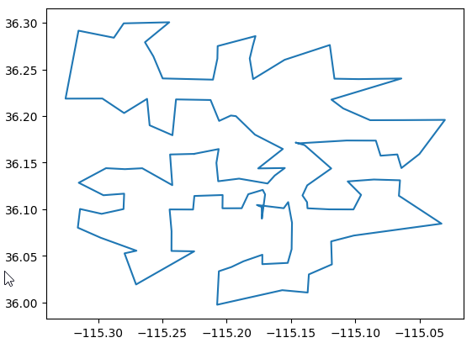
TravelingSalesmanHeuristics.jl
using TravelingSalesmanHeuristics
sol = TravelingSalesmanHeuristics.solve_tsp( distance_mx,quality_factor =100)
More info:
http://evanfields.github.io/TravelingSalesmanHeuristics.jl/latest/heuristics.html

