Slide 1
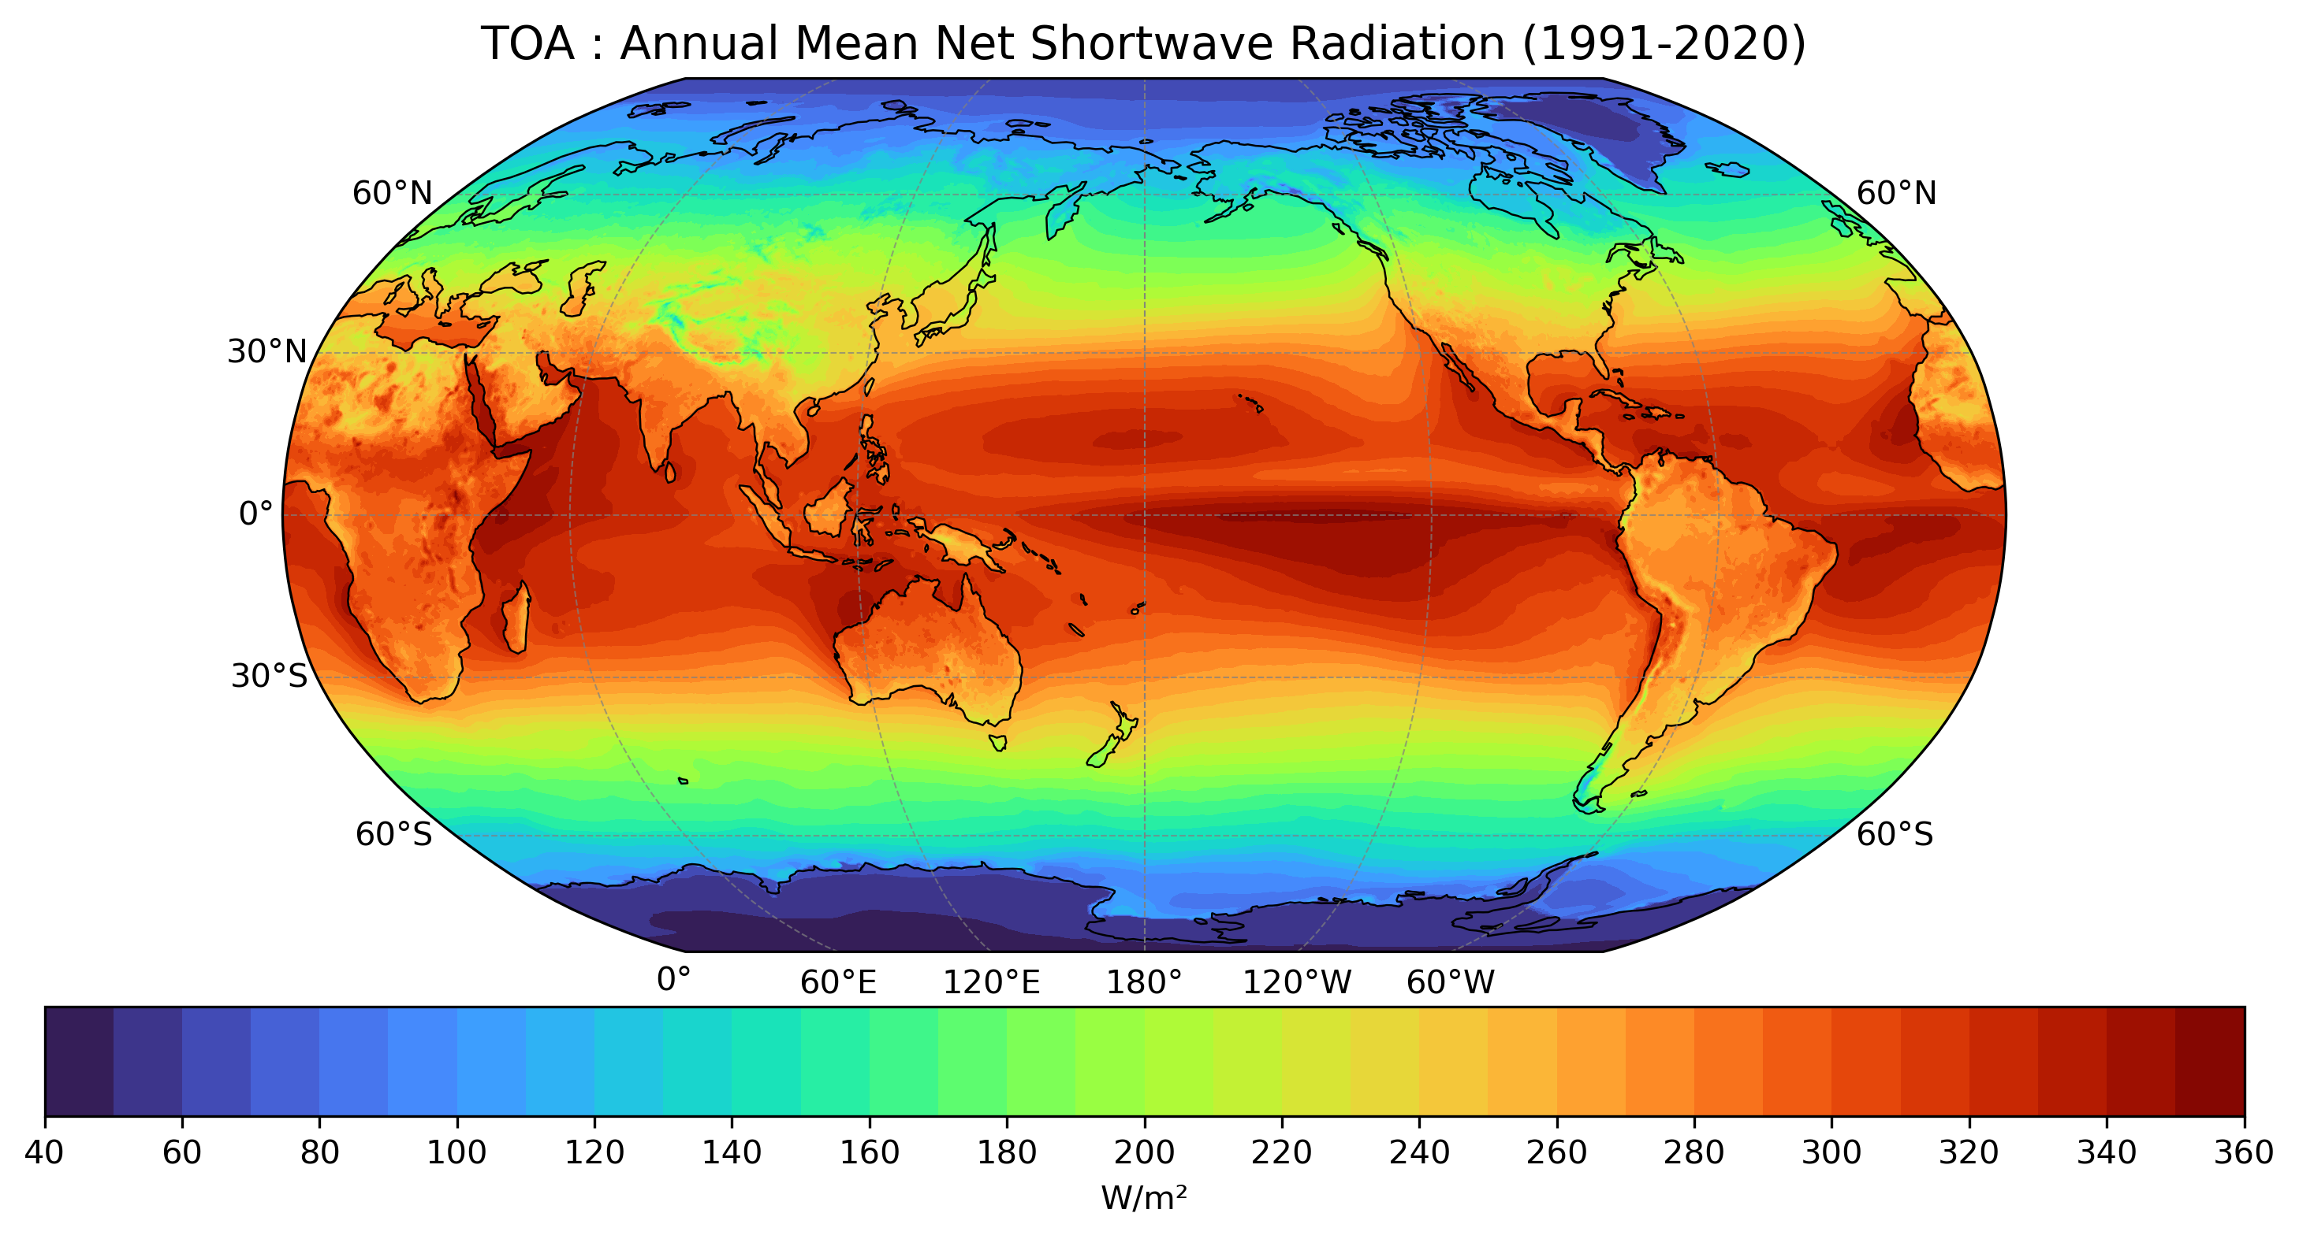

Slide 2
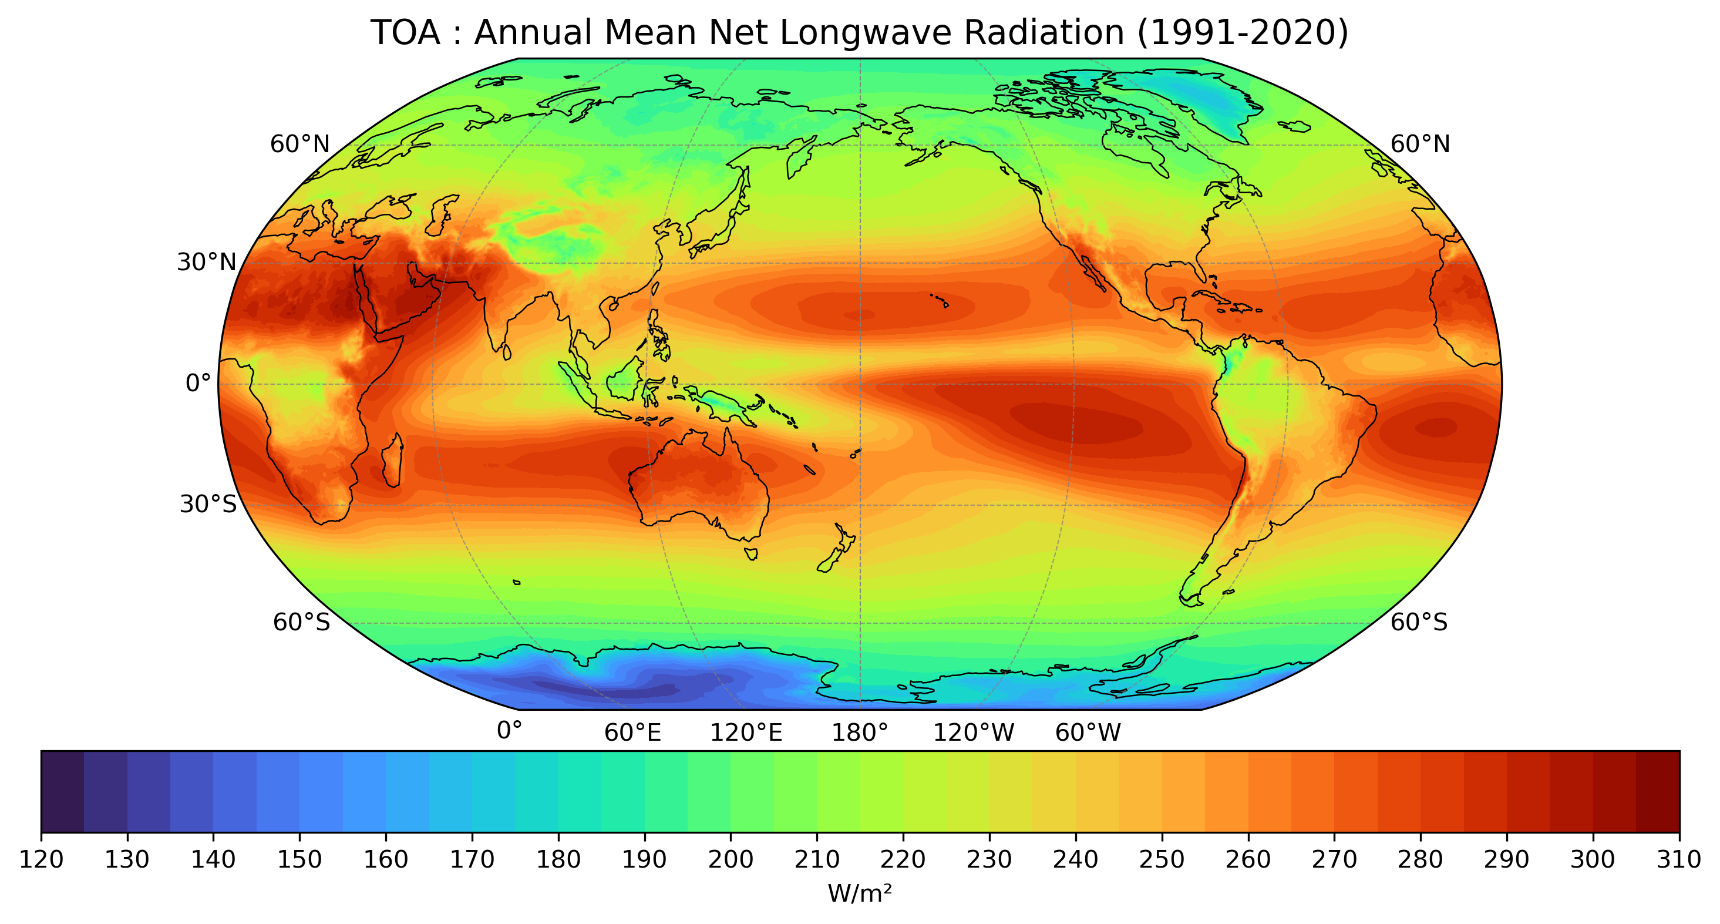

Slide 3
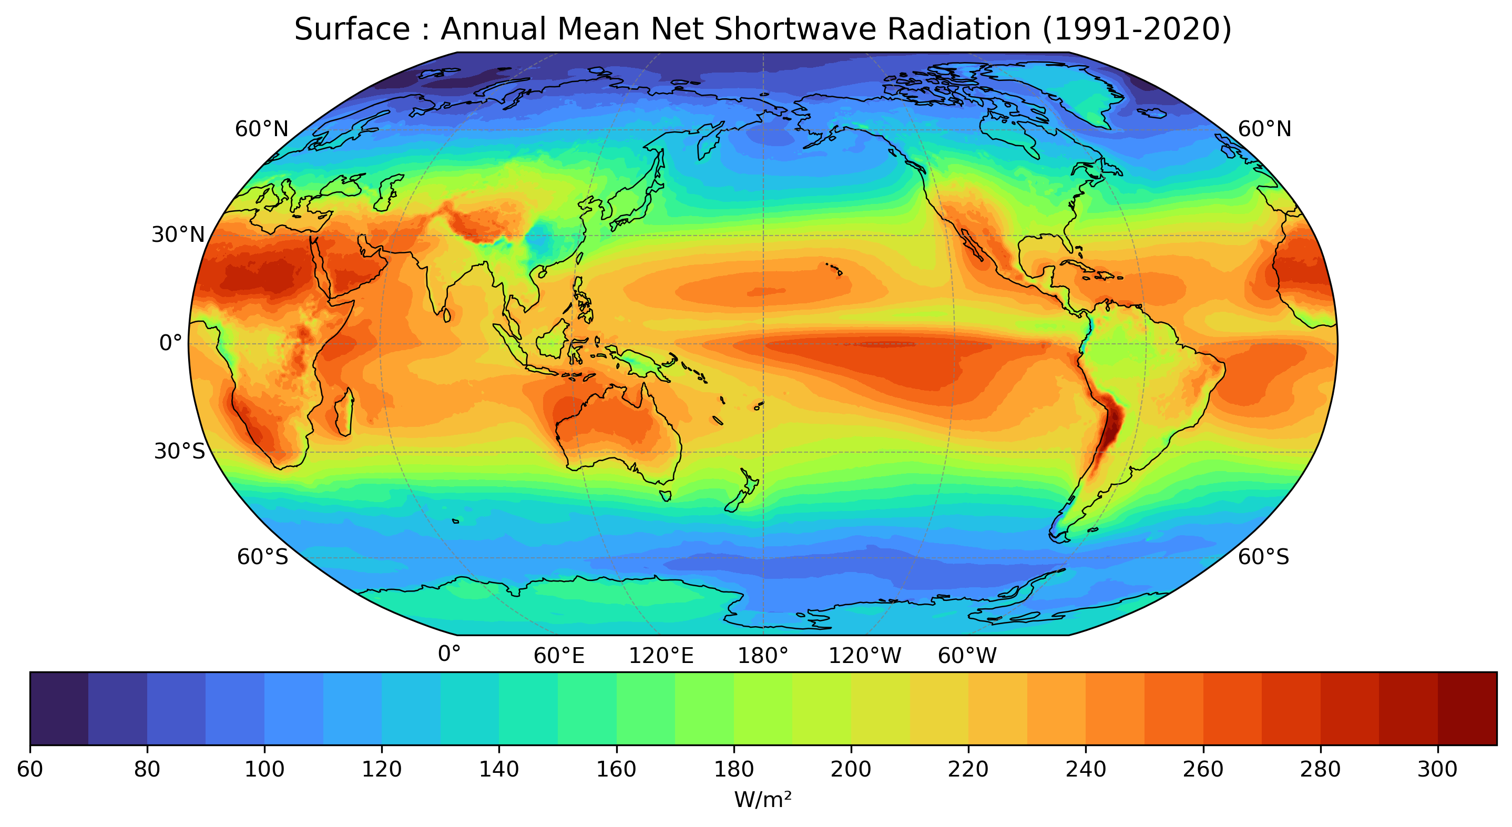

Slide 4
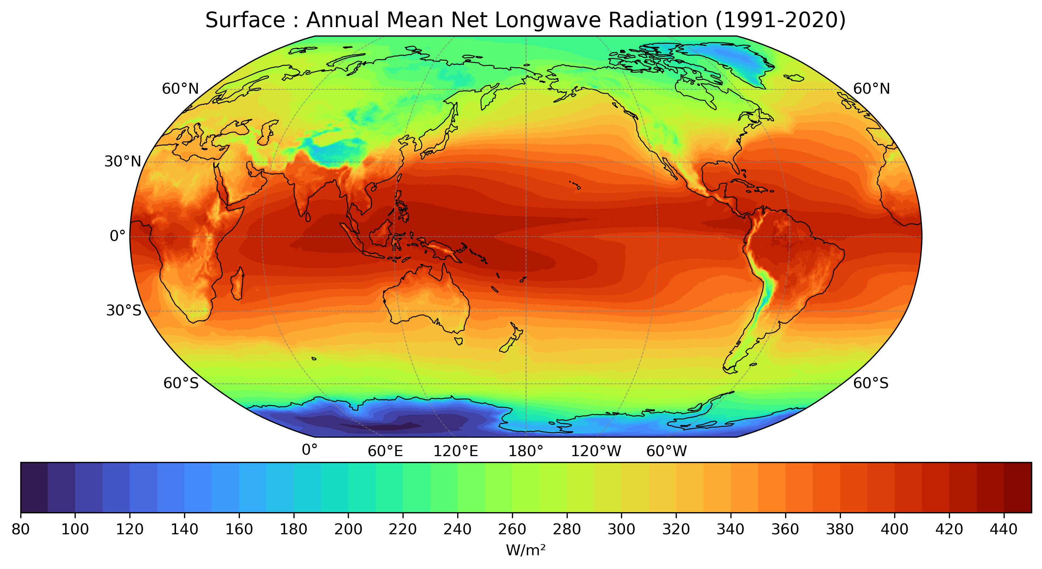

Slide 5
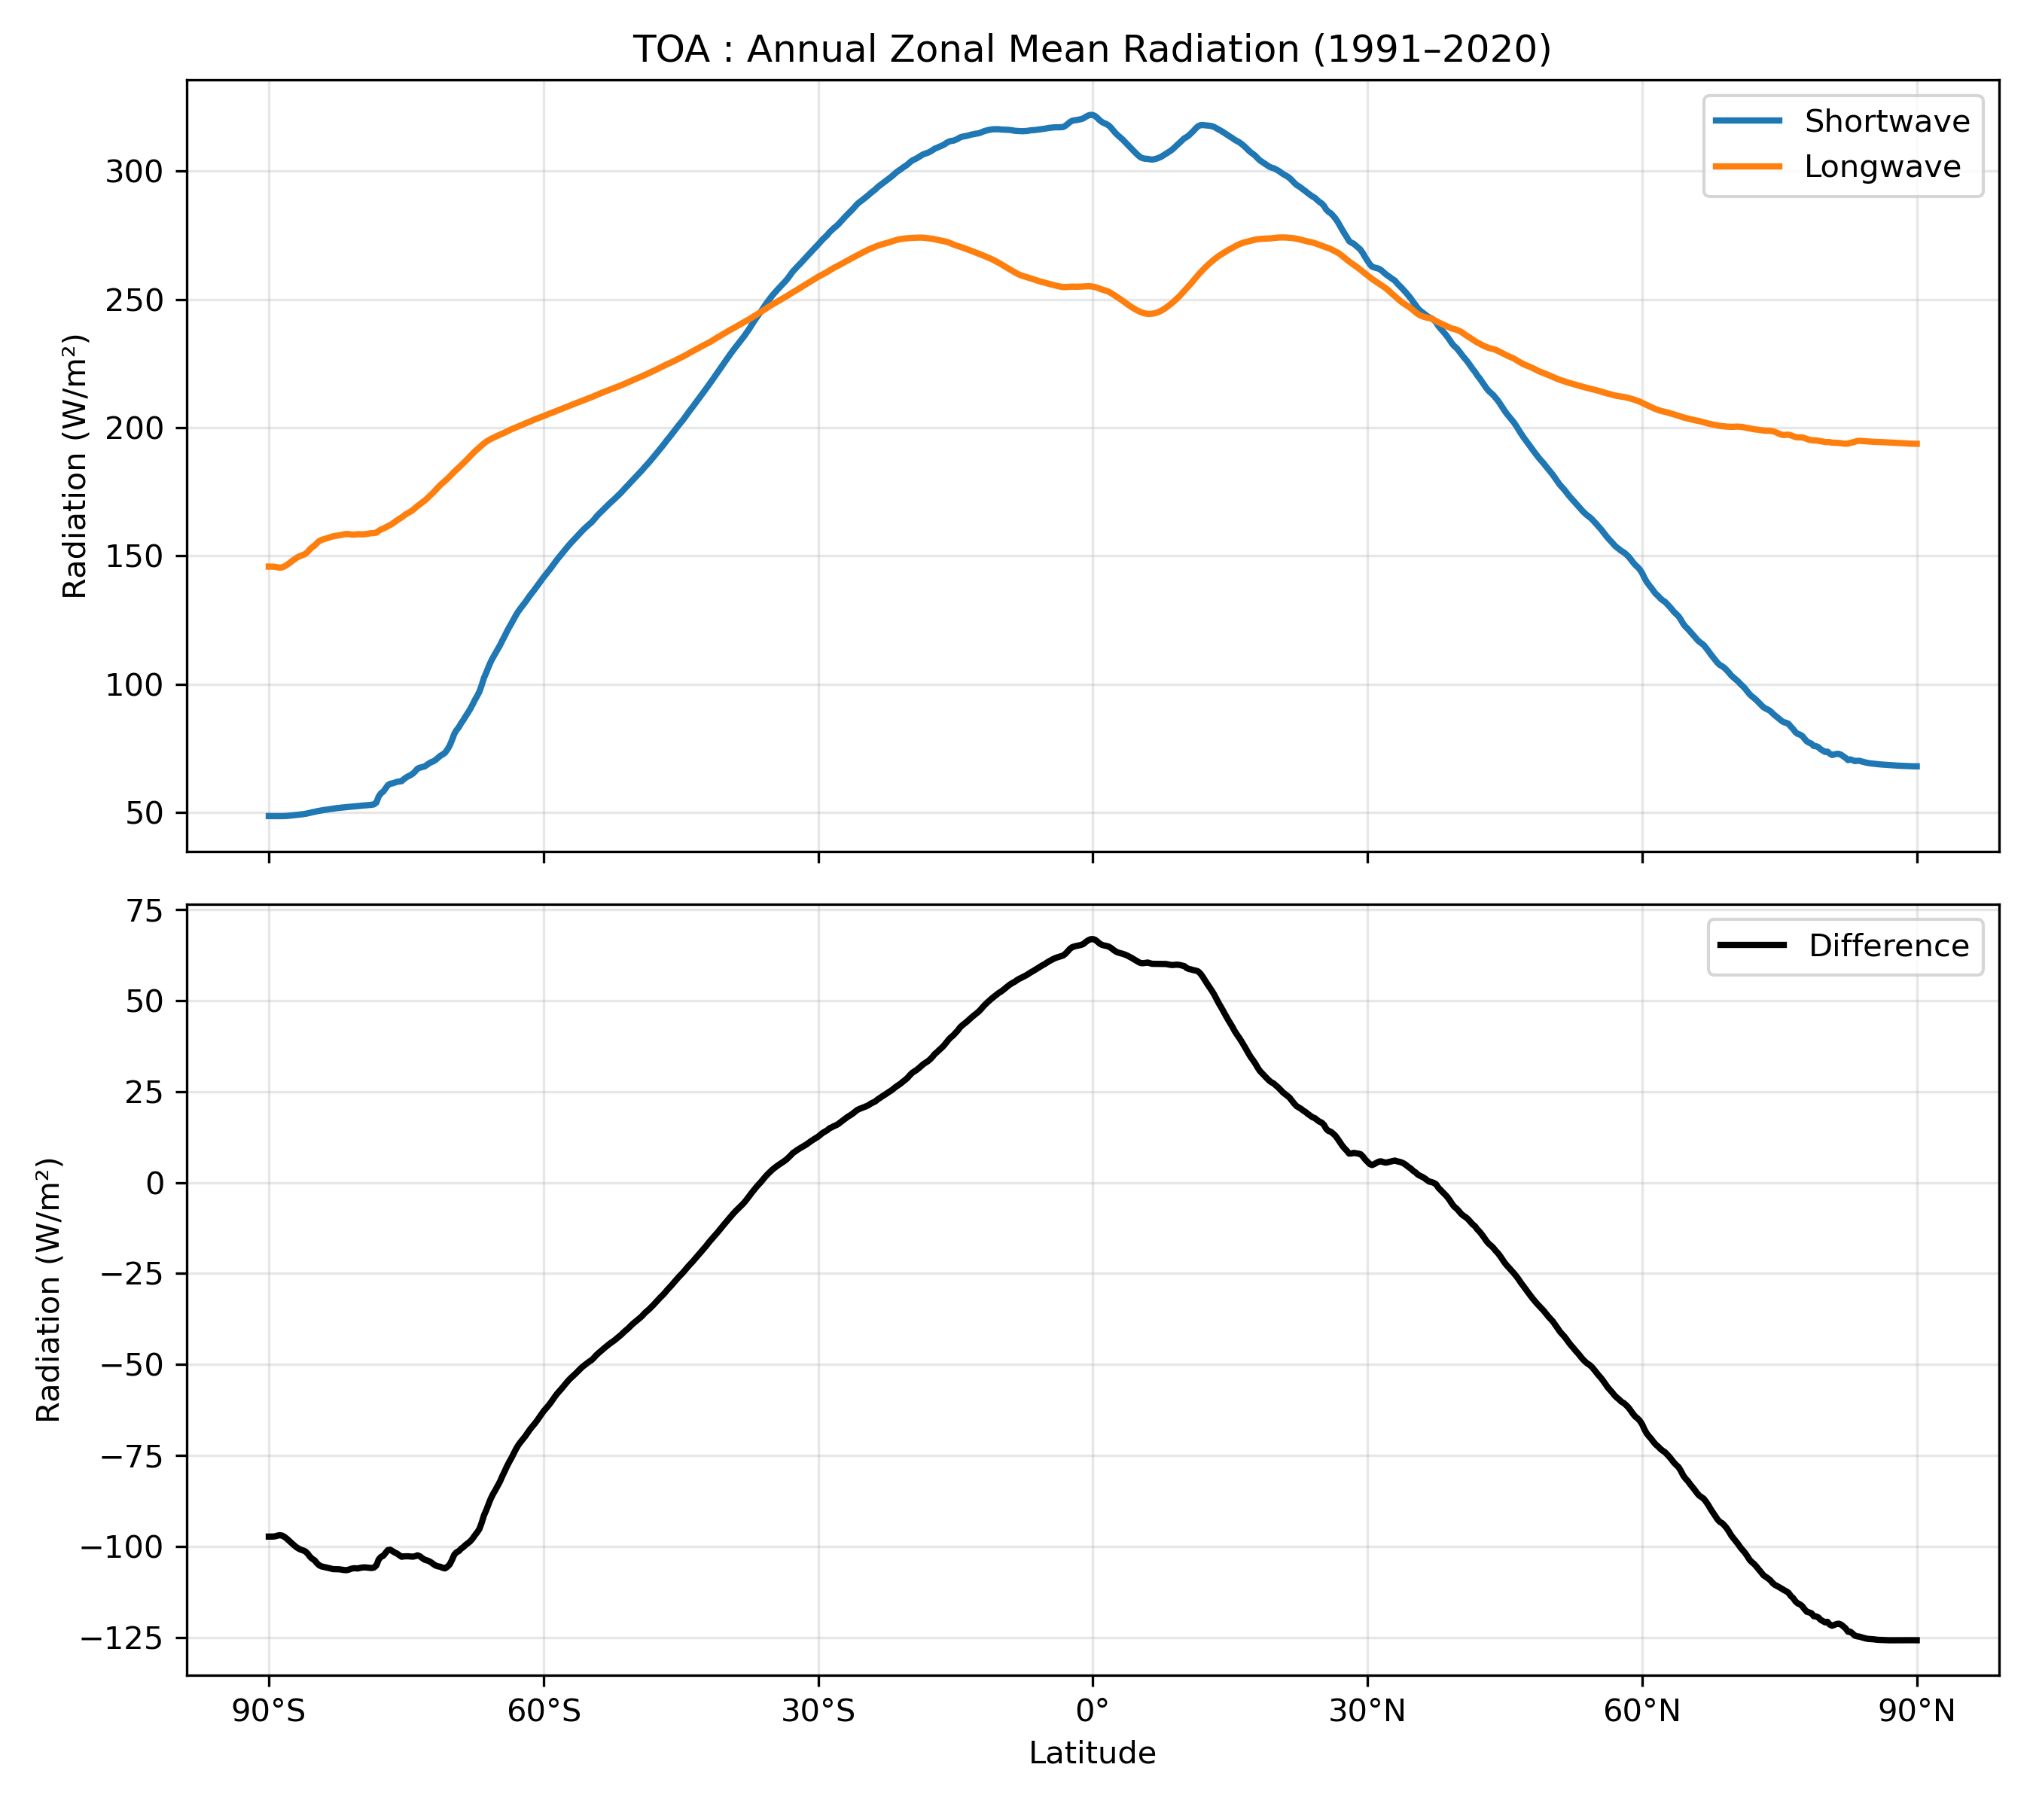

Slide 6
The global maps of the annual mean energy balance components (figure1) show that the largest incoming shortwave radiation at the top of the atmosphere is concentrated in the tropical belt between 30°N and 30°S. This reflects the high solar elevation angle and the relatively constant insolation throughout the year in low latitudes. Toward higher latitudes, the incoming solar radiation decreases due to the lower solar angle and seasonal variability.
However, not all incoming solar radiation is absorbed (figure3). Regions with persistent cloud cover, such as the Intertropical Convergence Zone (ITCZ), reflect a significant portion of shortwave radiation back to space, reducing the absorbed energy at the surface. In contrast, subtropical regions with fewer clouds tend to absorb more solar radiation.

Slide 7
The outgoing longwave radiation at the top of the atmosphere (figure2) is generally strongest in dry subtropical regions, where the atmosphere is relatively transparent to infrared radiation. Conversely, lower outgoing longwave radiation is observed over cloudy and humid tropical regions, where greenhouse gases and clouds trap infrared radiation. This illustrates the greenhouse effect: the atmosphere absorbs and re-emits longwave radiation, reducing the amount that escapes directly to space.

Slide 8
At the surface, downward longwave radiation is enhanced in warm and humid regions due to atmospheric emission by greenhouse gases and clouds. The surface net radiation is therefore highest in the tropics, where strong solar input combined with atmospheric greenhouse effects results in a surplus of energy. In contrast, high latitudes experience a net energy deficit.

