Slide 1
Luther Project Predicting the WIN Percent of NBA Teams using stats from previous years
Pavan Talakala
Jan 26, 2018

Slide 2
Question:
Is there a relation between the previous years performance of an NBA Team and if so can we predict its future performance

Slide 3
Objective/Approach:
Use Web Scrapping and Collect Data required for predicting the NBA Win Percentage of all the NBA Teams.
Clean & Analyze the Data and forecast the Win Percentage of the upcoming season using the historic data from previous seasons
Apply Linear Regression & others and evaluate the results to validate if the Model is good

Slide 4
Design/Tools: Web Scrapping:
Employed Selenium to do the web scrapping.
Scrapped the http://stats.nba.com to for data collection.
Clean Data:
Clean & Analyze the Data using EDA & account for missing values
Remove multicollinearity that exists among the recorded team metrics
Regression Analysis:
Use stats model / sklearn for Regression Analysis and evaluate the models and make appropriate recommendations.

Slide 5
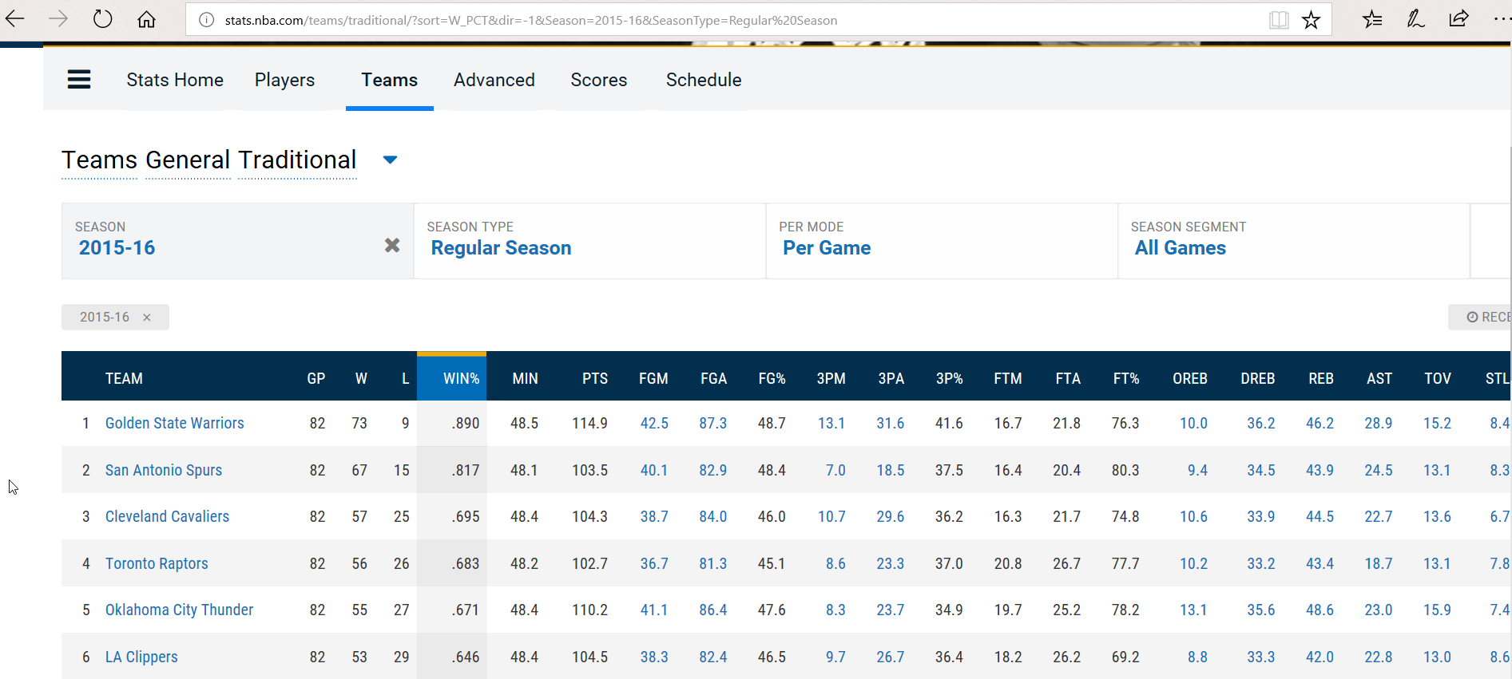
stats.nba.com

Slide 6
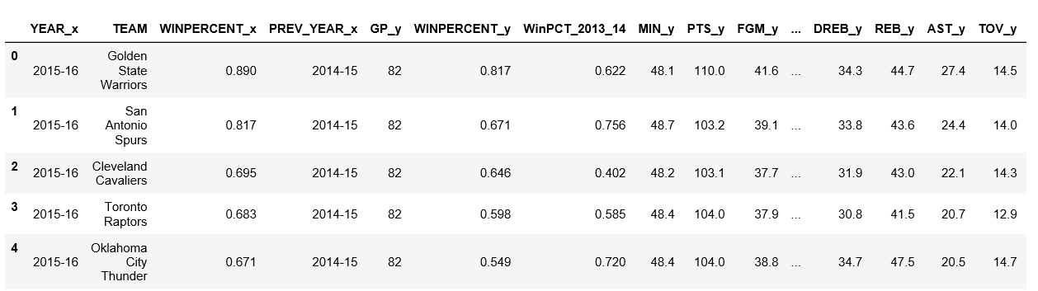
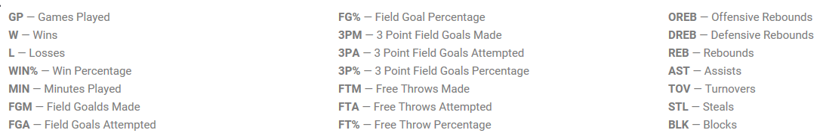
Dataset Structure:
Features:

Slide 7
Data:
Scrapped the Statistics of all NBA Teams for the following seasons:
2017 – 2018 (Validation Data set)
2016 – 2015 (Test Data Set)
2015 – 2013 (Training Data set)

Slide 8
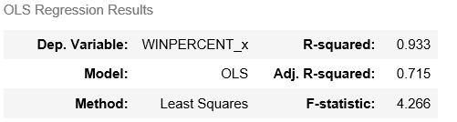
Regression Analysis
Linear Regression using stats models on Train:
Linear Regression using stats models on Test Data set:
Calculated R-square value when fitted on Test Data set: -2.239

Slide 9
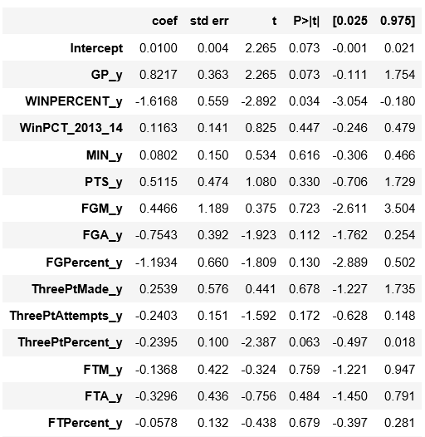
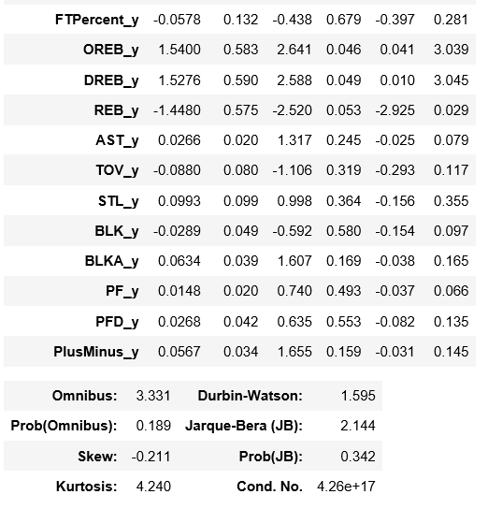
Linear Regression using stats models:

Slide 10
Linear Regression using skLearn:
Model | R-square Values |  |  | Recommendation
 | Train | Test | Validate
Linear Regression | 0.968 | -2.239 | -2.274 | NO
Ridge | 0.727 | 0.397 | 0.378 | YES
RidgeCV | 0.669 | 0.533 | 0.400 | Not Applicable
Lasso | 0.0 | -2.469 | -5.728 | NO
LassoCV | 0.609 | 0.658 | 0.517 | Not Applicable

Slide 11
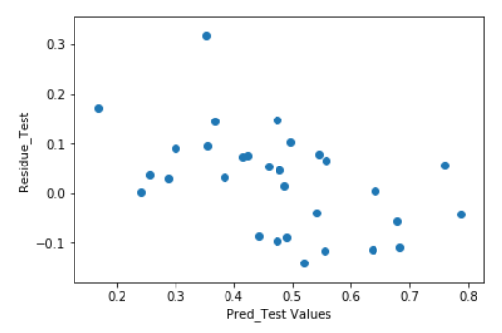
Analysis of the Ridge Model on Test Data:
Predicted Values of the Win Percent for 2016 – 2017 Season (Test Data set)
array([ 0.76032243, 0.78678967, 0.35298014, 0.64194299, 0.47432509, 0.54402987, 0.67953993, 0.55684384, 0.4958499 , 0.68308685, 0.47694255, 0.63777803, 0.45916249, 0.36606562, 0.42344235, 0.48582771, 0.54102028, 0.41473246, 0.35538154, 0.55487377, 0.38334411, 0.49025095, 0.29988149, 0.47397727, 0.52025238, 0.44155237, 0.16807459, 0.28748329, 0.25599829, 0.24204834])

Slide 12
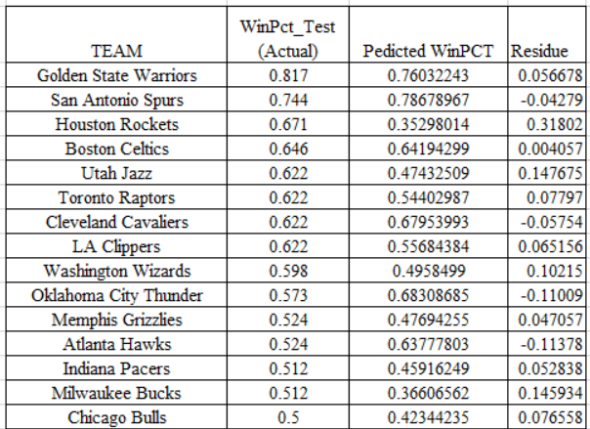
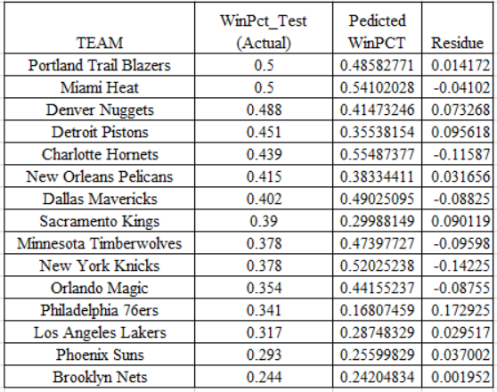
Analysis of the Ridge Model Actual Win% Vs Predicted Win% (2016 – 2017 Season)

Slide 13
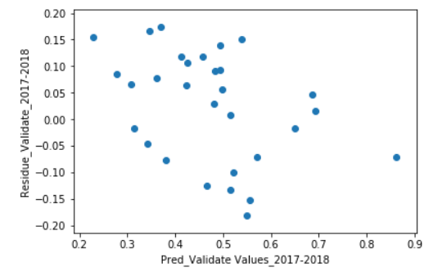
Analysis of the Ridge Model on Validate Data:
Predicted Values of the Win Percent for 2017 – 2018 Season (Validate Data set)
array([ 0.86210455, 0.68546156, 0.69179369, 0.53810981, 0.65012672, 0.49317017, 0.49484278, 0.48234518, 0.45676726, 0.49718475, 0.36990439, 0.52236657, 0.41304046, 0.42586624, 0.51447811, 0.34581427, 0.48063562, 0.56997992, 0.42425617, 0.3609975 , 0.55658613, 0.22886543, 0.51489342, 0.3082912 , 0.55038256, 0.27747901, 0.46541079, 0.38033354, 0.31463613, 0.34280489])

Slide 14
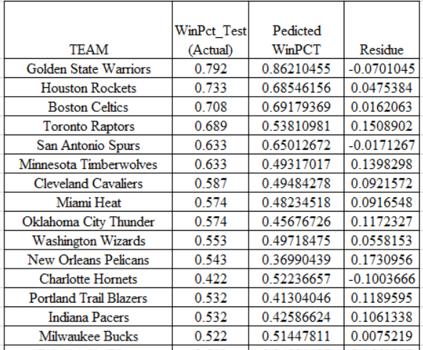
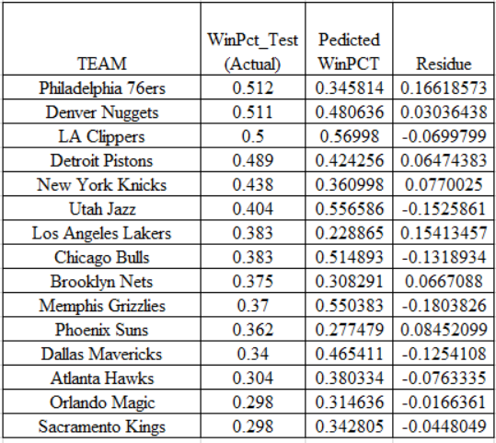
Analysis of the Ridge Model Actual Win% Vs Predicted Win% (2017 – 2018 Season)

Slide 15
Next Steps/Future work
Add Additional features for better Prediction rate/R-square value.
Collect the Data/Statics of the all players from each team, calculate the respective PER (i.e.) Player Efficiency Rating and include these as additional features and run new models to predict the WIN Percent of the NBA Teams.

Slide 16
Questions ?

Slide 17
Resources:
http://stats.nba.com
GitHub Url:
https://github.com/pt03445/nba_luther_project_02

