Slide 1
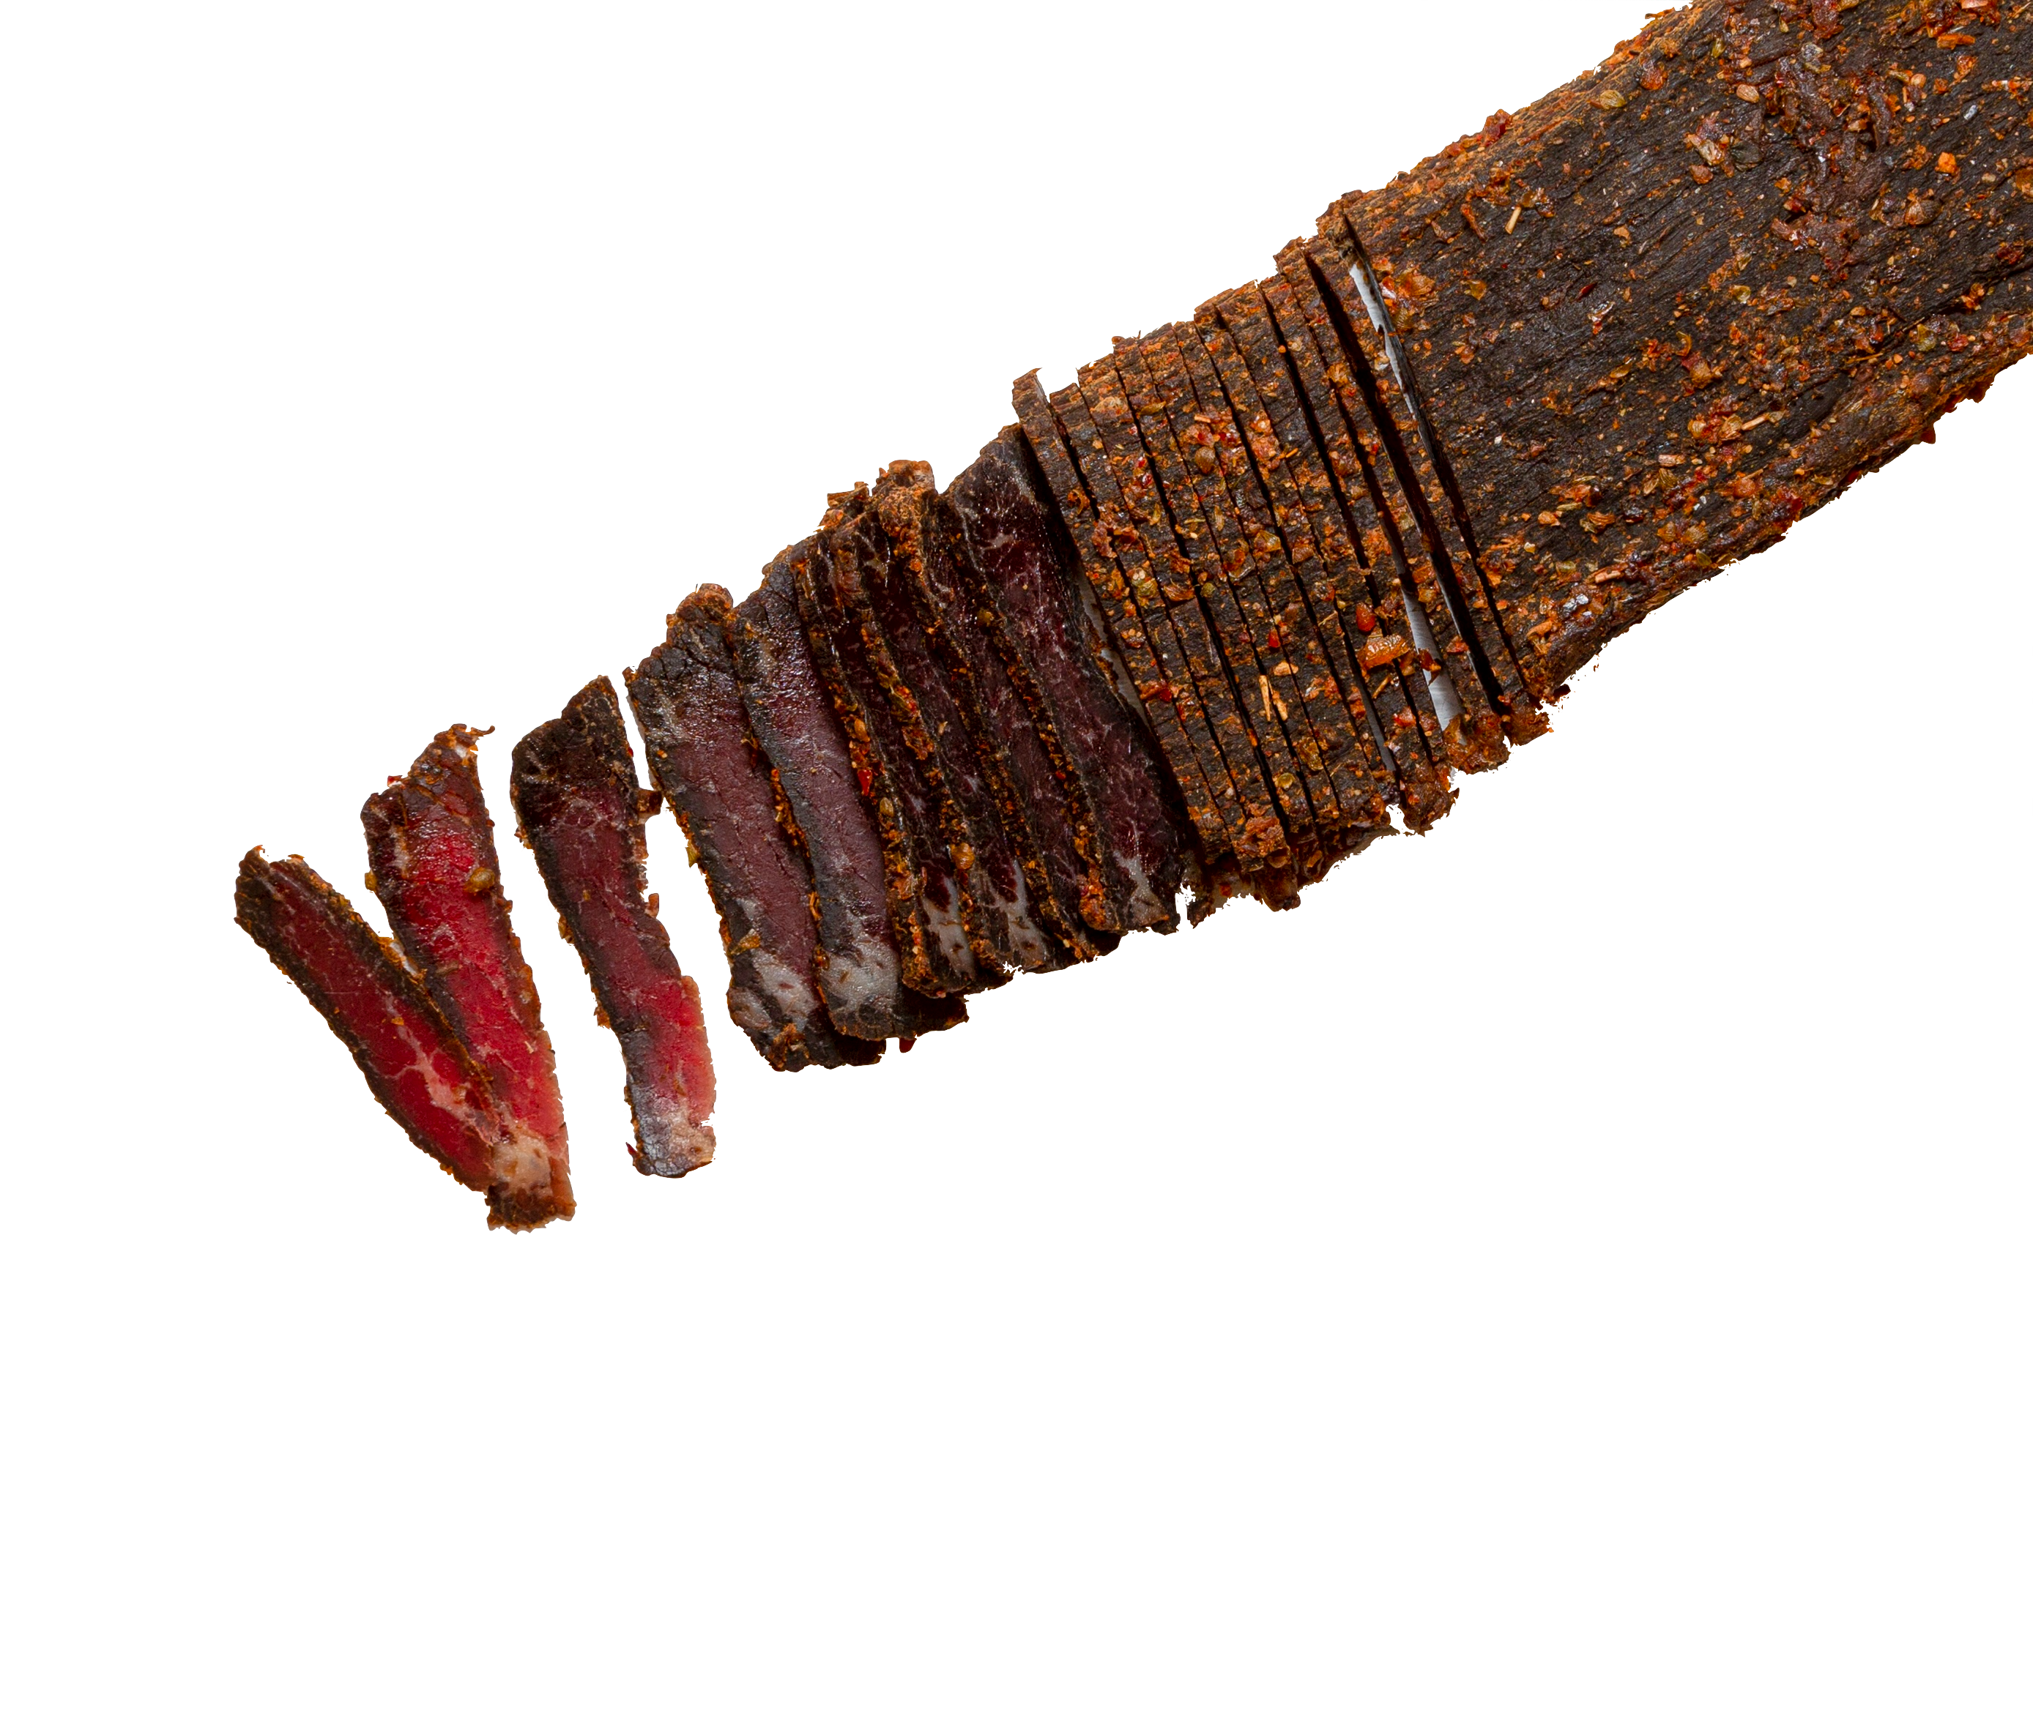
It's Not Jerky
Legacy Ranch High School • It's Not Jerky

Slide 2
Integrated Marketing Campaign - Product
▪ Stryve - Braav Biltong
▪ It's Not Jerky
▪ 45-day campaign: January 5 - February 18, 2027

Slide 3
Agenda
Table of Contents
▪ I. Overview
▪ II. Product & Company
▪ III. Campaign Objectives
▪ IV. Target Market
▪ V. Research, Insights & Connection
▪ VI. Strategy, Activities & Schedule
▪ VII. Proposed Budget
▪ VIII. Impact & Measurement
▪ IX. Bibliography

Slide 4
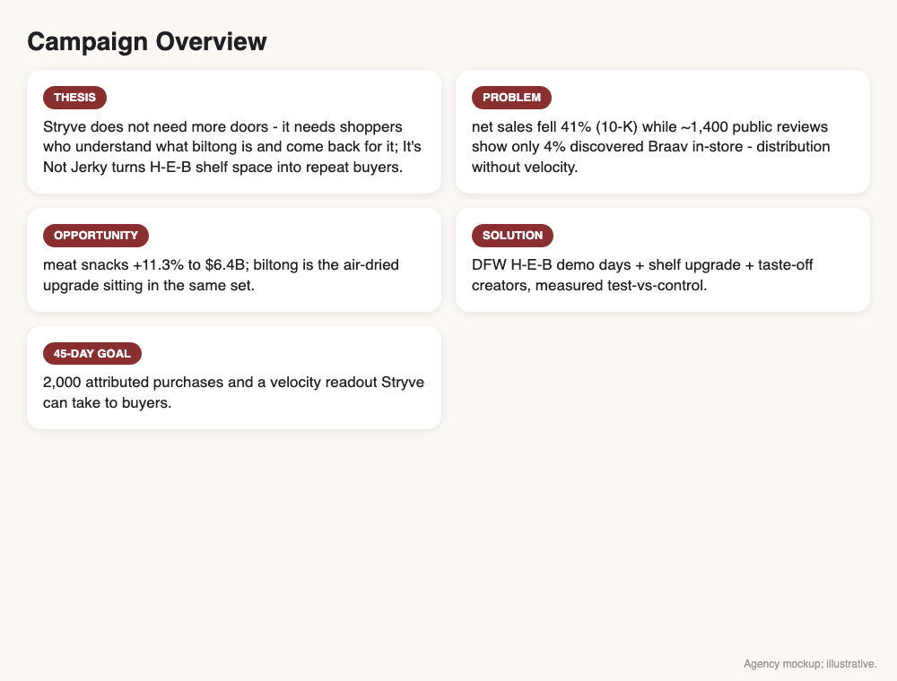
Overview
Campaign Overview
▪ Thesis: Stryve does not need more doors - it needs shoppers who understand what biltong is and come back for it; It's Not Jerky turns H-E-B shelf space into repeat buyers .
▪ Problem: net sales fell 41% (10-K) while ~1,400 public reviews show only 4% discovered Braav in-store - distribution without velocity .
▪ Opportunity: meat snacks +11.3% to $6.4B; biltong is the air-dried upgrade sitting in the same set .
▪ Solution: DFW H-E-B demo days + shelf upgrade + taste-off creators, measured test-vs-control .
▪ 45-day goal: 2,000 attributed purchases and a velocity readout Stryve can take to buyers .
Notes:
Open with the paradox: the brand is on more shelves than ever while sales fell 41%. The problem is not distribution - it is what happens at the shelf.

Slide 5
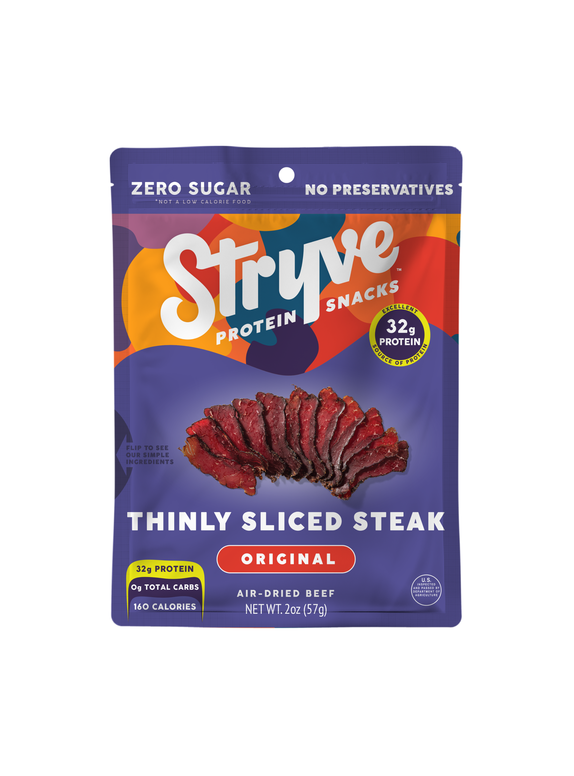
The Business
The Product
▪ Braav biltong: South African air-dried beef - cured and air-dried, never cooked like jerky; thick, tender, intensely beefy .
▪ Clean label: sugar-free, gluten-free, keto/paleo/whole30-friendly, 30g+ protein per serving; Original, Steak Bites, and Zero Sugar Hickory lines .
▪ Retail ~$8-9 per 2.25oz bag (Sprouts $7.99, Walmart multipacks); Plano, TX HQ .
▪ Sold DTC, on Amazon, and in H-E-B, Walmart, Whole Foods, Sprouts, CVS, Circle K and Love's .
Notes:
The key sensory difference: jerky is cooked and shredded; biltong is air-dried whole muscle - denser, richer, chewier in a different way.

Slide 6
The Business
The Company & Its Position
▪ Stryve Foods Corp (NASDAQ: SNAX), Plano TX; founded by Ted Casey (Dymatize), ex-NFL player Gabe Carimi, and South African native Warren Pala .
▪ Net sales $29.9M -> $17.7M (-41%) in FY2023; 10-K cites discontinuing 'non-profitable accounts' and rationalizing 'low-quality revenue' .
▪ Competitors in Texas biltong are fragmented regional players (Brooklyn Biltong, Shaka's, Billi Tong's, Lowfeld Soul Food); Stryve is the only national brand with H-E-B scale .
▪ Position: premium air-dried beef for performance and clean-label shoppers - the jerky upgrade, not another jerky .
VISUAL
Left: net sales FY2022 $29.9M vs FY2023 $17.7M falling while banner count grows. Right: positioning map (x = commodity j
Notes:
This is the credibility slide: the 10-K's own words - 'low-quality revenue' - hand judges the problem statement.

Slide 7
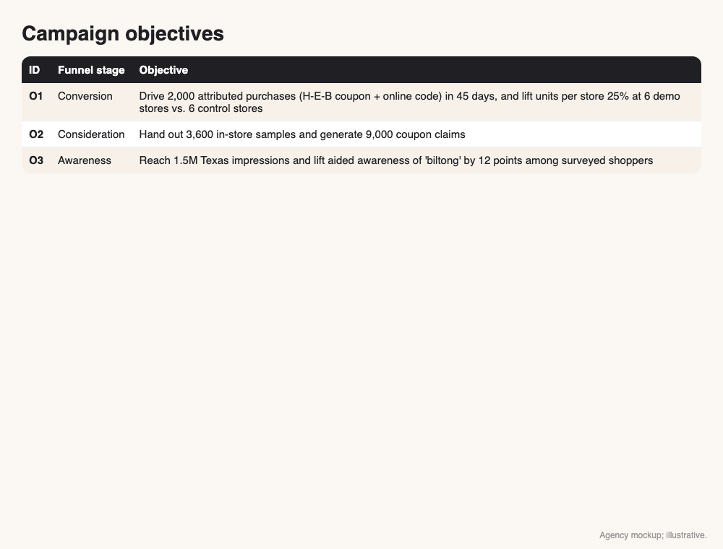
Objectives
Campaign Objectives
▪ O1 (primary): 2,000 attributed purchases (1,000 H-E-B coupon + 1,000 online) and +25% units per store at 6 demo stores vs. 6 control .
▪ Baseline: week-0 shelf count via audit + company sell-through data .
▪ O2 (consideration): 3,600 in-store samples and 9,000 coupon claims .
▪ O3 (awareness): 1.5M Texas impressions and +12 points aided awareness of 'biltong' .
Notes:
One primary objective - bags sold - measured against control stores, so the client sees lift, not noise.

Slide 8
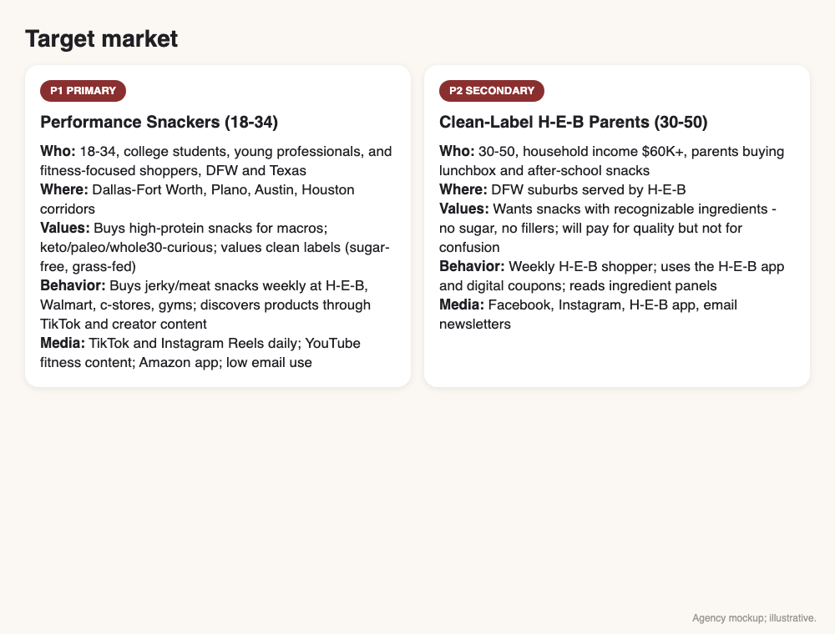
Target Market
Target Market
▪ P1 Performance Snackers, 18-34: DFW/Texas jerky buyers focused on macros; keto/paleo/whole30-curious; buy on protein and clean labels .
▪ P2 Clean-Label H-E-B Parents, 30-50: weekly H-E-B shoppers wanting no-sugar, recognizable-ingredient snacks for lunchboxes .
▪ Both share one need: a meat snack that is clearly better than jerky - the reason 12% of reviewers cite clean-label benefits and 5% compare it directly .
▪ Market: meat snacks +11.3% to $6.4B; high-protein snack positioning is the fastest-growing claim set in the aisle .
Notes:
Interactive moment: show the two persona cards printed side by side.

Slide 9
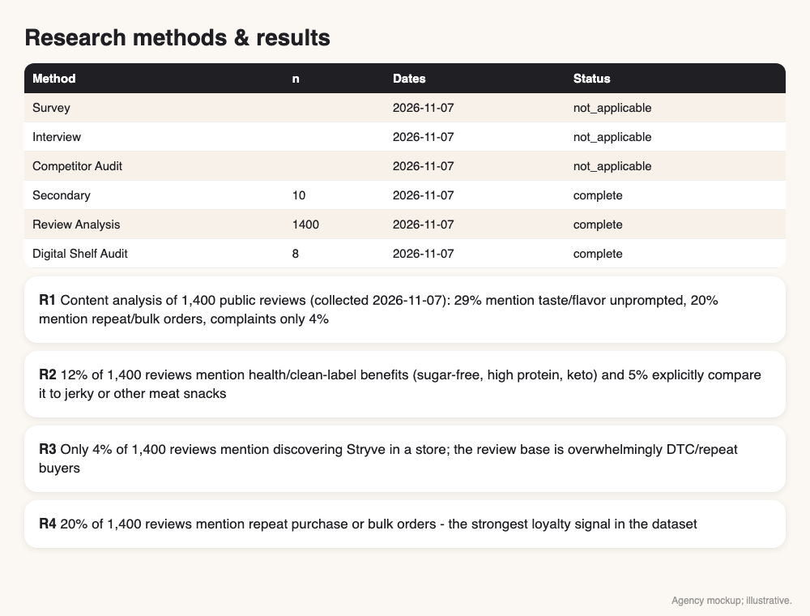
Research
Research Method & Results
▪ Secondary (complete): 10-K via last10k, company site/stores, Walmart/Sprouts listings, trade press - 10 sources .
▪ Primary, no-survey (complete): keyword-coded analysis of 1,400 public Stamped.io reviews and a public distribution/digital-shelf audit of 8 sources ; survey/interviews not run - published reviews skew positive.
▪ Key results: sales -41% while doors multiplied ; taste and reorder dominate reviews ; only 4% discovered it in a store ; biltong is an unfamiliar word in Texas .
▪ Influences: protein-snack boom (social), clean-label/keto trend (cultural), meat-snack growth +11.3% (market), retail app coupons (technological) .
Notes:
Name the methods and sample sizes out loud. The 10-K's 'low-quality revenue' line is the finding judges will remember.

Slide 10
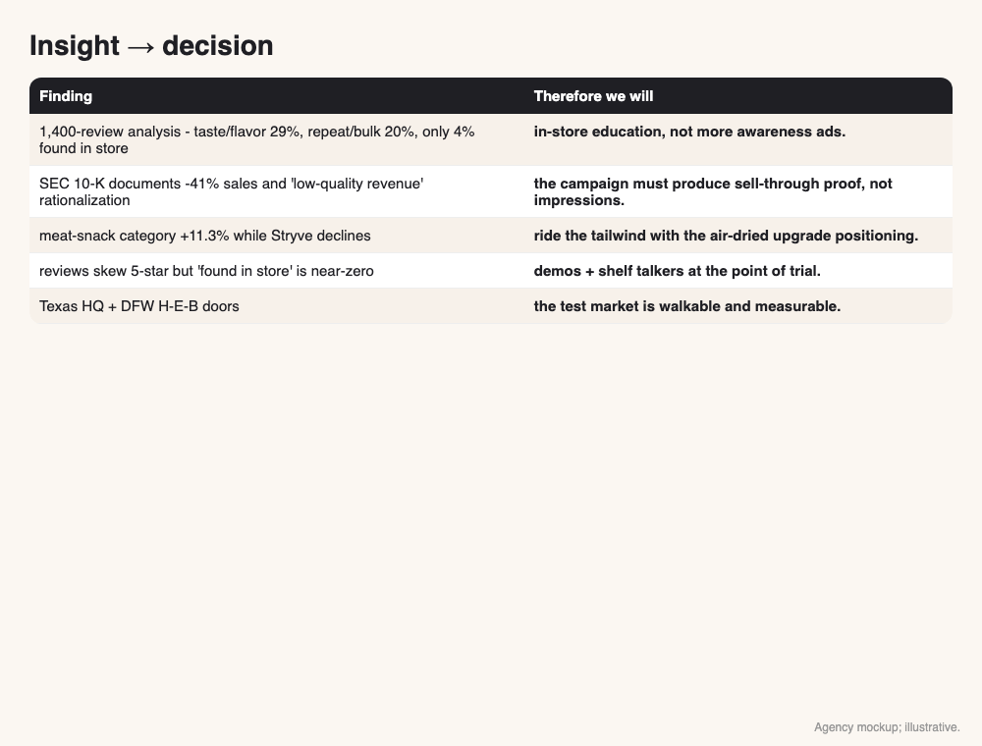
Research
Insights -> Campaign Decisions
▪ Finding: 1,400-review analysis - taste/flavor 29%, repeat/bulk 20%, only 4% found in store -> in-store education, not more awareness ads.
▪ Finding: SEC 10-K documents -41% sales and 'low-quality revenue' rationalization -> the campaign must produce sell-through proof, not impressions.
▪ Finding: meat-snack category +11.3% while Stryve declines -> ride the tailwind with the air-dried upgrade positioning .
▪ Finding: reviews skew 5-star but 'found in store' is near-zero -> demos + shelf talkers at the point of trial.
▪ Finding: Texas HQ + DFW H-E-B doors -> the test market is walkable and measurable.
Notes:
Every decision traces to evidence. Point at the arrows, not the text.

Slide 11
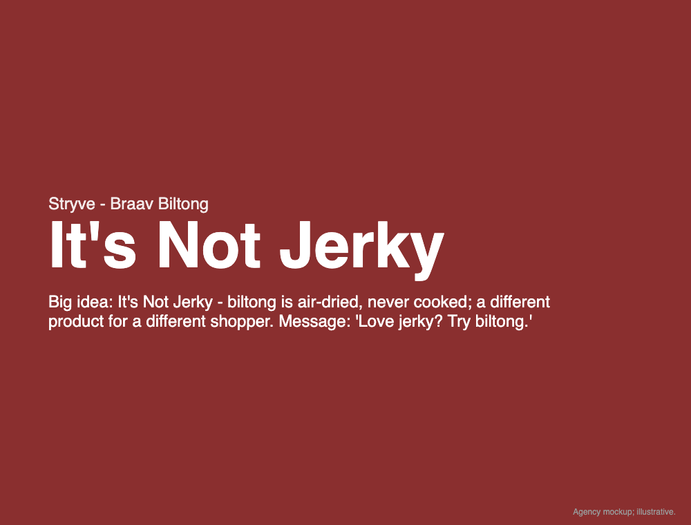
Strategy
Campaign Strategy
▪ Big idea: It's Not Jerky - biltong is air-dried, never cooked; a different product for a different shopper. Message: 'Love jerky? Try biltong.'
▪ Positioning: for performance and clean-label shoppers who want more from a meat snack, Braav is the air-dried beef upgrade .
▪ IMC mix, all testable: Paid geo-social -> store traffic; Earned Plano founder/ex-NFL story -> H-E-B buyer pitch; Shared #ItsNotJerky taste-off duets -> proof; Owned email/SMS + shelf talkers -> repeat .
▪ Push-pull: H-E-B gets a measurable velocity test (push); shoppers get samples and a coupon (pull) .
Notes:
Point to the positioning statement. 'Air-dried, not cooked' is a factual difference no jerky brand can claim.

Slide 12
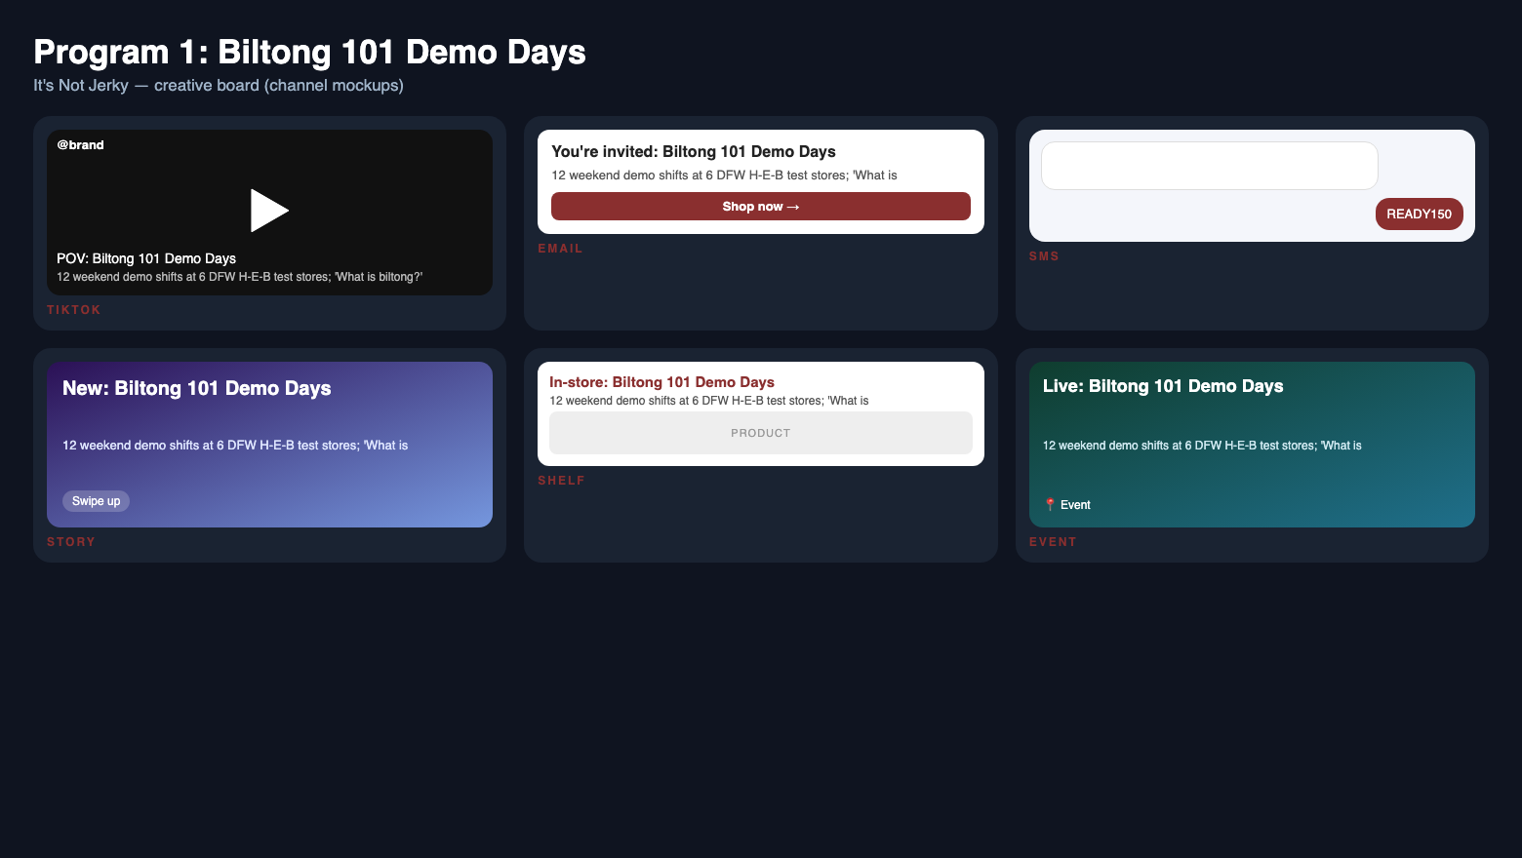
Strategy
Program 1: Biltong 101 Demo Days
▪ It's Not Jerky in person: 12 weekend Biltong 101 demo shifts at 6 DFW H-E-B test stores; 6 control stores get the coupon only .
▪ Mechanic: 'What is biltong?' sample cups at the jerky/meat-snack set; QR to '$2 off 2 bags'; 300 samples per shift = 3,600 total .
▪ Why: biltong is an unfamiliar word in Texas and only 4% of reviewers found it in a store - the shelf is where education must happen.
▪ Measured: QR scans per store and units per store vs. control stores .
Notes:
Interactive moment: hand the judge the printed shelf talker and sample-cup sleeve.

Slide 13

Strategy
Program 2: The Jerky Aisle Upgrade
▪ It's Not Jerky on the shelf: proposed clip strip inside the H-E-B meat-snack set at 6 test stores .
▪ Sell-in: pitched to H-E-B's snack buyer Oct-Nov as a 6-week velocity test; if the clip strip is declined, demos + brand's printable coupon still run the test - the leg shrinks, not collapses .
▪ App coupon at DFW H-E-B stores carrying Braav: 'Love jerky? Try biltong. $2 off 2 bags.'
▪ Why: meat snacks are growing 11.3% - put the air-dried upgrade where those shoppers already are .
Notes:
This is a proposal to H-E-B's buyer, framed as a 6-week velocity test with control stores; the fallback keeps the campaign alive if they say no.

Slide 14
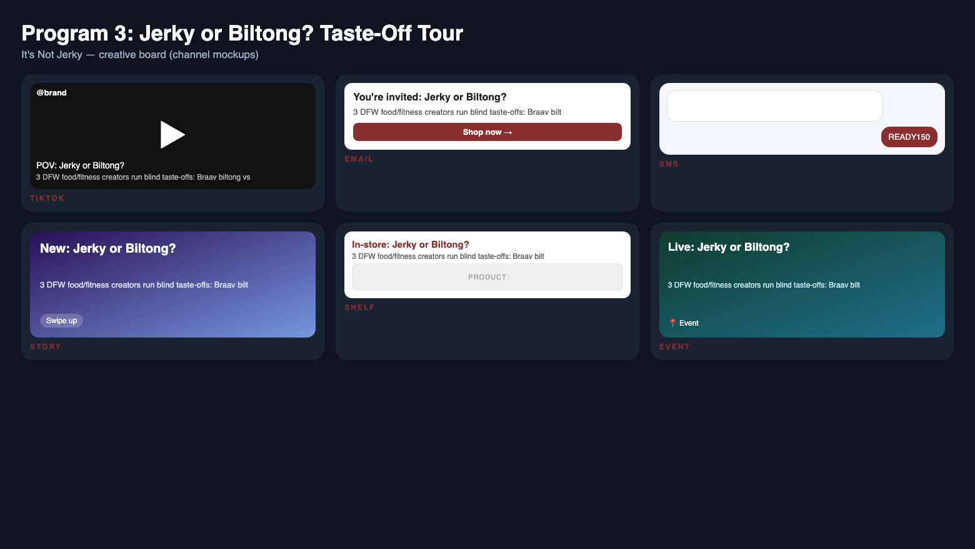
Strategy
Program 3: Jerky or Biltong? Taste-Off Tour
▪ It's Not Jerky online: 3 DFW food/fitness creators run blind Braav vs. beef jerky taste-offs with macros on screen; fans duet with #ItsNotJerky .
▪ Every video links to the store finder + coupon or the online starter pack (code BILTONG) with #ad disclosure .
▪ Story fuel for the tour: Plano HQ + South African heritage + ex-NFL founder in 3 short videos and 3 emails/SMS - converting the 20% repeat base into bulk buyers .
▪ Named credibility: Ted Casey (Dymatize), Gabe Carimi (ex-NFL), Warren Pala (SA native) - the H-E-B pitch's proof points .
Notes:
Walk the judge through the phone mockup of the taste-off. The reveal - 'you can't tell it's not jerky' - is the whole campaign.

Slide 15

Strategy
Creative Samples
▪ Shelf talker: 'It's not jerky - it's biltong. Air-dried beef. $2 off 2 bags.'
▪ TikTok caption: 'Blind taste-off: beef jerky vs. biltong with 36g protein. I did not expect this. #ItsNotJerky #ad'
▪ SMS (opted-in): 'Stryve: Braav biltong is at your H-E-B. Save $2 on 2 bags this week: [link]. Reply STOP to opt out.'
▪ Email subject/preview: 'We took beef snacks public. Then sales fell 41%.' / 'Here's the fix - The Stryve Team'
Notes:
Read the shelf talker aloud: six words do the whole job - permission to try something new.

Slide 16

Strategy
45-Day Week-by-Week Schedule
▪ Pre-work (Oct-Nov): H-E-B buyer sell-in + DFW store selection; plan-B doors (Walmart/Sprouts) if demos declined | W1 (Jan 5): talkers + coupon live (P2, retail, O1/O2, Rafsan); founder email 1 (P1, email, O3, Santhosh)
▪ W2-W3 (Jan 12-25): Biltong 101 demos begin (P1, field, O1/O2, Nino); Taste-Off videos 1-2 (P1, TikTok, O3, Santhosh)
▪ W4-W5 (Jan 26-Feb 8): demos continue; Taste-Off 3 + duets (P1, TikTok, O1/O3, Santhosh); founder emails 2-3 (P1, email, O1, Santhosh); retargeting (P1/P2, paid, O1, Nino)
▪ W6-W7 (Feb 9-18): final demos; last-chance SMS (P1/P2, O1, Rafsan); read test vs. control + awareness survey w/ non-campaign holdout (O1/O3, all)
Notes:
Read the grid left to right: sell-in first, then shelf, then demos, then social proof, then conversion.

Slide 17
Budget
Proposed Budget & Financial Viability
▪ Total $15,000: social $5,500 ; creators 3 x $1,000 ; demos 12 x $250 ; production $900 ; tools $400 ; contingency $2,200 .
▪ Funnel: 1.5M x 1.5% x 10% = 2,250 purchases at $18 avg = $40.5K .
▪ The $2 coupon is manufacturer-funded, netted in revenue .
▪ GP 45% = $18.2K; ROI 21%; ROAS 4.8x; CAC $6.67 vs CLV ~$23 = 1:3.5 .
▪ Conservative (50%): ROI ~-40%; ~720 demo purchases +$5.8K GP + repeat tail -> breakeven ~wk 10-12; plan-B doors if demos declined .
▪ Margin sensitivity: at 35% GP (10-K low end) ROI ~-6%; breakeven margin ~37% - upside case holds at 45% .
Notes:
Lead with honesty: conservative case loses in-window; the return comes from repeat buyers and from keeping shelf space the 10-K is rationalizing. Then show the test-vs-control design.

Slide 18
Impact
Impact & Measurement
▪ O1: attributed purchases; baseline 0; target 2,000; H-E-B coupon + Shopify code reports; weekly .
▪ O1: units per store per week, demo vs. control; baseline week-0 audit ; target +25%; retailer data; weekly .
▪ O2: samples and claims; baseline 0; target 3,600 and 9,000; tally sheets + coupon platform; weekly .
▪ O3: 1.5M impressions; aided awareness of 'biltong' baseline at week 0 vs. post-campaign survey of 150 shoppers + non-campaign holdout DMAs; target +12 pts net of control .
▪ Trigger: under 30 QR scans per shift by week 3, move demos to top 3 stores; creator CTR under 1%, shift spend to Meta .
VISUAL
chart
Notes:
Test vs. control is what a CPG buyer wants: proof the lift came from the campaign.

Slide 19
Impact
Why It Matters
▪ Thesis: Stryve does not need more doors - it needs shoppers who try it once to come back. It's Not Jerky turns H-E-B shelf space into repeat buyers .
▪ Projected: 2,000 purchases and $18.2K gross profit on $15K (21% ROI), plus a test-vs-control result Stryve can take to every retailer .
▪ Mission: South African air-dried beef, made in Plano - kept on Texas shelves because Texans tried it .
▪ Next: if test stores beat control by 25%, roll It's Not Jerky to more H-E-B stores and feed the velocity data the 10-K says is missing .
VISUAL
Braav biltong bag + 'It's Not Jerky' lockup + projected results callouts
Notes:
Close on the thesis, word for word, as we opened.

Slide 20
Sources
Bibliography
▪ Stryve Foods Corp. 'FY2023 Form 10-K.' 2024. https://last10k.com/sec-filings/snax/0000950170-24-039516.htm
▪ Stryve Protein Snacks. 'Where to find Stryve - store locator.' 2026. https://stryve.com/stores
▪ Walmart. 'Stryve Snacks brand storefront.' 2026. https://business.walmart.com/browse/food-grocery/snacks-meats-jerky/stryve/4143521_5238190_4277991_3648286/YnJhbmQ6U3RyeXZl
▪ Sprouts Farmers Market. 'Stryve Original Biltong listing.' 2026. https://shop.sprouts.com/store/sprouts/products/18629245-stryve-beef-biltong-original-2-25-oz
▪ Billi Tong's Biltong. 'Biltong in Texas guides.' 2026. https://btbiltong.com/blogs/biltong/texas-biltong
▪ Stryve Protein Snacks. 'Homepage - Braav biltong products.' 2026. https://stryve.com/
▪ Snack Food & Wholesale Bakery / Circana. 'Meat snack makers play with bold flavors.' 2025. https://www.snackandbakery.com/articles/116408-meat-snack-makers-play-with-bold-flavors-on-the-go-portions
▪ Food Business News / Circana. 'Consumers recalibrating meat purchasing patterns.' 2026. https://www.foodbusinessnews.net/articles/30165-consumers-recalibrating-meat-purchasing-patterns
▪ The Good Food Institute / SPINS. 'Plant-based retail market overview.' 2026. https://gfi.org/marketresearch/
▪ Stryve Protein Snacks (Stamped.io). '1,400 public customer reviews - keyword-coded content analysis.' 2026-11-07. https://stryve.com/

