Slide 1
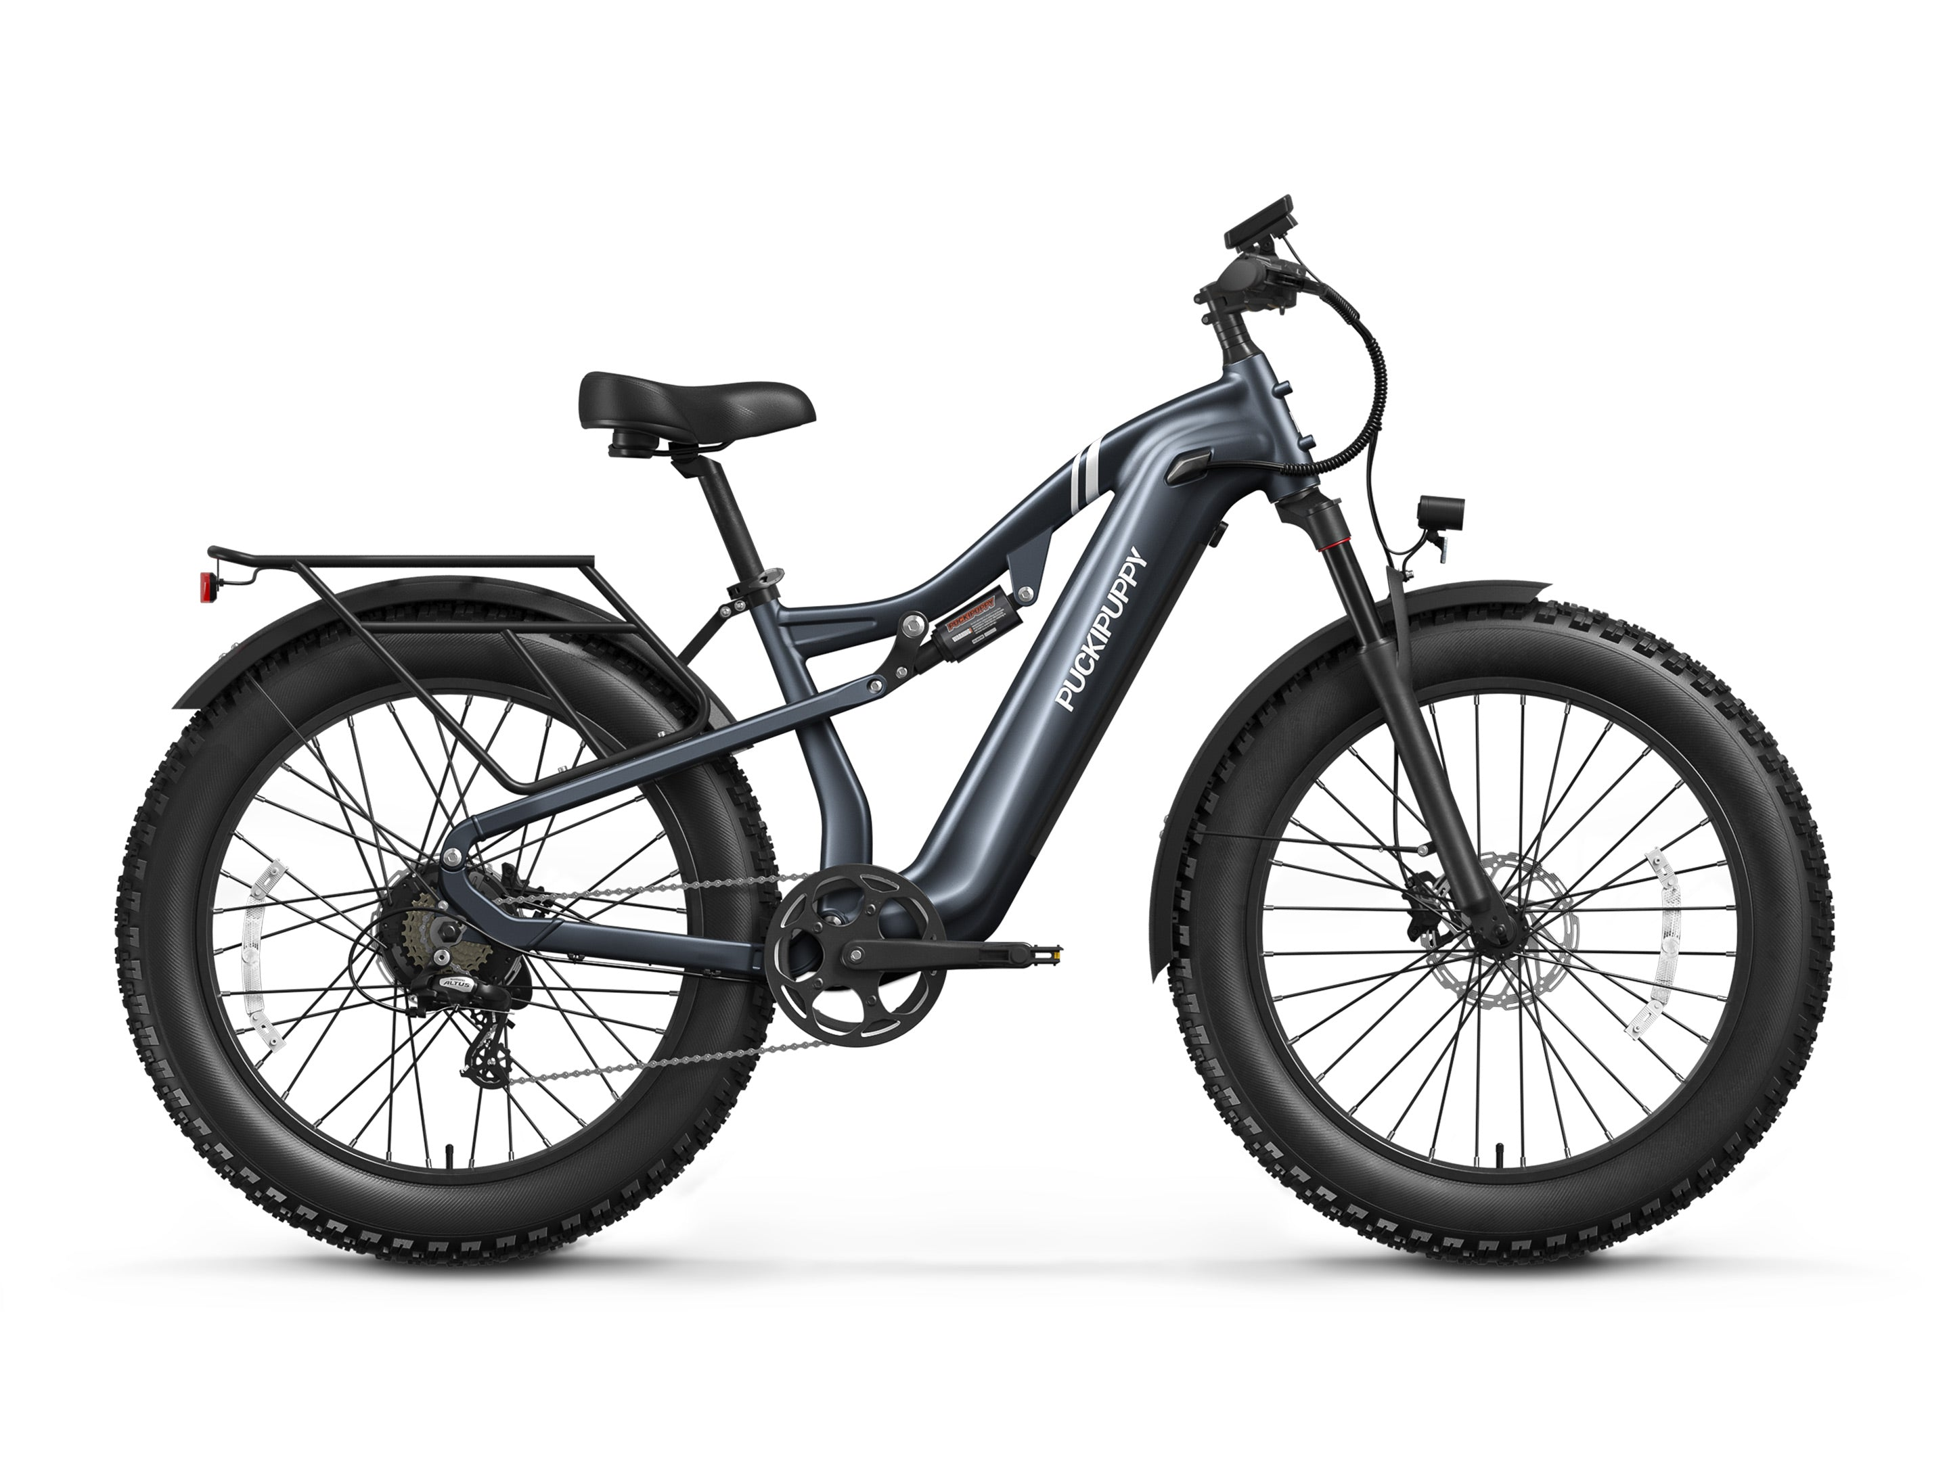
Arrive Ready
PUCKIPUPPY Ebikes - Integrated Marketing Campaign
Legacy Ranch High School - IMCP
Legacy Ranch High School • Arrive Ready

Slide 2
Integrated Marketing Campaign - Product
▪ Arrive Ready
▪ PUCKIPUPPY Ebikes
▪ 45-day campaign - DTC + Texas test rides

Slide 3
Agenda
Table of Contents
▪ Campaign Overview
▪ The Product & Company
▪ Objectives & Target Market
▪ Research Method & Results
▪ Campaign Strategy & Programs
▪ Budget & Financial Viability
▪ Impact & Measurement
▪ Bibliography

Slide 4
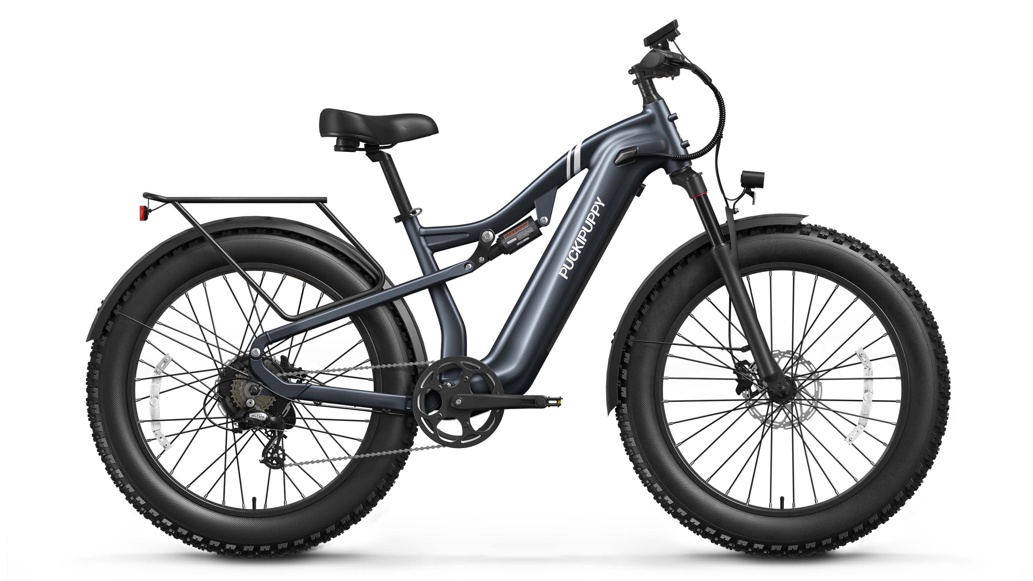
Overview
Campaign Overview
▪ Thesis: PUCKIPUPPY's product wins - its delivery journey loses buyers. 11% of 500 reviews are 1-star; ~68% of those cite shipping damage, assembly, app issues, or support .
▪ Big idea: Arrive Ready - every order ships with a damage-claim promise, QR setup concierge, and finance/trade-in path; trust badges move above the fold .
▪ Demo: judges sit on the Labrador Pro and ride - the product demos itself .
▪ Goal: 90 attributed orders + 400 test rides + cut damage-review share in 45 days.
Notes:
Open with the stat: 1 in 9 reviews is 1-star, and most blame the delivery, not the bike.

Slide 5
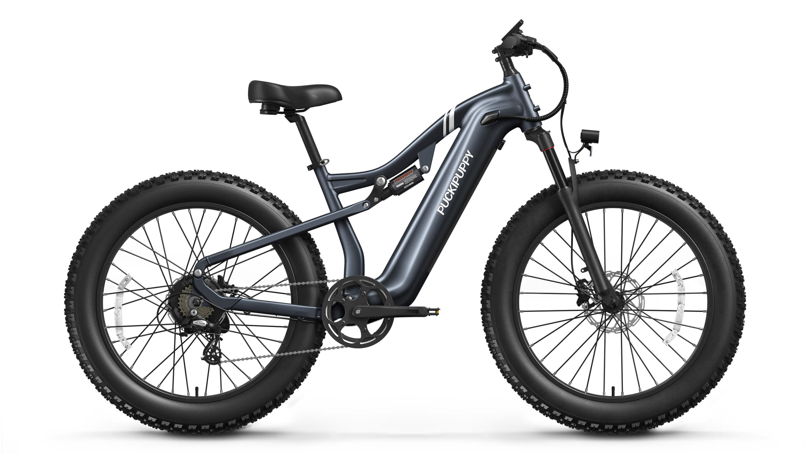
The Business
The Product
▪ PUCKIPUPPY makes dog-breed-named ebikes - Labrador Pro (~$1,399), Boxer ST, Corgi, Husky trike - for riders 28-50 who want car-free trips .
▪ UL 2849/2271 certified; torque sensor praised as 'natural' feel; 80-mile range in reviews .
▪ Problem: $1,299-$1,699 sticker + freight shipping + self-assembly = the highest-anxiety purchase in the category .
Notes:
Pass around the photo; 'this is a $1,400 decision made on a website - here's where it breaks.'

Slide 6
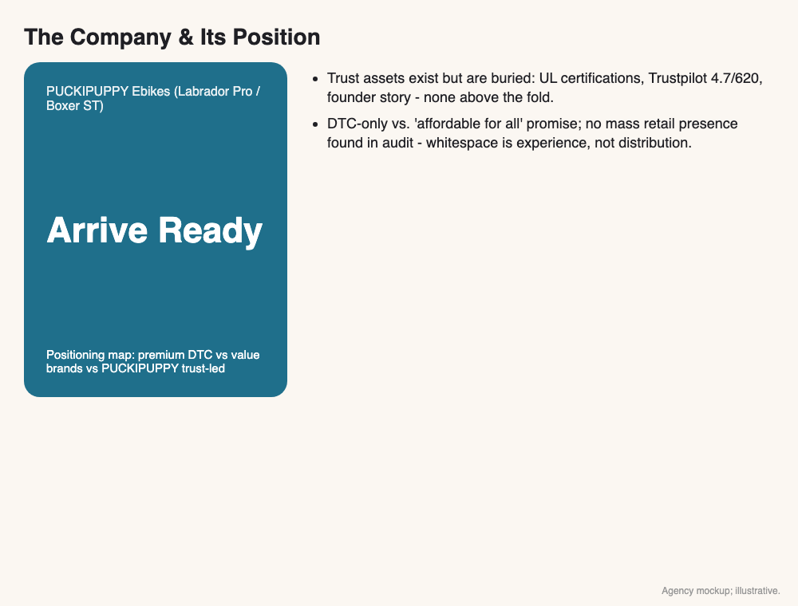
The Business
The Company & Its Position
▪ California DTC brand est. 2022 by founder Bob, named for his dog Puck; ~145K monthly visits, 11-50 employees .
▪ Trust assets exist but are buried: UL certifications, Trustpilot 4.7/620, founder story - none above the fold .
▪ DTC-only vs. 'affordable for all' promise; no mass retail presence found in audit - whitespace is experience, not distribution .
Notes:
Company position: DTC-only premium vs 'affordable for all' promise - whitespace is experience, not distribution.

Slide 7
Objectives
Campaign Objectives
▪ O1 (primary): 90 attributed orders via READY150 code + test-ride QR at ~$950 blended AOV .
▪ O2: 400 test-ride signups and 800 email/SMS captures.
▪ O3: cut damage/support-driven 1-star share from ~68% of 1-star reviews to under 50% of negatives via Arrive Ready .
VISUAL
Objective funnel: awareness -> consideration -> conversion -> retention
Notes:
Three objectives: orders, consideration captures, and the review-mix fix that proves Arrive Ready worked.

Slide 8
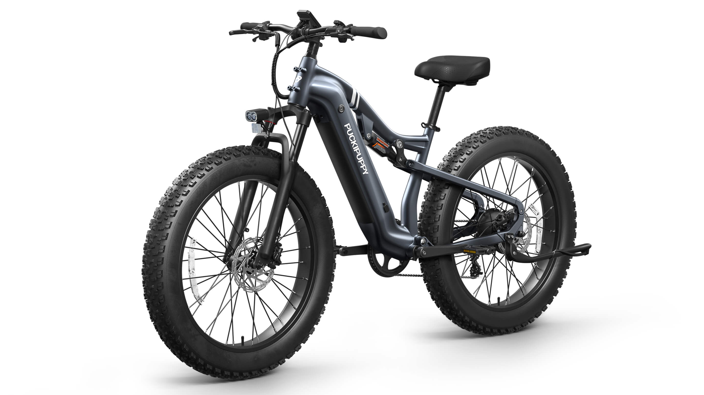
Target Market
Target Market
▪ P1 - First-Time E-Commuters (28-50): suburbs, one car per adult, 2-6 week consideration, reads reviews + certifications .
▪ P2 - Pet-People Lifestyle Buyers (25-45): dog owners who ride with pets; respond to founder story + breed models .
▪ Both need the same thing: proof the $1,400 bike arrives ready and is supported when it doesn't .
Notes:
Two segments, one anxiety: a $1,400 bike bought online needs proof it arrives ready.

Slide 9
Research
Research Method & Results
▪ Secondary (complete): 8 sources - about/press, product pages, Trustpilot, Tom's Guide, third-party metrics, industry data .
▪ Primary, no-survey (complete): keyword-coded analysis of 500 public Judge.me reviews incl. 1-star deep-dive ; digital shelf/price audit of 6 sources .
▪ Key results: product satisfies intact-delivery buyers ; negatives cluster on damage+support ~68% of 1-stars ; trust assets buried ; repeat path thin .
▪ Influences: e-bike category growth (market), review-driven purchase behavior (cultural), DTC fulfillment expectations (technological) .
VISUAL
Research methods + findings summary
Notes:
Emphasize: this is real coded review data, not vibes - 500 reviews, 53 one-stars, every theme counted.

Slide 10
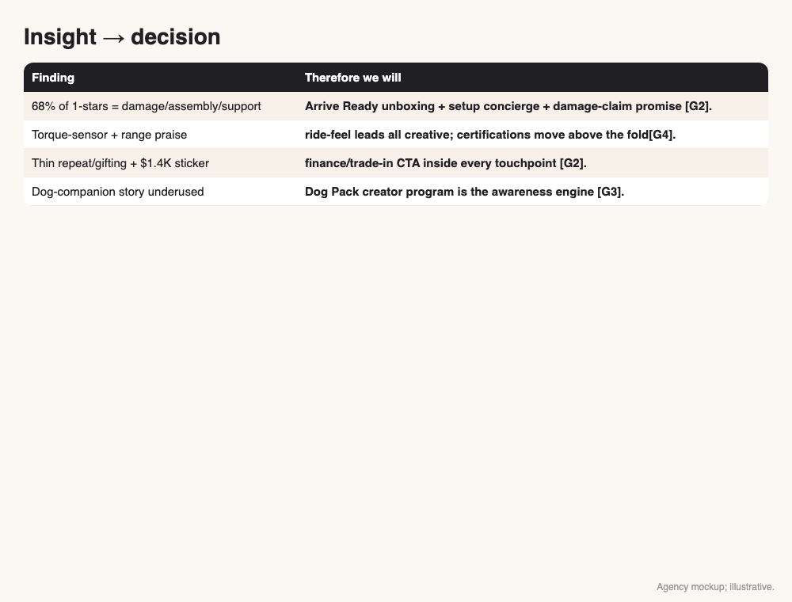
Research
Insights -> Campaign Decisions
▪ 68% of 1-stars = damage/assembly/support -> Arrive Ready unboxing + setup concierge + damage-claim promise .
▪ Torque-sensor + range praise -> ride-feel leads all creative; certifications move above the fold .
▪ Thin repeat/gifting + $1.4K sticker -> finance/trade-in CTA inside every touchpoint .
▪ Dog-companion story underused -> Dog Pack creator program is the awareness engine .
Notes:
Four findings, four decisions - every campaign element traces to a coded review theme.

Slide 11
Strategy
Campaign Strategy
▪ PESO: Paid (geo social/search) + Earned (ebike press push) + Owned (email/SMS, site trust dashboard) + Shared (creator UGC) [G1-G4].
▪ Positioning: 'the ebike that arrives ready' - own the delivery-experience gap no competitor claims .
▪ Message house: proof (UL, 4.7 Trustpilot, ride feel) -> protection (Arrive Ready) -> pathway (test ride, finance).
▪ Measurement: codes + UTMs on every program; weekly KPI review; pre/post review-corpus recount .
Notes:
PESO mix plus positioning: own the delivery-experience gap. Proof -> protection -> pathway.

Slide 12
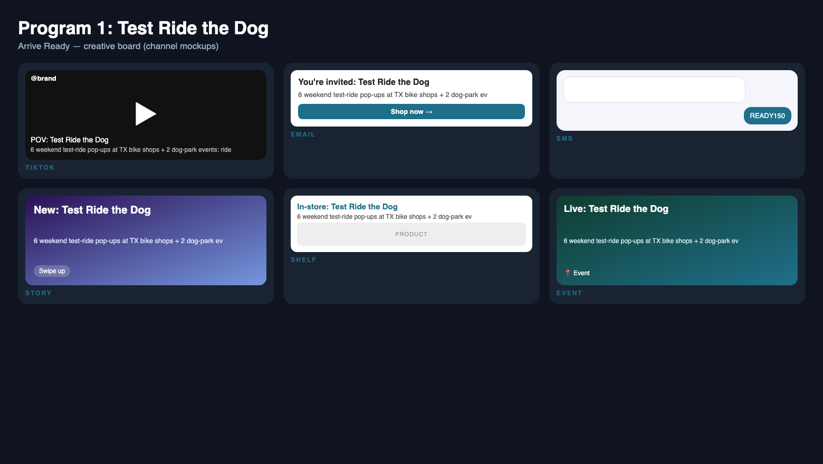
Strategy
Program 1: Test Ride the Dog
▪ Arrive Ready test rides: 6 weekend pop-ups at TX bike shops + 2 dog-park events ;
▪ Every rider gets a 'ride report' card -> email capture; control group gets the QR offer with no event, isolating event lift.
▪ Segment P1; weeks 1-6; owner Nino (field). Target: 400 rides, 15% quote rate.
Notes:
Program 1: the bike demos itself - judges can ride it. Control group isolates event lift.

Slide 13

Strategy
Program 2: Arrive Ready
▪ Every order in window ships an insert: damage-photo claim promise (<24h), QR to 10-min setup + torque-sensor guide, finance/trade-in CTA.
▪ Email/SMS sequence mirrors the insert; trust dashboard publishes live claim-resolution times and UL badges above the fold.
▪ Segment P1; weeks 1-7; owner Santhosh. Target: damage-review share <50% of 1-stars.
▪ Ready Ledger: live trust dashboard + 'brand that shows its receipts' PR push to ebike press .
Notes:
Program 2: the core fix - make the last mile of the purchase the brand promise.

Slide 14

Strategy
Program 3: Dog Pack
▪ Arrive Ready Dog Pack: 8 dog/lifestyle micro-creators (10K-80K) film 'ride with your dog' content + unboxing reactions .
▪ Each links to the test-ride finder + READY150 code; #ad disclosure on every post.
▪ Segment P2; weeks 2-6; owner Rafsan (social). Target: 400K creator views, 800 email captures .
Notes:
Program 3: the awareness engine - dog-companion creators carrying the Arrive Ready offer.

Slide 15
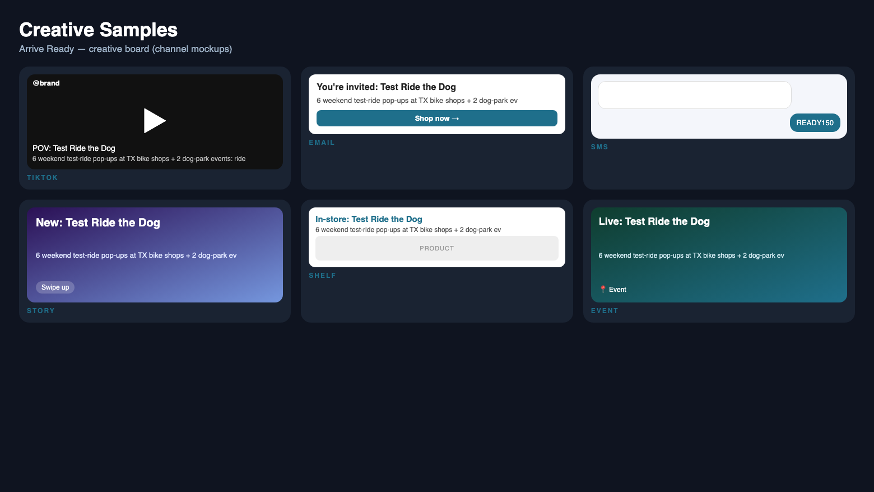
Strategy
Creative Samples
▪ Arrive Ready hero video: 'your bike, ready in 10 minutes' - unboxing -> setup QR -> first ride, dog cameo ;
▪ Static: UL badges + '4.7 on Trustpilot' + '$150 off test rides' - proof stack above the fold.
▪ Email subject: 'The part nobody films: your bike, ready in 10 minutes' - setup concierge teaser.
▪ All creative shows real product photography, no stock ebike footage.
Notes:
Show real product photography in every asset - no stock ebike footage.

Slide 16

Strategy
45-Day Week-by-Week Schedule
▪ Wk1: Arrive Ready inserts live; trust badges above fold; test-ride bookings open; press outreach.
▪ Wk2-4: 6 test-ride pop-ups + 8 Dog Pack creator posts; paid social/search live; weekly KPI review.
▪ Wk5-6: second test-ride wave; email/SMS nurture to captures; review-corpus recount #1.
▪ Wk7: final push; recount #2; retro + scale recommendation to company.
Notes:
Walk the 45 days: inserts live wk1, events wk2-4, second wave wk5-6, retro wk7.

Slide 17
Budget
Proposed Budget & Financial Viability
▪ Total $21,000: media $8,000 ; creators 8 x $800 ; events 8 x $300 ; inserts ; tools ; contingency .
▪ Funnel: 1.2M x 1.5% x 0.6% = ~108 orders x $950 = $102.6K .
▪ GP 32% = $32.8K; ROI ~56% . Breakeven ~69 orders .
▪ Conservative (40%): ~43 orders -> -$7K, offset by 800 captures (~$12K list value) + lower support cost .
▪ Margin sensitivity: 25% GP -> -14%; 40% GP -> +95% (ebike hardware range) .
Notes:
Line-item every dollar; show the conservative case honestly and how email list + support savings mitigate.

Slide 18
Impact
Impact & Measurement
▪ O1: attributed orders - Shopify code + UTM report, weekly; target 90.
▪ O2: test rides (event tally) + email captures (Klaviyo) - target 400/800.
▪ O3: 1-star review share recount - re-crawl Judge.me corpus bi-weekly, same keyword method .
▪ Leading indicators: QR scan rate, quote requests, insert redemption; lagging: orders, review mix.
▪ Triggers: if wk3 rides <150, shift media to CA home market; if claims >2%, pause inserts and audit packaging .
VISUAL
KPI dashboard - real product photography
Notes:
KPI dashboard: orders, rides, captures, review-share recount. Triggers if off-track.

Slide 19
Impact
Why It Matters
▪ For buyers: a $1,400 purchase that arrives ready, supported, and financed - the anxiety removed.
▪ For PUCKIPUPPY: converts its best asset (product love) into retained revenue; every damage claim prevented is margin saved .
▪ For the category: proves DTC ebike brands can own the delivery experience as a brand promise.
▪ Mission metric: 'X orders arrived ready, 0 unresolved damage claims' - the number we print on the trust dashboard.
VISUAL
Arrive Ready brand lockup
Notes:
Close on the mission metric: orders arrived ready, zero unresolved damage claims.

Slide 20
Sources
Bibliography
▪ PUCKIPUPPY. 'About / Our Story.' 2026. https://www.puckipuppy.com/pages/about-us
▪ PUCKIPUPPY. 'Labrador Pro Ebike product page.' 2026. https://www.puckipuppy.com/products/labrador-pro
▪ Tom's Guide. 'PUCKIPUPPY ebike review.' 2026. https://www.tomsguide.com
▪ Trustpilot. 'PUCKIPUPPY reviews (4.7/5, ~620).' 2026. https://www.trustpilot.com/review/www.puckipuppy.com
▪ PUCKIPUPPY (Judge.me). '584 public customer reviews - keyword-coded content analysis.' 2026-11-08. https://www.puckipuppy.com
▪ EcomScout/ListSignal. 'PUCKIPUPPY Shopify metrics estimate.' 2026. https://ecomscout.com
▪ PeopleForBikes. 'E-bike participation and retail data.' 2025. https://peopleforbikes.org

