Slide 1

DSCI MINI PROJECT Cuisine Predictions

Slide 2
Problem Statement: Classifying the cuisine from a given list of ingredients and recommending recipes which can be made from ingredients available and nutrition requirements entered by the user.
Project Objectives:
• Classifying cuisine from the given ingredients list according to nutrition.
• Predicting recipes from the given ingredients list.
Auto completion of recipes.
Search Recipes

Slide 3
1) Data Scraping
• To gather data, finding resources on the internet which provide dishes of various cuisines, and their nutritional values like calories, carbs, proteins and fats.
• Websites used:
RecipeDB (iiitd.edu.in)
Allrecipes | Recipes, How-Tos, Videos and More
NO API is used. Entire data is scrap from these 2 websites.

Slide 4
1) Data Scraping (continued….)
Scraping the data from the internet The first website i.e., Allrecipes was a static website hence Beautiful Soup was the only tool required to scrape the data from the website
The second website i.e., RecipeDB was dynamic and required user input to be provided and to view each recipe’s details buttons had to be clicked and it was a multi-page website.
Selenium and Chrome Driver tools were used.

Slide 5
2) Data Pre-Processing
Cleaning the data – From the data scraped many ingredients contain words which are not important in determining the cuisine for e.g. ground turmeric, or to taste – here “or to taste” phrase is not important hence data has to be cleaned by applying nlp so that only main words from each ingredient is used.
Also, while scraping such a huge amount of data – some data fields were empty hence removing such empty data elements is important.

Slide 6
2) Data Pre-Processing (continued…)
Word Net Lemmaztizer:
Handling Null Instances. (Removing the recipe with no ingredients)
Lemmatize
Parenthesis, Digits using regular Expression
Lowercase
Non-word characters
Removing excessive while space
Normalization:
Before pre-processing all nutrients were according to different servings
After pre-processing all nutrients -> 0 to 1 range

Slide 7
POS Tagging
Removing Stop Words
Keep defined tags
And also remove words like chopped, minced, all-purpose etc

Slide 8
Count Vectorization
Converting text data into numerical vectors that can be used as input to machine learning models.
Creating a vocabulary of all unique words in the text corpus & then transforming each document into a vector of frequencies.

Slide 9
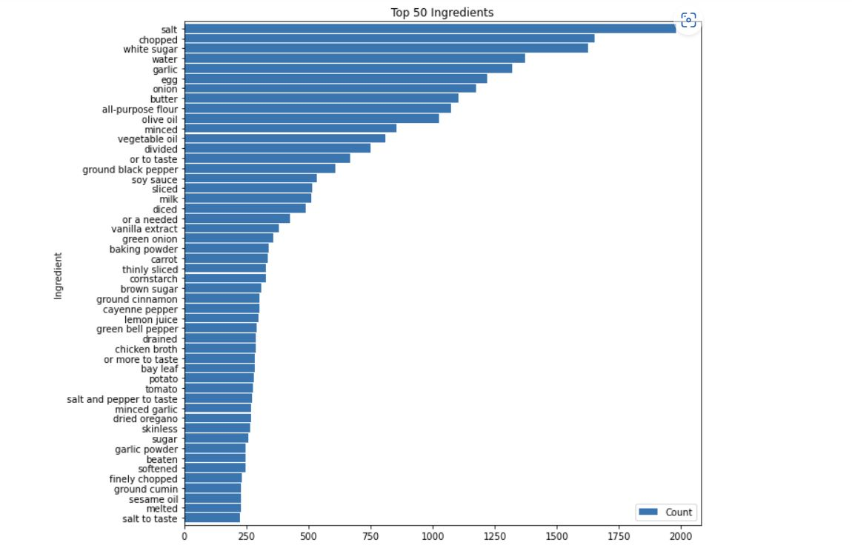
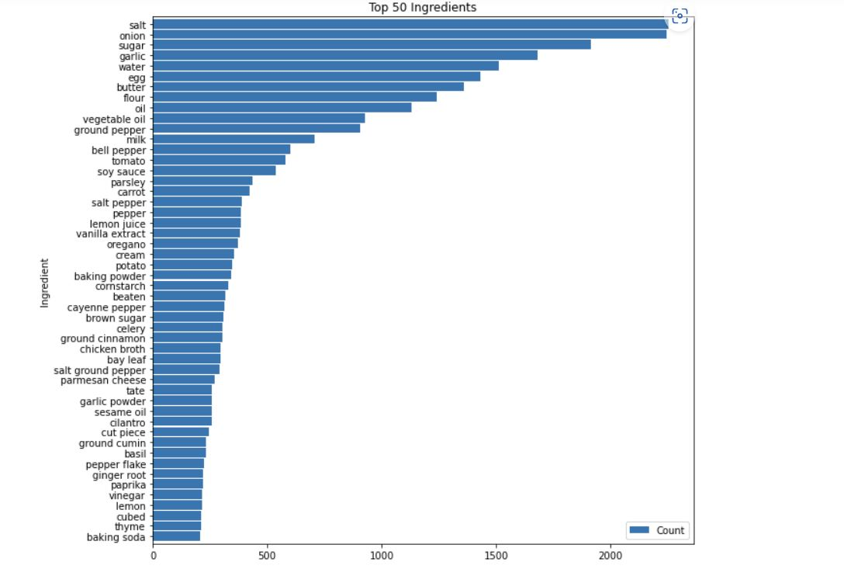

Slide 10
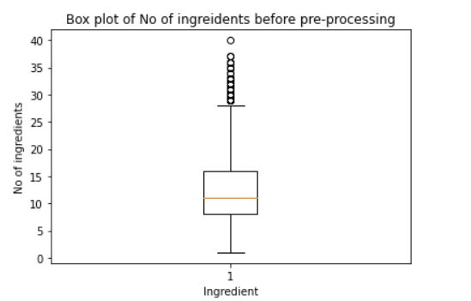
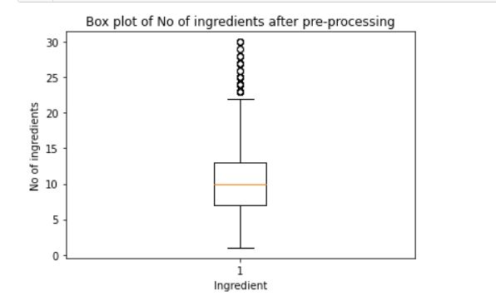

Slide 11
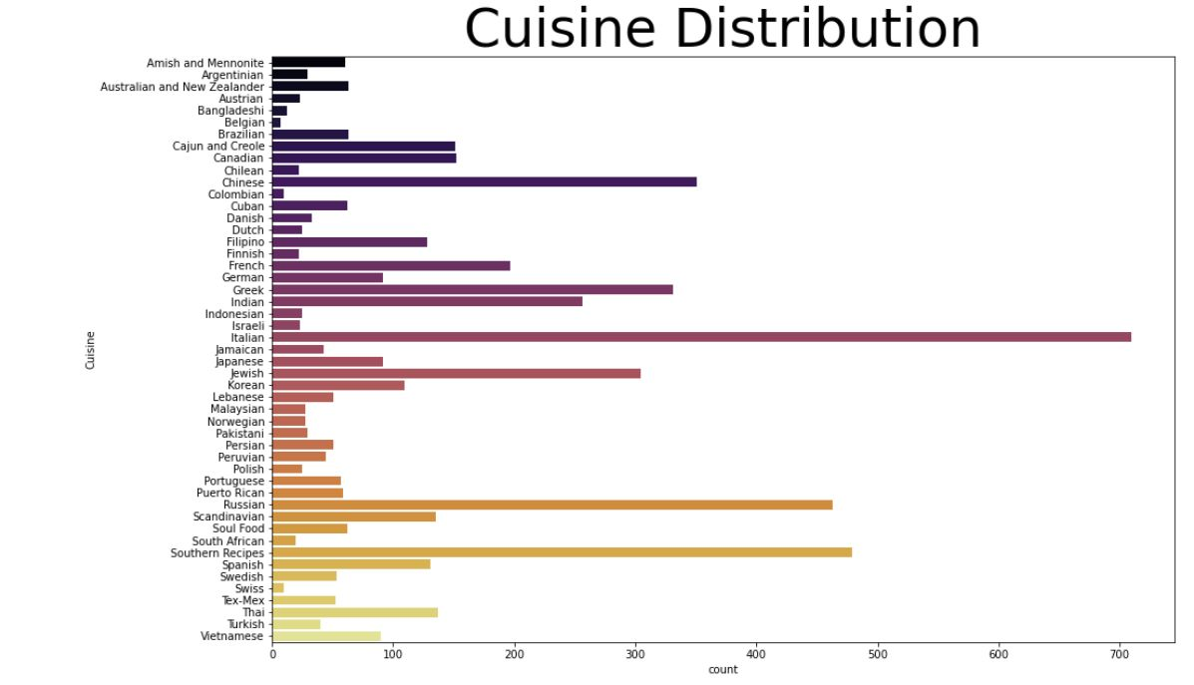

Slide 12
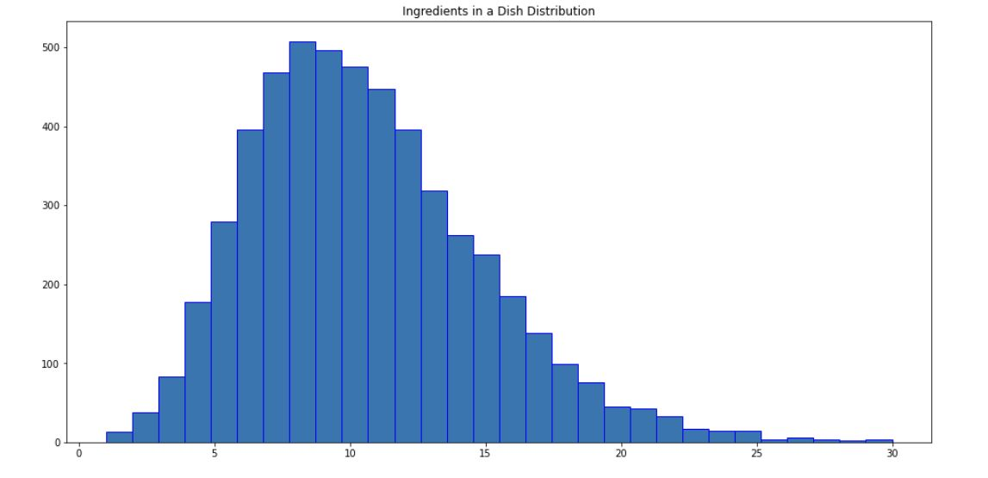

Slide 13
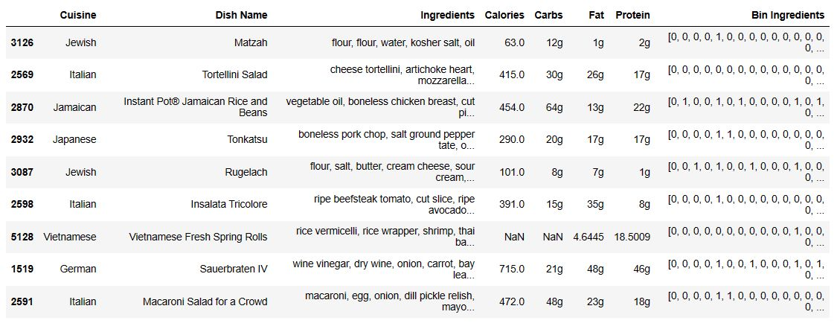
Cosine Similarity

Slide 14
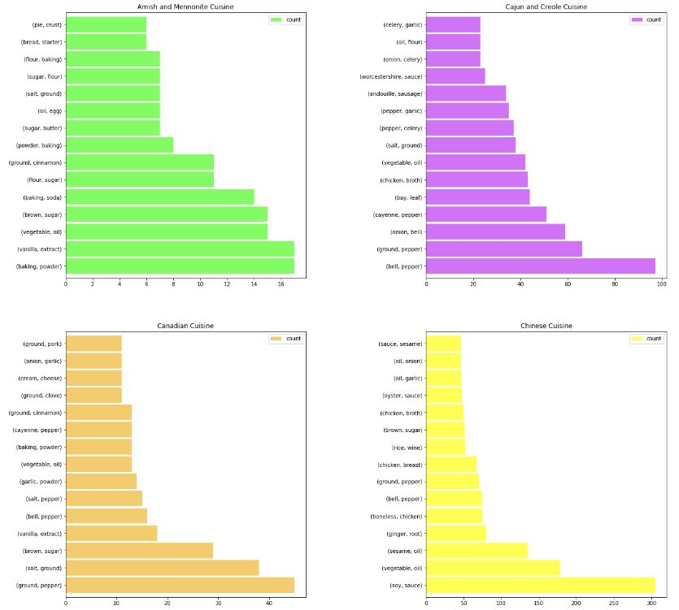
Finding top 10 Bigrams

Slide 15
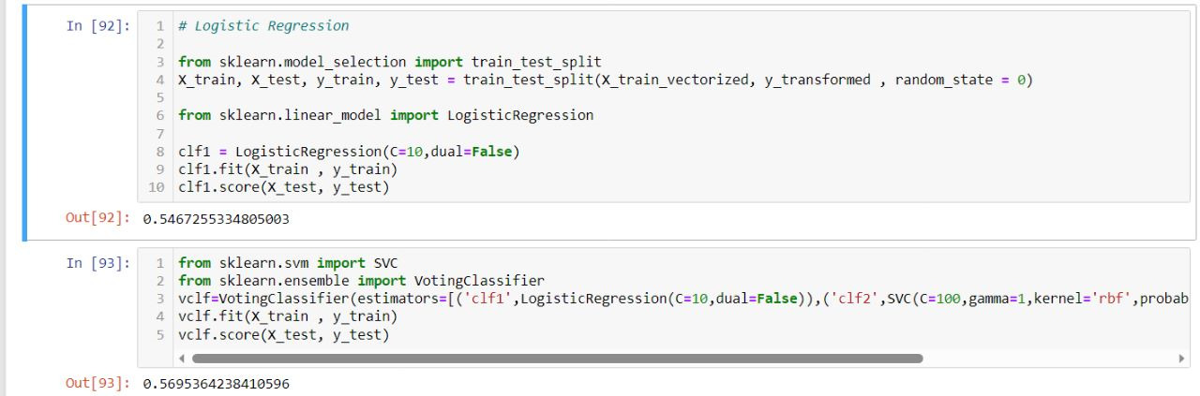
Final step
Logistic Regression
Voting classifier

Slide 16
