Slide 1
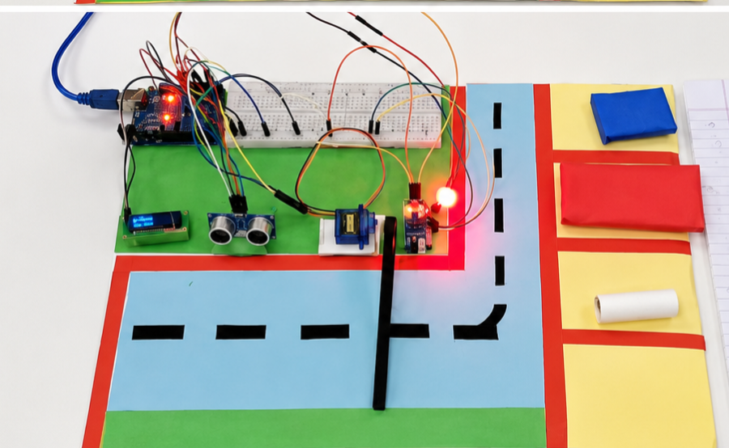
Smart Parking System🚗

Slide 2
Introduction
Smart system for parking management
Detects vehicle entry and exit
Displays available slots in real-time

Slide 3
Objectives
Reduce parking congestion
Automate gate control
Provide real-time availability

Slide 4
Components Used
Arduino Uno
Ultrasonic Sensor
IR Sensor
Servo Motor
OLED Display
Red & Green LEDs

Slide 5


Working Principle
Ultrasonic detects vehicle entry
IR sensor detects exit
Servo controls gate
OLED displays slot count
LEDs show availability

Slide 6
System Architecture
Sensors → Arduino → Output Devices
Outputs: Servo, OLED, LEDs
Real-time processing

Slide 7
Circuit Connections
Ultrasonic → Pins 6,7
IR Sensor → Pin 3
Servo → Pin 9
OLED → A4, A5
LEDs → Pins 10,11
VCC → 5V
Ground → GND

Slide 8
Algorithm
Start system
Check entry sensor
If slot available → open gate
Decrease slot count
Check exit → increase slot

Slide 9
Advantages
Low-cost system
Easy to implement
Real-time monitoring
Reduces manual work

Slide 10

Applications
Shopping malls
Airports
Office parking
Smart cities

Slide 11
Result
Accurate slot detection
Automatic gate operation
Clear display of availability

Slide 12
Conclusion
Efficient parking solution
Improves user experience
Scalable for smart cities

Slide 13
Thank You
Thank you for your attention
Any Questions?

