Slide 1
RESTAURANT FOOD ORDERING SYSTEM
ARANYA SINGH CHAUHAN : RA1911028010008
PRANIT TANDON : RA1911028010014

Slide 2
PROBLEM STATEMENT
The basic problem in the food service industry is that restaurants are not realizing efficiencies that would result from better applications of technology in their daily operations. Every fast food has counter where you can place your order and then make the payment. So every fast food needs an employee for taking the order and processing the payment. Labor rates are increasing every now and then and it is difficult to find employees these days.

Slide 3
AIM OF OUR SYSTEM
The project aims to build a system for restaurants, which automates food ordering system.
Such an automated system would simplify the food ordering process for both the customer and the restaurant.
The pruposed system would speed up the entire process of ordering food and also, would lead to a reduction in the labour cost that is spent by a restaurant.
The said system would also rid restaurants of long queues at the counter which would result in a hassle free experience for the customer.

Slide 4
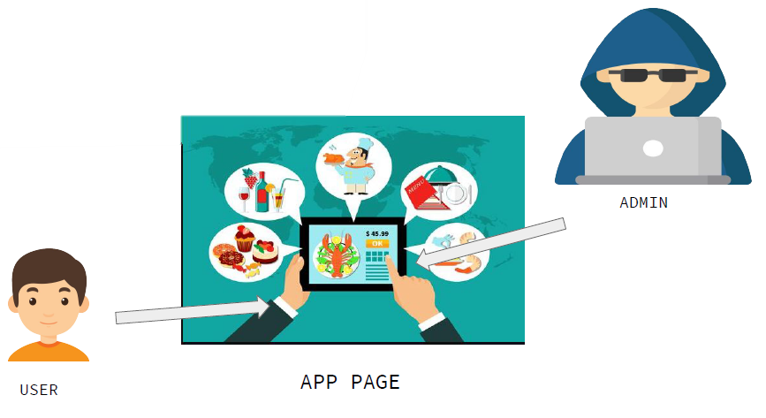

Slide 5
FUNCTIONAL REQUIREMENTS
Requirements, which are related to functional aspect of software fall into this category.
They define functions and functionality within and from the software system.
In HRMS Software functional requirements are:
Everyone using the software would have their specific IDs. (Staff would need to have an account while Customers would be given a choice).
Adding or modifying details on the menu would be an available option.
Adding Offers for the customers would be an available option.
Users (customers) would have the option to update their details.

Slide 6
FUNCTIONAL REQUIREMENTS
A workshop for the staff to understand the working of the software.
Provide ability to view and keep record of receipts.
Provide regular report generation of employee, salary, attendance, training and vacation.
The system would generate monthly revenue reports for the restaurant.
All new user entries, changes in descriptions/details will be accommodated via the database.

Slide 7
NON-FUNCTIONAL REQUIREMENTS
Requirements, which are not related to functional aspect of software, fall into this category. They are implicit or expected characteristics of software, which users make assumption of.
Non- Functional requirements are:
Performance: All pages should load within 3 seconds
Performance: Search should bring the results less than 7 seconds
Availability: Application should be available for 24x7
Scalability: Registration Service should scale to serve 1000 request per second over 5 minutes timespan
Confidentiality: The users should not have permissions to view details about other users.
Usability: The system is planned to be made user friendly with an easy-to-use UI.

Slide 8
NON-FUNCTIONAL REQUIREMENTS
Security: The system will be secured and information files will be encrypted
Traceability: The status of each progress will be made traceable.
Flexibility: The platform will be made alterable wherein specifications can be added at any time
Extensibility: Service should be extensible to other countries
Interoperability: A number of pcs will be interconnected and share the database
Reliability: Reliability testing will be done to ensure effective operation.
Rapidity: Integrate New Payment Integrator

Slide 9
SYSTEM REQUIREMENTS (Client)
1. Hardware Limitations: The minimum hardware requirement for the system to run the software : CPU SPEED: 2 GHz.
RAM: 2 GB (Windows XP) 2.5 GB (Windows Vista)
Operating System: Windows Vista - Service Pack 1 / XP - Service Pack 3 / Windows 7/8/10
2. Others: Lack of training about how the software is to be used.

Slide 10
SYSTEM REQUIREMENTS (Devs)
HARDWARE REQUIREMENTS:
• Disk space: 20 GB minimum for storage of program files and their backup.
• Backups: to keep backups of the site
• Memory: 256 MB (min), 1GB or more is strongly recommended.
SOFTWARE REQUIREMENTS:
• Web server
• Cloud storage
• Programming languages: PHP, SQL, CSS, HTML and JavaScript

Slide 11
INFRASTRUCTURE REQUIREMENTS
Infrastructure requirements define the capabilities, features or qualities that are necessary (or desired) for an infrastructure on which application is executed.
Development Machine with 6 GB Ram and 4 Cores
Code Repository
AWS S3 Bucket
IDE – Eclipse
MySql Administrator
Microsoft SQL Server

Slide 12
Design State

Slide 13
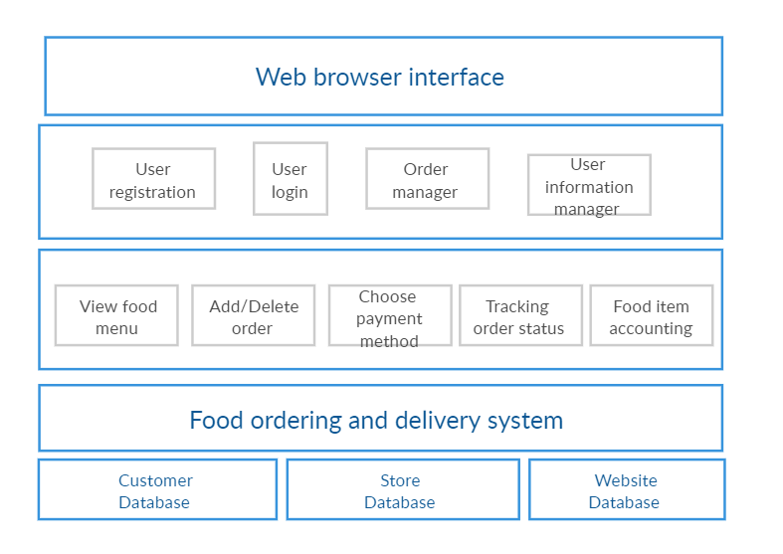
Architecture Diagram

Slide 14
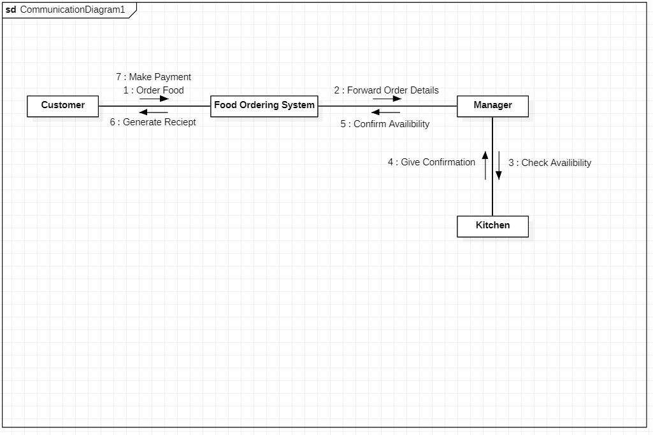
Collaboration Diagram

Slide 15
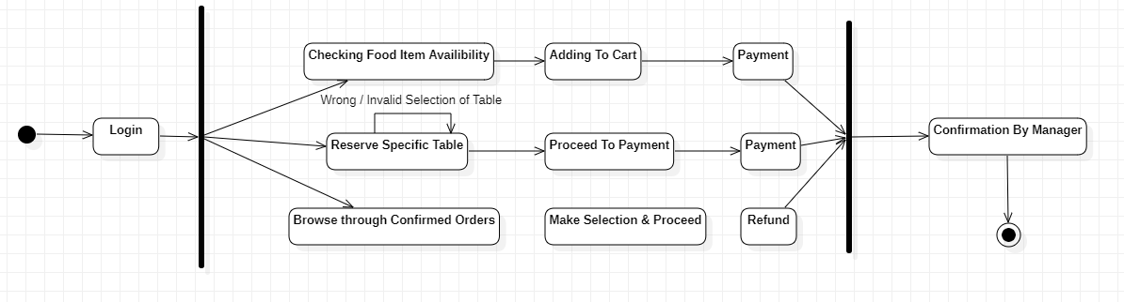
State Diagram

Slide 16
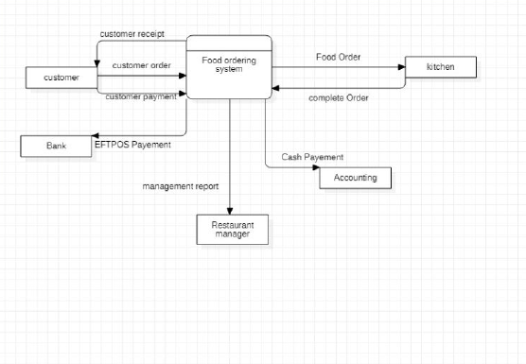
DFD Diagram

Slide 17
MODULES

Slide 18
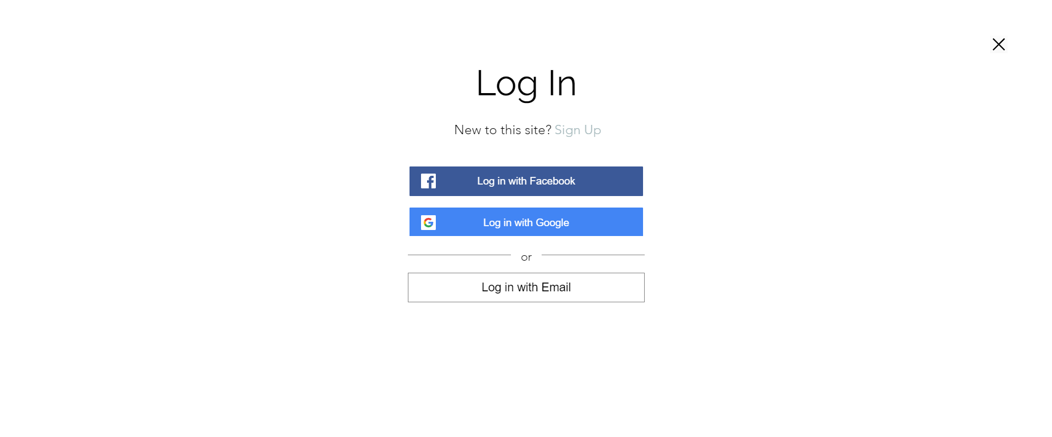
LOGIN

Slide 19

About

Slide 20
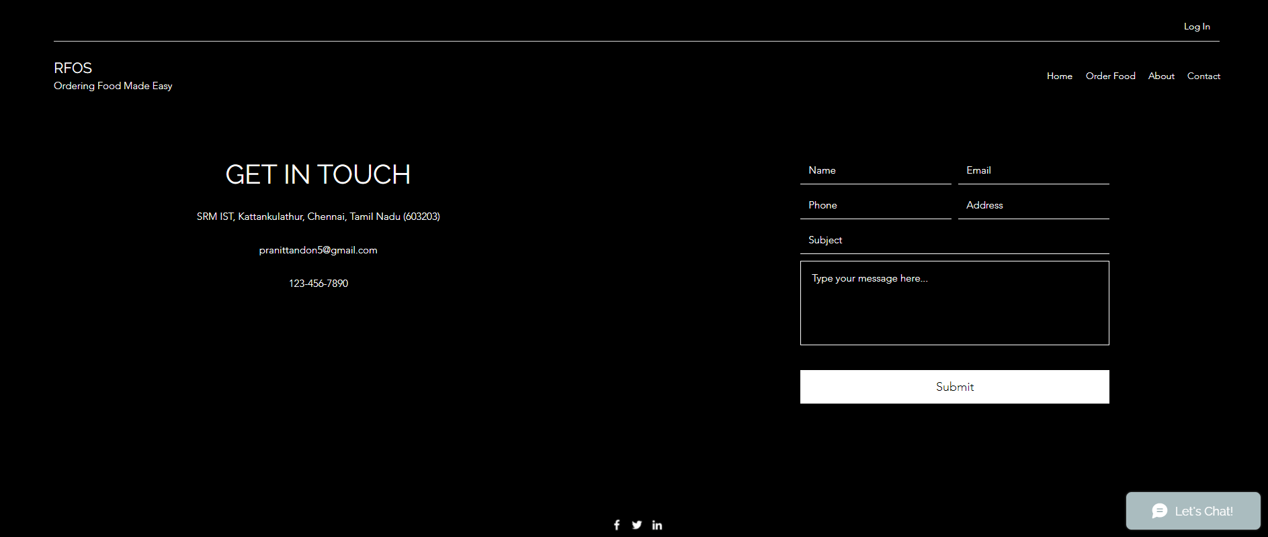
Contact

Slide 21
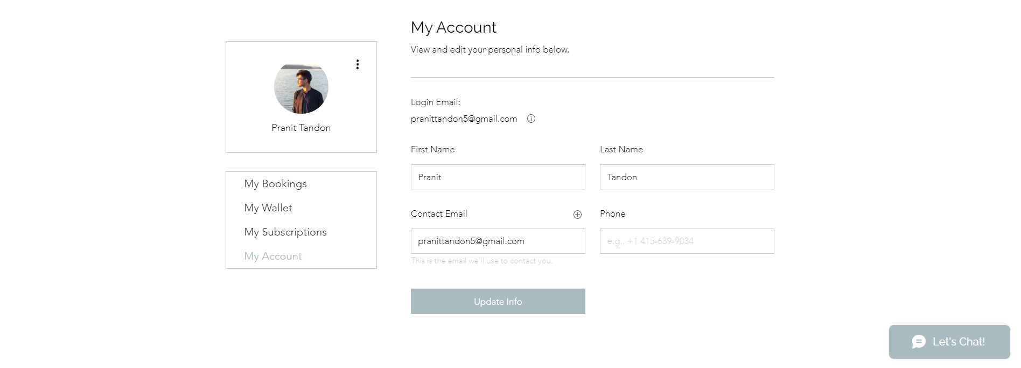
Update User Profile Page

Slide 22
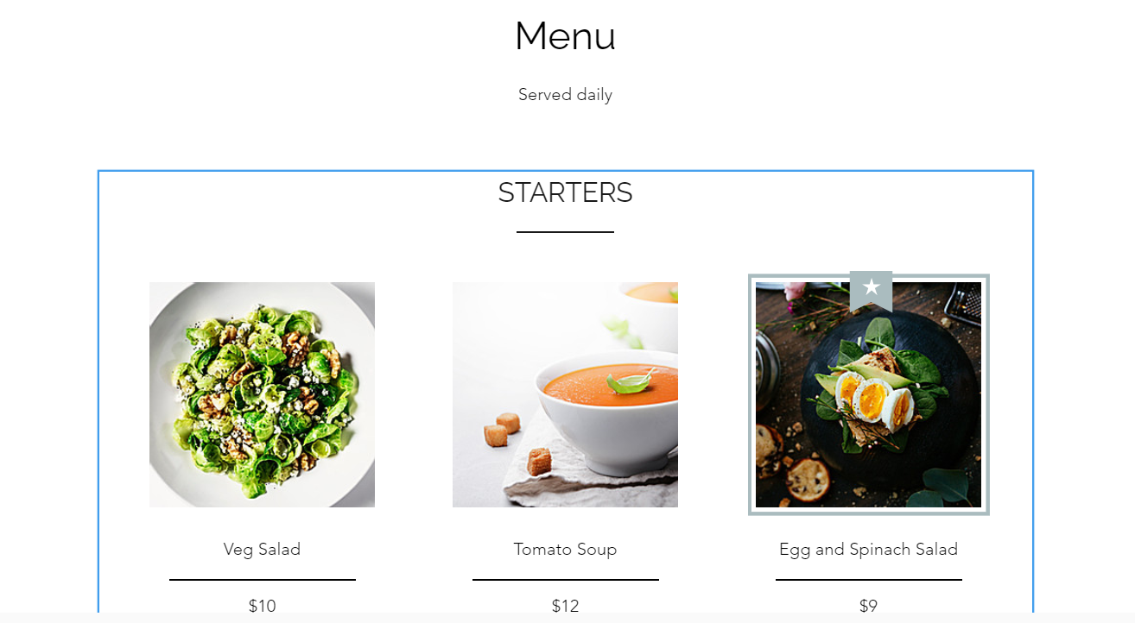
Sample Menu Page

Slide 23
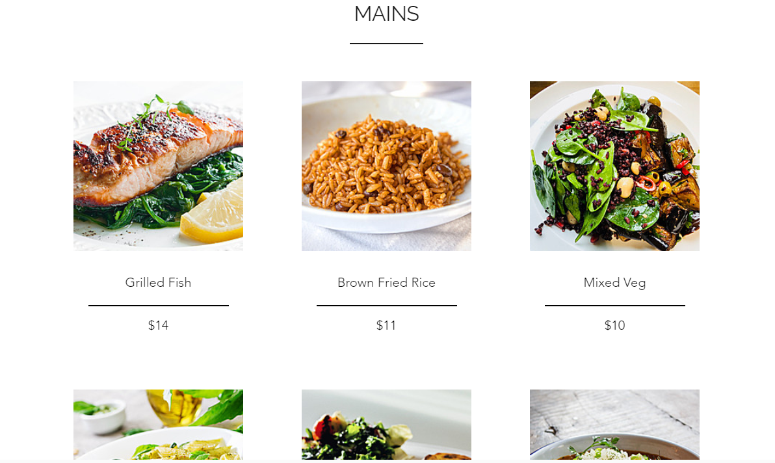

Slide 24
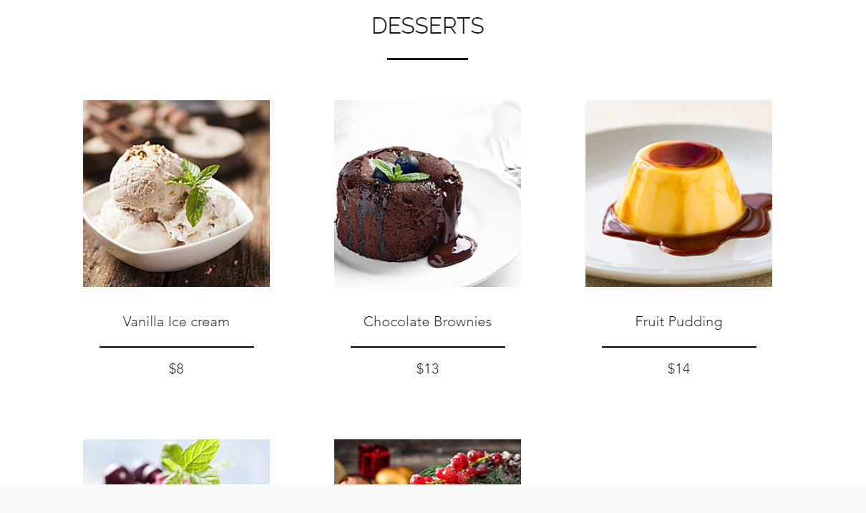

Slide 25
Test Cases
Test ID | Test Scenario | Test Case | Execution Steps | Expected Outcome | Actual Outcome | Status | Remarks
T1 | Entering email ID | Accept Valid email ID | User clicks on Sign up Enter their email ID | User should be taken to the next line for entering password | User was taken to the next line for entering password | Pass | Success
T2 | Entering password | Don’t Accept password that is less than 8 characters | User enters valid email ID User enters a password of more than 8 characters | User should be signed up | User was signed up | Pass | Success
T3 | Signing in through Google | Let the user use their google ID | User clicks on Sign up User selects google | User should be taken to a new window to use their google ID | User was taken to a new window | Pass | Success
T4 | Signing in through Facebook | Let the user use their Facebook ID | User clicks on Sign up User selects Facebook | User should be taken to a new window to use their Facebook ID | User was taken to a new window | Pass | Success

Slide 26
THANK YOU

