Slide 1
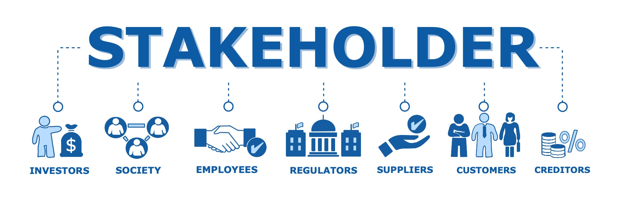
RESTAURANT FOOD ORDERING SYSTEM:
STAKEHOLDER ANALYSIS
Pranit Tandon (RA1911028010014)
Aranya Singh Chauhan (RA1911028010008)

Slide 2
Why Stakeholders?
Involving stakeholders from the beginning is the single most impact full step developers can take but identifying stake holders isn’t that easy though.

Slide 3
CONSIDERATIONS TAKEN FOR IDENTIFICATION OF STAKEHOLDERS.
-First thing taken into consideration was that who is affected positively and negatively by the
-Second thing taken into consideration was that who are the suppliers and the end users and who has the influence over the stakeholders.
And finally the must question arises, who can solve all the potential problems arising with the project?

Slide 4
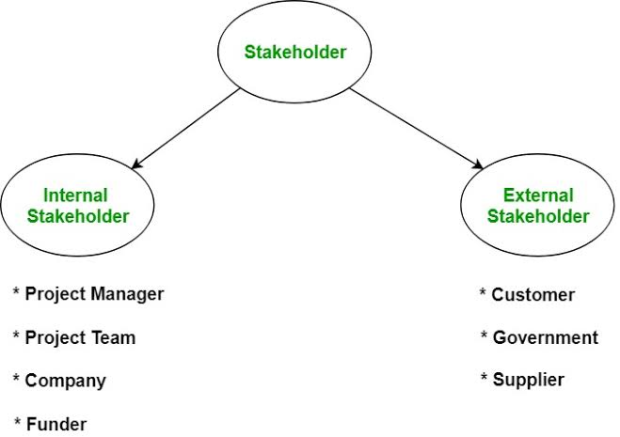
Who can be the Stakeholder ?

Slide 5
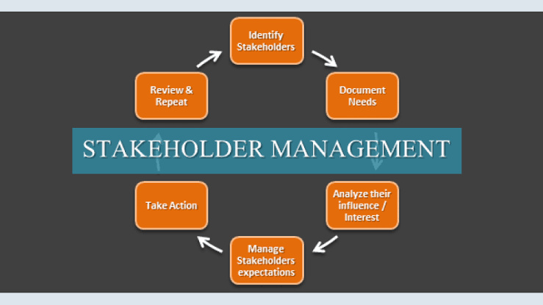
Stakeholder identification therefore takes place before the stakeholder analysis. It aims to identify all organisations and individuals who are directly or indirectly affected by a company’s activities or who have a specific interest in these activities. The result should be a list of all stakeholders.

Slide 6
Stakeholder Management
Stakeholder Name | Area | Interest | Influence
Database Administration | Storage, management of data | High | High
Restaurant | End user (Customer) | High | High
Chef | Knows the menu | Low | High
Developer | Develop and Update the application | High | High
Manager | Responsible for the strategic reputation | Low | High
Waiters | Implementing the software | High | Low

Slide 7
Communication Plan For Stakeholders
Weekly progress meetings among the team (manager, chef, developer, waiters)
Weekly progress report will be taken.
We will have a customer satisfaction survey.
Walk through of progress to High Interest and High Influence stakeholders.

Slide 8
Work tasks by Stakeholders Explained
Database Administration - It involves the management of the data at the servers by the data administrators.
Customers- Have access to main UI, using which they can order food, book tables..
Chef- Can make amendments to the menu.
Developer-Can modify and update the entire software/application.

Slide 9
CONCLUSION
The stakeholders of our project are identified and selected with
respect to the crucial skill sets needed for the operations of the respective jobs. Every stakeholder has the skill set to solve the
Potential problems related to the project. The stakeholders identified
has the vested interest in our project and can affect for the positives for the whole
involved assets.

Slide 10
Thank You

