Slide 1
Differentiable Karplus-Strong
@DMRN+20
Pablo Tablas de Paula, David Marttila & Joshua D. Reiss
Queen Mary University of London

Slide 2
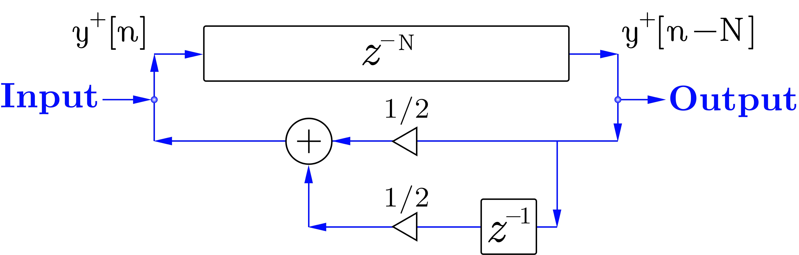
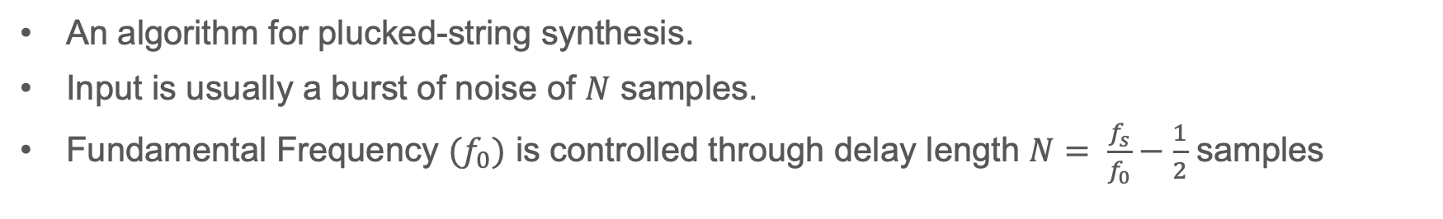
Karplus-Strong Algorithm
An algorithm for plucked-string synthesis.
Input is usually a burst of noise of $N$ samples.
Fundamental Frequency ${(f}_{0})$ is controlled through delay length $N= \frac{f_{s}}{f_{0}}−\frac{1}{2}$ samples
Karplus, K. and Strong, A., 1983. Digital synthesis of plucked-string and drum timbres. Computer Music Journal, 7(2), pp.43-55.

Slide 3

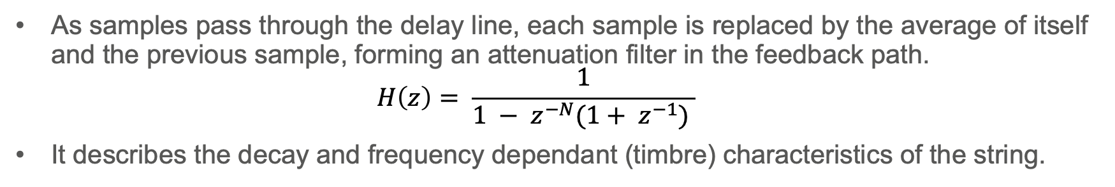
Karplus-Strong Algorithm
As samples pass through the delay line, each sample is replaced by the average of itself and the previous sample, forming an attenuation filter in the feedback path.
$$H\left(z\right)= \frac{1}{1 − z^{−N}(1+ z^{−1}) }$$
It describes the decay and frequency dependant (timbre) characteristics of the string.
Karplus, K. and Strong, A., 1983. Digital synthesis of plucked-string and drum timbres. Computer Music Journal, 7(2), pp.43-55.

Slide 4
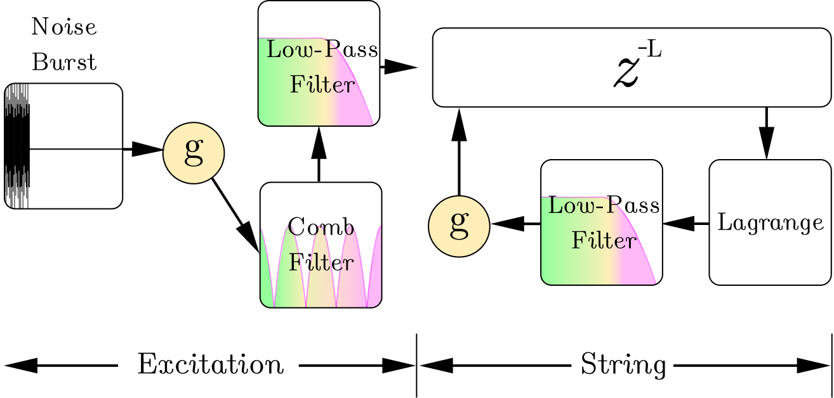
Karplus-Strong Algorithm (Extensions)
Jaffe & Smith proposed filtering the input noise with:
a comb filter to simulate pluck position,
and a low-pass filter and gain stage to simulate playing dynamics.
Jaffe, D.A. and Smith, J.O., 1983. Extensions of the Karplus-Strong plucked-string algorithm. Computer Music Journal, 7(2), pp.56-69.

Slide 5
Karplus-Strong Algorithm (Extensions)
Välimäki, Huopaniemi and Karjalainen proposed:
using a Lagrange interpolator (flat frequency response) for fractional delay lengths,
using a normalized first-order IIR, with a gain stage for decay control.
Välimäki, V. et al. 1996. Physical modeling of plucked string instruments with application to real-time sound synthesis. JAES.

Slide 6
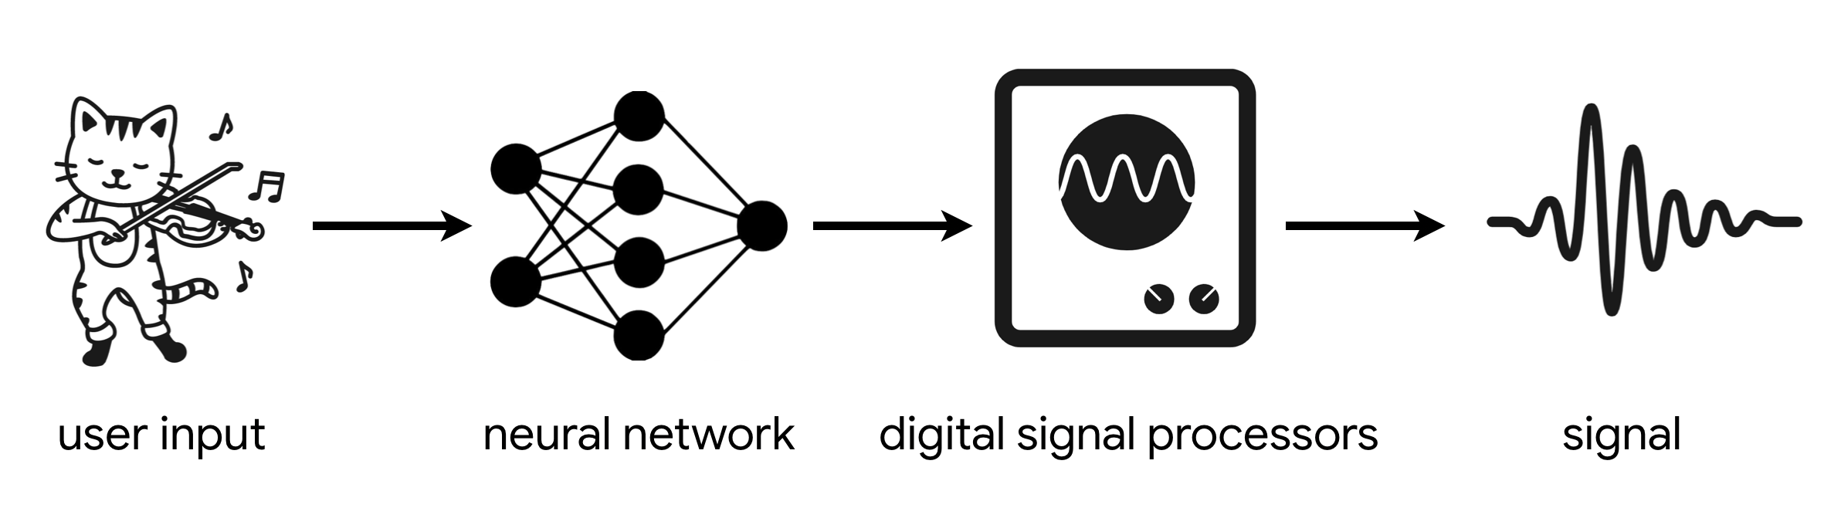
DDSP & Timbre-Transfer
Engel et al., proposed backpropagating through the parameters of Digital Signal Processors (hence, DDSP, differentiable DSP).
Allows Self-supervised learning for the synthesiser parameter inversion problem.
Since the output is limited to the DSP, training time is reduced substantially.
Engel, J., Gu, C. and Roberts, A., 2020. DDSP: Differentiable Digital Signal Processing. In ICLR.

Slide 7
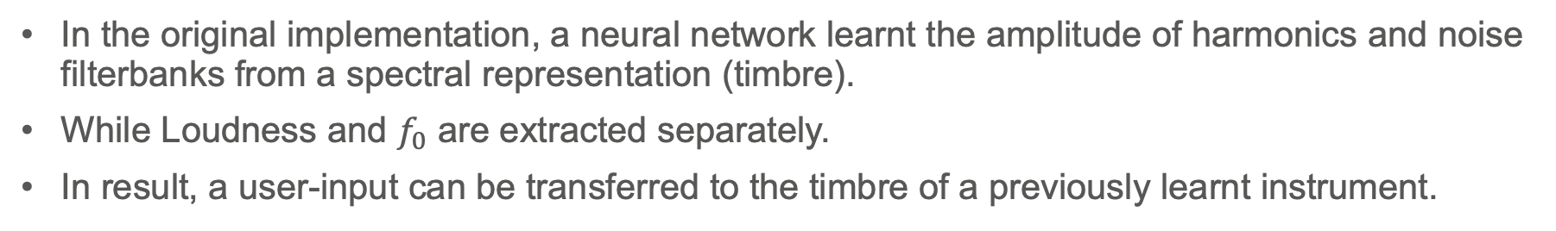
DDSP & Timbre-Transfer
In the original implementation, a neural network learnt the amplitude of harmonics and noise filterbanks from a spectral representation (timbre).
While Loudness and $f_{0}$ are extracted separately.
In result, a user-input can be transferred to the timbre of a previously learnt instrument.
Engel, J., Gu, C. and Roberts, A., 2020. DDSP: Differentiable Digital Signal Processing. In ICLR.

Slide 8
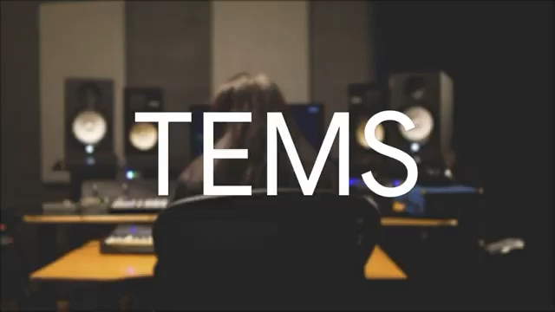
DDSP & Timbre-Transfer
Source: https://www.youtube.com/watch?v=bXBliLjImio

Slide 9
DDSP & Timbre-Transfer
The last five years have seen numerous applications to other DSP:
FM Synthesis
Waveshaping
Physical Modelling
Some general-purpose libraries:
FLAMO, a Frequency-sampling library for LTI systems
PhilTorch, library for Time-Domain filters (LTI and LTV)
Hayes, B., Saitis, C. and Fazekas, G., 2021. Neural Waveshaping synthesis. In ISMIR.
Caspe, F., McPherson, A. and Sandler, M., 2022, December. DDX7: Differentiable FM Synthesis of Musical Instrument Sounds. In ISMIR.
Südholt, D., Cámara, M., Xu, Z. and Reiss, J.D., 2023. Vocal Tract Area Descent Estimation by Gradient Descent. In DAFx23.
Mezza, A.I., Giampiccolo, R. and Bernardini, A., 2025. Differentiable Scattering Delay Networks for Artificial Reverberation. In DAFx25.
Dal Santo, G., et al., 2025, April. FLAMO: An Open-Source Library for Frequency-Domain Differentiable Audio Processing. In ICASSP.
Yu, C.Y. and Fazekas, G., 2025. Accelerating Automatic Differentiation of Direct Form Digital Filters. EurIPS

Slide 10
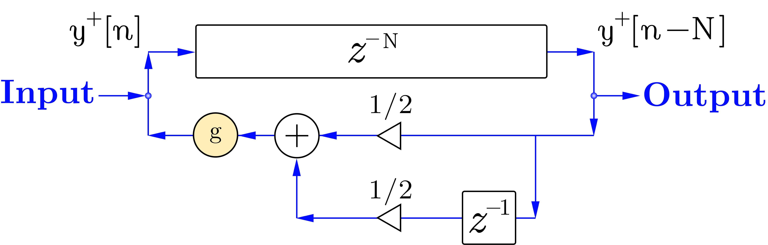
Previous Work
In the accompanying materials of Hayes et al.
LTI implementation with frequency sampling,
Where decay, as a gain stage in the loop, can be optimised.
Source: https://intro2ddsp.github.io/physical-modeling/wave_equation.html

Slide 11
Differentiable Karplus-Strong – why?
We propose using Karplus-Strong for timbre-transfer because:
It is very efficient;
It can simulate strings with a fraction of the DSP.
It offers a strong structural prior.
Hence, we hypothesize:
the neural network will need fewer parameters,
train faster,
and transients will be better represented.

Slide 12
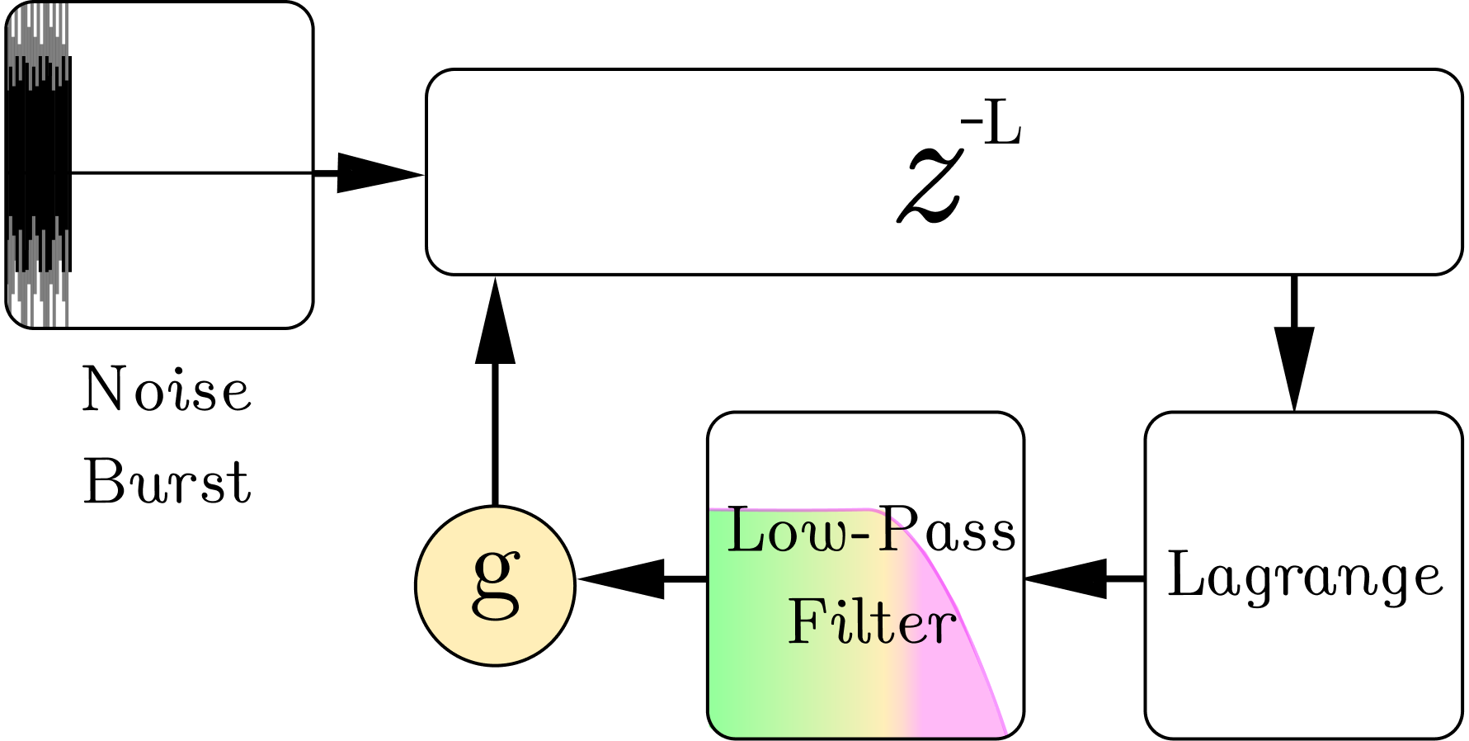
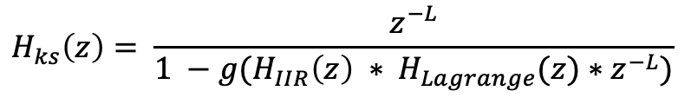
Differentiable Karplus-Strong – how?
IIR systems have dense computational graphs if implemented naively, but we can do:
Frequency Sampling methods.
Time-Domain methods, handle time-varying systems natively
but do not (currently) allow for additional filtering in feedback paths.
We can fold the recursion
into one big
IIR!
$$H_{ks}\left(z\right)= \frac{z^{−L}}{1 −g(H_{IIR}\left(z\right) ∗ H_{Lagrange}(z)∗z^{−L})}$$
Yu, C.Y., Mitcheltree, C., et al., 2024. Differentiable All-Pole Filters for Time-Varying Audio Systems. In DAFx24

Slide 13
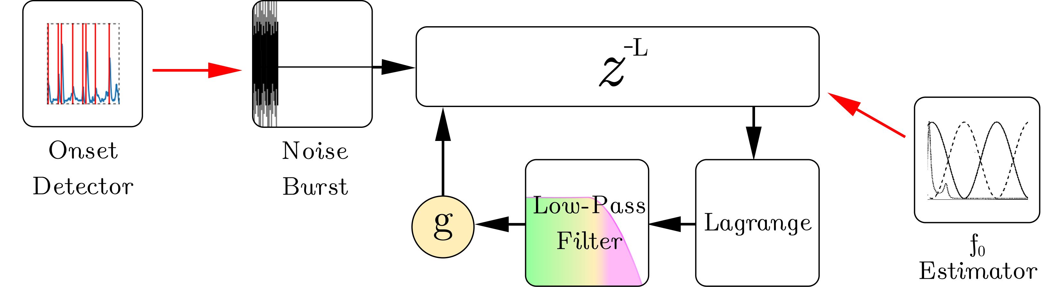
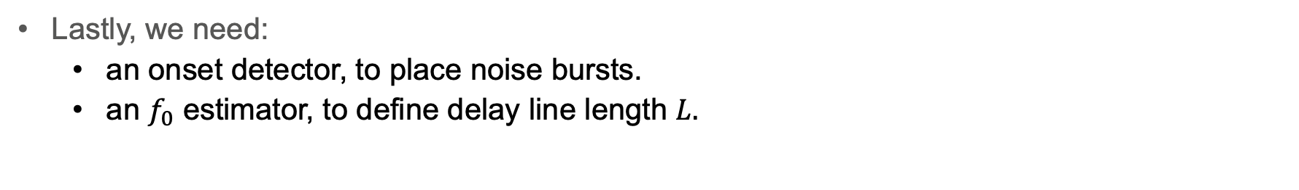
Differentiable Karplus-Strong – how?
Lastly, we need:
an onset detector, to place noise bursts.
an $f_{0}$ estimator, to define delay line length $L.$
McFee, B. et al. 2023. librosa/librosa: 0.10. 0. zenodo.

Slide 14
Differentiable Karplus-Strong – how?
Lastly, we need:
an onset detector, to place noise bursts.
an $f_{0}$ estimator, to define delay line length $L.$
McFee, B. et al. 2023. librosa/librosa: 0.10. 0. zenodo.

Slide 15
Differentiable Karplus-Strong – how?
* Only the coloured blocks are optimized.
Target (Nsynth)
Reconstructed
Engel, J. et al. 2017. Neural audio synthesis of musical notes with wavenet autoencoders. In ICML

Slide 16
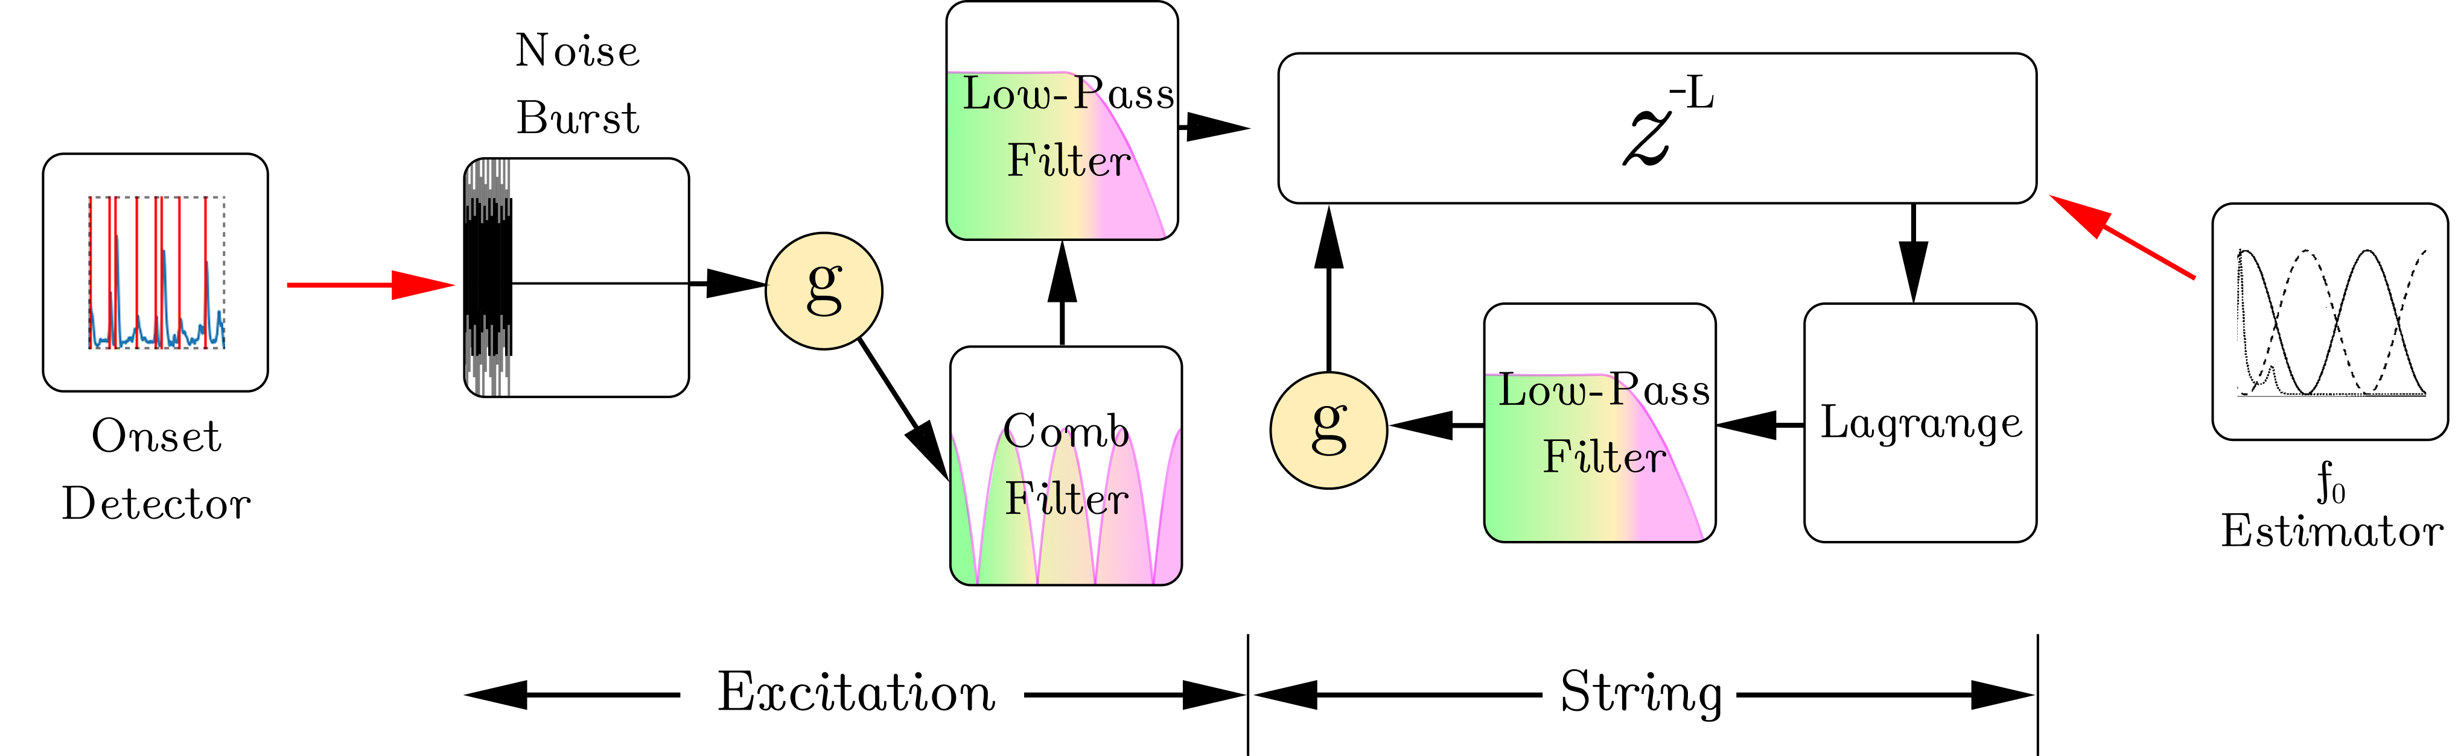
Differentiable Karplus-Strong – how?
* Only the coloured blocks are optimized.
Target (Nsynth)
Reconstructed
Engel, J. et al. 2017. Neural audio synthesis of musical notes with wavenet autoencoders. In ICML

Slide 17
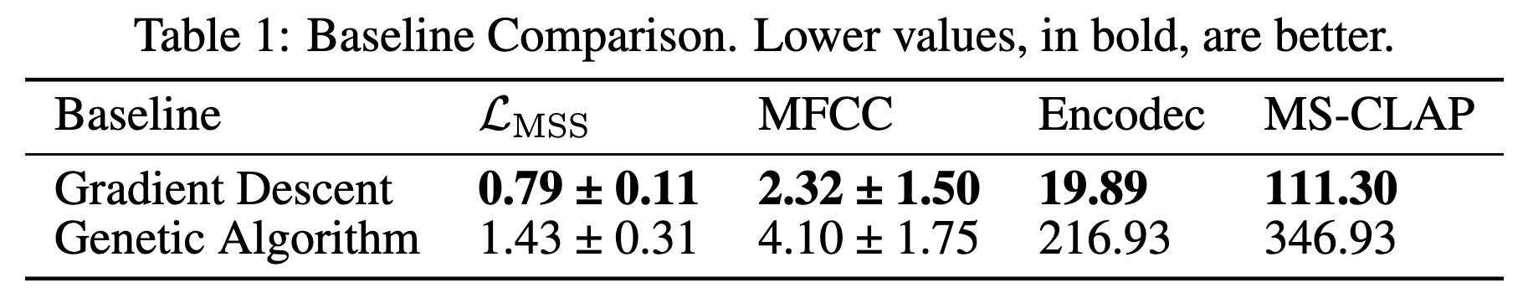
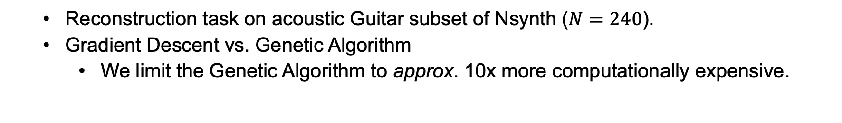
Experiment 1.
Reconstruction task on acoustic Guitar subset of Nsynth ($N=240$).
Gradient Descent vs. Genetic Algorithm
We limit the Genetic Algorithm to approx. 10x more computationally expensive.

Slide 18
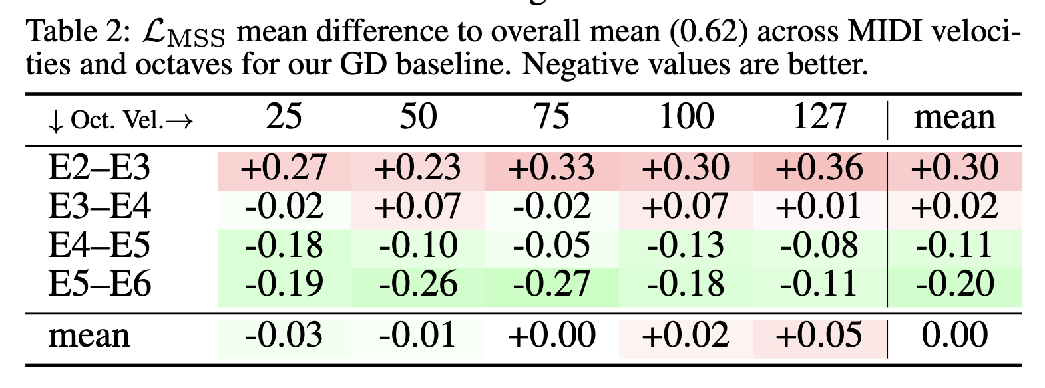
Experiment 2.
Karplus-Strong performs inconsistently across dynamics and pitches.
Worse at lower octaves
Worse at higher dynamics

Slide 19
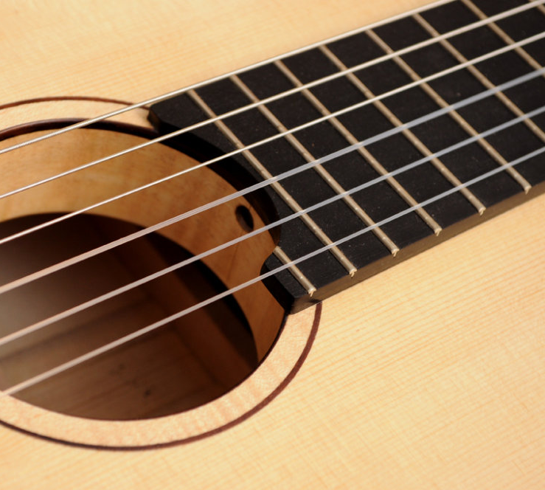
Discussion
In acoustic guitars:
Inharmonicities and non-linearities are more prominent in the low end and at higher dynamics
Helmholtz and plate modes (guitar body) peak at 100 and 200 Hz.
But our Karplus-Strong Algorithm does not model any of these.
V. Välimäki and and T. Tolonen, 1998. “Development and Calibration of a Guitar Synthesizer,” in JAES.
J. S. Abel et al., 2010 “Robust, efficient design of allpass filters for dispersive string sound synthesis,” in Signal Proc. Lett.

Slide 20
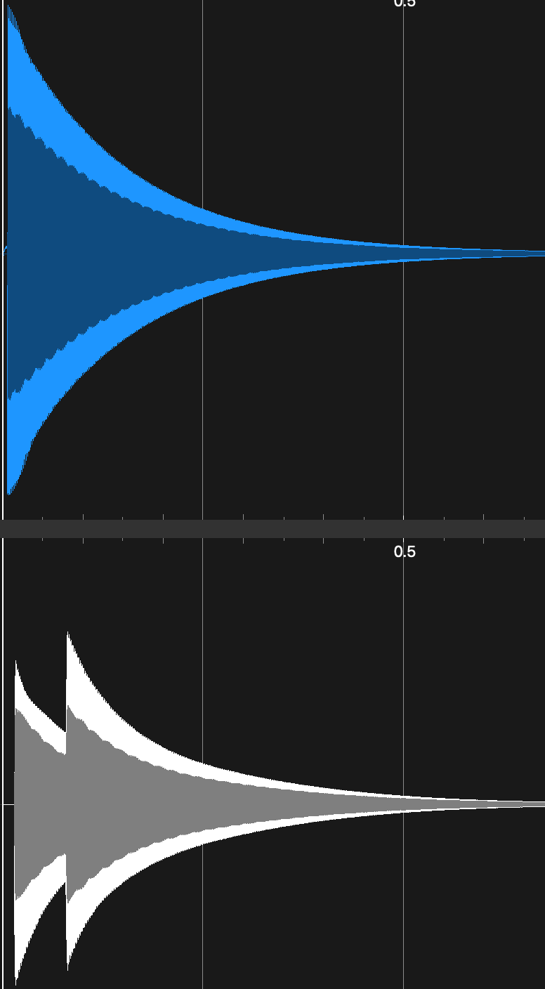
Discussion
We are also limited by our choice of:
onset detector;
It might double trigger,
or it might trigger late.

Slide 21
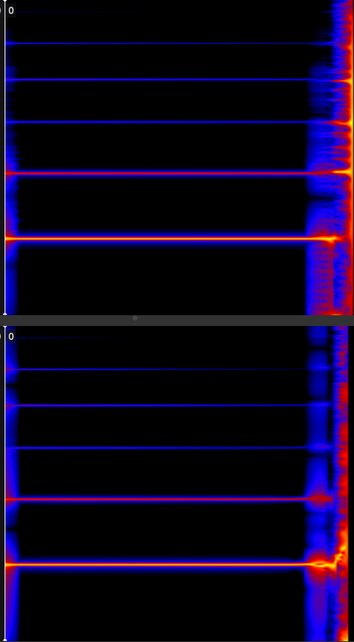
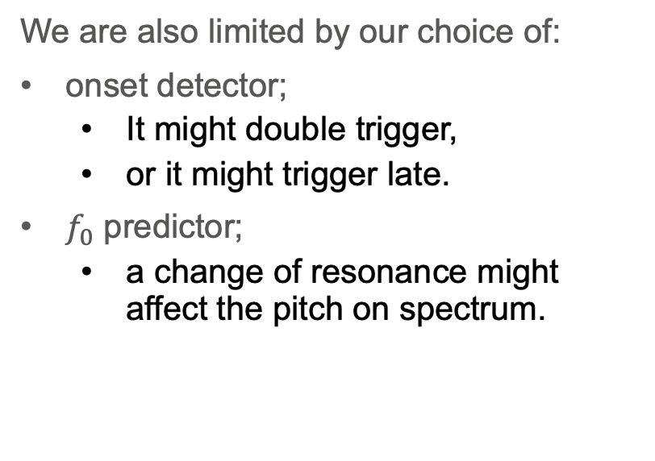
Discussion
We are also limited by our choice of:
onset detector;
It might double trigger,
or it might trigger late.
$f_{0}$ predictor;
a change of resonance might affect the pitch on spectrum.

Slide 22

Future Work
Should address two orthogonal sets of issues:
Reconstruction capacity of Karplus-Strong.
Embedding excitation and $f_{0}$ in the neural network.

Slide 23
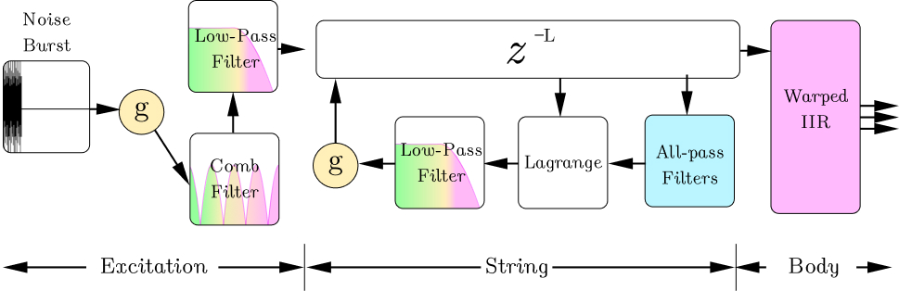
Future Work: Reconstruction Capacity
Parallel sections of warped IIRs have been proposed to model instrument bodies.
Allpass filters in the loop can efficiently model inharmonicity
B. Bank, 2007 “Direct design of parallel second-order filters for instrument body modeling,” in ICMC.
J. S. Abel et al., 2010 “Robust, efficient design of allpass filters for dispersive string sound synthesis,” in Signal Proc. Lett.

Slide 24
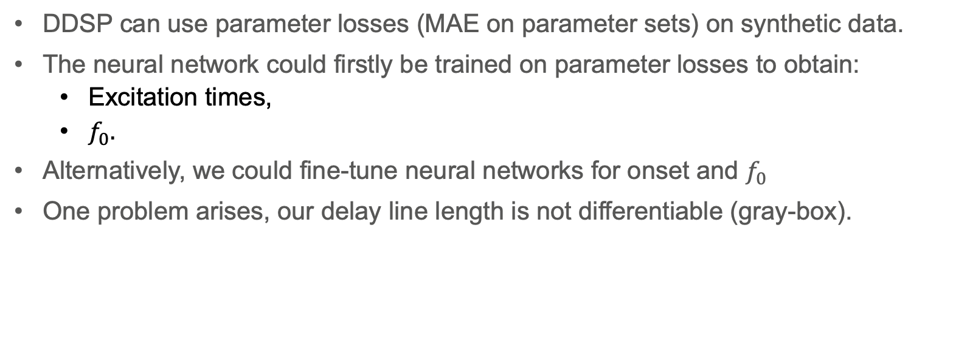

Future Work: Embedding excitation and $f_{0}$
DDSP can use parameter losses (MAE on parameter sets) on synthetic data.
The neural network could firstly be trained on parameter losses to obtain:
Excitation times,
$f_{0}.$
Alternatively, we could fine-tune neural networks for onset and $f_{0}$
One problem arises, our delay line length is not differentiable (gray-box).
Engel, J. et al., 2020. Self-supervised pitch detection by inverse audio synthesis. In ICML
Masuda, N. and Saito, D., 2023. Improving semi-supervised differentiable synthesizer sound matching. In TASLP
Han, H. Lostanlen, V., Lagrange, M., 2024 Learning to solve inverse problems for perceptual sound matching. In TASLP

Slide 25
Contributions
A time-domain time-variant differentiable implementation for an extended Karplus-Strong Algorithm.
We found that extensions are needed to consistently model the full dynamic and pitch range of the guitar.
We observed onset and fundamental frequency predictors can limit timbre-transfer tasks.

Slide 26
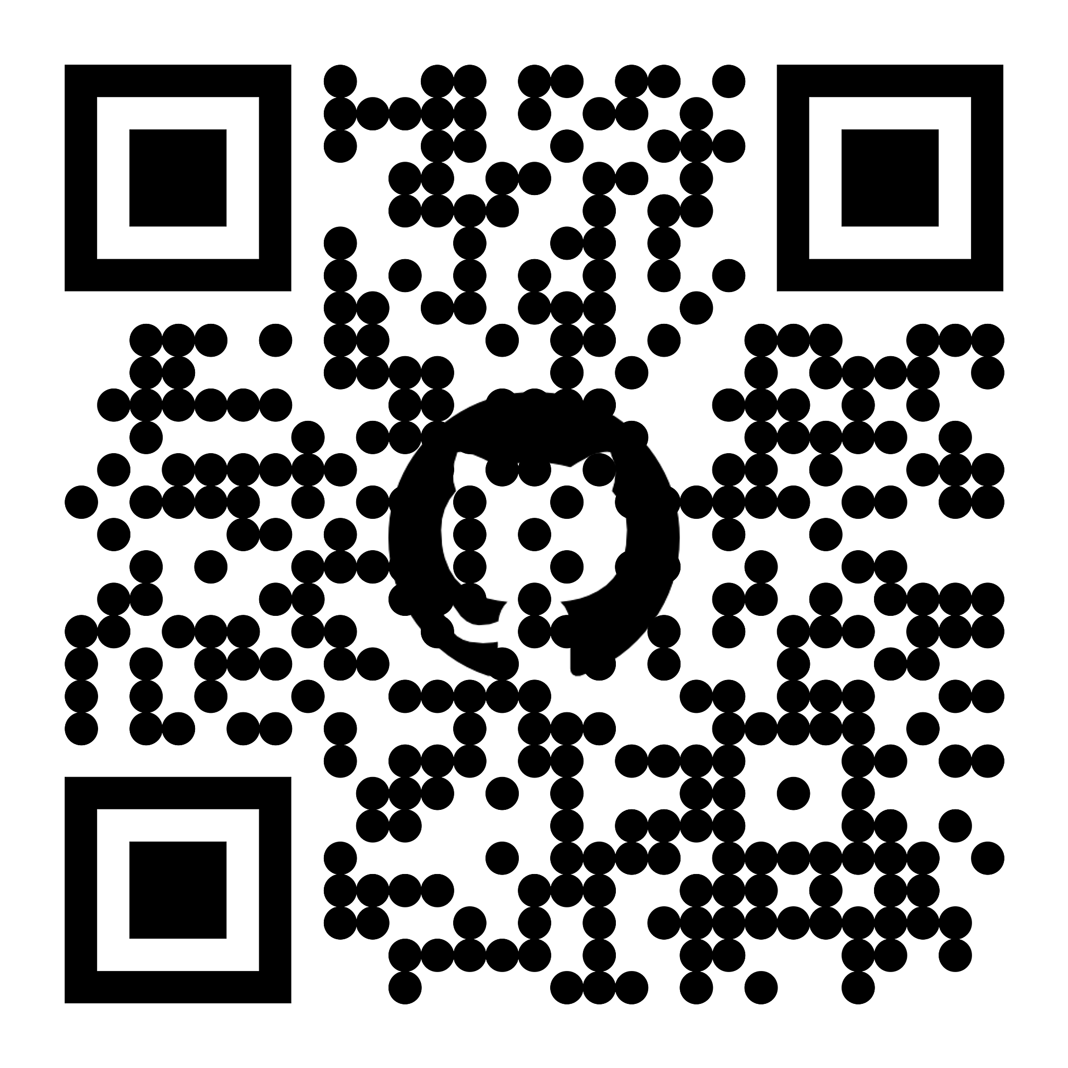

Questions?
QR Code
QR Code
Audio examples, presentation, paper, tutorials & code
Let’s connect on
Linkedin!

