Slide 1
Nutritional assessment
By Ian Macharia, Janter Lindsay Mwiba and Lawrence Shikuku

Slide 2
What is nutritional assessment?
Nutritional assessment is the interpretation of anthropometric, biochemical (laboratory), clinical and dietary data to determine whether a person or groups of persons are well nourished or malnourished (over-nourished or under-nourished).
Nutritional status is the condition of the body as a result of the intake, absorption and use of nutrition, as well as the influence of disease-related factors.

Slide 3
Importance of nutritional assessment
Optimal nutritional status- this is the state of the body with respect to each nutrient and overall body weight and condition. It is a powerful factor in promoting health and preventing and treating diseases.
Nutritional status affects immune response and response to medical therapies. Health providers assess clients’ nutritional status for many reasons:
To identify people at risk of malnutrition for early intervention or referral before they become malnourished
To identify malnourished clients for treatment
To monitor the patients’ nutritional status during hospitalization
To track child growth
To identify medical complications that affects the body’s ability to digest food and utilize nutrients
To identify practices that increase the risk of malnutrition and infection
To inform nutritional education and counselling
To establish appropriate nutrition care plans

Slide 4
The ABCD Methods
Nutritional assessment can be done using the ABCD methods. These include;
Anthropometric
Biochemical/ biophysical methods
Clinical methods
Dietary methods

Slide 5
Anthropometric
Anthropometry- Anthropo means ‘human’ and metry means ‘measurement’. Anthropometry therefore means the scientific study of the measurements and proportions of the human body.
Anthropometric measurements used to assess growth include; height, weight, length, skin-fold thickness, and head circumference.
These could detect the change of the body composition to assess the nutritional status in specific population groups, including newborn, children under the age of five and adults.
The advantage of using anthropometric measurements is that routine measurements can suggest patterns of growth and development of an individual.

Slide 6
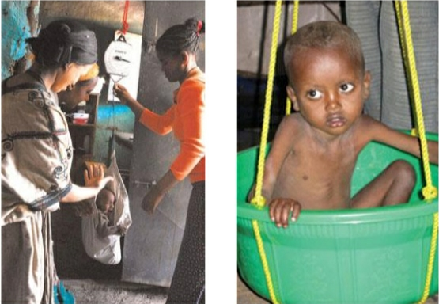
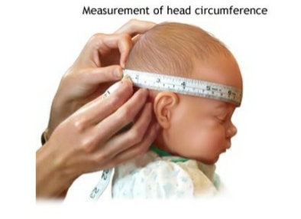
Anthropometry

Slide 7
Converting measurements to indices
An index is a combination of two measurements or one measurement plus the person’s age.
Weight for age is an index used in growth monitoring for assessing children who may be underweight. You assess weight-for-age of all children under two years old when you carry out your community-based nutrition (CBN) activities every month.
Weight for age = weight of child
Height-for-age is an index used for assessing stunting (chronic malnutrition in children). Stunted children have poor intellectual performance and lower work output leading to lower productivity at individual level and poor socioeconomic development at the community level.
Weight-for-height is an index used for assessing wasting (acute malnutrition). Wasted children are vulnerable to infection an stand a greater chance of dying.
x 100
Weight of the reference child of the same age

Slide 8
Body mass index: is the weight of a child or adult in kg divided by their height in meters squared:
Weight
BMI =
Height in M²
Here is how to calculate each index for children in your community.
Birth weight is weight of the child at birth and is classified as follows:
More than 2500 grams = normal birth weight
1500 – 2499 grams = low birth weight
Less than 1500 grams = Very low birth weight

Slide 9
Indicator
An Indicator is an index (for example, a scale showing the weight for age, or weight for height) combined with specific cut-off values that help you determine whether a child is underweight or malnourished
Index | Cut off value based on SD percentage | Indications
Weight-for-age | Less than 2 and more than 3 | Moderate underweight
Weight-for-age | Less than 3 | Severe underweight
Height-for-age | Less than 2 and more than 3 (i.e. 70-79.99% of the norm) | Moderate acute malnutrition
Height-for-age | Less than 3(i.e. 70% of the norm) and bilateral pitting oedema | Severe acute malnutrition

Slide 10
Anthropometric measurements used to asses body composition
In assessing body composition (fat content) the body is considered to be made up of two compartments:
The fat mass
The fat free mass
Therefore different measurements are used to assess these two compartments.
Measurement of fat mass (fatness)
As we discussed earlier Body Mass Index is the weight of a person in kilograms divided by their height in meters squared.
The table below shows us the different categories of nutritional status based on a person’s BMI
Risk of mortality and morbidity is related to the nutritional status as assessed by the BMI. If people are too fat or too thin their health suffers. The risk of mortality and morbidity increases with a decrease in BMI
Measuring fat-free mass
An accurate way to measure fat-free mass is to measure the Mid Upper Arm Circumference (MUAC).
The MUAC is the circumference of the upper arm at the midway between the shoulder tip and the elbow tip on the left arm.
The mid-arm point is determined by measuring the distance from the shoulder tip to the elbow and dividing it by two.
A low reading indicated a loss of muscle mass.
MUAC is a good screening tool in determining the risk of mortality among children, and people living with HIV/AIDS.
It is also used for screening target children and pregnant women for Severe Acute Malnutrition (SAM) and Moderate Acute Malnutrition (MAM).

Slide 11
Cut-off values for BMI for assessing adult nutritional status
BMI (Kg/m2) cut-offs | Nutritional status
More than 40.0 | Very obese
30.0-40.0 | Obese
25-29.9 | Overweight
18.5-24.9 | Normal
17-18.49 | Mild chronic energy deficiency
16-16.9 | Moderate chronic energy deficiency
Less than 16.0 | Severe chronic energy deficiency

Slide 12
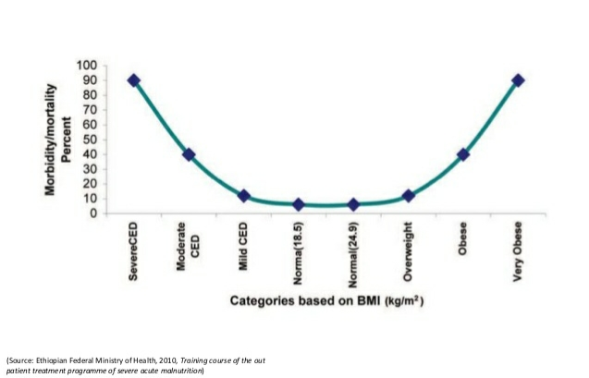
The relationship between BMI and risk of Morbidity and Mortality

Slide 13
Cut-off points for screening in the community for SAM and MAM using MUAC
Target Groups | MUAC (in cm) | Malnutrition
Children under Five | 11-11.9 | Moderate acute malnutrition
 | < 11cm | Severe acute malnutrition
Pregnant women/ Adults | 17-21cm | Moderate malnutrition
 | 18-21cm with recent weight loss | Moderate malnutrition
 | <17cm | Severe malnutrition
 | < 18cm with recent weight loss | Severe malnutrition

Slide 14
Biochemical assessment
Biochemical assessment means checking levels of nutrients in a person’s blood, urine or stools. Lab results can provide useful information to medical professionals about medical problems that may affect appetite or nutritional status.
The disadvantages of this assessment technique is that:
It is time consuming
It is expensive
Therefore, it cannot be used on a large scale

Slide 15
Clinical assessment
Clinical methods of assessing nutritional status include:
Checking signs of deficiency at specific places on the body
Asking the patient whether they have any symptoms that might suggest nutrient deficiency from the patient.
Clinical signs of nutrient deficiency include:
Pallor ( on the palm of the hand or the conjunctiva of the eye)
Bitot’s spots on the eye
Pitting oedema
Goiter and severe visible wasting

Slide 16
Pitting oedema
Pitting oedema is when a swollen part of your body has a dimple or pit after you press it for a few seconds.
It can be a sign of serious health issue such as blood clot, congestive heart failure. Kidney disease, liver disease and vein problems.
Oedema usually happens in your feet, ankles or legs. But you might also notice it in your face, hands, arms or other areas.
It is caused by extra fluid in your tissues. This can happen for many reasons, including:
Standing or sitting for too long
An allergic reaction
Side effect of medicine, such as drugs for diabetes, high blood pressure etc.
pregnancy
Pitting oedema can happen to anyone. But it’s more likely if you:
Are pregnant
Have other chronic illnesses like heart, kidney, or liver disease
Have a traumatic injury
Eat too much salt or processed food
Take certain medication
Are inactive, especially when it’s hot
Grades of oedema
An increase in grades indicates an increase in the severity of oedema
0 = no oedema
+ = below the ankle (pitting oedema)
++ = pitting oedema below the knee
+++ = generalized oedema

Slide 17
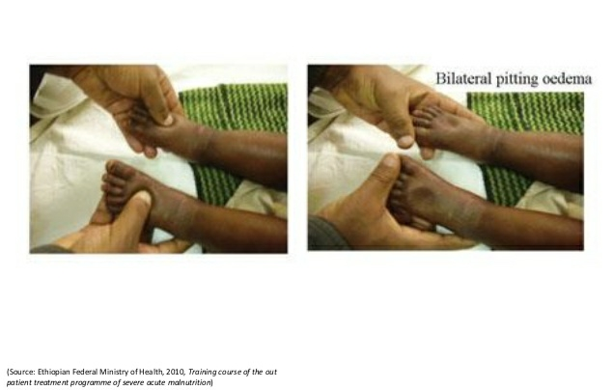
Checking for pitting oedema in a child
In order to determine the presence of oedema,
You should apply normal thumb pressure on feet for three seconds.
If a shallow print persists on both feet, then the child has nutritional oedema
You must test for oedema with a finger because you cannot tell by just looking.

Slide 18
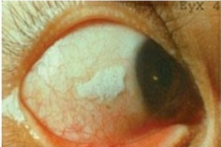
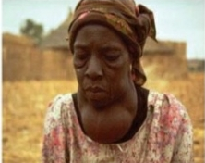
Other clinical symptoms
Bitot’s spots
These are a specific manifestation of vitamin A deficiency
They are the buildup of keratin located superficially in the conjunctiva of human’s eyes.
Look at the figure; as you can see, these spots are a creamy color and appear on the white of the eye.
Goiter
This is a swelling on the neck and is the only visible sign of iodine deficiency.

Slide 19
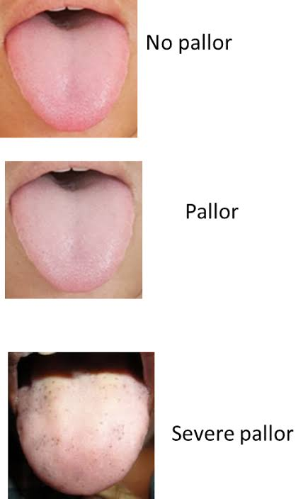
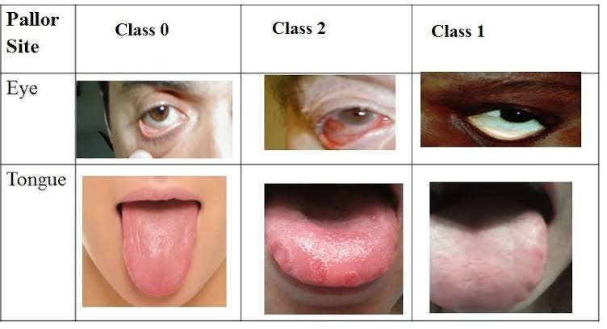
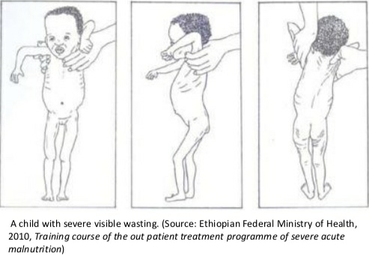
Other clinical symptoms
Pallor
This is an unhealthy pale appearance.
Pale skin can be caused by lack of sun exposure, exposure to cold temperatures or extreme fright.
Pallor can often be diagnosed by sight, but is can be harder to detect in dark complexions. Your doctor may therefore check your inner eyelids and mucous membranes for a loss of color.
Visible severe wasting
In order to determine the presence of visible severe wasting for children younger than six months, you will need to ask the mother to remove all the child’s clothing so you can look at the arms, thighs and buttocks for loss of muscle bulk.
Sagging skin and buttocks indicates visible severe wasting.

Slide 20
Dietary methods
Assessing food and fluid intake is an essential part of nutritional assessment.
It provides information on dietary quality and quantity, changes in appetite, food allergies and intolerance, and reason for inadequate food intake during or after an illness.
The results are compared with recommended intake such as recommended dietary allowance (RDA)⁷ to counsel in how to improve their diets to prevent malnutrition or to treat conditions affected by food intake and nutritional status (e.g. cancer, obesity, cardiovascular disease and hyperlipidemia)
Dietary assessment include looking at past or current intake of nutrients from the body by individuals or a group to determine their nutritional status.
You can ask what the family or the mother and the child have eaten over the past 24 hrs. and use this data to calculate the dietary diversity score
Diversity score is an indicator of both the balance of nutrient consumption and the level of food security (or insecurity) in the household.
The higher the dietary diversity score in a family, the more diversified and balanced the diet is and the more food-secure the household

Slide 21
Dietary diversity is a measure of the number of food groups consumed over a reference period, usually 24 hours. Generally, there are six food groups that our bodies need to have everyday. These can be represented in the food guide pyramid.
Fish, oils & sweets
Milk, yoghurt, cheese
Meat, poultry, fish, dry beans, eggs & nut group
vegetables
Fruits
Bread, cereal, rice and pasta.

Slide 22
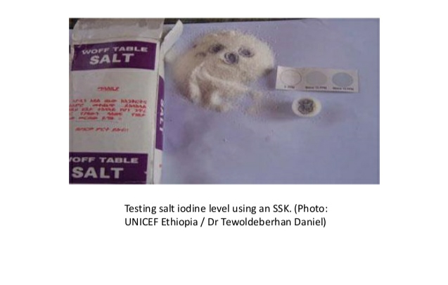
Dietary methods
As part of the dietary assessment you should also check the salt iodine level of households using the single solution kit (SSK)
This enables you to determine whether the salt iodine level is 0, more than 15 parts per million (PPM) or less than 15 PPM
Normally, an iodized salt should have iodine level of more than 15 PPM to be effective in preventing iodine deficiency and its consequences.

Slide 23
Self- Assessment Questions (SAQs)
What is nutritional assessment used for? Name the different ways un which it can be carried out.
What is the difference between an anthropometric index and an indicator?
Describe some of the different methods you could use to determine whether a child is suffering from severe acute malnutrition
What are the anthropometric indicators of moderate acute malnutrition in: 1. children 2. pregnant women
What things can be measured to make a nutritional assessment

Slide 24
The End

