Slide 1

APPLIED DATA SCIENCE CAPSTONE
Predicting Falcon 9 First-Stage
Landing Success
A data science analysis of SpaceX launch outcomes — from data collection through predictive modeling
Abdou A. Diakite
IBM Data Science Professional Certificate
August 11, 2026
Github: https://github.com/ptah222/IBM-Data-Science-Capstone-Project.git

Slide 2

OVERVIEW
Executive Summary
This project aims to predict whether the Falcon 9 first stage will land successfully so that a competing company can make more informed launch bids.
Methods used: data collection (API + web scraping), data wrangling, exploratory data analysis, interactive visual analytics and predictive classification modeling.
After comparing multiple models, we find that the Falcon 9 booster has a high probability of successful landing (87.7% based on decision tree classifier). Success is highly correlated with launch site, orbits, boosters and payload mass.
Success rate has reached 90% in recent years, thanks to new generation of boosters.
87.7%
Best model accuracy
Decision Tree classifier
90
Launch records analyzed
Falcon 9 launches (2010–2020)
66.7%
Overall landing success rate
60 of 90 landings succeeded
EXECUTIVE SUMMARY
2

Slide 3
BACKGROUND
Introduction
Project Background
SpaceX advertises Falcon 9 launches at ~$62M, far below competitors' ~$165M+, largely because SpaceX reuses the first stage instead of discarding it.
Reuse is only possible when the first stage successfully lands, so landing success directly determines launch cost.
A competing company bidding against SpaceX would benefit from estimating this cost — which requires predicting landing success.
Problem Statement
Can we predict whether the Falcon 9 first stage will land successfully, using publicly available launch data — payload mass, orbit type, launch site, booster version, and more?
Key Questions Explored
Which variables most influence landing outcome?
How has success rate changed over time?
Which classification model predicts outcome best?
INTRODUCTION
3

Slide 4

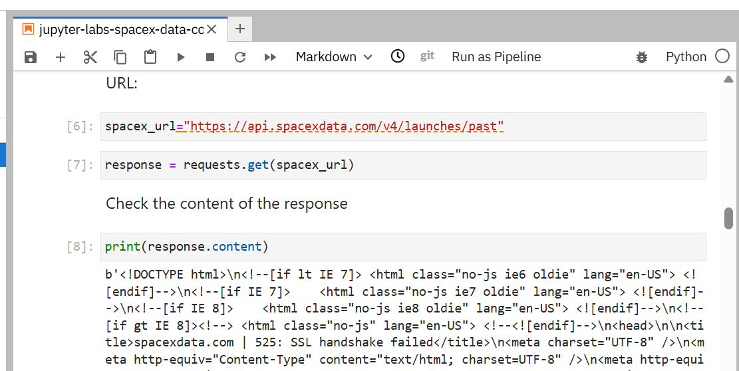

DATA COLLECTION
SpaceX REST API
1
2
3
4
5
GET request to api.spacexdata.com/v4/launches/past
Parse JSON response into a pandas DataFrame
Use rocket, payload, launchpad, core IDs to make follow-up GET requests for details
Merge nested results into flat columns per launch
Filter to Falcon 9 launches only (drop Falcon 1)
Key Steps
requests.get(url).json() against the SpaceX v4 API
IDs returned per launch (rocket, payloads, launchpad, cores) require separate GET calls to resolve into readable fields
Custom functions (e.g. getBoosterVersion(), getLaunchSite()) map IDs → names and append to lists
Combine into a single DataFrame; export to spacex_api.csv
Notebook / Code: github.com/ptah222/IBM-Data-Science-Capstone-Project
DATA COLLECTION — API
4

Slide 5

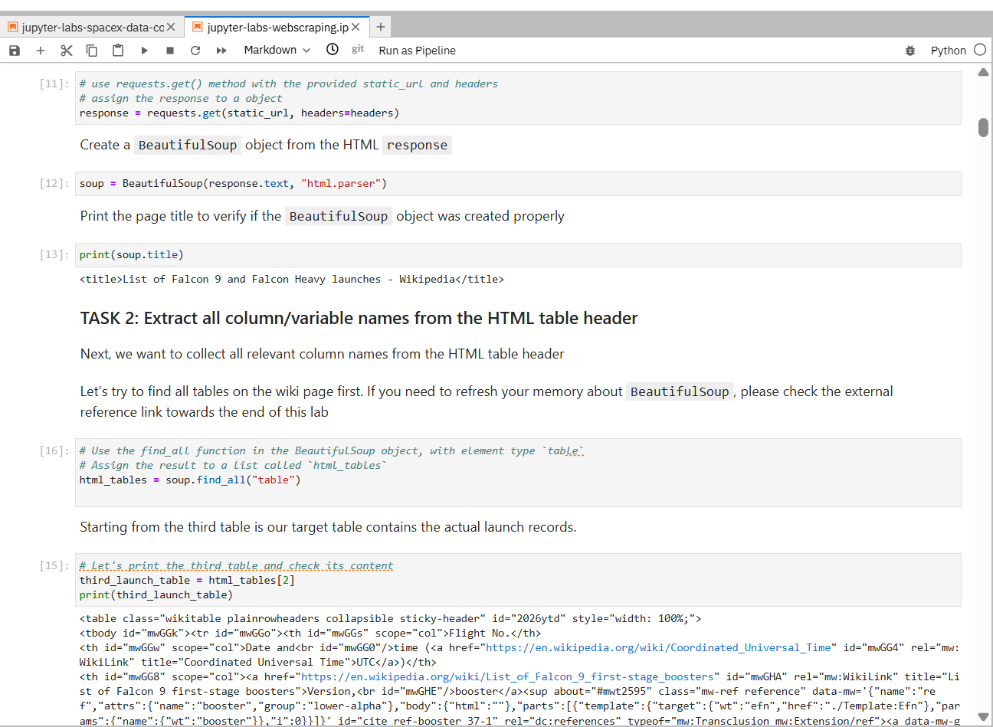
DATA COLLECTION
Web Scraping (Wikipedia)
1
2
3
4
5
GET the Wikipedia “List of Falcon 9 and Falcon Heavy launches” page
Parse HTML with BeautifulSoup
Locate the launch-record HTML table
Extract each column (date, booster, site, payload, outcome)
Assemble rows into a DataFrame
Key Steps
requests.get() the Wikipedia revision URL, then BeautifulSoup(html, 'html.parser')
soup.find_all('table', 'wikitable plainrowheaders collapsible') to locate the launch table
Custom parsing functions per column (date/time, booster version, payload mass, orbit, outcome)
Append parsed cells into a dict of lists → pd.DataFrame; export to spacex_web_scraped.csv
Notebook / Code: github.com/ptah222/IBM-Data-Science-Capstone-Project
DATA COLLECTION — WEB SCRAPING
5

Slide 6

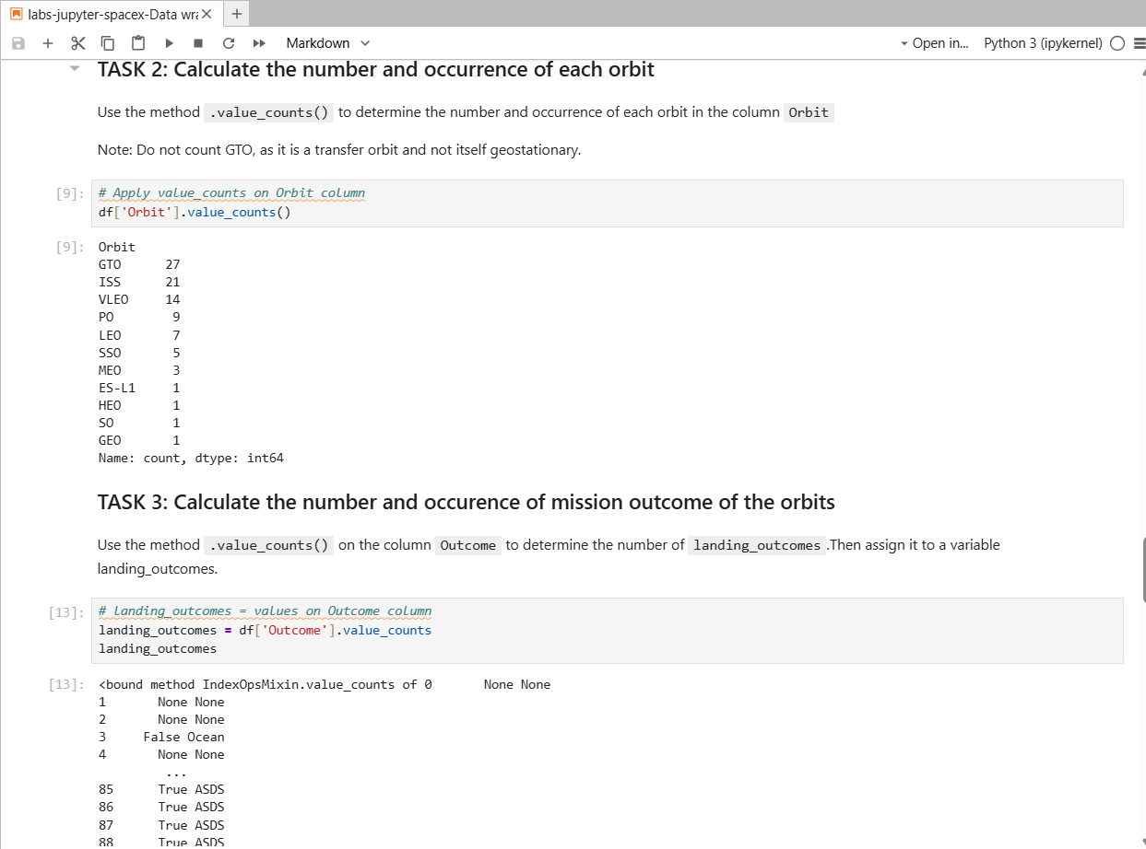
PREPARATION
Data Wrangling Methodology
1
2
3
4
5
Combine API + scraped datasets; resolve column mismatches
Handle missing values (e.g. impute mean payload mass)
Standardize categorical labels (site, orbit, outcome text)
Engineer the binary Class label (1 = success, 0 = failure) from landing outcome text
Export the clean, model-ready dataset
What Counts as a “Successful Landing”
Outcome strings like 'True ASDS', 'True RTLS', 'True Ocean' → Class = 1
'False ASDS', 'False RTLS', 'None None' → Class = 0
This binary label becomes the target variable for the classification models
Notebook / Code: github.com/ptah222/IBM-Data-Science-Capstone-Project
DATA WRANGLING
6

Slide 7

EXPLORATORY ANALYSIS
EDA with Data Visualization
Charts Used & Purpose
Scatter — Flight Number vs. Launch Site
Reveal whether success improved over successive flights, per site
Scatter — Payload Mass vs. Launch Site
Check whether heavier payloads cluster at certain sites or fail more
Bar — Success Rate by Orbit Type
Compare landing reliability across orbit classes (LEO, GTO, ISS, …)
Scatter — Flight Number / Payload vs. Orbit Type
Look for interaction effects between orbit, payload, and experience
Line — Yearly Launch Success Trend
Show how success rate evolved as SpaceX iterated on booster design
Each chart tests one hypothesis about landing success — experience, mass, orbit energy, or time — and every one of them fed a feature into the final classifier.
Notebook / Code: github.com/ptah222/IBM-Data-Science-Capstone-Project
EDA — VISUALIZATION
7

Slide 8

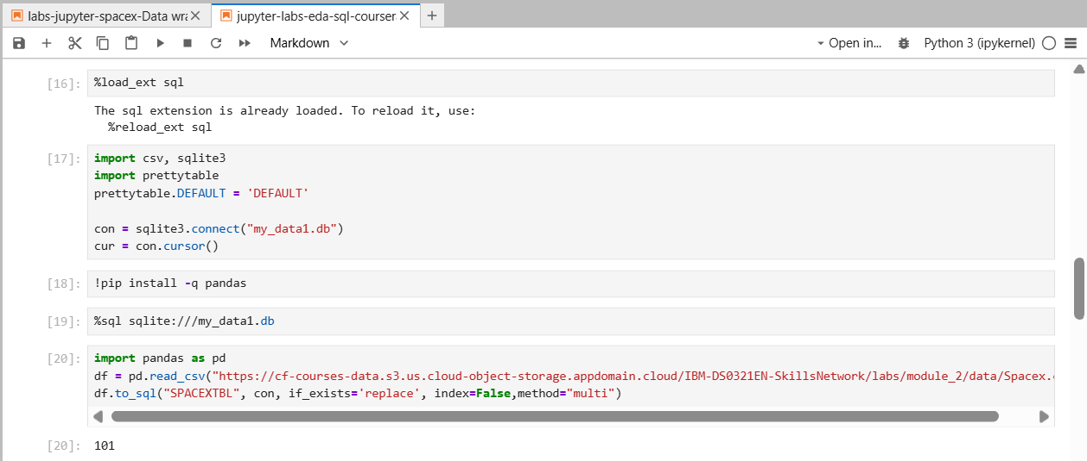
EXPLORATORY ANALYSIS
EDA with SQL
Loaded the wrangled dataset into a SQLite / Db2 table via %sql / ibm_db
Queries covered: distinct launch sites, payload totals by customer, average payload by booster, first successful landing date, boosters meeting payload + outcome criteria, mission-outcome counts, max-payload boosters, month-level 2015 records, and a ranked landing-outcome count (2010–2020)
Each query answers one specific analytical question used later in the results section
Query Categories Covered
Launch Sites
Payloads
Success Rates
Rankings
Time Analysis
Notebook / Code: github.com/ptah222/IBM-Data-Science-Capstone-Project
EDA — SQL
8

Slide 9


EXPLORATORY ANALYSIS
Interactive Visual Analytics
Folium Map
Plotly Dash App
Marker for every launch site, colored by success/failure ratio
Circle markers for each individual launch record, clustered by site
Distance lines from a launch site to nearby coastline, highway, and city, to explore siting rationale
Dropdown to filter by launch site
Pie chart of success-rate share across sites (or per-site success vs. failure)
Range slider + scatter chart of payload mass vs. success, colored by booster version
Why it matters
The map makes the siting logic visible: every pad is coastal, so a failed first stage falls over open water rather than populated land.
Why it matters
The dashboard lets a non-technical bidder test payload and site combinations directly, without rerunning any of the notebooks.
Notebook / App Code: github.com/ptah222/IBM-Data-Science-Capstone-Project
INTERACTIVE VISUAL ANALYTICS
9

Slide 10
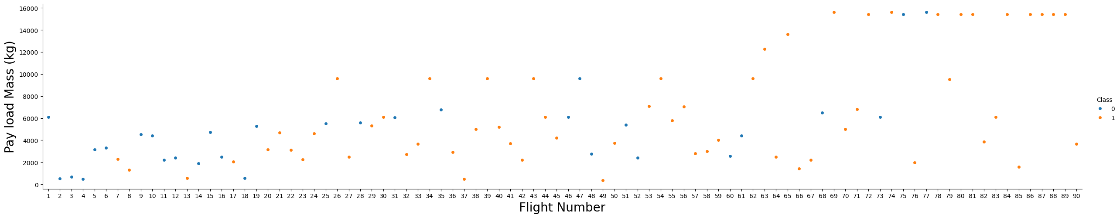
EDA RESULTS
Flight Number & Payload vs. Launch Outcome
Each point is one Falcon 9 launch; orange = successful landing (Class 1), blue = failure (Class 0)
Flight Number vs. Payload Mass, colored by outcome (Class)
EDA Notebook: github.com/ptah222/IBM-Data-Science-Capstone-Project
EDA RESULTS
10

Slide 11
EDA RESULTS
Success Rate by Orbit Type
ES-L1, GEO, HEO and SSO orbits show a 100% landing success rate; GTO is lowest at 51.9%, reflecting its higher energy requirements.
EDA RESULTS
11

Slide 12
EDA RESULTS
Yearly Launch Success Trend
Success rate climbed from 0% before 2014 to 90% in 2019 as SpaceX iterated on Block 5 boosters and landing technique.
EDA RESULTS
12

Slide 13
EDA RESULTS — SQL
Launch Sites & Payload Totals
Query | Sample Result
Distinct launch site names | CCAFS SLC 40, KSC LC 39A, VAFB SLC 4E
Average payload mass by launch site (KSC LC 39A) | 7,606.5 kg
What these queries establish
Only three pads appear across all 90 launches — CCAFS SLC 40, KSC LC 39A and VAFB SLC 4E — so launch site is a low-cardinality categorical feature and one-hot encodes cleanly for the classifier.
KSC LC 39A averages 7,606.5 kg per launch, the heaviest of the three sites, because it handles the high-energy GTO and heavy-lift missions.
That pairing matters later: site and payload mass are correlated, so their apparent effects on landing success cannot be read independently of each other.
Computed directly from the 90-launch wrangled dataset (dataset_part_2.csv).
EDA RESULTS — SQL
13

Slide 14
EDA RESULTS — SQL
Success Rates & Rankings
Query | Sample Result
First successful ground-pad landing date | 2015-12-22 (booster B1019)
Boosters: success (drone ship, ASDS) & payload 4,000–6,000 kg | B1021, B1022, B1026, B1031, B1046, B1059
Total successful vs. failed mission outcomes | Success: 60 | Failure: 30
Boosters carrying the maximum payload mass | B1048, B1051 (15,600 kg each)
Computed directly from the 90-launch wrangled dataset (dataset_part_2.csv).
EDA RESULTS — SQL
14

Slide 15
EDA RESULTS — SQL
Time Analysis
Query | Sample Result
Month names for 2015 records with landing failure | January, April, June
Rank landing outcome counts across all 90 launches (2010–2020) | 1) True ASDS — 41 2) No attempt — 19 3) True RTLS — 14 4) False ASDS — 6
What the time analysis shows
The three 2015 failures cluster in the first half of the year (January, April, June), the period when drone-ship recovery was still being proven.
True ASDS is the single most common outcome at 41 of 90 launches, confirming drone-ship recovery — not ground-pad return — as the dominant landing mode.
The 19 no-attempt records are early or high-energy missions with no recovery planned; they are labelled Class 0 and are part of why the pre-2014 success rate is 0%.
Computed directly from the 90-launch wrangled dataset (dataset_part_2.csv).
EDA RESULTS — SQL
15

Slide 16
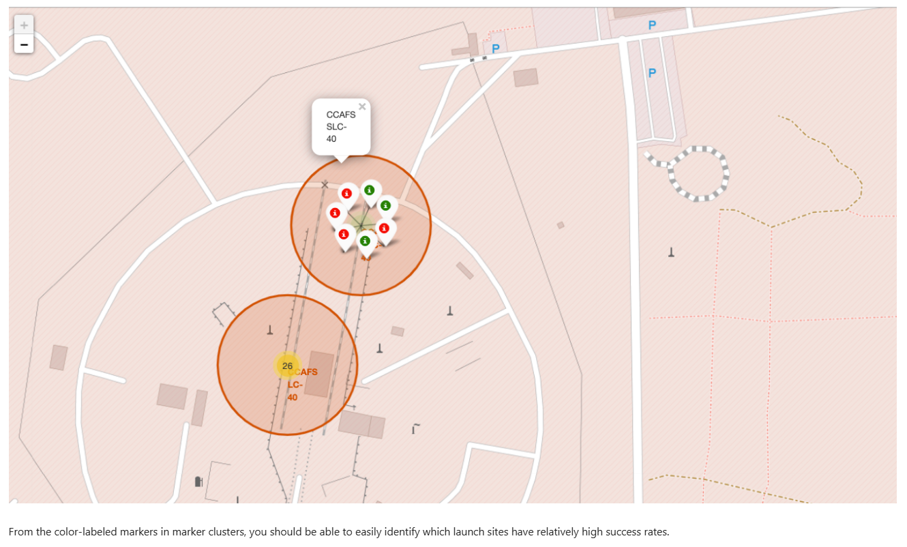
INTERACTIVE VISUAL ANALYTICS
Folium Map — Launch Site Markers
Site markers — folium.Circle + folium.Marker
nasa_coordinate = [29.5597, -95.0831]
site_map = folium.Map(
location=nasa_coordinate, zoom_start=5)
for _, row in launch_sites.iterrows():
coord = [row['Latitude'], row['Longitude']]
folium.Circle(
coord, radius=1000, color='#000000',
fill=True
).add_child(
folium.Popup(row['LaunchSite'])
).add_to(site_map)
folium.Marker(
coord, popup=row['LaunchSite']
).add_to(site_map)
Folium Notebook: github.com/ptah222/IBM-Data-Science-Capstone-Project
INTERACTIVE VISUAL ANALYTICS — FOLIUM
16

Slide 17
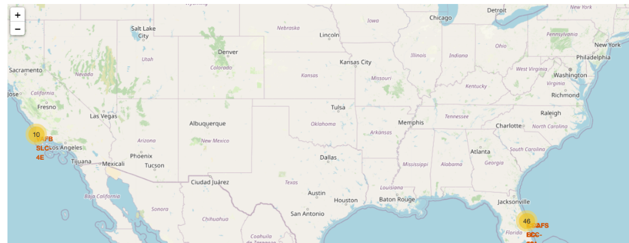
INTERACTIVE VISUAL ANALYTICS
Folium Map — Launch Records & Proximities
Marker clusters & proximity analysis
Every launch record is added to a MarkerCluster, with marker_color set from the Class label — green for a successful landing, red for a failure.
Clusters expand on zoom, so overlapping launches at CCAFS SLC-40, KSC LC-39A and VAFB SLC-4E stay readable.
folium.PolyLine plus a Haversine distance calculation measure each site to its nearest coastline, railway, highway and city.
What the map shows
All three sites sit within roughly 1 km of the coast — failed stages fall over water — while cities are kept much further away.
CCAFS SLC-40 and KSC LC-39A carry the bulk of launches and show visibly denser green clusters than VAFB SLC-4E.
All 90 launch records, color-coded by outcome and clustered by site
Folium Notebook: github.com/ptah222/IBM-Data-Science-Capstone-Project
INTERACTIVE VISUAL ANALYTICS — FOLIUM
17

Slide 18
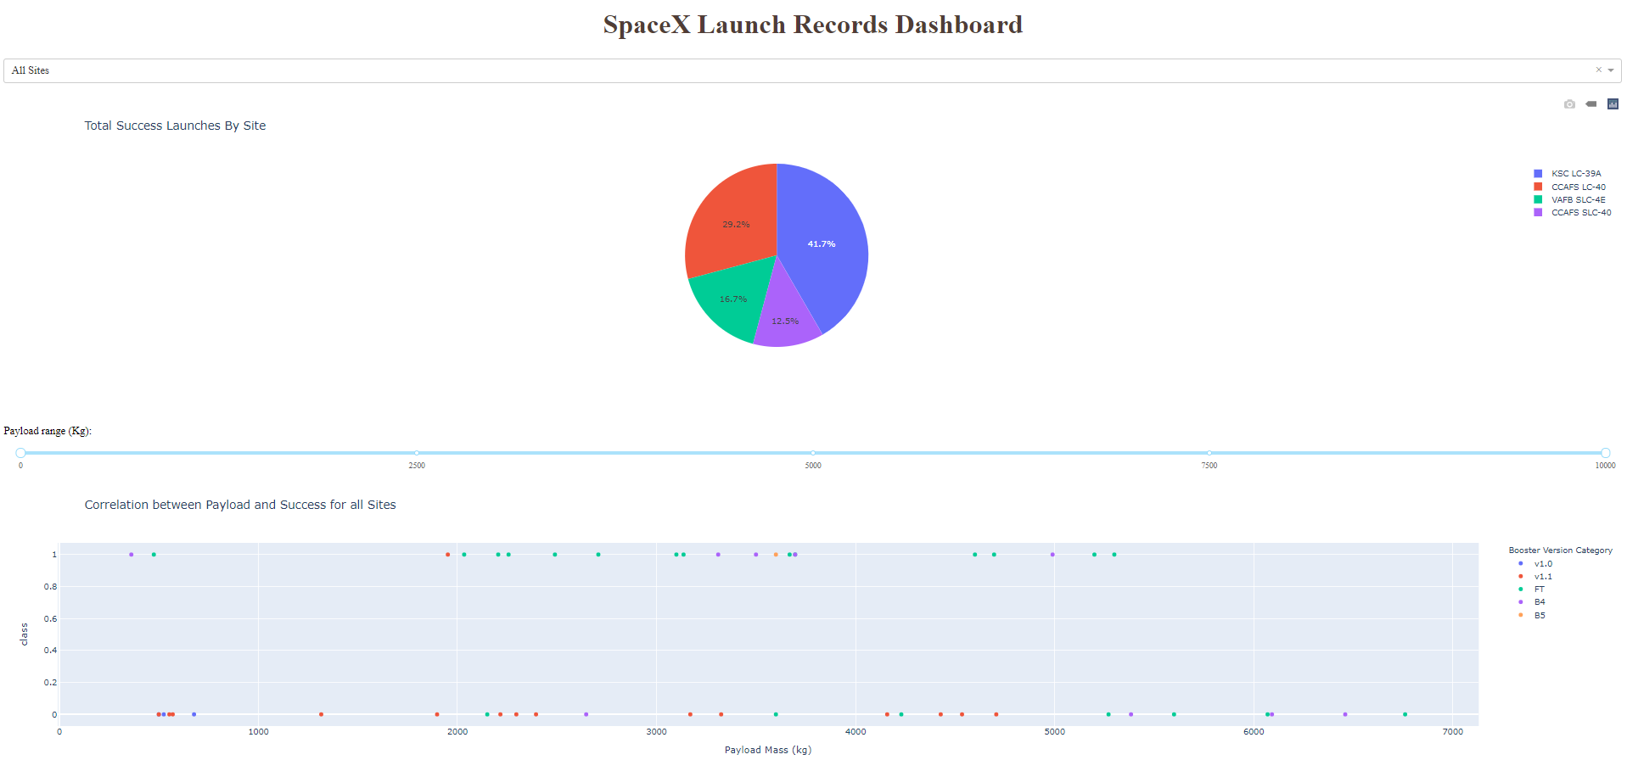
INTERACTIVE VISUAL ANALYTICS
Plotly Dash — Interactive Dashboard
Dash App Code: github.com/ptah222/IBM-Data-Science-Capstone-Project
INTERACTIVE VISUAL ANALYTICS — DASH
18

Slide 19

PREDICTIVE MODELING
Predictive Analysis Methodology
1
2
3
4
5
Standardize numeric features (StandardScaler)
Train/test split of the labeled dataset
Grid-search hyperparameters with cross-validation, per model
Fit Logistic Regression, SVM, Decision Tree, and KNN classifiers
Compare test-set accuracy; select the best model
Target variable: Class (1 = successful landing, 0 = failure), engineered during data wrangling
Features: flight number, payload mass, orbit type, launch site, booster version/grid fins/legs, and reused-booster flag
Each model tuned via GridSearchCV; best estimator per model type evaluated on the held-out test set
Modeling Notebook: github.com/ptah222/IBM-Data-Science-Capstone-Project
PREDICTIVE ANALYSIS
19

Slide 20
PREDICTIVE MODELING
Model Comparison & Best-Model Results
Best Model: Decision Tree — 87.7% Accuracy
Best params: gini, depth=8, min_leaf=2, min_split=10, best splitter
Tuned with GridSearchCV over a 5-fold cross-validation split.
All four models exceed 84%, so the signal is in the features, not the algorithm.
Confusion matrix: the model finds nearly every successful landing; its errors are false positives — failures predicted as successes.
Decision Tree scored best in cross-validation (87.7%), ahead of SVM/KNN (84.8%) and Logistic Regression (84.6%), and was selected as the final model.
PREDICTIVE ANALYSIS RESULTS
20

Slide 21

Conclusion
The Decision Tree Classifier was the best performing model, at 87.7% cross-validated accuracy — ahead of SVM and KNN (84.8%) and Logistic Regression (84.6%).
The strongest predictors of a successful landing are flight number (accumulated experience), orbit type, launch site and payload mass.
Landing success is strongly time-dependent: 0% before 2014, rising to 90% by 2019 as SpaceX iterated toward the Block 5 booster.
Orbit type matters sharply — ES-L1, GEO, HEO and SSO reached 100% success, while high-energy GTO missions managed only 51.9%.
KSC LC-39A had the highest per-site success rate; heavier payloads above ~7,000 kg showed noticeably fewer successful landings.
A competitor can therefore estimate whether SpaceX will recover a first stage — and so whether a bid is priced against a ~$62M reusable launch or a full-cost expendable one.
CONCLUSION
21

Slide 22
APPENDIX
GitHub Repository Links
Data Collection — API notebook: https://github.com/ptah222/IBM-Data-Science-Capstone-Project/blob/0584d6d27082113542dc9254eb112fbda10bb4f8/part%201%20jupyter-labs-spacex-data-collection-api.ipynb
Data Collection — Web Scraping notebook: https://github.com/ptah222/IBM-Data-Science-Capstone-Project/blob/bb0d5b67337cbdf7ec640d6aaa9d6e046e613737/part%201%20jupyter-labs-webscraping.ipynb
Data Wrangling notebook: https://github.com/ptah222/IBM-Data-Science-Capstone-Project/blob/03cf6dd686448d61155a02de20f39b63c7e72e58/labs-jupyter-spacex-Data%20wrangling.ipynb
EDA — Data Visualization notebook: https://github.com/ptah222/IBM-Data-Science-Capstone-Project/blob/f95268ea8e1c61bacbb2be381b085205bc301cb0/edadataviz.ipynb
EDA — SQL notebook: https://github.com/ptah222/IBM-Data-Science-Capstone-Project/blob/f95268ea8e1c61bacbb2be381b085205bc301cb0/part%202%20jupyter-labs-eda-sql-coursera_sqllite.ipynb
Interactive Visual Analytics — Folium notebook: https://github.com/ptah222/IBM-Data-Science-Capstone-Project/blob/c4cfb8f28e87c02f9103472e11f476a3fd3c9572/lab_jupyter_launch_site_location_folium.ipynb
Interactive Visual Analytics — Plotly Dash app: https://github.com/ptah222/IBM-Data-Science-Capstone-Project/blob/0a065d79f08a9dac8a9bd57f4a0756986d7ecb52/spacex-dash-app.py
Predictive Analysis — Modeling notebook: https://github.com/ptah222/IBM-Data-Science-Capstone-Project/blob/2f4e7255690fa8ce7c7aa9f9847a3803ac14a9fd/SpaceX_Machine%20Learning%20Prediction_Part_5.ipynb
APPENDIX
22

