Slide 1
NBA Game Simulation
Author: Philip Tanofsky
Course: DATA 604, CUNY Summer 2020
Date: July 16, 2020

Slide 2
Problem and Significance
Problem: Model an NBA game based on available team statistics to evaluate probable winner of a game or playoff series.
Model a team’s possession as a discrete event
Simulate game by repeating possession model to match team’s pace
Simulate a matchup between teams by simulating the game model for each
Simulate a playoff series between two teams by simulating the matchup
Significance: Ability to predict the winner of an NBA game or playoff series.
Coach or general manager could identify specific statistics to improve in order to maximize overall team performance
Influence player personnel decisions and playing time for some players
Notes:
I just thought it was a cool model simulation to try; as for significance, given the inputs, this sort of model would allow a team to identify statistics for focus for improvement. For example, following the Houston Rockets strategy, I given team could see if average game scores if the percentage of 3P shots were to increase at the expense of 2P FG attempts. Sure, a team with high turnovers or low offensive rebounds could identify those as areas of improvement. This model would allow a team to run the model with different variable values to see if the change were meaningful. And if so, then how to change strategy or player personnel to achieve those goals.
Does not take into account game location
Does not take into account individual player statistics

Slide 3
Statistics Per Team: System definition
Turnover percent per play (TO%)
Field Goal Attempt percent per play (FGA%)
Offensive Rebound percent per play (OReb%)
2-Point Field Goal percent of team’s Field Goal attempts (2FGA%)
2-Point FG shooting percent (2PFG%)
3-Point FG shooting percent (3PFG%)
Free Throw Shooting Percent (FT%)
Shooting Foul Drawn Percent per play (SFD%)
Pace (Average possessions per game)
Offensive Rating
Defensive Rating
Data sources: https://stats.nba.com/teams/advanced/ https://www.basketball-reference.com/leagues/NBA_2020.html

Slide 4
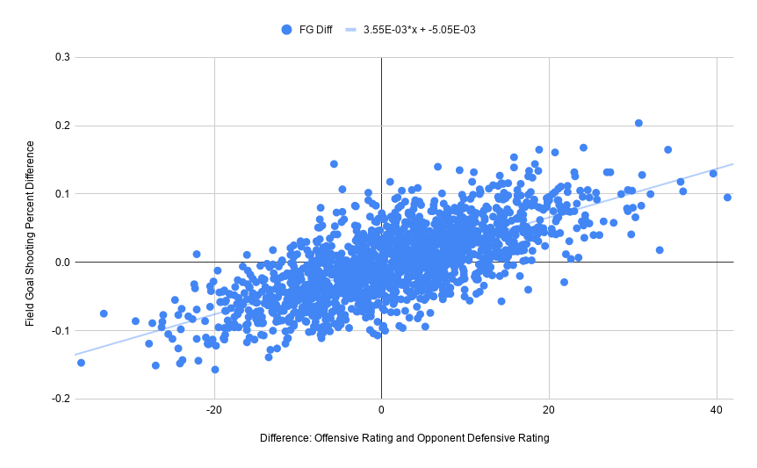
Matchup Calculations
Possession calculation relies on team’s system variables
To address matchup, calculated linear regression equation in order to adjust below statistics based on difference in offensive rating and opponent’s defensive rating
2-point FG percentage
3-point FG percentage
Turnover percentage

Slide 5
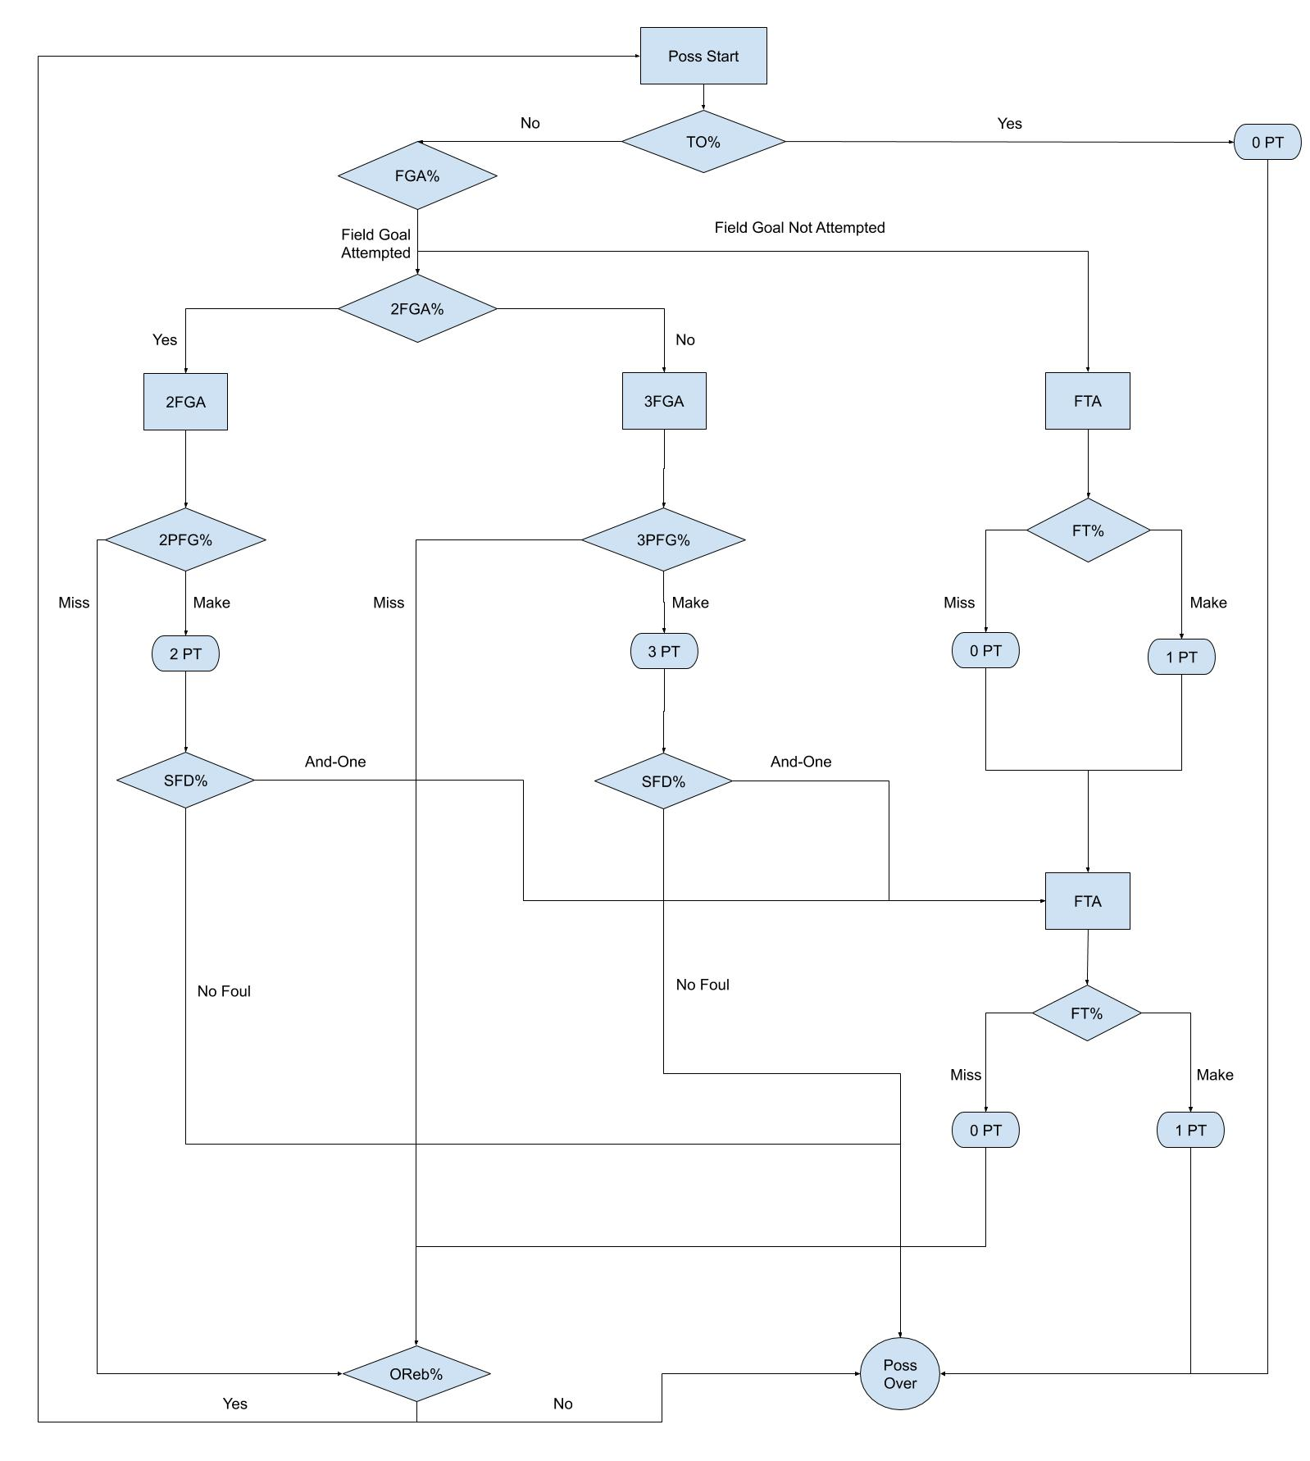
Flow Chart Model
Possession as discrete event
Result of each possession: 0-4 points
Game model repeats possession based on pace of matchup
State of the game tracks the accumulation of the score along with the team statistics

Slide 6
Simulate Process
San Antonio Spurs for the 2019-20 season
63 Games
Average Points Scored: 113.16
Standard Deviation: 10.72
Standard Error: 1.35
Simulation 100
100 Games
Average Points Scored: 113.26
Standard Deviation: 11.735
Standard Error: 1.1735
Simulation 500
500 Games
Average Points Scored: 111.73
Standard Deviation: 11.5464
Standard Error: 0.516
Notes:
Appropriate number of iterations (and justify)

Slide 7
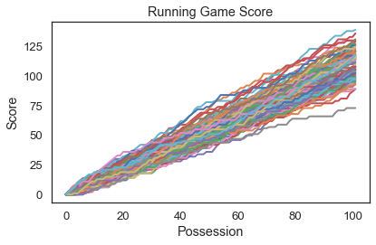
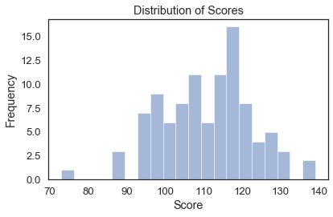
Game Simulation: Spurs
Single team (Spurs) game simulation
Running score for 100 simulations
Distribution of simulation final scores for the 100 game simulations plotted to the left

Slide 8
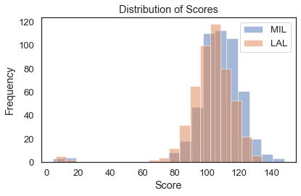
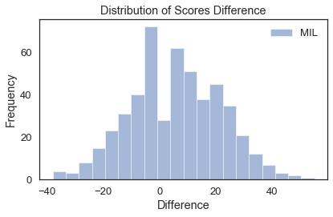
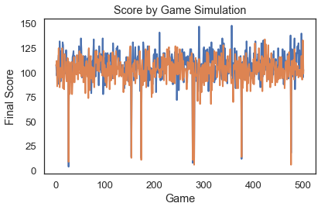
Matchup: Bucks vs. Lakers
Games: 501
MIL wins: 305
LAL wins: 196
Overtime games: 7
Score differential mean: 5.55

Slide 9
Playoff Simulation: 501 games per matchup
MIL | 332 |  |  |  |  |  |  |  |  | 300 | LAL
ORL | 169 | MIL | 326 |  |  |  |  | 285 | LAL | 201 | MEM
MIA | 225 | IND | 175 |  |  |  |  | 216 | OKC | 240 | UTA
IND | 276 |  |  | MIL | 311 | 257 | LAL |  |  | 261 | OKC
TOR | 284 |  |  | TOR | 190 | 244 | LAC |  |  | 281 | LAC
BKN | 217 | TOR | 277 |  |  |  |  | 268 | LAC | 220 | DAL
BOS | 254 | BOS | 224 |  | MIL | LAL |  | 233 | DEN | 273 | DEN
PHI | 247 |  |  |  | 323 | 178 |  |  |  | 228 | HOU
Total run time: 3682.48 seconds (61.4 minutes)

Slide 10
Verification and Validation
Verification: Performed through coding and testing practices. Small functions tested independently for correct behavior.
Validation: Compared the Spurs 100 game simulation to current season stats
Season averages per game:
Points: 113.16
Turnovers: 12.3
2P FGAs: 60.8
2P FGMs: 31.3
3P FGAs: 28.7
3P FGMs: 10.7
FTAs: 22.8
FTMs: 18.4
Off Rebounds: 8.8
Simulation averages per game:
Points: 113.26
Turnovers: 11.33
2P FGAs: 59.18
2P FGMs: 31.03
3P FGAs: 29.18
3P FGMs: 11.2
FTAs: 23.74
FTMs: 17.6
Off Rebounds: 9.52
Difference:
Points: 0.10
Turnovers: -0.97
2P FGAs: -1.62
2P FGMs: -0.27
3P FGAs: 0.48
3P FGMs: 0.5
FTAs: 0.94
FTMs: -0.8
Off Rebounds: 0.72

Slide 11
Conclusion
Accurate model for a single team
Incremental model allows for easy-to-run playoff simulation
Model relies primarily on offensive statistics
Defensive rating of opposing team factored into three statistics
Matchup simulation identifies better statistical team
Gaps
Outlier scores seem problematic
Model does not account for flow of game, particularly blowout
Team level statistics instead of player level statistics
Would not account for star player not playing
Game location not addressed
NBA statistics are a good predictor of team success

