Slide 1
Brainstorming Themes for 2006
Paul Tarau
University of North Texas
http://www.cs.unt.edu/~tarau
Dec 2005

Slide 2
VIRTUAL IMAGINATION
About making things happening in a virtual 3D world as a result of written or spoken input.

Slide 3
Jinni3D Agents
Jinni3D is a high-level, agent-oriented Jinni extension built on top of Java3D
Jinni acts as a scripting language to specify agent behavior and handle events
Combination of 3D-models and force-based graph layout algorithms – provides easy means to animate realistic characters or display/visualize complex data

Slide 4
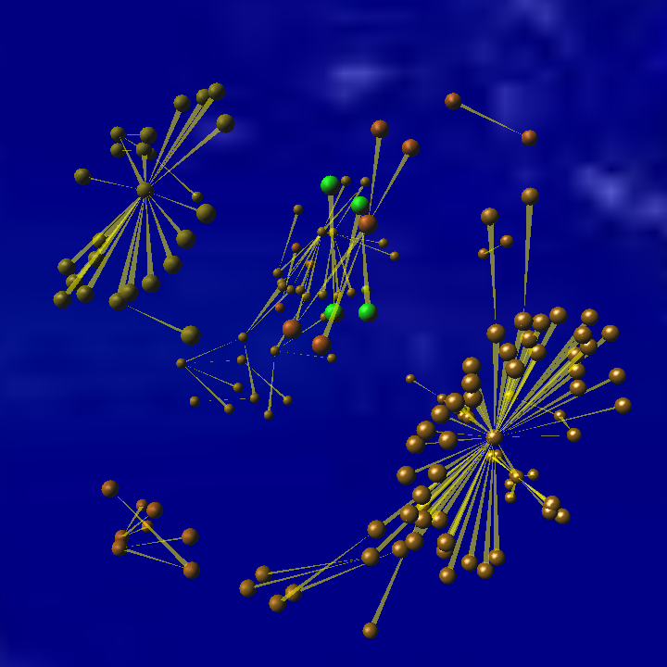
Jinni3D’s Prolog Call Graph: Happy New Year ☺

Slide 5
Virtual Imagination:
seeing what you say: making it “happen”
3D world
Next step - beyond PicNet
Models for Nouns/Entities – like in PicNet, but 3D
Mostly from what’s out on the net, some created

Slide 6
What about Verbs?
Some Verbs have relatively good static pictorial representations – but this is time and culture sensitive
http://www.wesleyan.edu/dac/coll/grps/goya/goya_intro.html
Key to verbs: METAPHORS/ANALOGIES
Represent Change as Animation

Slide 7
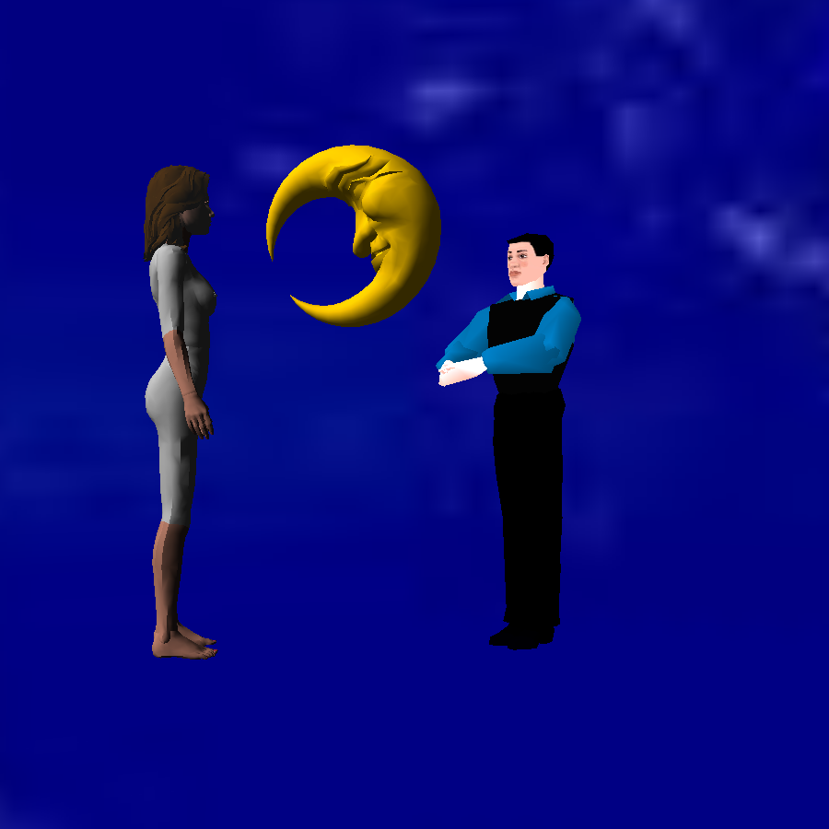
Offering you the Moon! ☺

Slide 8
I, you –?
what about pronouns?
ViewPoint Shifting
ViewPoint Animation
ViewPoints can suggest effectively who is the “First Person” in a dialog
Same techniques for deictics – here, there etc.

Slide 9
Sign languages – standardizing 3D metaphors – what can we learn from them?
American Sign Language
http://commtechlab.msu.edu/sites/aslweb/browser.htm
http://www.csdl.tamu.edu/~su/asl/
Animated characters can do more than a “stand-up” sign language speaker – content can be more concrete, less symbolic

Slide 10
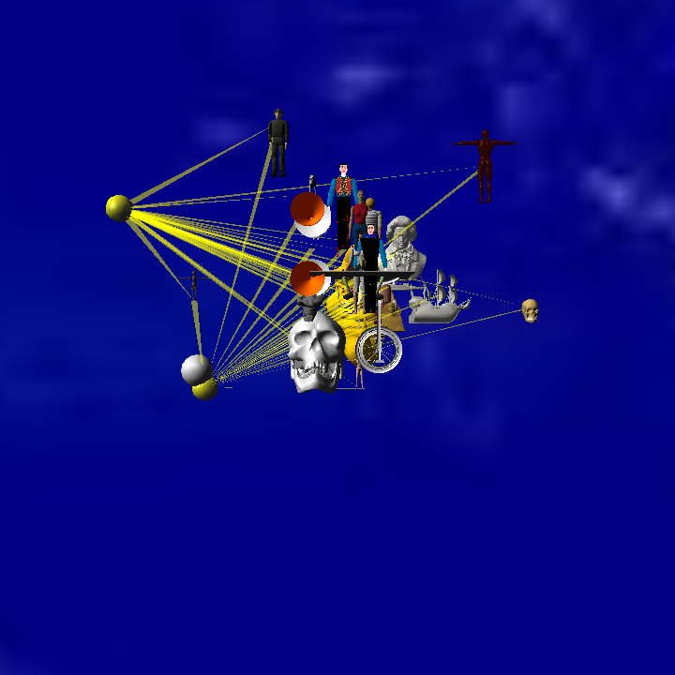
Compositionality: 3D Models as Graph Vertex Agents & 3D-layout

Slide 11
Animations through 4D Graph Layout Algorithms
Starting point: relativistic space+time
What would a relativistic interstellar traveller see?
http://math.ucr.edu/home/baez/physics/Relativity/SR/Spaceship/spaceship.html
http://www.anu.edu.au/Physics/Searle/Movies.html

Slide 12
What is an animation: simply a 4D object!
3D layout finds “optimal” placement in space
4D layout => optimal placement in a story line?
The Project: adapt Jinni3D’s data structures to N-dim vectors (that might have some other interesting uses!), then play with 4D layout algorithms to “organize” 3D scenes into sequences seen as 4D animations
Using constraint propagation - CHR

Slide 13
Graph Algorithms for NLP
PageRank and friends – quite effective on simple tasks (disambiguation, keyword/senetece extraction)
How can we extract richer structures - topological and geometrical properties?

Slide 14
Generalized Maps
http://www.loria.fr/~levy/publications/papers/1999/g_maps/g_maps.pdf
Paper: Cellular Modellng in Arbitrary Dimension using Generalized Maps
By Bruno Levy and Jean-Laurent Mallet

Slide 15
Geometrical View of NLP Graphs
We can view word phrases as vertices of a graph, sentences as faces of a polygon obtained by sewing together with forward edges consecutive phases and documents as 3D surfaces obtained by sewing together consecutive sentences.
The resulting 3D object can be analyzed as a multi-partite graph, connecting vertices to edges, connecting edges to faces and connecting faces into polyhedra

Slide 16
Higher Dimensional Views
If we extend this to Web pages containing text and links we can see the links as connections between pages forming a 4D object.
If we extend this by connecting first Wordnet synsets to their associated word phrases we obtain a set of 5D objects.

Slide 17
HYPOTHESIS on GM in NLP
The geometry of the resulting Generalized Maps is meaningful for disambiguation, keyword and sentence extraction and document similarity, as well as to improve Web page ranking by involving elements of text understanding (i.e. links from semantically related pages will weight more).

Slide 18
Entailment and Logic Representations of NL text
Pascal contest – the most natural representation is some form of
Intuitionist and Modal Logic might need to be used to formalize NL entailment
Extract a logic form and than see if the entailed sentence is provable from it
Horn Theory – provable in Prolog – possibly more general form – CNF – requires stronger theorem provers
Interesting alternative logics: Intuitionist, Linear

Slide 19
Intuitionist (Predicate) Logic
There are three rules of inference:
Modus Ponens: From A and (A → B), conclude B.
E. -Introduction: From (C → A(x)), where x is a variable which does not occur free in C, conclude (C → ∀E.x A(x)).
V. -Elimination: From (A(x) → C), where x is a variable which does not occur free in C, conclude (Vx.A(x) → C).

Slide 20
Axioms
A ->(B ->A).
(A ->B) ->((A ->(B ->C)) ->(A ->C)).
A ->(B ->A & B).
A & B ->A.
A & B ->B.
A ->A or B.
B ->A or B.
(A ->C) ->((B ->C) ->(A or B ->C)).
(A ->B) ->((A ->¬B) ->¬A).
¬A ->(A ->B).
V:x A(x) ->A(t).
A(t) -> E:x A(x).

Slide 21
Open Question: How we best representing NLP “knowledge” for entailement?
How to extract logic forms through statistical NLP techniques?
learned: “(attribute=value)* vectors”
Same as:
“attribute(value).” Prolog facts
More interesting, relational learning?
CGs derived from CLCE-like forms:
http://www.jfsowa.com/clce/specs.htm
ILP?

