Slide 1
IDSS Lab – research directions
Sept 6, 2002
Paul Tarau
University of North Texas

Slide 2
Summary
Jinni 2002: a fast Java based knowledge processing and agent programming software infrastructure
distributed processes centered around active, constraint processing enabled blackboards
high-level knowledge exchange protocols for mobile agents, advanced OO model

Slide 3
Motivation
networked, mobile computing
increasingly complex patterns of interaction
large scale knowledge processing tasks
=> agent programs with increasingly sophisticated inference capabilities, autonomy and self-reliance

Slide 4
Jinni 2002: fast Prolog in pure Java
1 million LIPS pure Java based Prolog - runs even on PocketPC - iPAQ
blackboards, threads, remote predicate calls
agents:
  flexible OO model – Cyclic Multiple Depth First Inheritance

Slide 5
Jinni Top Ontology
Places: blackboard + a server thread listening on a port – agents can enter and leave places
Objects: sets of Prolog clauses
Agents:
  An agent is a set of mobile threads initiated by a unique goal at a given Place
  coordination: through blackboards - some local, some remote

Slide 6
Remote Calls
run_server(Port,Pwd):
ask_server(X,GX,Pwd,Host,Port,Result)
abstract transport layer
  unicast sockets
  RMI, Corba, multicast sockets

Slide 7
Basic Linda Operations
out(X): puts X on the blackboard
in(X): waits until it can take an object matching X from the blackboard
all(X,Xs): reads the list Xs matching X currently on the blackboard
derived operations: cin/1, rd/1

Slide 8
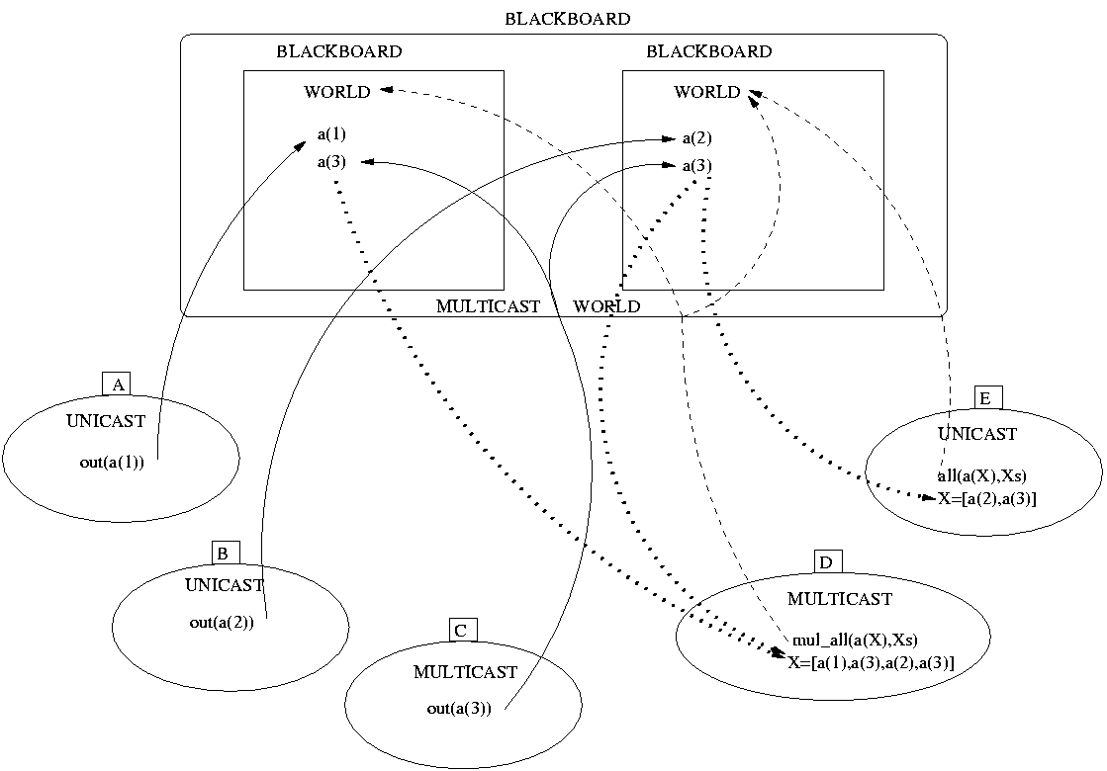
Unicast and Multicast Implementation

Slide 9
Beyond Linda: Blackboard Constraint Operations
wait_for(Pattern,Constraint): waits for a Pattern on the blackboard, such that Constraint holds, and when this happens, it removes the result of the match from the blackboard
notify_about(Pattern): notifies about this Pattern one of the blocked threads which waits for it with a matching constraint

Slide 10
Coordination with Blackboard Constraints
Two threads: T1 (prod) and T2 (cons)
?-notify_about(stock_offer(aol,11)). %T1
?-notify_about(stock_offer(aol,9)). %T1
% action triggered in T2 => Price=9
?-wait_for(stock_offer(aol,Price), %T2 less(Price,10)).

Slide 11
Mobile threads: WHY?
Large database, small agent
Speed-up: move to a fast processor and back, transparently
same code can be run locally or remotely
fault tolerance - move->run->come back
Simplify the design of complex multi-agent networks

Slide 12
Designing Jinni Agent Classes
Java layer:
  reflection based Java/Prolog interface
  reaction to events
  Java libraries
Prolog layer
  conceptual structures processing
  reaction to blackboard constraints
  mobile threads, extended OO model

Slide 13
XML Processing

Slide 14
AIML Agent Development

Slide 15
Artificial Personalities

Slide 16
Generation of VRML animations

Slide 17
Agent Based P2P Infrastructure

Slide 18
Memory Management

Slide 19
Statistical Properties of Memeory Reference Graphs

Slide 20
Conclusion
Direct support for Conceptual Structures – on top of Jinni’s Cyclical Multiple Inheritance OO model
Synergy between knowledge processing, networking, Internet protocols and agents
Advanced component technology – seamless integration with Java and Prolog components

