Slide 1
A Logic Programming Based Mobile Agent Infrastructure
January 19, 2001
Paul Tarau
University of North Texas
&
BinNet Corporation
Copyright © 2000, Paul Tarau

Slide 2
Motivation
networked, mobile, ubiquitous computing
increasingly complex patterns of interaction
post OO pardigm: intelligent, reactive, mobile computational entities
=> agent programs with increasingly sophisticated inference capabilities, autonomy and self-reliance

Slide 3
Summary
design and implementation issues for a new Prolog and Java based multi-threaded agent programming software infrastructure
how to provide advanced inferential and knowledge processing abilities while supporting mobile computations
multi-agent coordination through blackboard constraints

Slide 4
PART I Internet and Network Programming with Jinni
LP languages are OLD - Prolog is already 20++
We need to specialize LP languages, transform them, adapt them, change them radically, if needed, e.g:
  Reading from a URL should be as simple as reading from a file
  Interacting over a socket should be as simple as interacting on a local console
  Computations should be able to move across the network transparently

Slide 5
Why we need a pure Java based Logic Programming Language?
LP needs to be specialized for high level networking, easy handling of URLs, client-server computations, execution of multiple “agent” threads, handling of various Internet protocols
Transparent access to zillions of Java libraries – it just seems the most pragmatic way to provide main stream programming patterns to logic programmers

Slide 6
Jinni 2000: fast Prolog in pure Java
1 million LIPS Java based Prolog
integrates Kernel Prolog with fast continuation passing BinWAM engine
runs even on Palm, Handspring (with Sun’s new Java engine: K-machine) palmtops
blackboards, threads, remote predicate calls
agents: generalization of class and object based OO systems – local and remote delegation mechanism

Slide 7
Jinni Ontology
Places: blackboards + a server thread listening on a port
Things: Prolog terms, in particular Prolog clauses
Agents:
  a set of mobile threads initiated by a unique goal at a given Place
  coordination: through blackboards - some local, some remote

Slide 8
Orthogonal Execution Mechanisms
engines (1MLips compiled or lightweight)
threads + hubs
remote predicate calls
derived: blackboard operations
  basic Linda coordination, associative search
  blackboard constraints - react when something becomes true

Slide 9
Engines as Generalized Iterators (Fluents): keep state minimal
Engine = an LD Resolution Interpreter with first order control: constructor+iterator
  new_engine(Goal,AnswerPattern, Handle): creates a new interpreter Handle solving Goal
  new_answer(Handle,AnswerInstance): If AnswerInstance is no then stops the engine, otherwise either returns a new answer, of the form the(AnswerInstance) or returns no if there are no more answers.

Slide 10
findall/3
  findall(X,G,Xs):- new_engine(G,X,E), new_answer(E,Answer), collect_all_answers(Answer,E,Xs).
  collect_all_answers(no,_,[]).
  collect_all_answers(the(X),E,[X|Xs]):-new_answer(E,Answer), collect_all_answers(Answer,E,Xs).

Slide 11
Thread Operations: minimal!
bg(Goal,ThreadHandle)
hub_ms(Timout): syncs M producers N consumers
thread_join(T)
sleep_ms(Duration)
current_thread(ThisThreadHandle)
Derived: thread_resume/1, thread_suspend/1

Slide 12
Remote Predicate Calls
run_server(Port,Pwd):
ask_server(X,GX,Pwd,Host,Port,Result)
abstract transport layer
  unicast sockets
  RMI, Corba, multicast sockets

Slide 13
Basic Linda Operations (now derived)
out(X): puts X on the blackboard
in(X): waits until it can take an object matching X from the blackboard
all(X,Xs): reads the list Xs matching X currently on the blackboard
derived operations: cin/1, rd/1

Slide 14
Assertional Constraints vs. Binding Constrains
From: when nonvar(X) ...
=> when provable(X) … re-execution
=> when a_fact(X)… more realistic
constraints on variable bindings are too fine-grained for distributed programming!

Slide 15
Beyond Linda: Blackboard Constraint Operations
wait_for(Pattern,Constraint): waits for a Pattern on the blackboard, such that Constraint holds, and when this happens, it removes the result of the match from the blackboard
notify_about(Pattern): notifies about this Pattern one of the blocked threads which waits for it with a matching constraint

Slide 16
Coordination with Blackboard Constraints
Two threads: T1 (prod) and T2 (cons)
?-notify_about(stock_offer(aol,91)). %T1
?-notify_about(stock_offer(aol,89)). %T1
% action triggered in T2 => Price=89
?-wait_for(stock_offer(aol,Price), %T2 less(Price,90)).

Slide 17
Mobile Threads: Motivation
  paradigm shift towards networked, mobile, ubiquitous computing with increasingly complex patterns of interaction
  threads: needed for programming reactive/proactive mobile agents
  back to pure LP - a good thing - but let’s give it an expressiveness lift:-)

Slide 18
mobile threads: WHY?
Large database, small agent
Speed-up: move to a fast processor and back, transparently
here/there switch: same code can be run locally or remotely
fault tolerance - move->run->come back

Slide 19
mobile threads with First Order AND-continuations
a:-b,c,d.
binarization: a(C)::-b(c(d(C))).
get_cont(C,C)::-true(C). % binarized
mobile threads algorithm:
  move/0: get continuation, send over the net, resume execution on target
  return/0: send back new continuation, resume execution back home

Slide 20
A Simple API for mobile threads (Jinni 98, BinProlog 7.x)
run_server/0, here/0, there/0, where/1: => local or remote focus
set_this_host/1, set_this_port/1, set_that_host/1,set_that_port/1
move/0, return/0 vs. remote_run/1
the(Pattern,Goal,Answer): runs Goal to produce the(Answer) or no => here/there switch =>local/remote

Slide 21
mobile threads vs. RPCs: move once, compute many times
?-for(I,1,1000), remote_run(println(I)), eq(I,1000).
?-there, move, for(I,1,1000), println(I), eq(I,1000).

Slide 22
Examples of mobile threads
Window 1: a mobile thread
?- there, move, println(on_server), member(X,[1,2,3]), return, println(back).
Window 2: a server
?- run_server.

Slide 23
The (Pseudo) Server-in -the Client Pattern
a client thread emulates server functionality (works behind a firewall!):
  pseudo_sever:-in(todo(X)),call(X),pseudo_server.
  ?- there,pseudo_server.
the real client: there,out(todo(…))
communication: through a blackboard on a (shared) real server

Slide 24
Shared Virtual Worlds
set-up a registration mechanism for agents on server
publish state changes to shared blackboard on server with out/1
one thread for each “ghost” (remote client) - too expensive!
=> NEED FOR MULTICAST

Slide 25
A Classic Design Pattern, Publish/Subscribe: with mobile threads + Linda operations
a reactive channel listener: in/1 loop
?-listen(fun(_)).
selective channel publisher: out/1 loop
?-talk(fun(jokes)).
will not match:
?-talk(stocks(quotes,nasdaq))

Slide 26
The (Pseudo) Server in The Client Pattern
a client thread emulates server functionality (works behind a firewall!):
  pseudo_sever:-in(todo(X)),call(X),pseudo_server.
  ?- there,pseudo_server.
the real client: there,out(todo(…))
communication: through a blackboard on a (shared) real server

Slide 27
The Octopus Agent Pattern
branch out multiple Reactive Agent threads to various places using RPCs or mobile threads
watch for patterns containing returned results on the local blackboard
failure or non-termination of one thread have minimal effect: fault tolerance

Slide 28
Designing Jinni Agent Classes
Java layer:
  code and type inheritance
  reaction to events
  libraries: Java3D, XML, special devices etc.
Prolog layer
  knowledge processing
  reaction to blackboard constraints
  mobile threads

Slide 29
Design Patterns in Visual Jinni
drives Java objects through handles
meta-programming is essential
Java events interoperate with blackboard coordination
easy extension to incorporate access to Java2D and Java3d libraries

Slide 30
Java Objects in Visual Jinni
jdialog(Query,Answer):-
  new_frame('Jinni Dialog',border,F),
  new_label(F,Query,_),
  new_panel(F,flow,P),
  new_button(P,'Cancel', out(bc(P,cancel))),
  new_button(P,'Ok',out(bc(P,ok))),show(F),
  in(bc(P,Answer)),destroy(F).

Slide 31
Shared Virtual Reality Agents
Web based: browser+EAI+Java+Jinni
Jinni Server + Thin Jinni Applet Connector
BETTER: Java 3D virtual worlds connected in a peer-to-peer Jinni network

Slide 32
Educational Agents
chat, self organizing groups, shared VR
alerts triggered by blackboard constraints
reusable agent hierarchies
Wizard of Oz help desk: combined human and programmed agents

Slide 33
A Multicast Layer for Jinni
Multicasting:In a network, a technique that allows data, including packets, to be simultaneously transmitted to a selected set of destinations (Some networks, such as Ethernet, support multicast by allowing a network interface to belong to one or more multicast groups).
API
  run_mul_server(Host, Port)
  remote_mul_run(Host, Port, X, G, PW, Res)

Slide 34
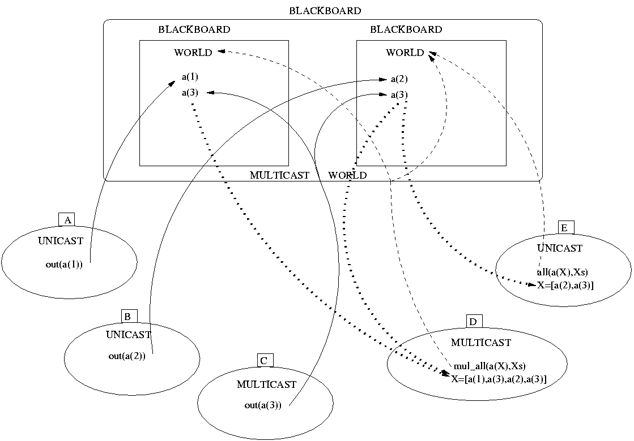
Basic Linda Operations with Unicast and Multicast

Slide 35
Impact on Mobile Computers and transient IP systems
  Server/Servant duality - pulling commands through multicast - applets as servers
  SETI-style distriuted computing
  mobile agents for mobile devices

Slide 36
Applications: Tele - Teaching
LANs are Multicast Capable
Student machines join multicast group of teaching server (run_mul_server)
Messages and todo tasks Multicasted to student machines (remote_mul_run(out(todo(X)))
The server can collect responses from local blackboards with expanded concept of blackboard remote_mul_run(mul_all(answer(X))

Slide 37
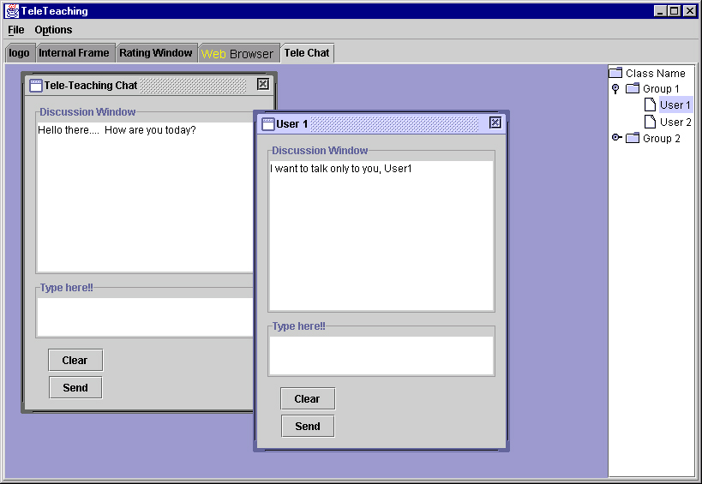
Dynamic Multicast based Tele-Teaching Chat
Work Done by Ravi Kiran Guntupalli

Slide 38
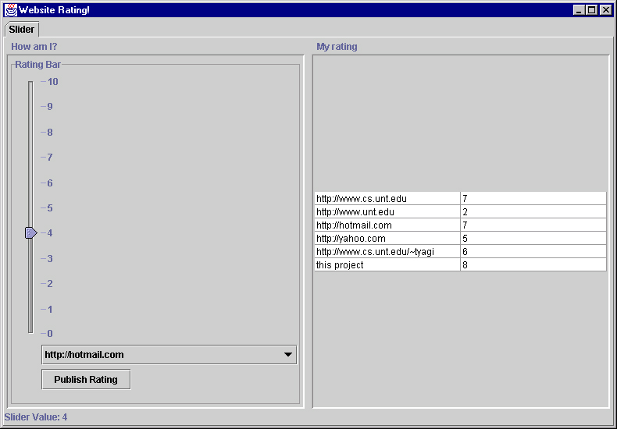
Dynamic Multicast based Performance Rater
Work Done by Ravi Kiran Guntupalli

Slide 39
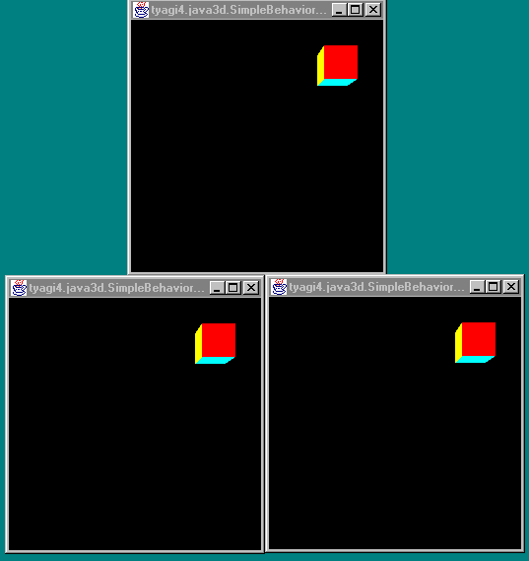
Application: Java3d Games
API new_obj(name), move_obj(name,x,y,z), remove_obj(name)
multicast - synchronization
blackboard - preserve state.
Prolog intelligent Logic Programming of agents

Slide 40
Future Work on Multicast Agents
multicast: UDP based unreliable Protocol
number of places attached unknown
blocking reads unreliable
experimentation with Reliable Multicast
experimentation outside LANs i.e. with Routers capable of multicast

Slide 41
Conclusion PART I
Synergy between high performance networking and Prolog agents
promising applications - networked AI games, tele-teaching, shared VR

Slide 42
PART II Programming with Fluents in Jinni 2000
Paul Tarau
University of North Texas
&
BinNet Corporation
Copyright © 2000, Paul Tarau

Slide 43
Motivation
uniform interface for controlling multiple interpreters and external stateful objects
redesigning Prolog's system of built-in predicates: OO hierarchy (other Fluents)
interoperation with the underlying Java system =>
elegant integration of Internet Programming patterns

Slide 44
What’s wrong with Prolog’s builtins?
LP => forever young!
old, deprecated builtins - early Fortran, C inspired design - consolidated into “industrial strength” ISO standard :-)
Zeppelins vs. air plains => the paradigm consolidation disease (do we have it?)
messy flat function set => we need a modern, clean, compositional OO hierarchy

Slide 45
What’s wrong with Prolog’s reflection?
call(X): control is not reflected properly - for instance backtracking is not a “first order” citizen
basic things difficult: i.e. source level definition of exception handling
general problem: lack of genericity (lists operations => conjunctions?)

Slide 46
What are Fluents?
simple stateful entities - evolving through an abstract set of stepping operations
Files, URLs, client/server interaction streams, GUI event streams
Prolog interpreters (and runtime engines): just other Fluents!
=> a way to map linear recursion to fast iteration

Slide 47
Refactoring Prolog: a Fluent based design
Kernel Prolog: a collection of Horn Clause Interpreters (Answer Sources) running LD-resolution on a given clause database and calling built-in operations
a constructor: goal + answer pattern => answers can be explored one by one
the Fluent encapsulating the state of the interpreter is very similar to a file or URL descriptor encapsulating the state of a Reader!

Slide 48
Fluent Classes
class Fluent extends SystemObject {
  Fluent(Prog p) {trailMe(p);}
  protected void trailMe(Prog p) {
    if(null!=p)
      p.getTrail().push(this);
  }
  public void stop() {}
  protected void undo() {stop();}
}

Slide 49
Source Fluents
abstract class Source extends Fluent {
Source(Prog p) {
super(p);
}
abstract public Term get();
}

Slide 50
Sink Fluents
abstract class Sink extends Fluent {
  Sink(Prog p) {super(p);}
  abstract public int put(Term T);
  public Term collect() {
    return null;
  }
}

Slide 51
Fluent Composers I
append_sources/3: creates a new Source with a get/2 operation such that when the first Source is stopped, iteration continues over the elements of the second Source.
compose_sources/3: a cartesian product style composition, get/2 returnins pairs of elements of the first and second Source
reverse_source/2 builds a new Source such that its get/2 returns in reverse order

Slide 52
Fluent Composers II
split_source/3 creates two Source objects identical to the Source given as first argument - allows writing programs which iterate over a given Source multiple times
join_sinks(S1,S2,S) creates a sink S such that its put operation go to both S1 and S2
discharge(Source,Sink): sends all the elements of the Source to the given Sink

Slide 53
Fluent Modifiers
Fluent modifiers allow dynamically changing some attributes of a give Fluent
set_persistent(Fluent,YesNo) is used to make a Fluent survive failure, by disabling its undo method, which, by default, applies the Fluent's stop method on backtracking

Slide 54
Interpreters (and run-time engines) as Fluents
Engine = LD Resolution Interpreter with first order control: constructor+iterator
  answer_source(+Goal, +AnswerPattern, -Handle): creates a new interpreter
  get(+Handle, -AnswerInstance): returns a new answer the(AnswerInstance) or no if no more answers
  stop(+Handle): frees resources

Slide 55
Building some “built-ins”
% returns the(X) or no as first solution of G
first_solution(X,G,Answer):-
answer_source(X,G,Solver),
get(Solver,R),
stop(Solver),
eq(Answer,R).

Slide 56
once/1 and not/1
% binds G to its first solution or fails
once(G):-
  first_solution(G,G,the(G)).
% succeeds without binding G, if G fails
not(G):-
  first_solution(_,G,no).

Slide 57
Reflective Meta-Interpreters
% metacall/1: just reflects backtracking
% through element_of/2
metacall(Goal):-
answer_source(Goal,Goal,E),
element_of(E,Goal).

Slide 58
Reflecting backtracking
element_of(I,X):-
  get(I,the(A)),
  select_from(I,A,X).
select_from(_,A,A).
select_from(I,_,X):-
  element_of(I,X).

Slide 59
Findall with Source Operations
findall(X,G,Xs):-
answer_source(X,G,Solver),
source_list(Solver,Xs).

Slide 60
Internet Related Fluents:
URL and ZIP/JAR reader fluents
=> consult(‘http://…./progs/test.pl’)
url2tokens(‘http://…/test.html’,Tokens).
URL, file, database, socket fluents – look all the same – this also extends to local and remote Prolog interpreters

Slide 61
Conclusion of Part II
uniform interoperation of Horn Clause Solvers with stateful entities (Fluents)
Integration of LP with external class libraries
a simplified Prolog built-in predicate system
=> transparent handling of Internet objects and protocols

Slide 62
Acknowledgements
Partly based on joint work with Veronica Dahl, Koen DeBosschere, Bart Demoen, Stephen Rochefort, Satyam Tyagi, Anima Gupta, Devender Gollapalli
Cross-influences –various LP/CLP groups, Madrid, Mozart-Oz, commercial Prologs
Peter Wilson – first port of BinWAM to Java
Java, w3.org etc. – free libraries and tools

