Slide 1
Conceptual Utilization Building Block Application
John Ristey
Smart Connected Operations
December 2023

Slide 2
Agenda
Purpose
Application Functionality
Building Block Overview

Slide 3
PURPOSE
Equipment state tracking is a common use case in Manufacturing
The conceptual Utilization application provides a simple application that uses the ThingWorx platform and the building block design pattern
There are two different deployment paths (ThingWorx data objects and SQL data objects) for the Utilization application that allow for the explanation of abstract / implementation concepts
This example is meant for learning and not production deployment as PTC has more robust solutions for state tracking

Slide 4
APPLICATION Functionality Overview

Slide 5
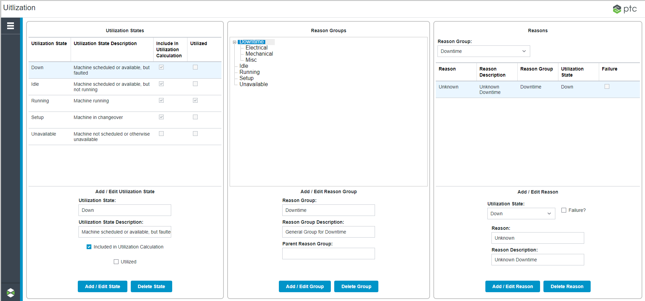
UTILIZATION Administration
Reason groups are simply a hierarchical method to manage reasons. You can add, edit and delete reason groups.
Add, edit and delete required utilization states. You can indicate whether the state is included in the utilization calculation and, if so, whether it is counted as utilization.
Reasons are the details behind the state. They must be tied to both a state and a reason group. A reason can be identified as a failure in order to calculate MTBF at a later time. You can add, edit and delete reasons.

Slide 6
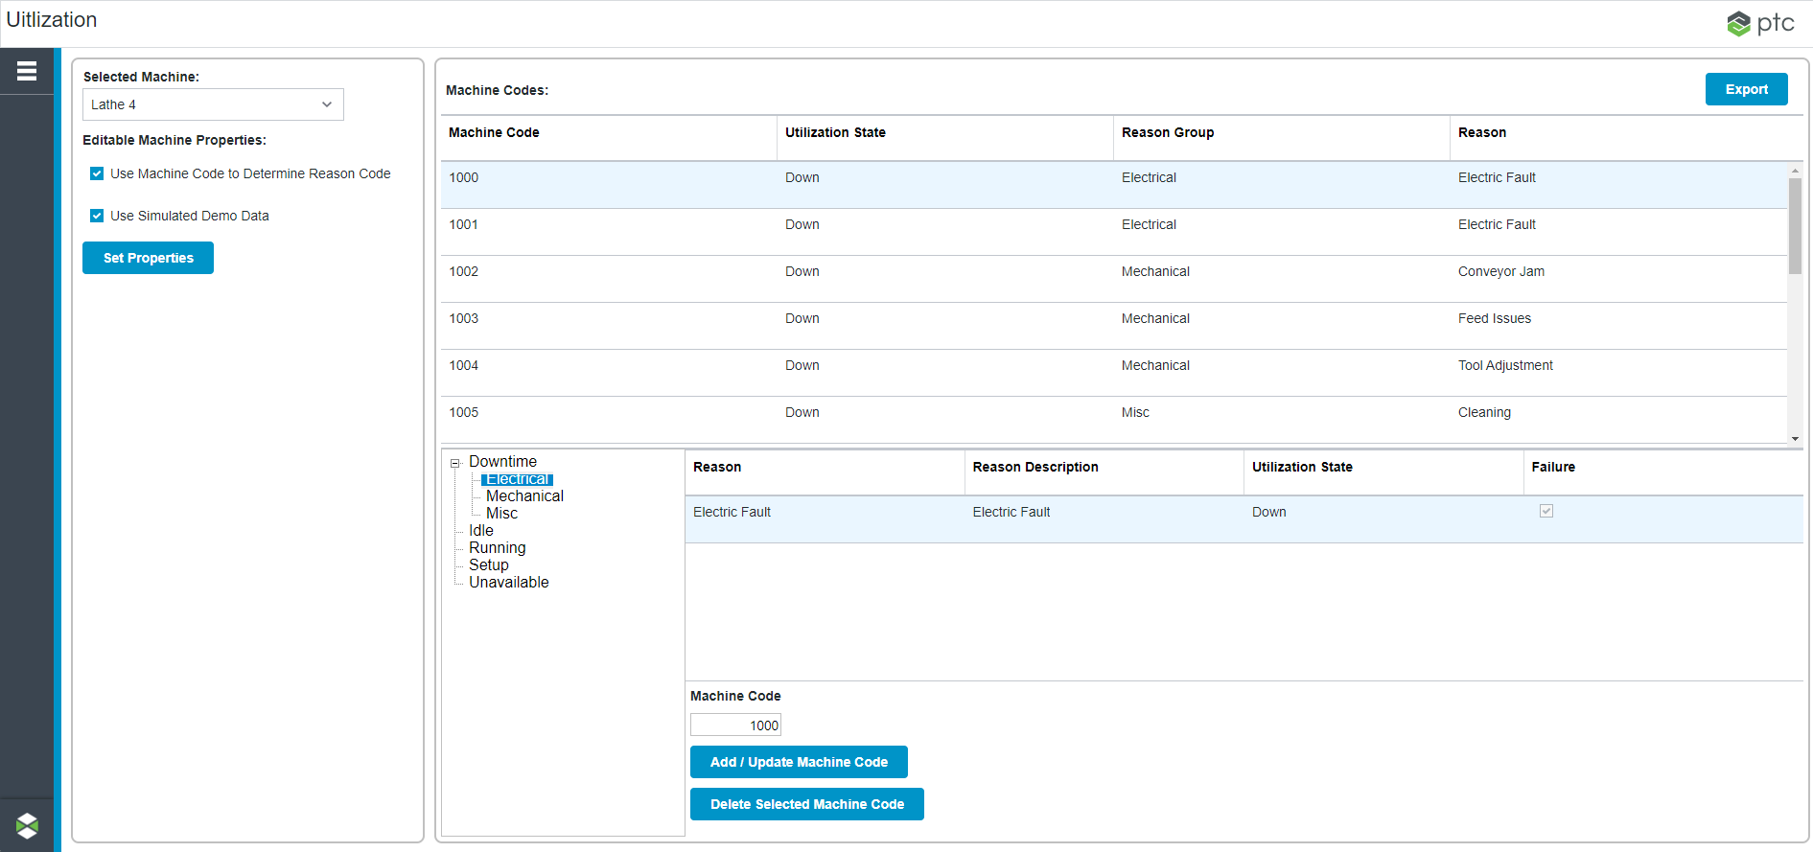
UTILIZATION Administration
A table can be configured to match machine codes with reasons. When the machine code changes, the state and reason code data will be looked up and the state will change
If a machine code integer exists to drive utilization state and reason code, you can select the machine and enable that property. You can also enable / disable simulation data.
Machine codes can be added and edited for a specific machine

Slide 7
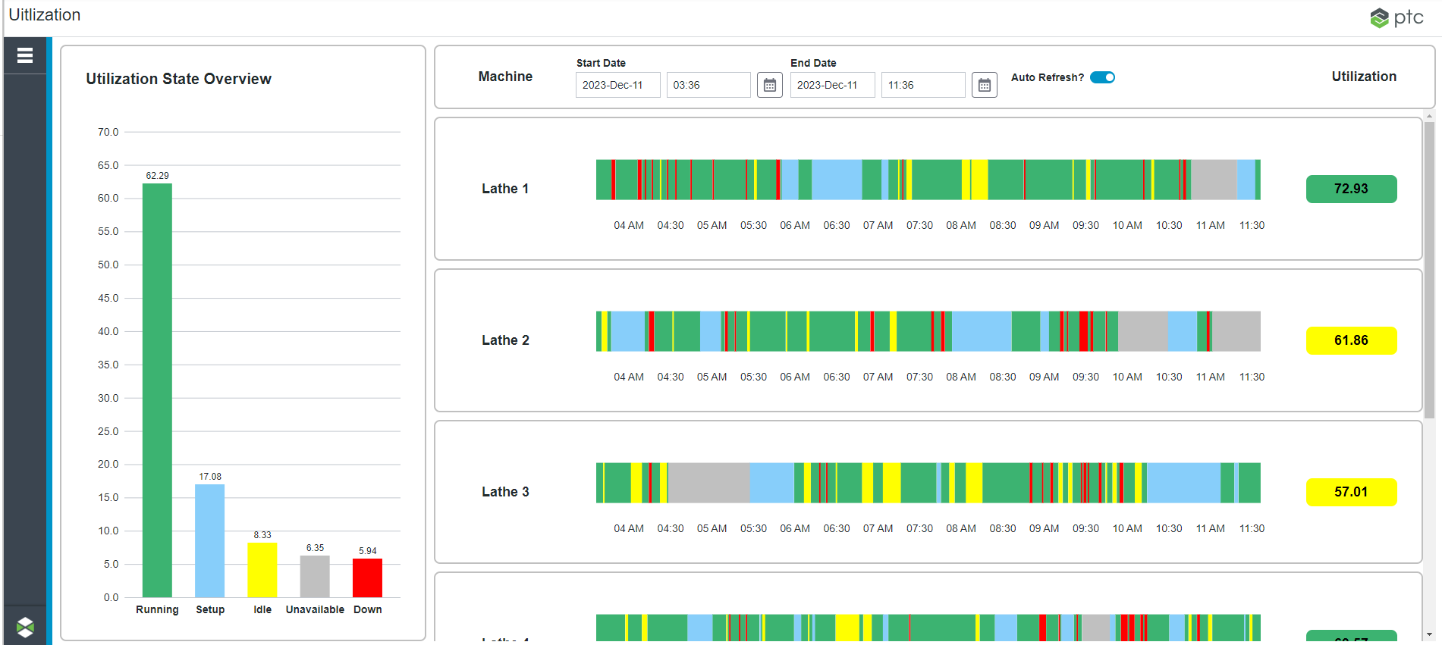
UTILIZATION OVERVIEW SCREEN
Adjust time frame to zoom in or out of selected data
The overview screen aggregates utilization state data for all machines and displays a “Gantt” and utilization calculation for each machine for the selected timeframe.

Slide 8
UTILIZATION OVERVIEW SCREEN
Double-click a utilization state to bring up details on the selected state events.

Slide 9
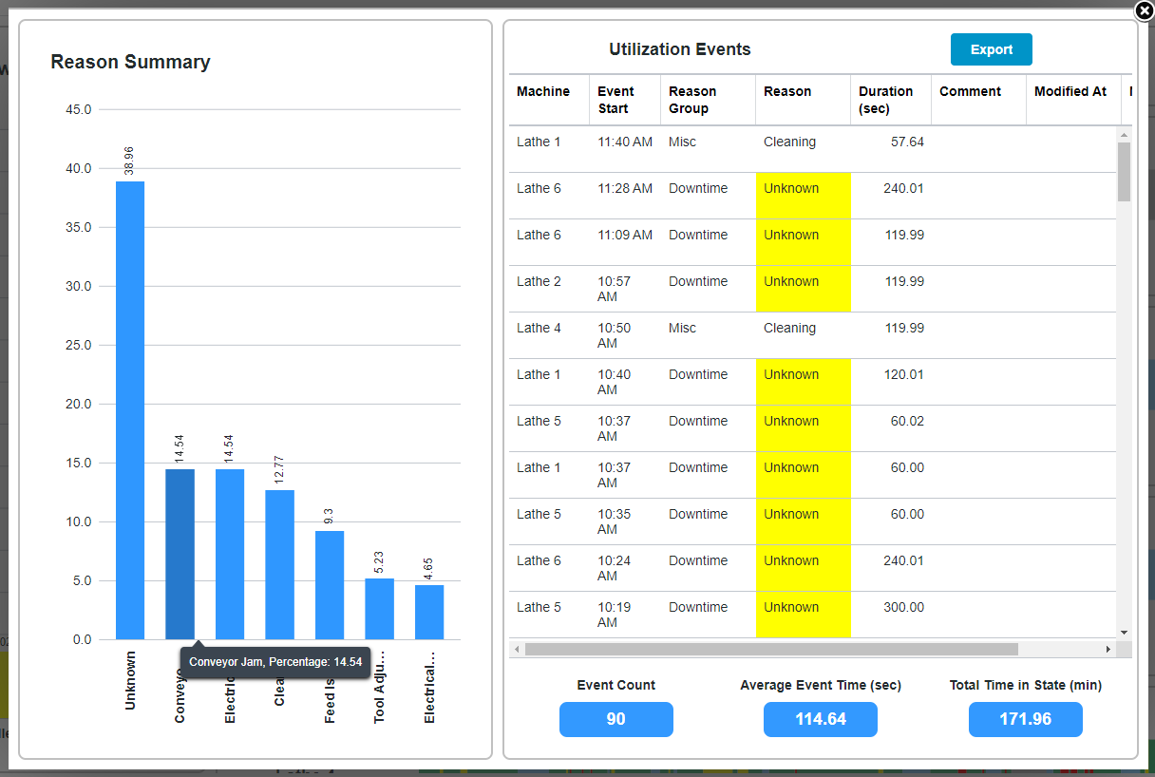
UTILIZATION EVENTS FOR SELECTED STATE
Specific utilization event data is available for the state.
Grid data available for export
Reason summary aggregates by reason. Hover over bar for reason and percentage of state.
Double click an event record to pop-up details
Aggregate COUNT, AVERAGE and SUM data for the selected state.

Slide 10
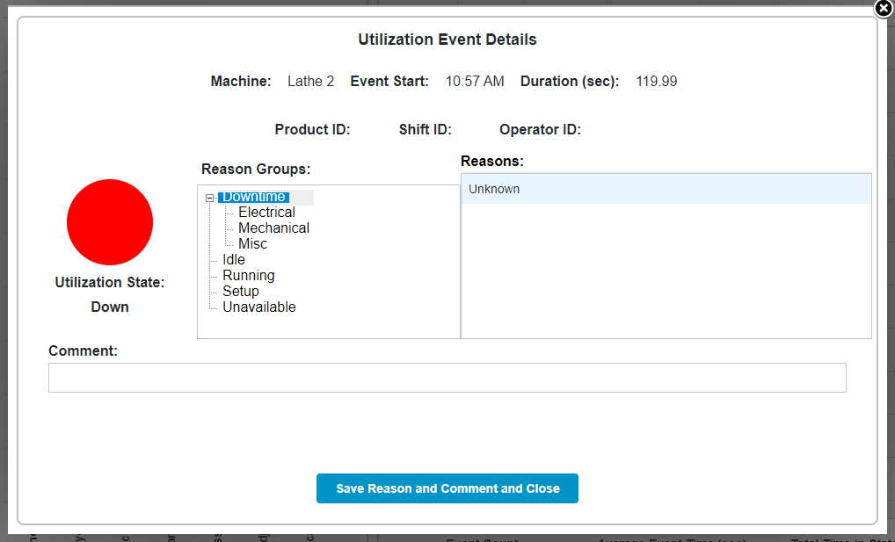
UTILIZATION EVENT DETAILS
For an event of State “Downtime” with Reason “Unknown”, a new Reason Group, Reason and Comment can be saved

Slide 11
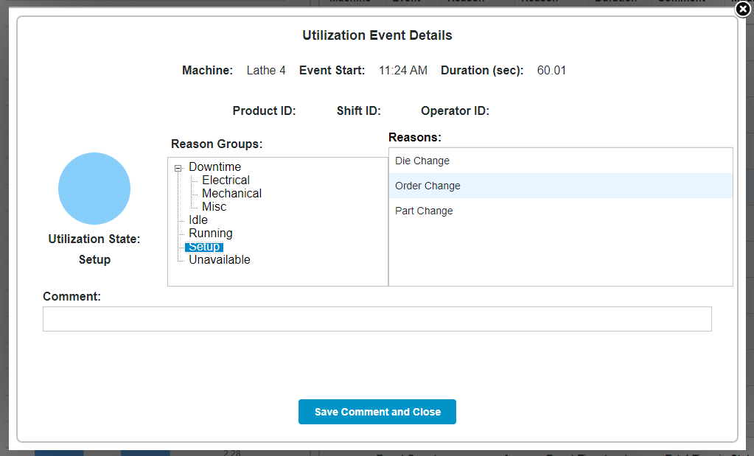
UTILIZATION EVENT DETAILS
For an event that does NOT have State “Downtime” with Reason “Unknown”, a Comment can be saved

Slide 12
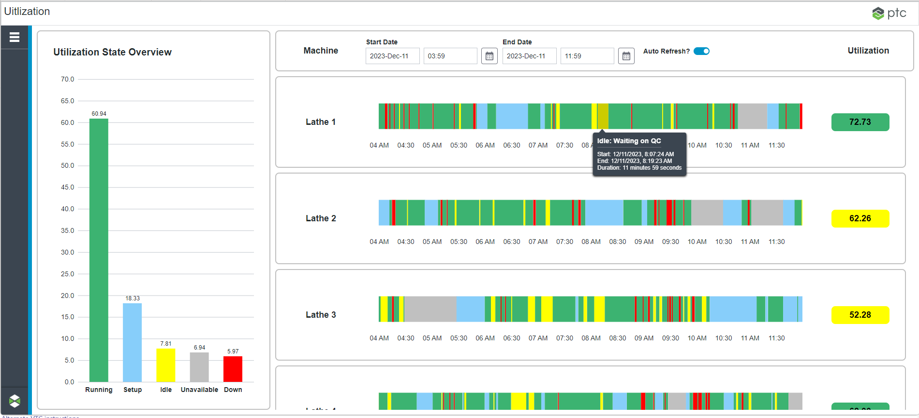
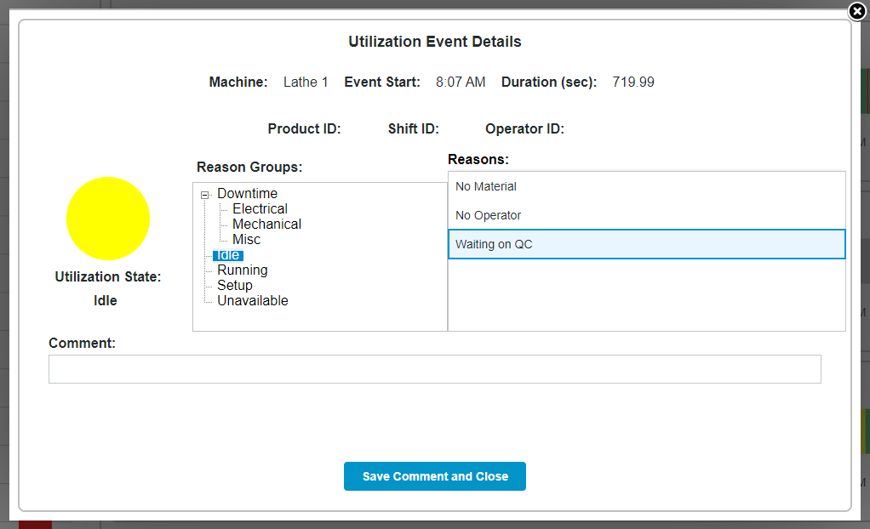
OVERVIEW SCREEN
You can also see event details by double clicking the event in the “Gantt”

Slide 13
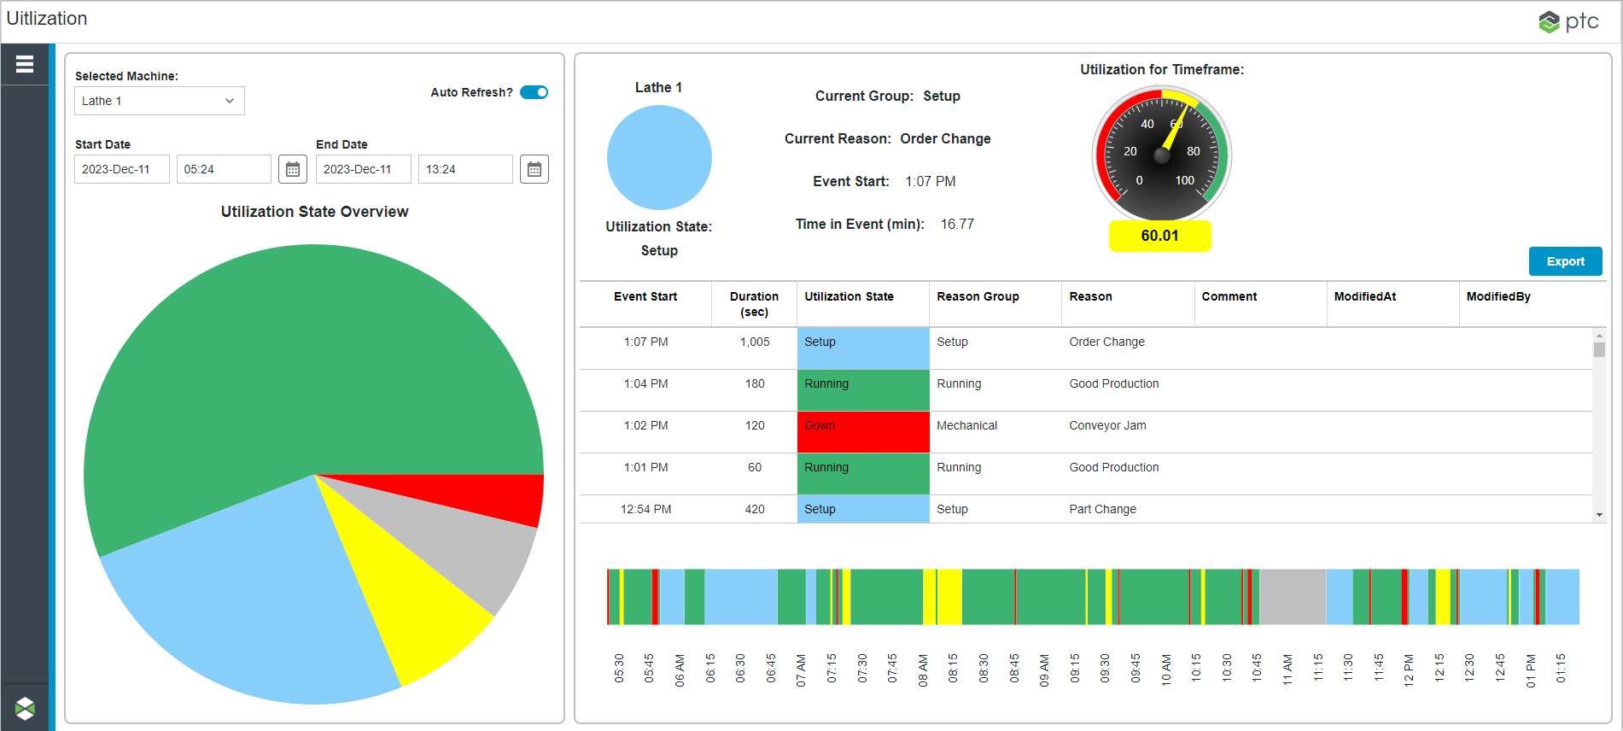
Specific Machine
Drop down to switch machines
Utilization gauge display (for selected time frame)
Display of current machine state data
Date time pickers to change utilization record time frame
Grid of specific utilization events for selected time frame
Option to export grid records
Pie chart of aggregated utilization states
Gantt chart of utilization events for time frame

Slide 14
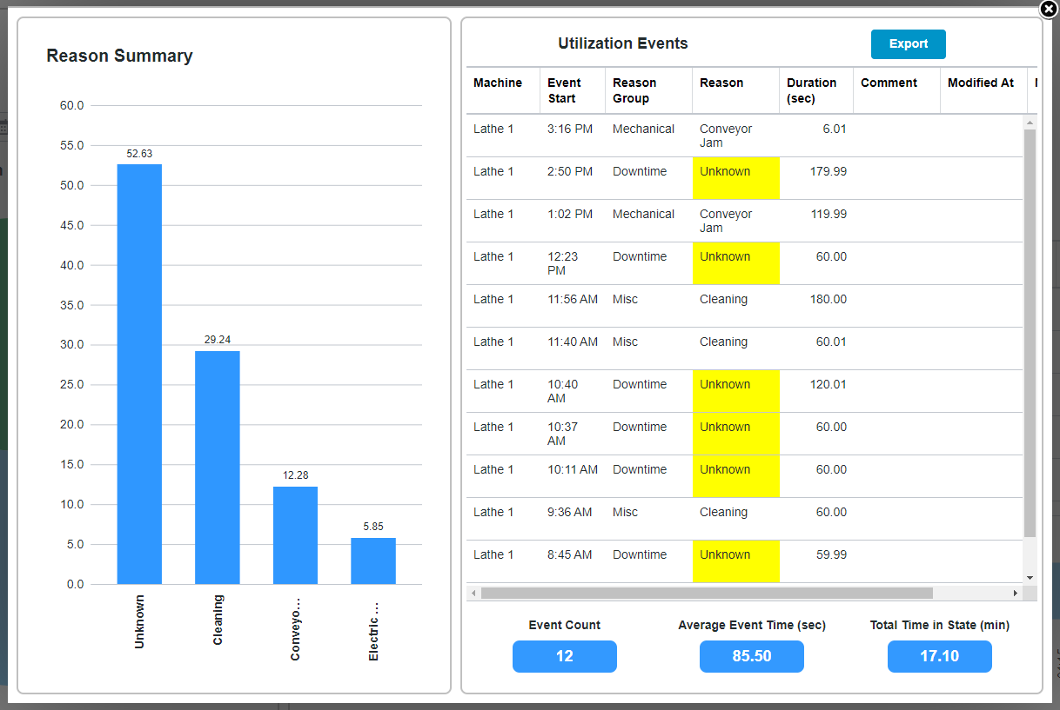
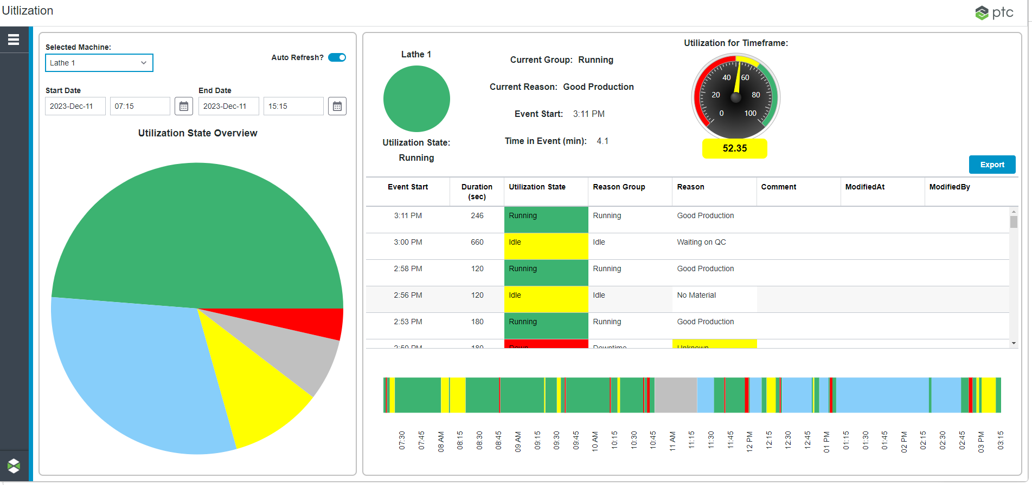
SPECIFIC MACHINE
Same utilization state pop-up as before, just for a single machine
Double click pie piece to view state details

Slide 15
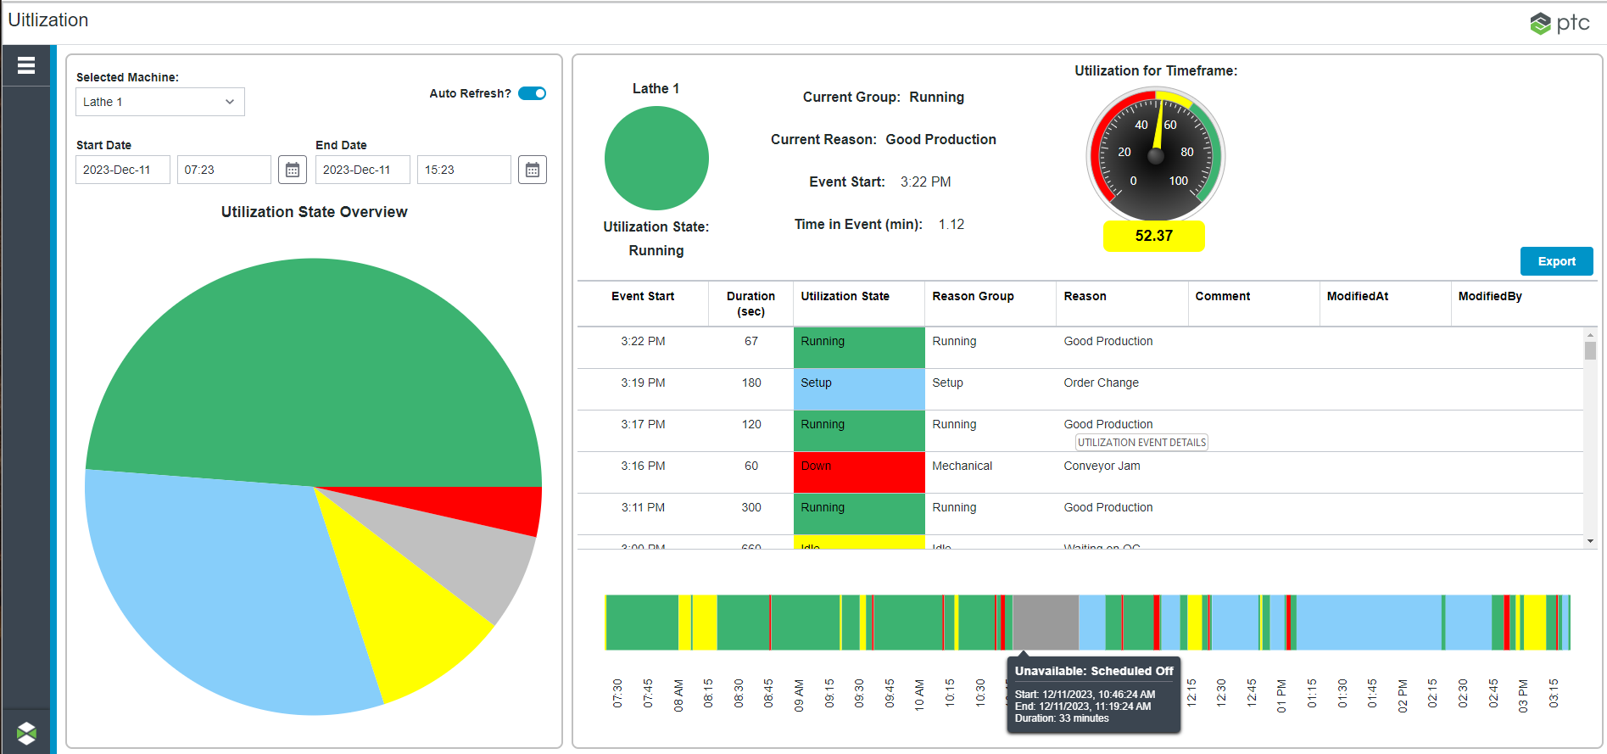
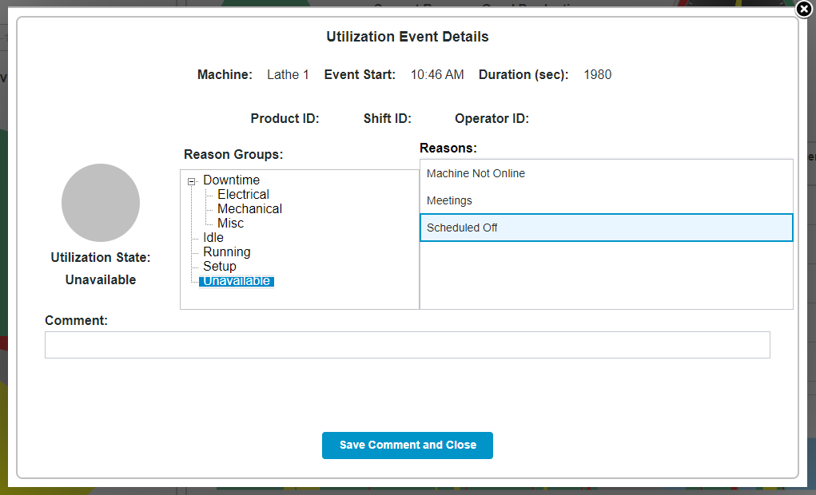
SPECIFIC MACHINE
Same utilization event pop-up as before – ability to save comment and change reason if state is “Downtime” and reason is “Unknown”
Double click grid or Gantt details to view event specific data

Slide 16
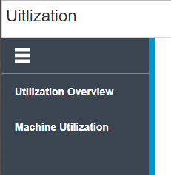
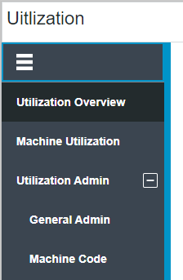




PERMISSIONS
Users in the PTCDTS.Base.Permissions.Default_UG will see the following menu options:
Users in the PTCDTS.Base.Permissions.ApplicationAdmin_UG will see the following menu options:

Slide 17
UTILIZATION Building Block Overview

Slide 18
Building Block Projects for Utilization Application
PTCSC.UtilizationUI
UI BLOCK
Utilization UI components that call into the PTCSC.Utilization
PTCSC.UtilizationTWImpl
IMPL BLOCK
Implementation of PTCSC.Utilization that uses ThingWorx data structures
PTCSC.Utilization
ABSTRACT BLOCK
Utilization logic, data shape and service definitions
PTCSC.UtilizationAdminUI
UI BLOCK
Utilization UI administration user components that call into the PTCSC.Utilization
PTCSC.UtilizationSQLImpl
IMPL BLOCK
Implementation of PTCSC.Utilization that uses SQL data structures

Slide 19
KEY PTCSC.Utilization ENTITIES and Notes
PTCSC.Utilization.Management_TS
Building Block services are defined here – name and parameters and configured to be overridden
PTCSC.Utilization.ModelLogic_TS
Building Block required model properties and services to call into the data structures are defined here. Services call into the configured implementation manager
Notes:
All required data shapes reside in this building block
The ModelLogic Thing Shape services can:
Look up the implemented block for the abstract manager:
let managerThing = me.GetConfiguredManagerForIdentifier({ identifier: "PTCSC.Utilization.Manager" });
And then reference that manager in the service calls on the shape
let result = Things[managerThing].GetElapsedTime();
Properties in ModelLogic use PTCSC prefix
Services in ModelLogic use something like “GetPTCSCElapsedTime”

Slide 20
UTILIZATION MODEL ENTITIES
Create a template for the model entities (equipment that will use the application)
May need to use a RemoteThing template if you are mapping some tags in from Kepware
Apply these two thing shapes to the model template
PTCSC.Utilization.ModelLogic_TS
PTC.Base.ConfigManagement_TS

Slide 21
KEY PTCSC.UtilizationTWIMPL ENTITIES and Notes
PTCSC.UtilizationTWImpl.Manager_TT
Code for the services inherited from the PTCSC.Utilization.Management_TS resides here.
Notes:
ThingWorx Data Objects
PTCSC.UtilizationTWImpl.MachineCode_DT
PTCSC.UtilizationTWImpl.Reason_DT
PTCSC.UtilizationTWImpl.ReasonGroup_DT
PTCSC.UtilizationTWImpl.UtilizationState_DT
PTCSC.UtilizationTWImpl.Utilization_SM

Slide 22
KEY PTCSC.UtilizationSQLIMPL ENTITIES and Notes
PTCSC.UtilizationSQLImpl.Manager_TT
Code for the services inherited from the PTCSC.Utilization.Management_TS resides here. These services will call into the PTCSC.UtilizationSQLImpl.Database.
PTCSC.UtilizationSQLImpl.SQLDatabase_TT
Code for the services that make calls directly into the database reside on this template.
Notes:
The PTCSC.UtilizationSQLImpl.Database thing inherits up the chain from the generic SQLThing thing template
A SQLThing uses an existing persistence provider and allows a database connection to be shared across things

Slide 23
UTILIZATION UI BUILDING BLOCK NOTES
PTCSC.UtilizationUI is the main UI building block and contains all of the application screens
PTCSC.UtilizationAdminUI is super simple UI building block that only allows admin users to access the administration utilization screens

