Slide 1
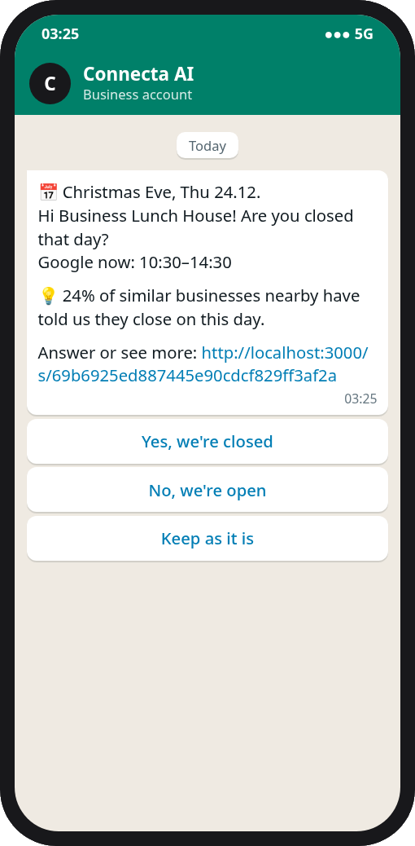
Connect Suggests
SINCE AI HACKATHON 2026 · FONECTA CHALLENGE
No customer walks to a closed door.
Connect notices when a business's holiday hours are about to be wrong, suggests the right hours with the reason, and the owner approves in one tap.
Team Token Burners
Notes:
We're Token Burners. Around holidays, Google often shows the wrong opening hours, because owners forget to update them. Connect Suggests fixes that: it notices when hours are about to be wrong, suggests the right ones with the reason, and the owner approves with one tap. What you see on the right is a real message from our demo.

Slide 2



Holiday hours go wrong when they matter most
Owners forget
Today the owner logs in and enters exception hours themselves. Many forget, or have no time.
6 in 10
Customers walk to a closed door
holiday dates where the owner has never entered hours for that holiday
Google keeps showing normal hours on Christmas Eve, New Year's Day and Epiphany.
Visibility drops when demand peaks
6,616 of 11,100 days for 802 businesses, 2026 season. There is nothing of their own to copy, so Connect has to work it out.
Missing or outdated hours can drop a business out of "open now" searches.
Notes:
The problem: today owners have to log in and enter their holiday hours themselves. Many forget. Google then shows normal hours, customers walk to a closed door, and the business can drop out of 'open now' searches exactly when people are searching most. And the hard part: on six out of ten holiday dates, the owner has never told us what they do. So we can't just copy last year.

Slide 3






One loop, five steps, and the owner decides
1 Detect
2 Suggest
3 Contact
4 Decide
5 Apply
Finds the special days where Google will show the wrong hours.
Proposes hours, with the reasons and how sure it is.
One message at a time, in the owner's language, channel and contact hours.
Yes, no or edit, in one tap. No login.
Written to Yext. The owner sees where the new hours show.
And it learns. Every answer goes back to the predictor, and the business is predicted again within seconds.
Notes:
Our solution is the whole chain Fonecta asked for. Detect: a predictor finds the days where Google will be wrong. Suggest: it proposes hours, with the reasons and how sure it is. Contact: one message at a time, in the owner's language, on their channel, within their contact hours. Decide: one tap, no login. Apply: the change is written to Yext and the owner sees where it shows. And every answer goes straight back into the predictor.

Slide 4
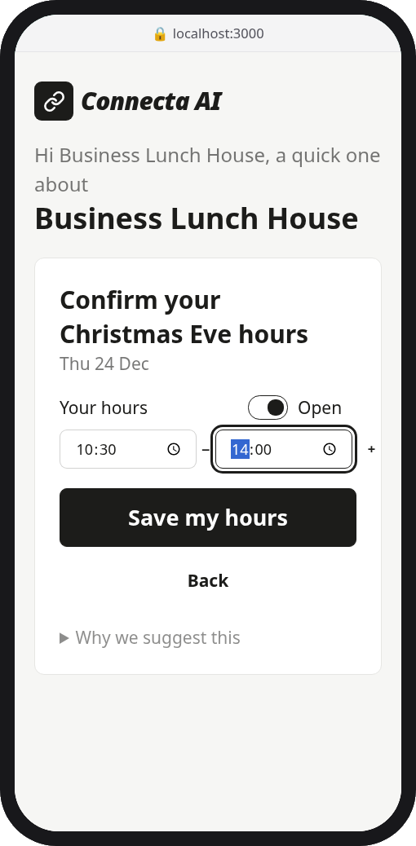
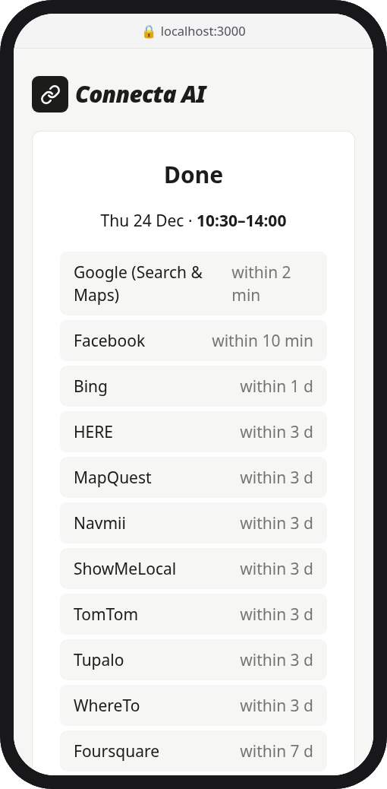



The owner answers in one tap, without logging in
Finnish, Swedish, Norwegian and English
WhatsApp, Telegram and email, sent for real
Waits for the owner's contact hours. Owners who opted out get nothing
1 WhatsApp: a yes-or-no question, with buttons
2 Or edit the hours on a page that needs no login
3 Saved to our real Yext sandbox, with where it shows
Business Lunch House is a test business in our Yext sandbox, read and written through the live Yext API.
Notes:
This is what the owner sees. The message asks one yes-or-no question, and the buttons answer it. If the hours need a change, the link opens a page that needs no login. Here the owner sets 10:30 to 14:00 on Christmas Eve. The change is written to our real Yext sandbox, only that one date, and the owner sees which sites show it now and how soon the rest follow. It works in four languages, and messages wait for the owner's contact hours.

Slide 5




How the predictor decides one day
Every special day
First checks
Clues propose hours
The model scores them
Each business, each day from 7 Nov 2026 to 6 Jan 2027.
Shut down for good? Flag it. Owner already answered the day? Stay quiet.
Each with the evidence behind it, and a reason the owner can read.
It predicts the points each option would earn on the organisers' scale.
Each day ends in one of three ways
Suggest
Stay quiet
Flag for a person
when it expects to be right more often than wrong
otherwise. Most owners without history keep their normal hours
when customers say the business has shut down for good
A full run decides every day in about 20 seconds on a laptop, with no internet and only Python's standard library.
Notes:
Here's how the predictor works. It goes through every business and every special day from 7 November to 6 January, one at a time. First checks: if customers say the business has shut down, it's flagged for a person. If the owner already answered or entered that day, we stay quiet, because the owner has the last word. Then the clues propose hours, each with its evidence. And a trained model scores every option by the points it would earn on the organisers' scale. We suggest only when we expect to be right more often than wrong. Otherwise we stay quiet. The whole season runs in about 20 seconds on a laptop.

Slide 6






Every clue brings its own evidence
The owner's history
The shopping centre
Customer reviews
The same holiday in earlier years, moved to this year's weekday. Surer when the years agree.
Shops used the hours their centre published about 85% of the time.
"Doors already closed at 16:20" becomes "closes at 16:00". About 9 in 10 "closed" readings were right.
New normal hours
Similar businesses and the type
Snow, seasons, Google edits
"Now only open Mon-Fri 10-18" in a review matched the true hours on 112 of 112 weekdays.
88% of businesses like Kahvila Kipinä were closed on Christmas Day in earlier years.
Ski rentals were always closed with under 10 cm of snow. Summer terraces close for the winter.
Notes:
Every clue comes with evidence from the data. The owner's own history is the strongest. Shops in a shopping centre used the centre's published hours about 85 percent of the time. Customer reviews are read by language models: 'we came at 16:20 and the doors were already closed' becomes 'closes at 16:00' next year. When a review states new normal hours, it matched the true hours on all 112 weekdays we could check. For new owners, what similar businesses and the business type do matters most. And small ones: no snow means the ski rental is closed.

Slide 7
Language models read. A trained model decides.
Reading reviews
Deciding
"Tultiin uudenvuodenpäivänä klo 16.20 ja ovet olivat jo kiinni. Netissä oli eri ajat."
Decision trees trained on past seasons, replayed as if they were happening live:
We came on New Year's Day at 16:20 and the doors were already closed. The internet had different hours.
Winter 2024
Winter 2025
Springs 2024-26
2025 pilot answers
Each season starts from its own snapshot date, with only what was known then. Every possible suggestion is scored the way the organisers score.
So it learns how far to trust each clue: last year's hours from an owner who updates every year, more than from one who skipped two years.
Next New Year's Day: closes at 16:00
Qwen2.5-72B reads Finnish, Mistral-Small 24B Swedish and Norwegian, through Featherless. All 1,350 reviews cost about 10 cents.
A language model deciding on its own: 17.7% Our trained model: 36.7% (on the days owners never told us about, 39 businesses)
Notes:
The split of work matters. Language models read: here a real Finnish review from the dataset, 'we came on New Year's Day at 16:20 and the doors were already closed', becomes 'closes at 16:00' for next New Year's Day. Reading all 1,350 reviews cost about ten cents. The decisions are made by decision trees trained on past seasons, replayed as if they were live, using only what was known at the time and scored the way the organisers score. That's how it learns how far to trust each clue. We also tried letting a language model decide everything by itself. On the hardest days it scored 17.7 percent, against 36.7 for our model.

Slide 8
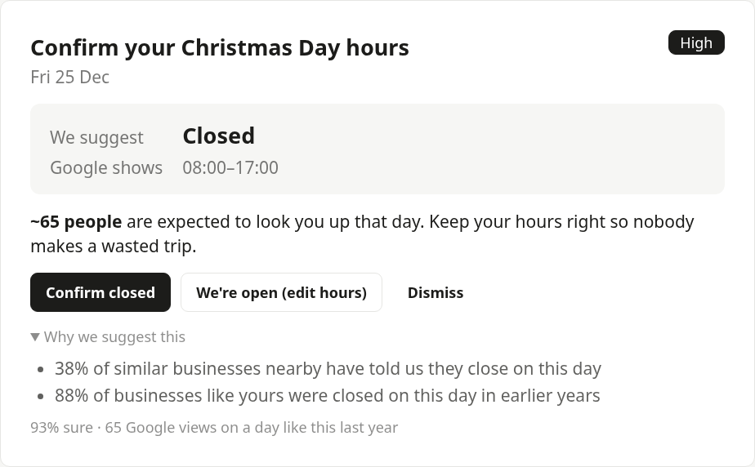



A new customer with no history still gets suggestions
Kahvila Kipinä, a café in Turku, had never entered any holiday hours
It gets five suggestions, each with its reasons and how sure it is
Nothing on days where the evidence is weak: most owners without history keep their normal hours
Notes:
The brief asked how it behaves for a customer with no history. Kahvila Kipinä, a café in Turku, had never entered holiday hours. It still gets five suggestions. Christmas Day closed is 93 percent sure, because 38 percent of similar businesses nearby told us they close, and 88 percent of businesses like it really were closed in earlier years. On days where the evidence is weak, it says nothing, because most new owners keep their normal hours.

Slide 9
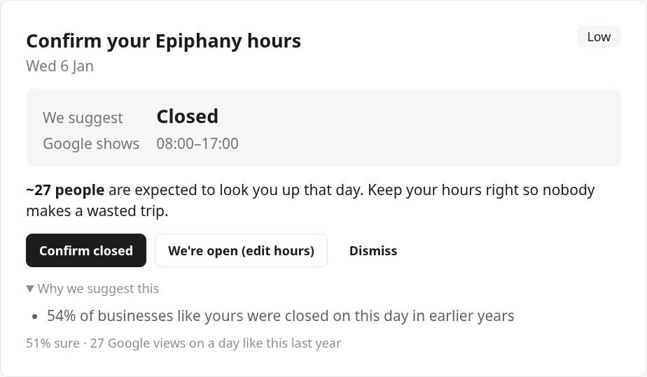




One answer improves the next suggestion
Before: 51% sure
After: 64% sure, with a new reason
Owner confirms Christmas Day closed
Within seconds
Declined means no
Standing permission
Every answer, on any channel, predicts the business again.
Declined hours are never suggested again for that holiday.
"Handle public holidays without asking", applied only when at least 70% sure.
Notes:
Connect learns from every answer. When Kipinä's owner confirms they're closed on Christmas Day, the predictor runs again within seconds. Their answer counts as their own word, so it changes the other days too: Epiphany closed goes from 51 to 64 percent sure, with a new reason, 'you were closed on most of the special days you have told us about'. A declined suggestion is never repeated for that holiday. And owners can give standing permission to handle public holidays without asking, which we only use when we're at least 70 percent sure.

Slide 10
68.3% on businesses the model never saw
When the owner had entered that holiday before
68.3%
88%
94%
96%
with the organisers' own scorer, 2026 season
of suggestions have exactly the right hours
right about open or closed
of lookups that would have hit a closed door, prevented
54.5%
the organisers' baseline
When they never had
Less to go on, and most owners keep their normal hours, so it speaks up on only 880 of 6,616 days. Every answer moves an owner into the first group.
65.2%
2025 back-test, using only what was known on 6 Nov 2025
802 dev businesses, 11,100 days, each decided by a model trained without it. Reproduce: uv run apps/predictor/train.py --check
Notes:
The results, measured honestly: every business is decided by a model that never saw it, the way the hidden test businesses will be, and scored with the organisers' own scorer. 68.3 percent, against their baseline of 54.5. Where the owner has told us about a holiday before, 88 percent of our suggestions have exactly the right hours, 94 percent get open or closed right, and 96 percent of the lookups that would have hit a closed door are prevented. Where they never have, we mostly stay quiet. Every answer moves an owner into the first group, which is why learning matters.

Slide 11



What moved the score, and what didn't
What we learned
Copying similar businesses failed
Most owners without history keep their normal hours, so it mostly messaged owners who were already right.
Activity, neighbours, events
Each looked promising alone, but added nothing on top of the clues we had.
Perfect memory stops at 81.9%
Repeating exactly what every owner did last time. Owners change their habits.
Notes:
How we got there. Hand-made rules took us from the baseline's 54.5 to 66.7. A trained model that learned from past seasons when to speak and when to stay quiet added another point, and reading new normal hours from customer reviews brought us to 68.3. Just as useful is what didn't help. Copying what similar businesses do mostly messaged owners who were already right, and customer activity, neighbours and event sizes added nothing the model didn't already know. And even perfect memory, repeating exactly what every owner did last time, would stop at 81.9 percent, because owners change their habits.

Slide 12




The owner always has the last word
Nothing is published without approval or standing permission
What the owner answered or entered is never overruled
The same loop, other jobs
Outdated normal hours
Reviews like "new owner, new hours, Google has the old ones" were right in 14 of 15 businesses.
Quiet when unsure, or when a page the owner linked disagrees
Every suggestion keeps what was suggested and why
Closed for good
Already flagged for a person at Fonecta to check.
Review replies and posts
Detect, suggest, ask, apply: the same steps.
Notes:
Reliability: the owner always has the last word. Nothing is published without their approval or standing permission, and a day they answered or entered themselves is never suggested again. We stay quiet when we're unsure or when a page they linked disagrees, and every suggestion keeps its reasons. Opt-outs, channel, language and contact hours are respected, as on the message slide. The same loop works for more than holiday hours: outdated normal hours, businesses that closed for good, and the review replies and posts Fonecta already has on the roadmap.

Slide 13

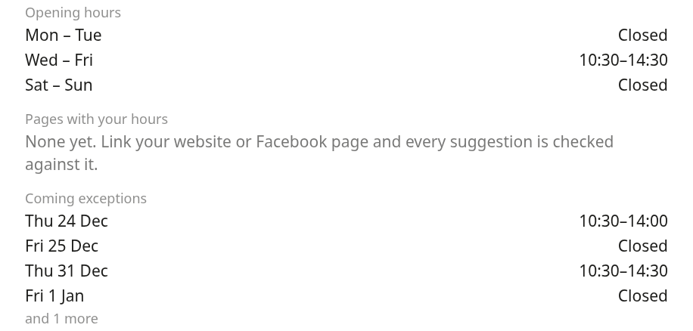


Live source: our Yext sandbox
We replaced entities.json and listings.json with Yext's Knowledge Graph Entities and Listings for the sandbox's businesses. They are read again each time the dashboard opens, and approved changes are written back.
Coverage
Two test businesses, both in Tampere. 11 publishers live, among them Google, Facebook and Bing. No Nordic directories, no Apple Maps.
Quality
Fonecta's category id isn't one of the dataset's types, so we guess the type from the name. Google and Facebook say NOT_CONNECTED.
Gaps
No reviews, Google suggestions or past holiday hours, and Analytics returned a server error. The predictor relies on similar businesses.
Business Lunch House's hours read back from Yext after the owner's edit: Christmas Eve 10:30-14:00.
Notes:
The bonus: we replaced the dataset's entities and listings with a live source, our team's Yext sandbox. Its businesses appear in the app, are read from Yext each time their dashboard opens, and approved changes go back through the Yext API. What we learned: coverage is two test businesses and 11 live publishers, with no Nordic directories. On quality, Fonecta's category id isn't one of the dataset's types, so we guess the type from the name. The gaps: no reviews, no suggestions, no history, and Analytics returned a server error, so the predictor relies on what similar businesses do.

Slide 14
Next steps
1
Ask when unsure
2
Outdated normal hours
"Are you open on 26 December?" instead of a doubtful suggestion. Every answer teaches the model.
Reviews like "new owner, new hours" were right in 14 of 15 businesses. The next suggestion type.
3
Retrain on everyone's answers
4
More live sources
Each answer already updates that owner's suggestions. Next, the model also retrains on them, as on the pilot's.
Shopping centres' feeds, business registers (PRH, Brønnøysund, Bolagsverket) and live weather.
Data: Connect Suggests simulator, Since AI ry 2026 (CC BY 4.0). All businesses are synthetic.
Notes:
Next steps. When we're unsure, ask a question instead of making a doubtful suggestion, because every answer teaches the model. Use the same loop for outdated normal hours, which customer reviews already point to. Today every answer updates that owner's own suggestions within seconds; next, the model itself also retrains on all owners' answers, as it already does on the pilot's. And connect more live sources: shopping centres' feeds, business registers and live weather. Thank you.

