Slide 1
CS382 FINAL PROJECT
CarWise Cambodia
A grounded RAG search system for Cambodian car recommendations · 29 July 2026
Notes:
Open with the user problem: marketplace search is broad, but buyer questions are specific.
[Sources]
- /Users/rith_45/Downloads/Final_Project_Brief.pdf
[/Sources]

Slide 2
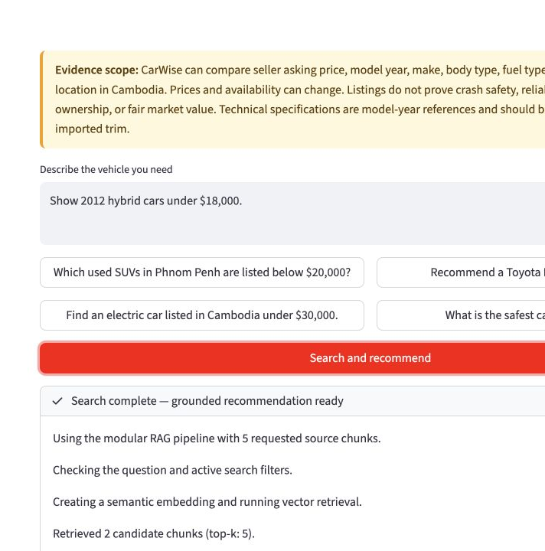
Verifiable car recommendations
THE USER EXPERIENCE
Ask a question in plain language. Adjust top-k, similarity, answer mode, provider, year, make, body type, location, and budget. Review photo cards, comparable prices, a grounded answer, and expandable source chunks.
2
Notes:
Demonstrate the query box, adjustable controls, and visible pipeline progress.
[Sources]
- /Users/rith_45/Documents/Search Engine/presentation_assets/carwise-demo.png
- /Users/rith_45/Documents/Search Engine/app.py
[/Sources]

Slide 3
The first half of the pipeline creates searchable evidence
INGEST
Load the checked-in Khmer24 snapshot and validate required listing fields. One unique marketplace listing becomes one document.
CHUNK
Create a complete-profile chunk plus section-aware chunks. Long text splits at sentence boundaries with controlled overlap.
EMBED
Encode every chunk with all-MiniLM-L6-v2 and normalize the vectors for cosine similarity.
01
02
03
3
Notes:
[Sources]
- /Users/rith_45/Documents/Search Engine/carwise/cambodia_dataset.py
- /Users/rith_45/Documents/Search Engine/carwise/chunking.py
- /Users/rith_45/Documents/Search Engine/carwise/embeddings.py
[/Sources]

Slide 4
The second half retrieves, generates, and shows its work
RETRIEVE
Embed the query, enforce price/year/make/fuel/body constraints, rank by cosine similarity, and keep the top-k distinct vehicles.
GENERATE
Pass the three strongest profiles to a real local instruction LLM. Require source labels before displaying the answer.
INTERFACE
Show recommendation cards, nearby-price options, latency, and every retrieved chunk with title, score, text, and direct links.
04
05
06
4
Notes:
This slide maps directly to the six-stage architecture required by the brief.
[Sources]
- /Users/rith_45/Documents/Search Engine/carwise/vector_store.py
- /Users/rith_45/Documents/Search Engine/carwise/generation.py
- /Users/rith_45/Documents/Search Engine/app.py
[/Sources]

Slide 5
Modular code and evidence artifacts make the system reproducible
SEPARABLE LAYERS
Ingestion · cambodia_dataset.py Chunking · chunking.py Embeddings · embeddings.py Retrieval · vector_store.py Generation · generation.py Interface · app.py
REPRODUCIBLE OUTPUTS
Timestamped raw snapshot 600 generated documents Persistent vector index Nine-query evaluation JSON Per-query written report 22 automated unit tests
5
Notes:
Use this slide to cover LLO3: code organization and documentation.
[Sources]
- /Users/rith_45/Documents/Search Engine/README.md
- /Users/rith_45/Documents/Search Engine/tests/
- /Users/rith_45/Documents/Search Engine/evaluation/report.md
[/Sources]

Slide 6
A focused Cambodian corpus is large enough for meaningful retrieval
DATASET COVERAGE
The collection is a reproducible snapshot of public Khmer24 vehicle listings, enriched conservatively with model-year or manufacturer-family specifications.
600
51
3,000
unique Cambodian listings
identified vehicle makes
searchable evidence chunks
6
Notes:
[Sources]
- /Users/rith_45/Documents/Search Engine/README.md
- /Users/rith_45/Documents/Search Engine/data/documents/_manifest.json
[/Sources]

Slide 7
Design choices prioritize demo reliability and transparent evidence
WHY THIS RETRIEVAL DESIGN
Section-aware chunks preserve context. Cosine search is sufficient for 3,000 chunks. Strict metadata filters protect budget and vehicle constraints. Top-k 5 balances choice with readable evidence.
WHY THIS GENERATION DESIGN
A compact three-profile prompt lowers local latency. Qwen 0.5B works offline with no API key. A citation guard blocks uncited output. Cards and source chunks remain authoritative when prose is weak.
7
Notes:
Explain the trade-off: offline reliability is stronger than prose quality.
[Sources]
- /Users/rith_45/Documents/Search Engine/README.md
- /Users/rith_45/Documents/Search Engine/carwise/chunking.py
- /Users/rith_45/Documents/Search Engine/carwise/generation.py
[/Sources]

Slide 8
Evaluation separates retrieval success from language-model quality
NINE RECORDED TEST QUERIES
Each query records retrieved documents, similarity scores, generated output, citations, latency, and a manual qualitative assessment.
9 / 9
9 / 9
4 / 9
retrieval evidence coverage
valid citation grounding
manual answer-quality passes
8
Notes:
Mean retrieval latency was 0.01 seconds; mean local generation latency was 4.79 seconds.
Do not hide the 4/9 result: it motivates the documented provider trade-off.
[Sources]
- /Users/rith_45/Documents/Search Engine/evaluation/latest_results.json
- /Users/rith_45/Documents/Search Engine/evaluation/report.md
[/Sources]

Slide 9
Evidence boundaries keep recommendations honest
SUPPORTED
Seller asking price Model year and make Body and fuel type Cambodian location Reference efficiency and specifications
NOT VERIFIED
Crash safety or reliability Mechanical condition Ownership or paperwork authenticity Fair market value Current availability Exact imported trim
9
Notes:
Show the unsupported safety query during the live demo to demonstrate graceful failure.
[Sources]
- /Users/rith_45/Documents/Search Engine/README.md
- /Users/rith_45/Documents/Search Engine/carwise/pipeline.py
[/Sources]

Slide 10
LIVE DEMO
Ask. Retrieve. Verify.
1 · Search: hybrid under $18k
2 · Verify: scored source chunks
3 · Refuse: unsupported safety
Notes:
Close by returning to the central claim: useful recommendations must remain verifiable.
[Sources]
- /Users/rith_45/Documents/Search Engine/README.md
- /Users/rith_45/Downloads/Final_Project_Brief.pdf
[/Sources]

