Slide 2
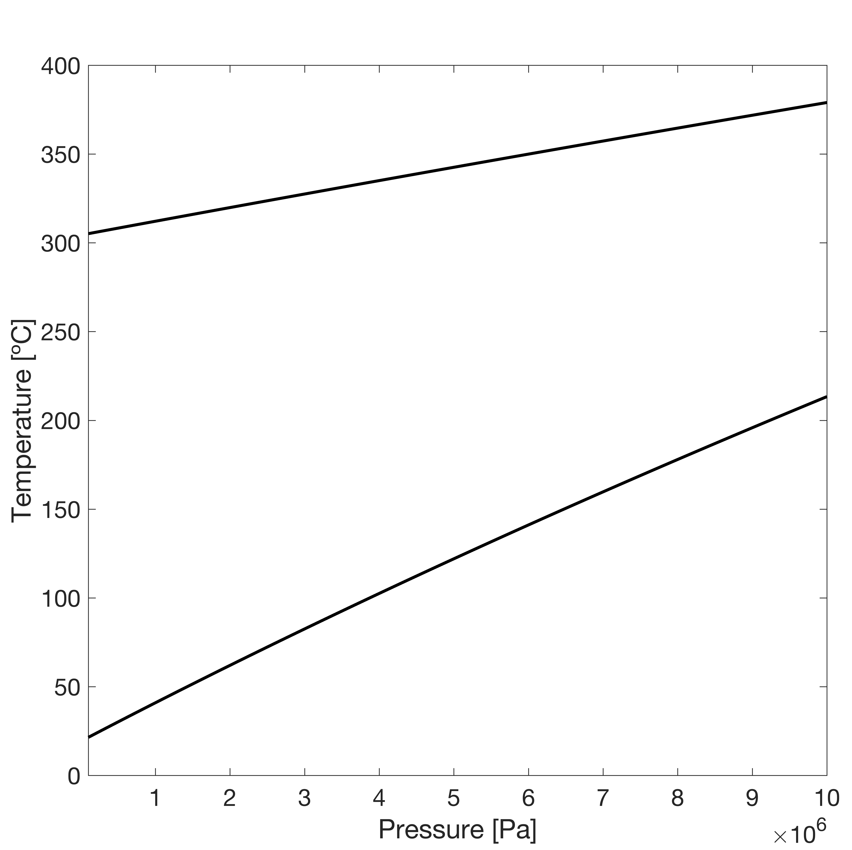



$$2Al+2H_{2}O→3H_{2}+Al_{2}O_{3}$$
$$2Al+4H_{2}O→3H_{2}+2AlO\left(OH\right)$$
$$2Al+6H_{2}O→3H_{2}+2Al{\left(OH\right)}_{3}$$

