Slide 3

Median drop in ridership is 28%
Median drop in ridership is 39%

Slide 4


Slide 5
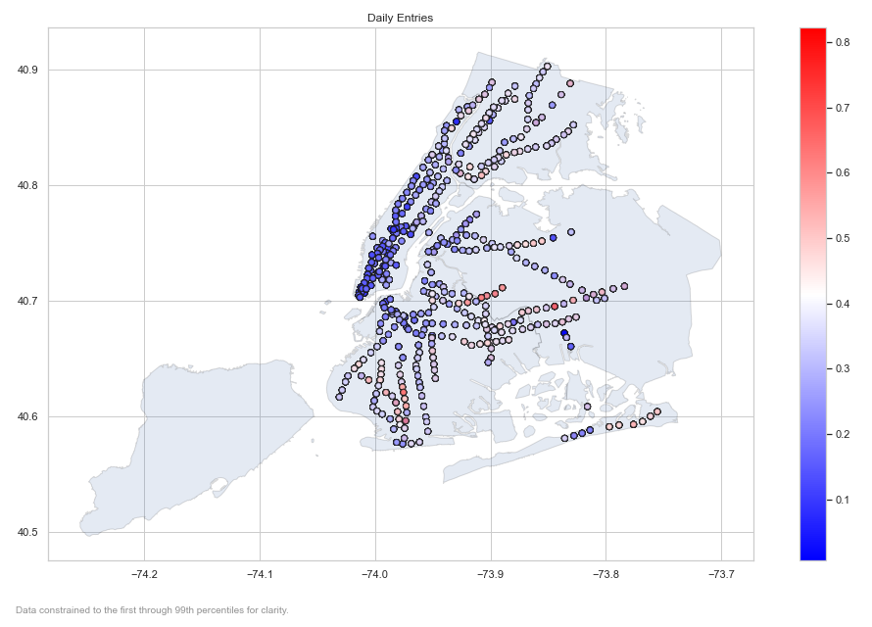

Slide 7


Slide 8
