Slide 1
Heterogeneity in Public Transit Usage During a Pandemic:
The case of NYC
Given the research on infection transmission and social proximity, MTA trains and stations are a likely source of virus propagation. As such, a better understanding of MTA usage during an outbreak can help determine if and how ridership policies, such as limiting hours of operation or instituting daily maximums, may complement existing policy to slow the spread of the virus.

Slide 2
Proportional Ridership Change
July
2020
GIS
Daily ridership
Day of the week ridership
July
2019
Hourly
July
2018
Geographic distribution
July
2017
3,558,944 observations of 5,116 turnstyles across 426 station complexes clustered in 4-hour daily time-blocks

Slide 3
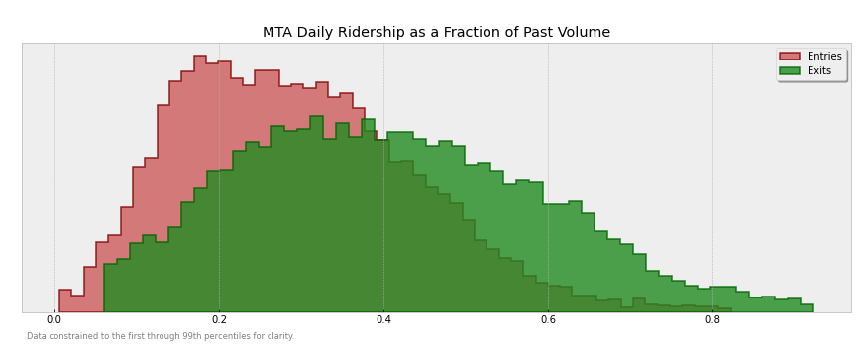
Median drop in ridership is 28%
Median drop in ridership is 39%

Slide 4
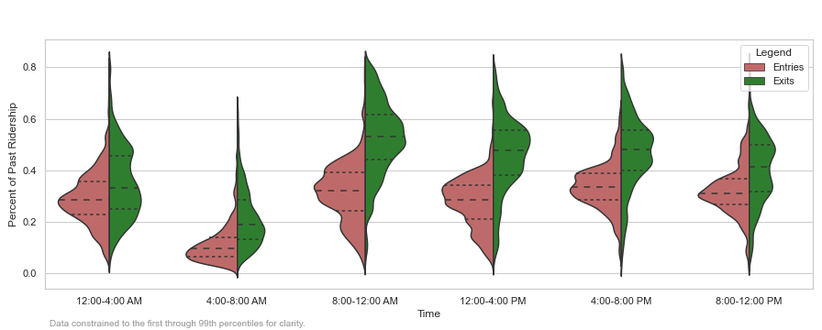
Bandwidth available in the 4:00 - 8:00 AM block.
Fare reductions could incentivize people to take an earlier commute

Slide 5
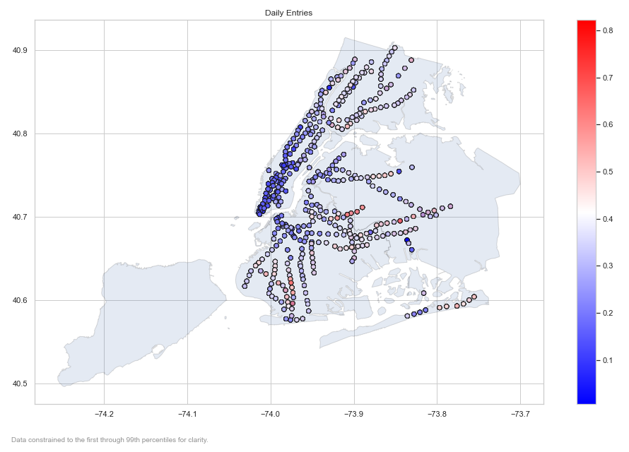

Slide 6
Meaningful heterogeneity in ridership decline? Yes.
Actionable implications for health and transportation policy? Yes.
Where to go next?
Reconciling entry with exits
Integrating weather data

Slide 7
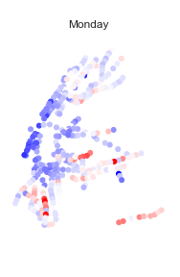
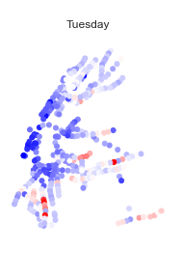
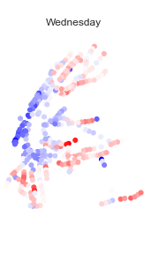
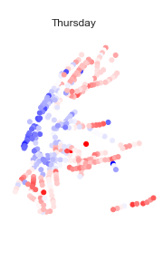
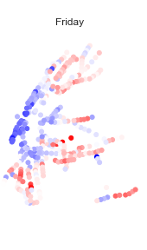
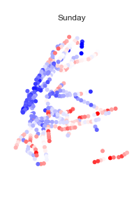
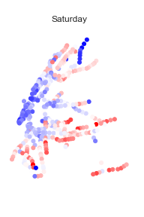
Smallest reductions occur later in the week, on the more remote areas of the system.

Slide 8
