Slide 1
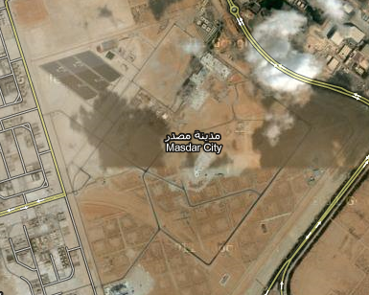
(θ,φ)
α
+X
+Y
N
W
E
S

Slide 13
Synthesis Template
City
Cell Regions
Cells
Systems
Node Regions
Nodes
Edge Regions
Edges
Cell
Origin
Layer
Destination
Node Type
Direction
Edge Type
Attributes
Attributes

Slide 14
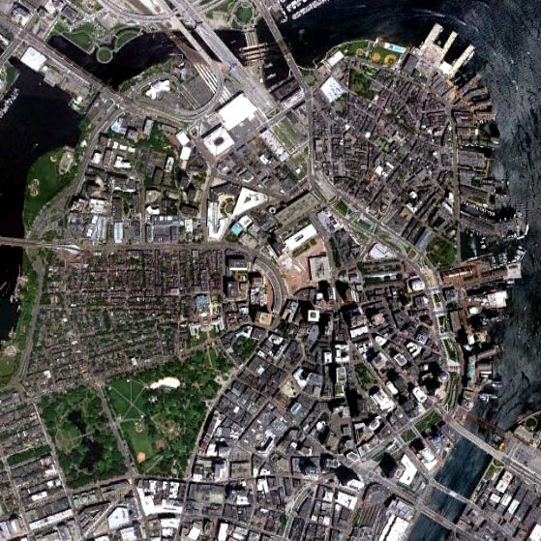
(0,0)
+X
(3,0)
North End
+Y
Esplanade
Beacon Hill
Downtown
Boston Common
Public Garden
South Boston
(0,3)
(3,3)

Slide 15
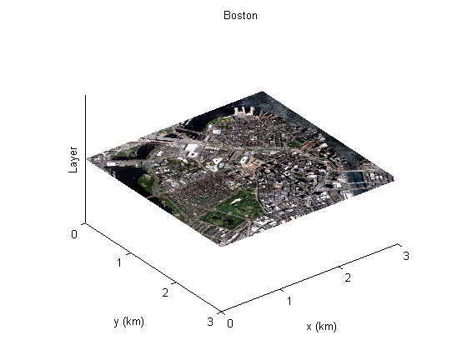

Slide 16
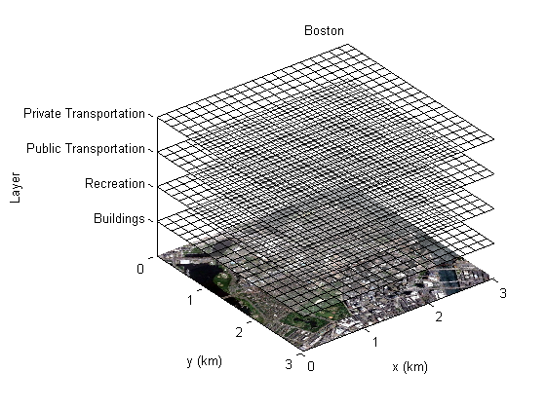

Slide 17
Legend
Residential
Commercial
Industrial
Recreational
Roadway
Red Metro Track
Blue Metro Track
Green Metro Track

Slide 18
(1.75, 1.00)
(2.10, 0.20)
(1.75, 0.40)
(2.50, 0.50)
Legend
Residential
Commercial
Industrial
Recreational
(0.90, 0.35)
(0.60, 0.55)
(1.15, 0.85)
(0.05, 1.15)
(1.40, 1.85)
(0.00, 2.20)
(0.20, 2.20)
(0.40, 2.75)
(1.05, 2.65)
(2.65, 2.10)
(0.00, 3.00)
(2.20, 3.00)
(2.50, 1.60)
(2.30, 2.80)

Slide 19
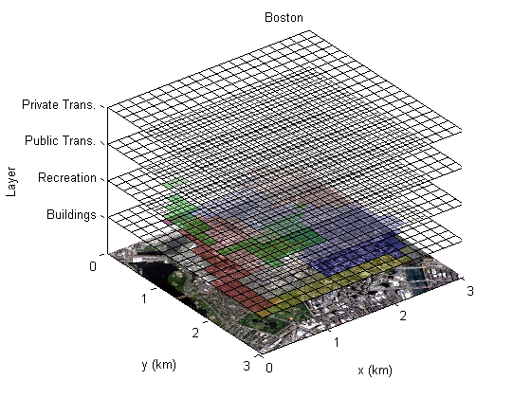

Slide 20
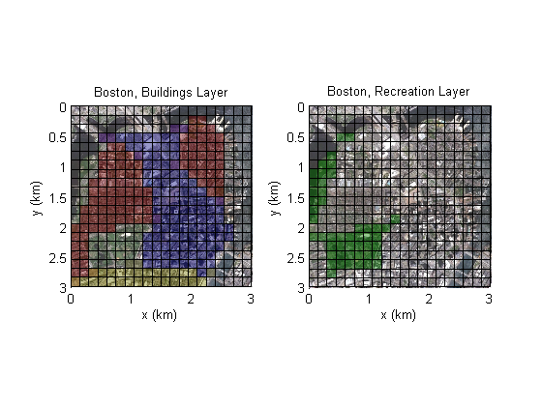

Slide 21
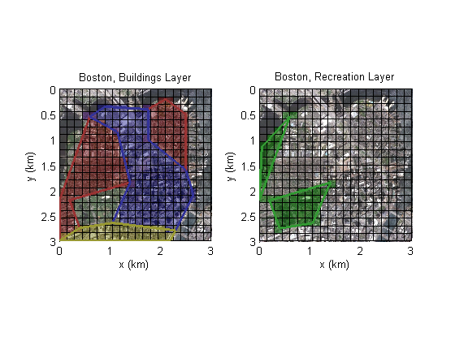

Slide 22
(2.35,1.50)
(1.00,0.00)
(3.00,0.10)
(1.95,1.20)
(1.20,0.40)
(3.00,0.65)
(0.00,0.10)
Legend
Roadway
Red Metro Track
Blue Metro Track
Green Metro Track
(0.80,0.65)
(1.40,0.80)
(1.60,1.20)
(1.35,1.30)
(0.00,1.35)
(0.35,1.40)
(1.65,1.60)
(1.80,1.65)
(0.00,2.15)
(1.35,2.00)
(0.55,2.80)
(0.00,3.00)
(1.05,2.65)
(1.85,2.60)
(2.50,2.15)
(1.60,3.00)
(1.90,3.00)

Slide 23
(2.35,1.50)
(1.00,0.00)
(3.00,0.10)
(1.95,1.20)
(1.20,0.40)
(3.00,0.65)
(0.00,0.10)
Legend
Roadway
Red Metro Track
Blue Metro Track
Green Metro Track
(0.80,0.65)
(1.40,0.80)
(1.60,1.20)
(1.35,1.30)
(0.00,1.35)
(0.35,1.40)
(1.65,1.60)
(1.80,1.65)
(0.00,2.15)
(1.35,2.00)
(0.55,2.80)
(0.00,3.00)
(1.05,2.65)
(1.85,2.60)
(2.50,2.15)
(1.60,3.00)
(1.90,3.00)

