Slide 1
REGRESSION TEST AUTOMATION
Topic 5 | Manual vs capture/replay vs data-driven
Product-search flow • Shop web app (Next.js) • Software Testing (ISTQB CTFL)
Hoàng Phúc
Hoàng Hưng
Quang Hưng
Quốc Dũng
Phương Thảo
Theory & tools
Test cases & manual
Capture/replay
Data-driven
Cost model, report, slides
Group no.: 5 • Member names and student IDs: see the assignment table in the report
Notes:
Introduce the topic: regression test automation, comparing manual, capture/replay and data-driven on the product-search flow. Introduce the five members and roles. (Fill in group number and names before presenting.)

Slide 2
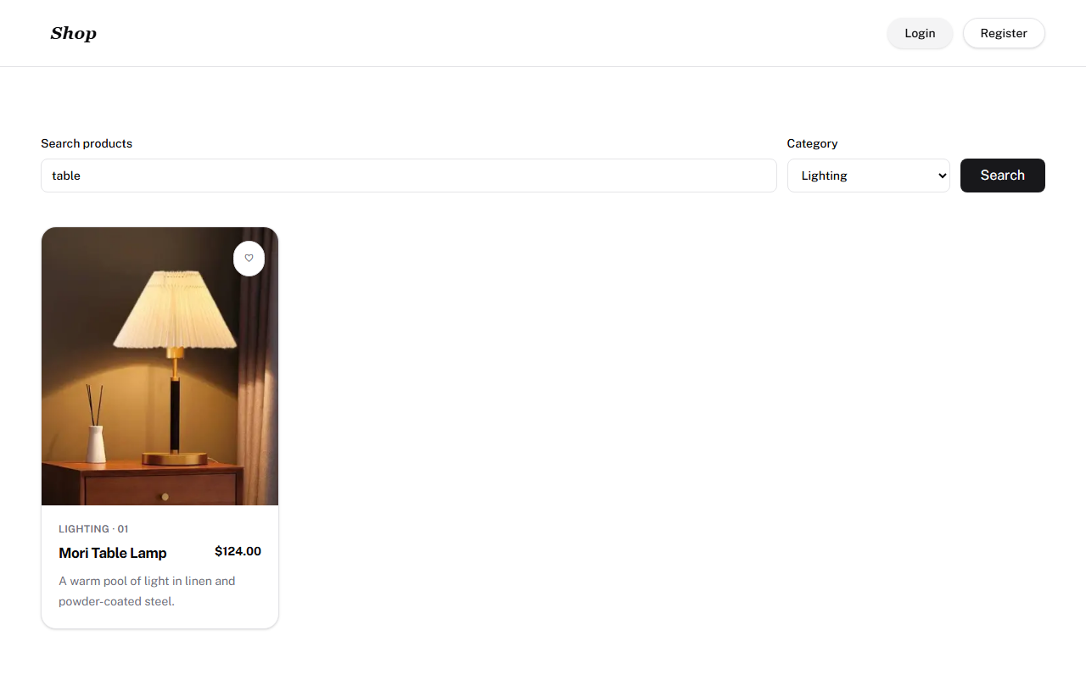
CONTEXT & MAIN QUESTION
Regression testing must be repeated after every change to protect working features. A manual run costs the same effort each time; automation costs effort to build and maintain, but later runs are cheaper.
MAIN QUESTION
After how many runs does automation have a lower total time cost than manual testing?
Target: Shop web app (Next.js) at my-app-nextjs-xi.vercel.app; source pthaok6/LabFer202. One flow only: product search.
Page under test: search box, category, Search button (TC03 evidence screenshot)
TOPIC 5 • 02 / 12
Notes:
Regression testing re-runs the suite after every change to make sure old features still work. Manual re-runs cost the same effort every time, so automation is worth considering. Main question: after how many runs is automation cheaper than manual? Target: the team Next.js Shop web app, search flow.

Slide 3
SCOPE & DESIGN
1 flow
5 test cases
3 methods
Product search
TC01–TC05 shared
Manual • capture/replay • data-driven
ID | Test case | Input (keyword / category) | Expected result
TC01 | Exact Name Search | Ripple Glass Set / All | Shows "Ripple Glass Set"
TC02 | Partial Name Search | lamp / All | "Mori Table Lamp" appears (case-insensitive)
TC03 | Keyword + Category Filter | table / Lighting | "Mori Table Lamp" appears
TC04 | Non-Existent Product | Laptop Dell XPS / All | Message "No products found."
TC05 | Empty Keyword | (empty) / All | All 6 products shown
Same data, environment (headless Chromium) and timing rule; 3 repeated runs; units in seconds/minutes.
TOPIC 5 • 03 / 12
Notes:
One flow, five shared test cases TC01 to TC05, three methods. Both automated suites use exactly the same data and timing rule, otherwise the comparison is meaningless.

Slide 4
THREE APPROACHES
RECORDED
MEASURED
MEASURED
MANUAL
CAPTURE / REPLAY
DATA-DRIVEN
Execute and check each case by hand
Record actions, refine, replay
One script reads many data sets
Follows 02_TestCases.xlsx (5 TC)
Results go to 02_ManualResults.csv
Recorded: 5/5 PASS, 51.5 s total (one run)
Playwright Codegen / Selenium IDE (.side)
search_products.spec.js: 5 tests, data hard-coded per test
Playwright Test (JavaScript), 3-run benchmark
pytest + Playwright (Python)
test_data.csv: 1 @parametrize function runs 5 rows
locators.py (Page Object): locators in one place
TOPIC 5 • 04 / 12
Notes:
Manual: step by step; durations are recorded in 02_ManualResults.csv (51.5 s for the 5 cases, one run). Capture/replay: recorded with Playwright Codegen or Selenium IDE, then assertions refined; data hard-coded. Data-driven: one pytest function reads 5 CSV rows; locators centralised in locators.py.

Slide 5
ISTQB TOOLS, BENEFITS & RISKS
ISTQB category | Tool | Purpose
Test management | Jira + Xray | Manage tests, traceability, defects
Static testing | SonarQube | Analyse code without running it
Test design | GraphWalker | Generate tests from a state model
Test execution | Selenium WebDriver | Drive browser, check results
Performance | Apache JMeter | Load, response time, throughput
Specialised | OWASP ZAP | Scan web security vulnerabilities
BENEFITS (SWT6)
Less repetitive work
Consistent, repeatable runs
Objective assessment
Easy access to information, reports
RISKS (SWT6)
Unrealistic expectations
Underestimated time and cost (S, R)
Over-reliance on the tool
Integration, interoperability issues
Vendor / open-source risks
This project uses Playwright + pytest: test execution category.
TOPIC 5 • 05 / 12
Notes:
Six ISTQB tool categories (chapter 6), one representative tool each. Playwright and pytest used here belong to test execution. Benefits and risks follow SWT6 slides 37-39; the biggest risk is underestimating build and maintenance cost, which are S and R in our model.

Slide 6
EXPERIMENT PROCESS
1
2
3
4
5
Fix test cases & environment
Run manually, log results & time
Build / run capture-replay
Build / run data-driven from CSV
Change 3 locators, time fix & verify
5 TC, URL, shared CSV schema
5/5 PASS; 51.5 s total (1 run)
spec.js, 3 runs: 11.24 s avg
pytest + CSV, 3 runs: 13.44 s avg
CR 12 min; DD 5 min; pass again 5/5
DONE
RECORDED
DONE
DONE
DONE
3 locators changed: search input, category, Search button (simulated with old selectors input.legacy-search-field, select#old-filter-category, button.btn-submit-search-v1).
TOPIC 5 • 06 / 12
Notes:
Five steps. Step 2 (manual): 51.5 s for the 5 cases, one run. Step 5: with 3 changed locators both scripts fail with TimeoutError 3000 ms on 3 interactions; after the fix both pass 5/5.

Slide 7
COST MODEL
M
A
S
R
Manual time / run
Automated time / run (5 TC)
Initial build time
Maintenance per run
51.5 s: sum of 5 cases, 1 run
Machine-measured, 3-run mean
Recorded working time
Assumed: 1 UI change per K = 30 runs
N_BE = S / (M − A − R)
Manual: C = N × M
Automated: C = S + N × (A + R)
R = R_locator / K (no double counting)
Only if M > A + R; otherwise automation never breaks even.
Smallest whole number of runs that is cheaper = floor(N_BE) + 1. All quantities in seconds.
TOPIC 5 • 07 / 12
Notes:
Four quantities M, A, S, R. A is machine-measured; S and locator-fix time are durations recorded by members; R is converted with the assumption K=30; M = 51.5 s is the sum of the manual durations in 02_ManualResults.csv (one run). The formula only makes sense when M > A + R.

Slide 8
COMPARISON TABLE
Metric | Manual | Capture/replay | Data-driven
S – initial build | — | 35 min (2,100 s) | 50 min (3,000 s)
Time / run (A, 5 TC) | 51.5 s (1 run) | 11.24 s | 13.44 s
Maintenance R / run (K = 30) | — | 24 s | 10 s
Pass rate (3 runs × 5 TC) | 100% (5/5, 1 run) | 100% (15/15) | 100% (15/15)
Time to fix 3 locators | — | 12 min (720 s) | 5 min (300 s)
Where locators are edited | — | In each test (5 tests) | 1 file: locators.py (3 lines)
Locator repair: data-driven is 2.4× faster (58.3% less). Initial build: data-driven takes 15 min more.
TOPIC 5 • 08 / 12
Notes:
Figures come from the 03/04 Metrics.csv files and the two reports. Capture/replay is cheaper in S (35 vs 50 min) and A, but fixing locators takes 12 vs 5 min. The manual column comes from 02_ManualResults.csv (one run; executed_at and evidence are still blank).

Slide 9
COST CURVES
107
runs: data-driven becomes cheaper than manual (K = 30); capture/replay needs 130
~76 runs: data-driven overtakes capture/replay. If the UI never changes (R = 0): break-even at 53 (CR) and 79 (DD) runs.
M comes from one recorded manual run (51.5 s). Break-even is very sensitive to M and K: treat it as indicative.
TOPIC 5 • 09 / 12
Notes:
The two automated lines use measured data; they cross at about 76.3 runs, so from run 77 data-driven is cheaper than capture/replay if K=30. If the UI never changes (R=0) capture/replay is always cheaper. The manual line N×M uses M = 51.5 s (single recorded run); data-driven beats manual after 107 runs and capture/replay after 130 (K=30).

Slide 10
RESULTS & DISCUSSION
M = 51.5 s FROM ONE RECORDED MANUAL RUN
NL1 • Testing shows presence of defects, not their absence
Option | A + R (s) | N_BE at M = 51.5 s | Smallest whole runs
CR, UI stable (R=0) | 11.24 | 52.2 | 53
CR, K = 30 (R=24) | 35.24 | 129.2 | 130
DD, UI stable (R=0) | 13.44 | 78.8 | 79
DD, K = 30 (R=10) | 23.44 | 106.9 | 107
15/15 pass only holds for these 5 TC; it does not prove the site is defect-free.
NL5 • Pesticide paradox
Repeated tests stop finding new defects; DD refreshes data by adding CSV rows.
Sensitivity (what-if): if M were 20% lower (41.2 s), break-even would move to 71 / 353 (CR) and 109 / 169 (DD) runs for R = 0 / K = 30.
NL6 • Testing is context dependent
Explained by the logs: R_locator = time to read the log, inspect the DOM, fix and re-run. All figures apply to these 5 TC only.
Low S suits a stable UI; if locators change often, DD is worth the investment.
TOPIC 5 • 10 / 12
Notes:
With M = 51.5 s (sum of the five manual durations in 02_ManualResults.csv, one run) the break-even is about 107 runs for data-driven and 130 for capture/replay when K = 30; 79 and 53 if the UI never changes. The what-if line shows how sensitive this is to M. Links to ISTQB principles 1, 5 and 6.

Slide 11
CONCLUSION
Both automated suites run reliably
SCOPE
1
15/15 pass each; A = 11.24 s (CR) and 13.44 s (DD) for 5 TC.
Product-search flow, Shop web app (Next.js), 5 TC, headless Chromium, 3 timed runs.
Data-driven is cheaper to maintain
2
Fixing 3 locators: 5 vs 12 min; initial build 50 vs 35 min. From ~77 runs (K = 30) DD is cheaper than CR.
LIMITATIONS
Break-even vs manual: ~107 runs (DD), ~130 (CR)
M from one manual run (no evidence yet); suites timed on different days; locator change simulated; R assumes K = 30.
3
With M = 51.5 s and K = 30. If the UI never changes: 79 (DD) and 53 (CR) runs.
Automation pays off when runs repeat often and maintenance cost is kept under control.
TOPIC 5 • 11 / 12
Notes:
Three conclusions. Both suites are reliable; data-driven is cheaper to maintain; against the recorded manual time (51.5 s, one run) automation breaks even after about 107 runs (DD) or 130 (CR) with K = 30. Caveats: the manual run has no timestamp or evidence yet, 3-run samples, one flow, simulated locator change.

Slide 12
Q&A • 5 MINUTES
Why must all methods share the same test cases?
What happens when M ≤ A + R?
1
2
How is R measured, and how is double counting avoided?
Can test quality be inferred from run time alone?
3
4
How do capture/replay and data-driven differ in data reuse?
How do results change with more runs or a frequently changing UI?
5
6
Thank you for listening!
TOPIC 5 • 12 / 12
Notes:
Suggested answers: (1) same test cases make the comparison fair; (2) if M ≤ A+R there is no finite break-even, automation does not save time; (3) R = R_locator / K, locator repair is already inside R so it is not added twice; (4) no, short run time does not mean high test quality: coverage and assertion quality matter; (5) CR hard-codes data in each test, DD moves data to CSV; (6) R depends on the assumed K.

