Slide 1


WILLSON FINANCIAL
GROUP 3:
PRAVEEN THEERTHAGIRI
LOREN ALVAREZ
MODULE 11.2
DATABASE DEVELOPMENT AND USE

Slide 2
Welcome
Hello, we are Praveen Theerthagiri and Loren Alvarez. For our presentation we chose the Willson Financial Case Study.
WILLSON FINANCIAL
GROUP 3:
PRAVEEN THEERTHAGIRI
LOREN ALVAREZ
MODULE 11.2
DATABASE DEVELOPMENT AND USE
Founded by Jake and Ned Willson, Willson financial has strived to bring excellent Financial Management and Advising Services to Southern New Mexico’s farmers, ranchers and retirees. Willson financial counts with CFA licensing and is compliant with SEC regulations. As the company has grown in the last year, Jake and Ned have decided it is time to assess the client list, their assets and their billing process.
The goal of this project is to analyze their current client list, assets, and billing structure to improve customer service and maintain profitability.

Slide 3
Founded by Jake and Ned Willson, Willson financial has strived to bring excellent Financial Management and Advising Services to Southern New Mexico’s farmers, ranchers and retirees. Willson financial counts with CFA licensing and is compliant with SEC regulations. As the company has grown in the last year, Jake and Ned have decided it is time to assess the client list, their assets and their billing process.
The goal of this project is to analyze their current client list, assets, and billing structure to improve customer service and maintain profitability.
THE QUESTIONS THAT NEED TO BE ANSWERED IN ORDER TO DETERMINE THIS ARE:

Slide 4
Founded by Jake and Ned Willson, Willson financial has strived to bring excellent Financial Management and Advising Services to Southern New Mexico’s farmers, ranchers and retirees. Willson financial counts with CFA licensing and is compliant with SEC regulations. As the company has grown in the last year, Jake and Ned have decided it is time to assess the client list, their assets and their billing process.
The goal of this project is to analyze their current client list, assets, and billing structure to improve customer service and maintain profitability.
THE QUESTIONS THAT NEED TO BE ANSWERED IN ORDER TO DETERMINE THIS ARE:

Slide 5
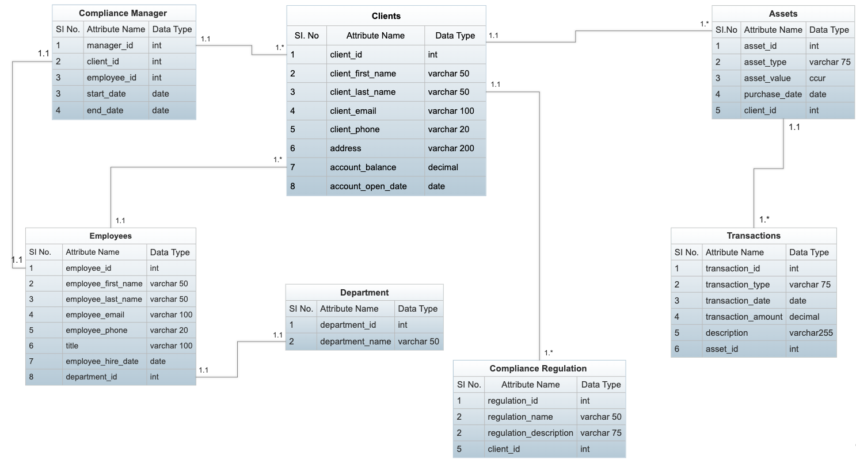
THE QUESTIONS THAT NEED TO BE ANSWERED IN ORDER TO DETERMINE THIS ARE:
How many clients have been added for each of the past six months?
What is the average amount of assets (in currency) for the entire client list?
How many clients have a high number (more than 10 a month) of transactions?

Slide 6
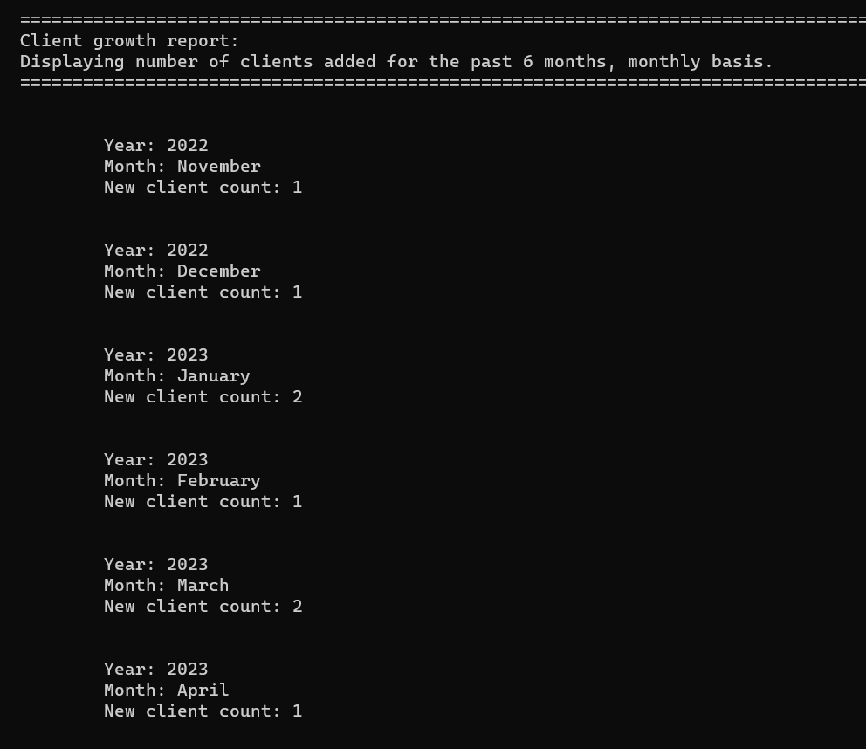
CLIENT GROWTH REPORT
ERD
How many clients have been added for each of the past six months?
This report shows the number of clients added for each of the past six months. This will help in analyzing the trend of client acquisition and deciding if the current billing structure is able to attract new clients or if changes need to be made.
What is the average amount of assets (in currency) for the entire client list?
How many clients have a high number (more than 10 a month) of transactions?
How many clients have been added for each of the past six months?
What is the average amount of assets (in currency) for the entire client list?
How many clients have a high number (more than 10 a month) of transactions?

Slide 7
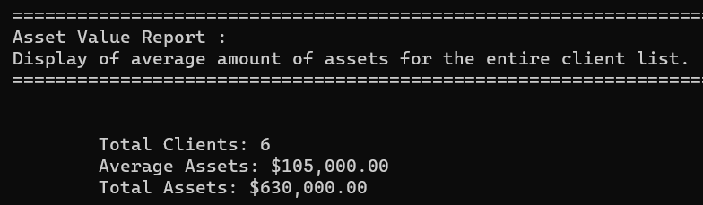
ERD
CLIENT GROWTH REPORT
This report shows the number of clients added for each of the past six months. This will help in analyzing the trend of client acquisition and deciding if the current billing structure is able to attract new clients or if changes need to be made.

Slide 8
CLIENT GROWTH REPORT
ASSET VALUE REPORT
This report will show the number of clients added for each of the past six months. This will help in analyzing the trend of client acquisition and deciding if the current billing structure is able to attract new clients or if changes need to be made.
This report shows the average amount of assets (in currency) for the entire client list. This will help in identifying the distribution of assets among clients and deciding if the current billing structure is able to generate enough revenue from clients with high assets.

Slide 9
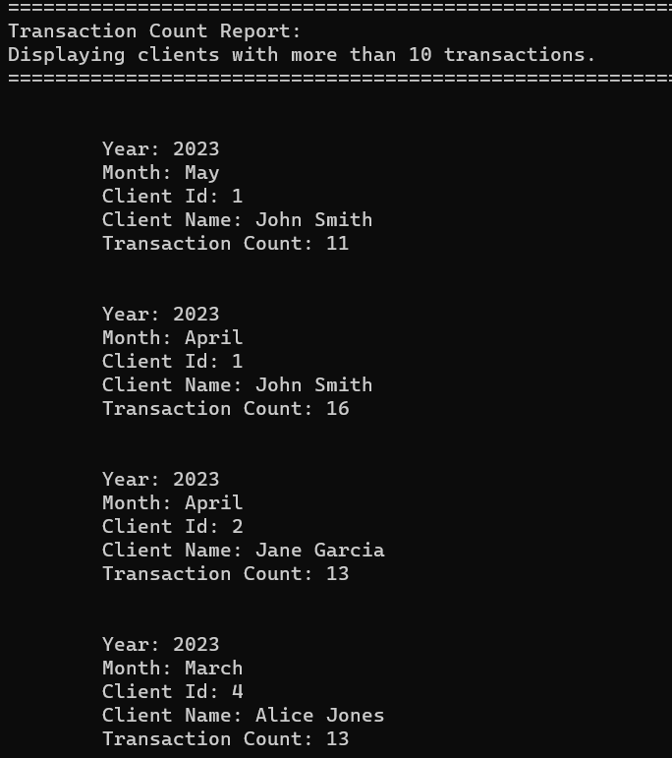
TRANSACTION COUNT REPORT
Asset Value Report
This report shows the number of clients with a high number (more than 10 a month) of transactions. This will help in identifying the clients that require more attention and resources and deciding if the current billing structure is able to generate enough revenue from such clients.
This report shows the average amount of assets (in currency) for the entire client list. This will help in identifying the distribution of assets among clients and deciding if the current billing structure is able to generate enough revenue from clients with high assets.

Slide 10
TRANSACTION COUNT REPORT
ASSUMPTIONS
Asset Value Report
This report shows the number of clients with a high number (more than 10 a month) of transactions. This will help in identifying the clients that require more attention and resources and deciding if the current billing structure is able to generate enough revenue from such clients.
For the purpose of each report we made the assumption that all clients of Willson Financial are SEC compliant.
Based on the information provided in the Case Study, it's reasonable to assume that Willson Financial does handle billing for its clients, and therefore, it may need to store billing information in its database. However, the specific details of what billing information should be stored and how it should be structured were not provided, hence we did not create/use a Billing table.

Slide 11
ASSUMPTIONS
CONCLUSION
Asset Value Report
As per the ERD, the database and the reports that we have generated will help provide information to Willson Financial for them to decide whether they need to change the billing process or not to make sure the customers were getting the best service possible, while keeping the business profitable.​
For the purpose of each report we made the assumption that all clients of Willson Financial are SEC compliant.
Based on the information provided in the Case Study, it's reasonable to assume that Willson Financial does handle billing for its clients, and therefore, it may need to store billing information in its database. However, the specific details of what billing information should be stored and how it should be structured were not provided, hence we did not create/use a Billing table.

Slide 12
CONCLUSION
Asset Value Report
THANK
YOU!
As per the ERD, the database and the reports that we have generated will help provide information to Willson Financial for them to decide whether they need to change the billing process or not to make sure the customers were getting the best service possible, while keeping the business profitable.​

