Slide 1
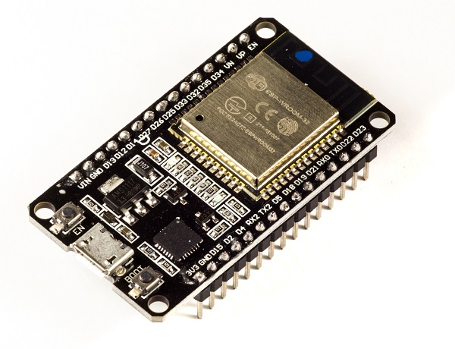

MAJOR PROJECT
TONG PHUOC THINH - 2010657

Slide 2
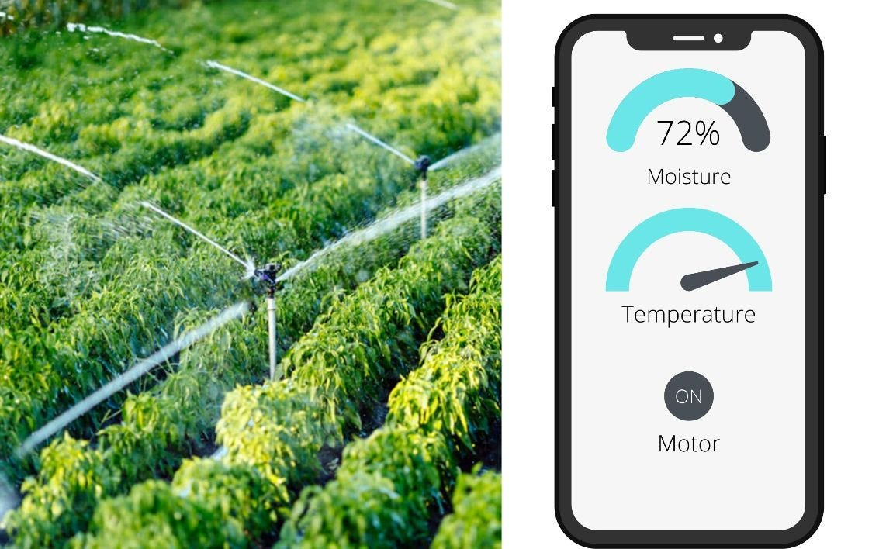
OVERVIEW
Introduction & goals
THEORY
Hardware & software
Result & Summary

Slide 3

Introduction
Self-operating irrigation system is very useful for people don’t have enough time to take care their plants, or save cost of managing, operating; improve plants’ quality.
By using data collect from moisture sensor, processor will control pump station to keep a good conditions for plants growth.

Slide 4


Primary goals
THEORY
SOFTWARE
HARDWARE

Slide 5
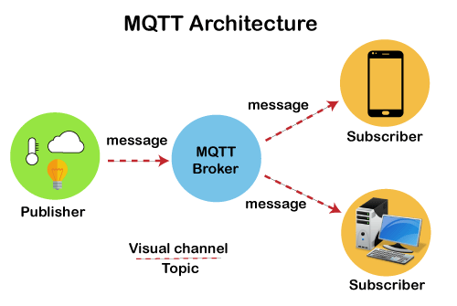
THEORY
MQTT is described on the mqtt.org site as a machine-to-machine (M2M) / IoT connectivity protocol.
MQTT is an IoT middleware (one to many) publish/subscribe messaging transport protocol
Over TCP/IP (or MQTT-S over UDP for LAN)
Its protocol is lightweight, simple and easy
to install
Places where telecommunications network prices
are expensive, low bw and unreliable.
When embedded devices are limited speed and memory resources.
Low bandwidth in high latency => ideal protocol for Machine to machine applications.

Slide 6
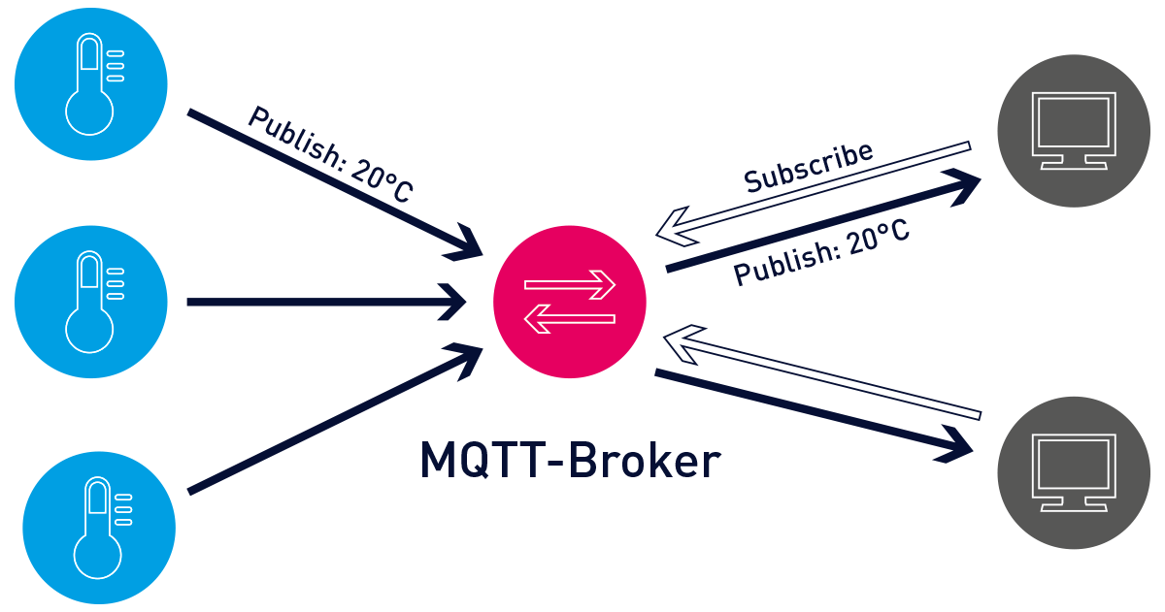
components
Theory
MQTT Client ( Publisher/ Subscriber)
MQTT Server (Broker)
Topic
Session
Subscription

Slide 7
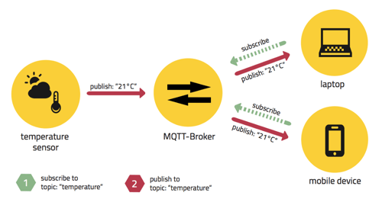
MQTT MEssaging
Theory
A producer publishes a message (publication) on a topic (subject)
A consumer subscribes (makes a subscription) for messages on a topic (subject)
A message server (called BROKER) matches publications to subscriptions
Notes:
A message server (called BROKER) matches publications to subscriptions:
If none of them match the message is discarded after modifying the topic
If one or more matches the message is delivered to each matching consumer after modifying the topic

Slide 8
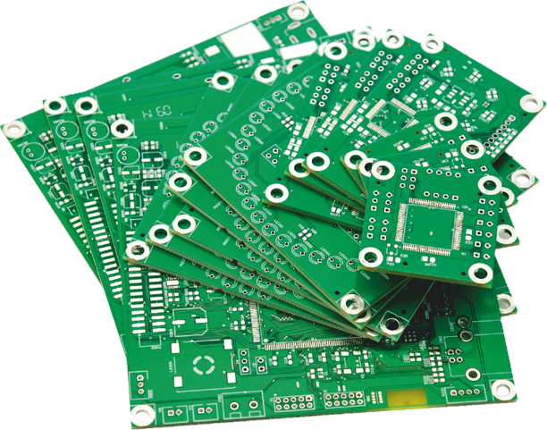
HARDWARE
HARDware
Vẽ mạch in
Làm mạch in thủ công

Slide 9
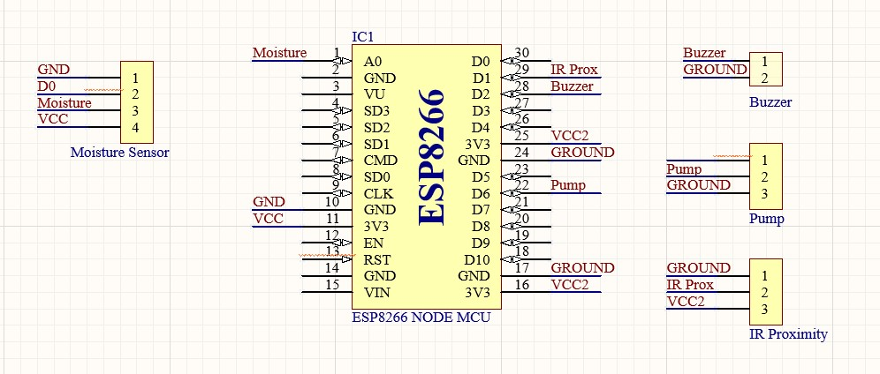
SCHEMATIC
HARDWARE

Slide 10
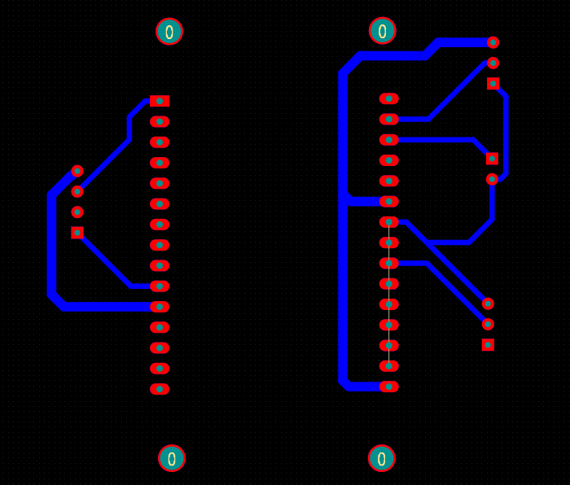
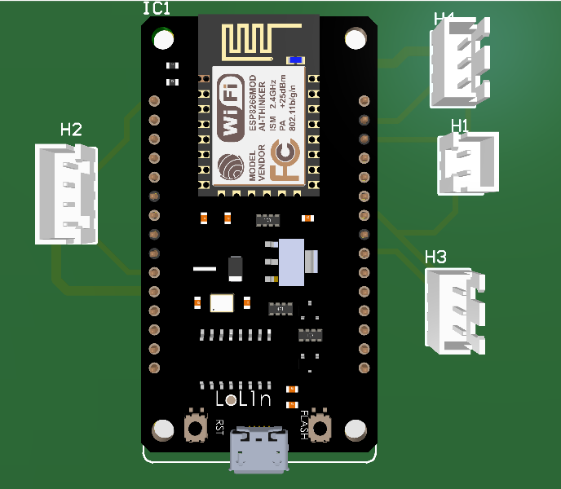
PCB
2D PCB:
3D PCB:

Slide 11

softWARE
Flow chart
Dashboard

Slide 12
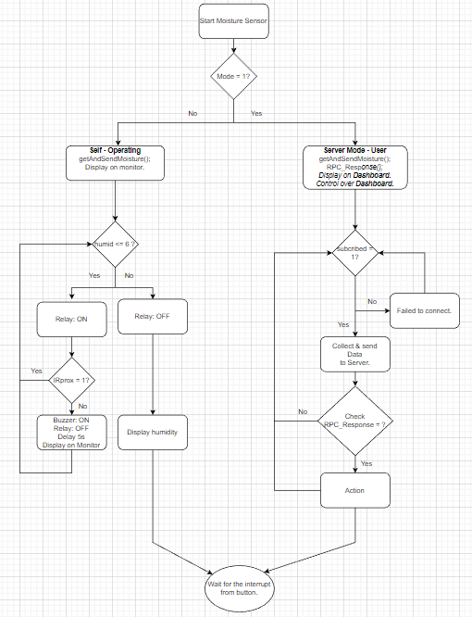
flowchart

Slide 13
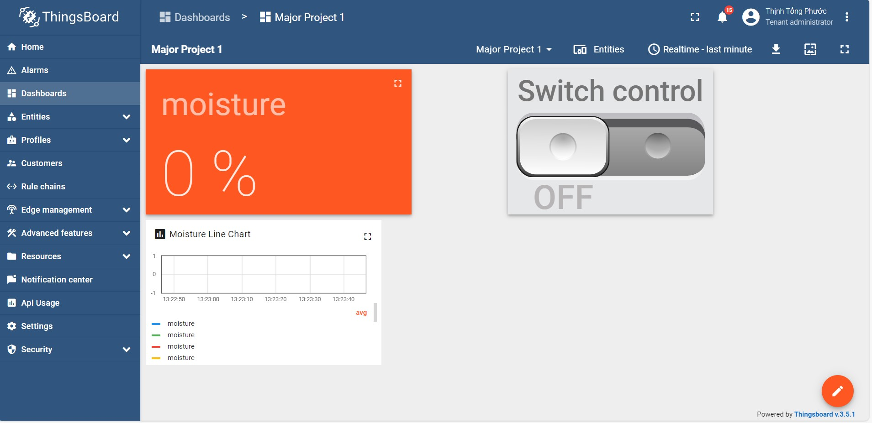
DASHboard

Slide 14
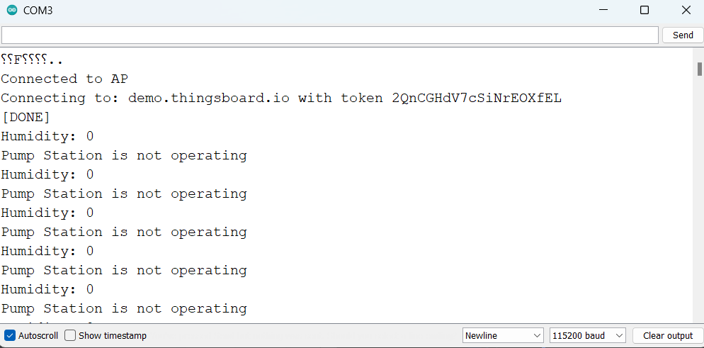
RESULT

Slide 15
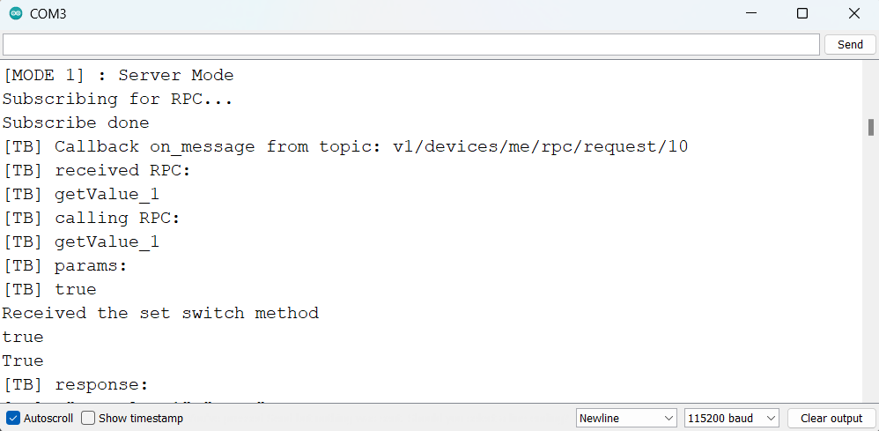
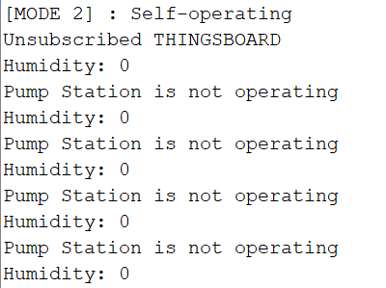
RESULT

Slide 16
SUMMARY
Đáp ứng được yêu cầu đặt ra của đồ án
Hoàn thiện sản phẩm cả phần cứng lẫn phần mềm
Tìm hiểu thêm về giao thức truyền thông IoT

Slide 17
THANK YOU FOR LISTENING
MAJOR PROJECT 1

