Slide 1

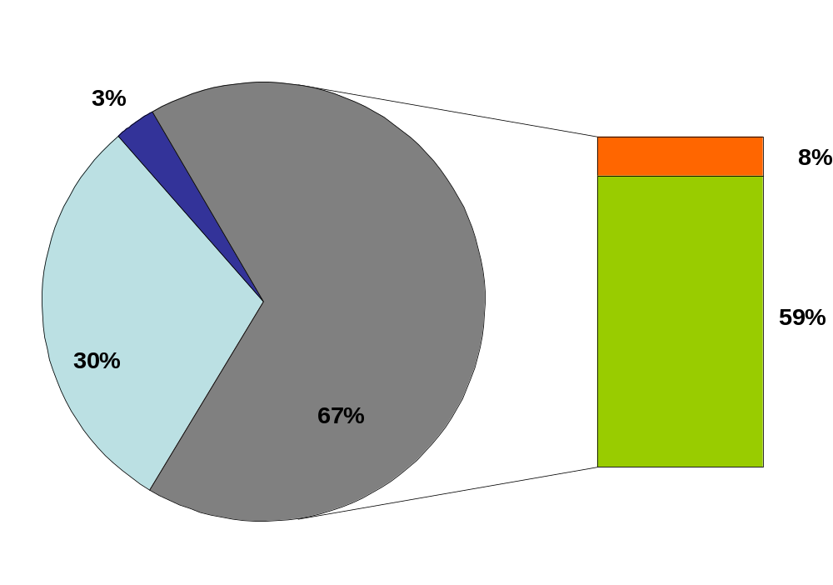
Hidden Markov Tree Model in Dependency-based Machine Translation
Zdeněk Žabokrtský, Martin Popel
Charles University in Prague, Institute of Formal and Applied Linguistics
Motivation
Example
Improve the transfer phase
of syntax-based MT
Use linguistic dependencies
as a context rather than phrases
Exploit large target-language corpora
in addition to limited size parallel
corpora during the transfer phase
Source tree (Czech)
TRANSFER
Target tree (English)
P(optimal_tree) = P_{E}(strojový | machine) · P_{T}(machine | translation)·
P_{E}(překlad | translation) · P_{T}(translation | be)·
P_{E}(snadný | easy) · P_{T}(easy | be)·
P_{E}(být | be) · P_{T}(be | ROOT)
ROOT
ROOT
P_{E}(být | have) = 0.01
0.01
SYNTHESIS
být
P_{E}(být | be) = 0.8
be
have
ANALYSIS
P_{E}(překlad | arcade) = 0.7
0.0001
1×10⁻⁸
0.002
0.001
překlad
snadný
P_{E}(překlad | translation) = 0.6
translation
arcade
easy
simple
P_{T}(machine | translation) = 0.02
1×10⁻¹⁰
1×10⁻⁸
1×10⁻⁸
strojový
P_{E}(strojový | machine) = 0.4
machine
engine
Source sentence:
Strojový překlad by měl být snadný.
P_{E}(strojový | engine) = 0.5
Target sentence:
Machine translation should be easy.
Translation Framework
P_{E}(source | target) … emission probabilities … translation model
P_{T}(dependent | governing) … transition probabilities … target-language tree model
Analysis-Transfer-Synthesis translation
Transfer at deep syntactic „tectogrammatical“ layer:
  elaborated in Prague Dependency Treebank
  abstraction from many language-specific phenomena
  each sentence ~ dependency tree
  autosemantic (meaningful) words ~ nodes
  functional words (prepositions, auxiliaries) ~ attributes
  syntactic-semantic relations (dependecies) ~ edges
  assumption: source and target trees are isomorphic
Resources:
  800 MW Czech monolingual Corpus
  60 MW parallel Corpus CzEng
Evaluation
English-Czech translation,
2700 sentences, 1 reference:
 | BLEU | NIST
Baseline system | 0.0898 | 4.5672
Hidden Markov Tree Model transfer | 0.1043 | 4.8445
Manual analysis of translation errors,
English-Czech, 250 sentences:
SYNTHESIS
Errors caused by the assumption of tree isomorphism
ANALYSIS
TRANSFER
Other transfer errors
Innovation: Tree-modified HMM
Transfer phase viewed as labeling nodes of dependency trees
with lexical values of the target language
Labeling nodes interpreted as revealing hidden states
  source tree labels ~ observed symbols
  target tree labels ~ hidden states
Tree-modified Viterbi algorithm can effectively find
the optimal combination of hidden states
Conclusion
Tree-modified HMM helps
to improve the quality of translation
Translation model and target-language tree model
are trainable separately
The isomorphism assumption causes
only 8% errors
ACL-IJCNLP 2009, Singapore

