Slide 1


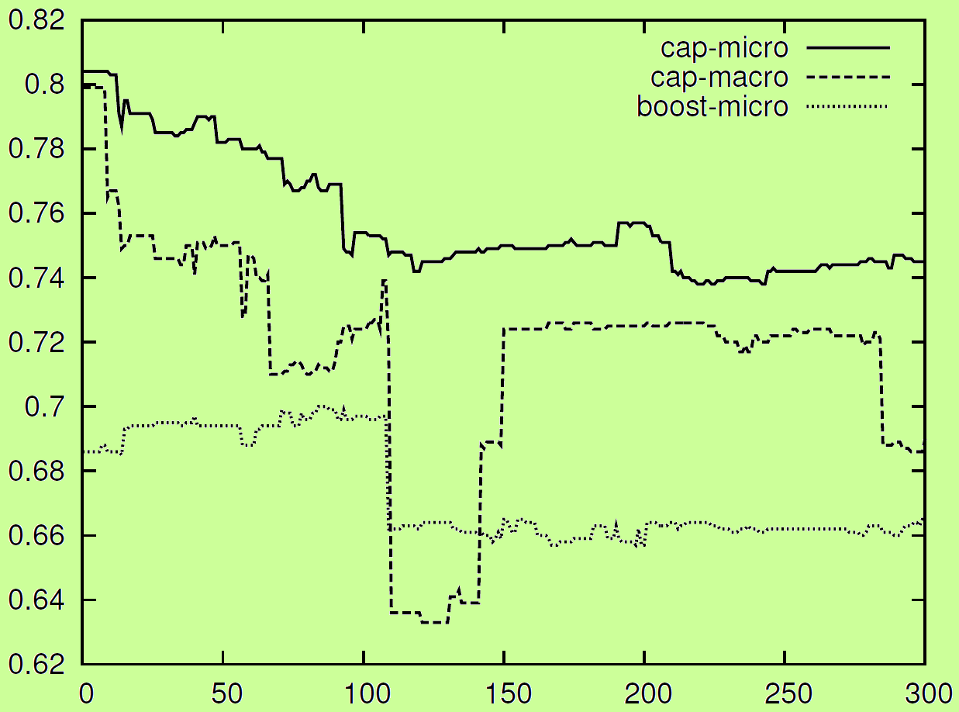
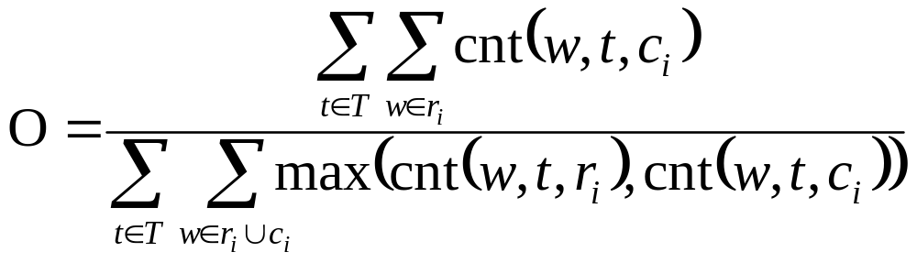
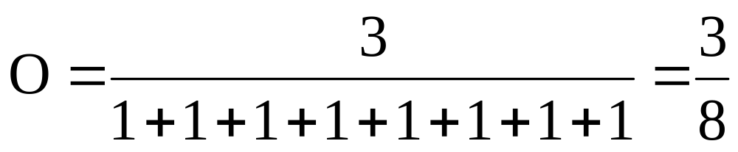
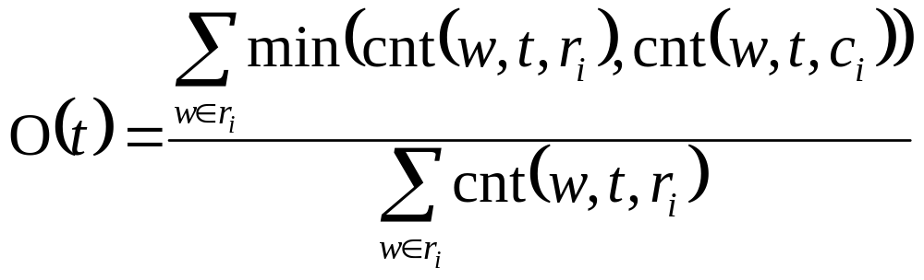
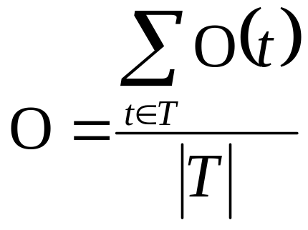
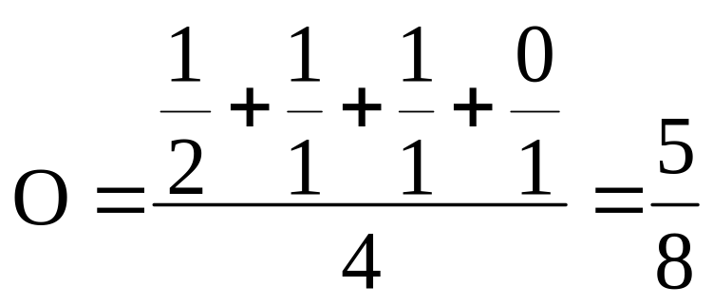
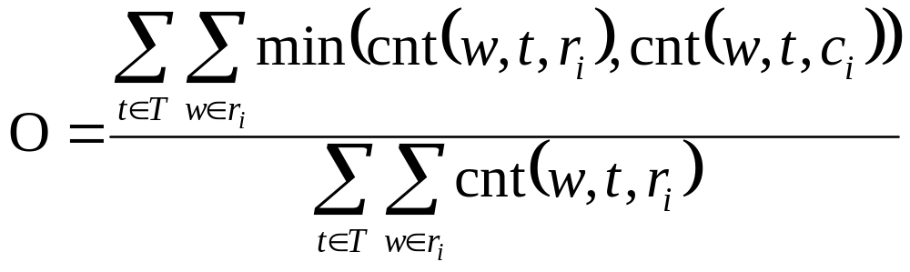
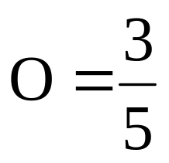
Approximating a Deep-Syntactic Metric for MT Evaluation and Tuning
Matouš Macháček, Ondřej Bojar; {machacek, bojar}@ufal.mff.cuni.cz; Charles University in Prague, MFF, ÚFAL
Overview
Approximations
Tunable Metric Task
SemPOS metric
Sempos from Tag
We optimized towards linear combination (equal weights) of BLEU and Approx + Cap-micro.
BLEU chooses sentences with correct morfology and word order, while SemPOS prefers sentences with correctly translated content words.
approx
Morph. Tag | Sempos | Rel. Freq.
NN | n.denot | 0.989
VBZ | v | 0.766
VBN | v | 0.953
JJ | adj.denot | 0.975
NNP | n.denot | 0.999
PRP | n.pron.def.pers | 0.999
Introduced by Kos and Bojar (2009), inspired by Giménez and Márquez (2007).
Counts overlapping of deep-syntactic lemmas (t-lemmas) of content words.
Lemmas are matched only if semantic parts-of-speech (Sgall et al. 1986) agree.
Does not consider word order and auxiliary words.
Morphological tag determines sempos.
CzEng corpus (Bojar and Žabokrtský, 2009) used to create dictinoray which maps morphological tag to most frequent sempos.
Surface lemmas are used instead of t-lemmas.
Accuracy on CzEng e-test:
  93.6 % for English
  88.4 % for Czech
Our final result heavily depends on the interpretation of human rankings. Out of 8, we are:
≥ others | > others
the fifth | the first
Issues
SemPOS requires full parsing up to the deep syntactic layer.
  => SemPOS is computational costly.
There are tools assigning t-lemmas and semposes only for Czech and English.
  => SemPOS is difficult to adapt for other languages.
Results
Example of used dictionary in English
Tested on newstest2008, test2008, newstest2009, newsyscombtest2010.
Proposed Solution:
Excluding Stop-Words
approx-stopwords
English as a target language
Approximate t-lemmas and semposes using only tagger output.
  => Faster and more adaptable for other languages.
  => More suitable for MERT tuning.
Deep syntactic layer does not contain auxiliary words.
Assumed that auxiliary words are the most frequent words, we exclude a certain number of most frequent words.
Stopwords lists were obtained from CzEng corpus.
Exact cut-offs:
  100 words for English
  220 words for Czech
Approximation | Overlapping | Min | Max | Avg
approx | cap-micro | 0.409 | 1.000 | 0.804
orig | cap-macro | 0.536 | 1.000 | 0.801
approx | cap-macro | 0.420 | 1.000 | 0.799
tagger | cap-micro | 0.409 | 1.000 | 0.790
orig | cap-micro | 0.391 | 1.000 | 0.784
approx+cap-micro and BLEU |  | 0.374 | 1.000 | 0.754
tagger | cap-macro | 0.118 | 1.000 | 0.669
BLEU |  | -0.143 | 1.000 | 0.628
Overlapping
Src: Polovina míst v naší nabídce zůstává volná.
Ref: Half of our capacity remains available.
Hyp: Half of the seats in our offer remains free.
Correlation with Human Judgments
boost-micro
half
n.denot
#perspron
n.pron.def.pers
remain
v
Hypothesis
(Giménez, Márquez, 2007)
The number of most frequent words
which are thrown away in English
seat
n.denot
offer
n.denot
free
adj.denot
Restricting the Set of Semposes
approx-restr
Czech as a target language
half
n.denot
capacity
n.denot
Reference
Contribution of each sempos type to the overall performance can differ a lot.
We assume that some sempos types raise the correlation and some lower it.
We restrict the set of considered semposes to the better ones.
Approximation | Overlapping | Min | Max | Avg
approx-restr | cap-macro | 0.400 | 0.800 | 0.608
tagger | cap-macro | 0.143 | 0.800 | 0.428
orig | cap-macro | 0.143 | 0.800 | 0.423
approx-restr | cap-micro | 0.086 | 0.769 | 0.413
tagger | cap-micro | 0.086 | 0.769 | 0.413
orig | cap-micro | 0.086 | 0.741 | 0.406
approx | cap-micro | 0.086 | 0.734 | 0.354
approx+cap-micro and BLEU |  | 0.086 | 0.676 | 0.340
approx | cap-macro | 0.086 | 0.469 | 0.338
BLEU |  | 0.029 | 0.490 | 0.279
#perspron
n.pron.def.pers
remain
v
available
adj.denot
Semposes with the highest correlation in English.
This is also the restricted set of semposes used in English.
Tag | Min | Max | Avg
v | 0.403 | 1.000 | 0.735
n.denot | 0.189 | 1.000 | 0.728
adj.denot | 0.264 | 0.964 | 0.720
n.pron.indef | 0.224 | 1.000 | 0.639
cap-macro
half
n.denot
#perspron
n.pron.def.pers
remain
v
Hypothesis
(Bojar, Kos, 2007)
seat
n.denot
offer
n.denot
free
adj.denot
Reference
Custom Tagger
half
n.denot
capacity
n.denot
tagger
#perspron
n.pron.def.pers
remain
v
available
adj.denot
We use sequence labeling algorithm to choose the t-lemma and sempos tag.
The CzEng corpus served to train two taggers (for English and Czech).
At each token, the tagger use word form, surface lemma and morphological tag of the current and previous two tokens.
Tagger chooses sempos from all sempos tags which were seen in corpus with the given morphological tags.
The t-lemma is often the same as the surface lemma, but it could also be surface lemma with an auxiliary word (kick off, smát se). The tagger can also choose such t-lemma if the auxiliary word is present in the sentence.
The overall accuracy on CzEng e-test:
    97.9 % for English
    94.9 % for Czech
cap-micro
half
n.denot
#perspron
n.pron.def.pers
remain
v
Hypothesis
Overlapping performance
(our)
seat
n.denot
offer
n.denot
free
adj.denot
 | Average rank in our experiments
Overlapping | in English | in Czech
boost-micro | 12 | 13
cap-macro | 6.6 | 5
cap-micro | 5.4 | 6
Boost-micro is not suitable for sempos-based metrics.
half
n.denot
capacity
n.denot
Reference
#perspron
n.pron.def.pers
remain
v
available
adj.denot
Full text, acknowledgement and the list of references in the proceedings of EMNLP 2011 Workshop on Statistical Machine Translation (WMT11).

