Slide 1


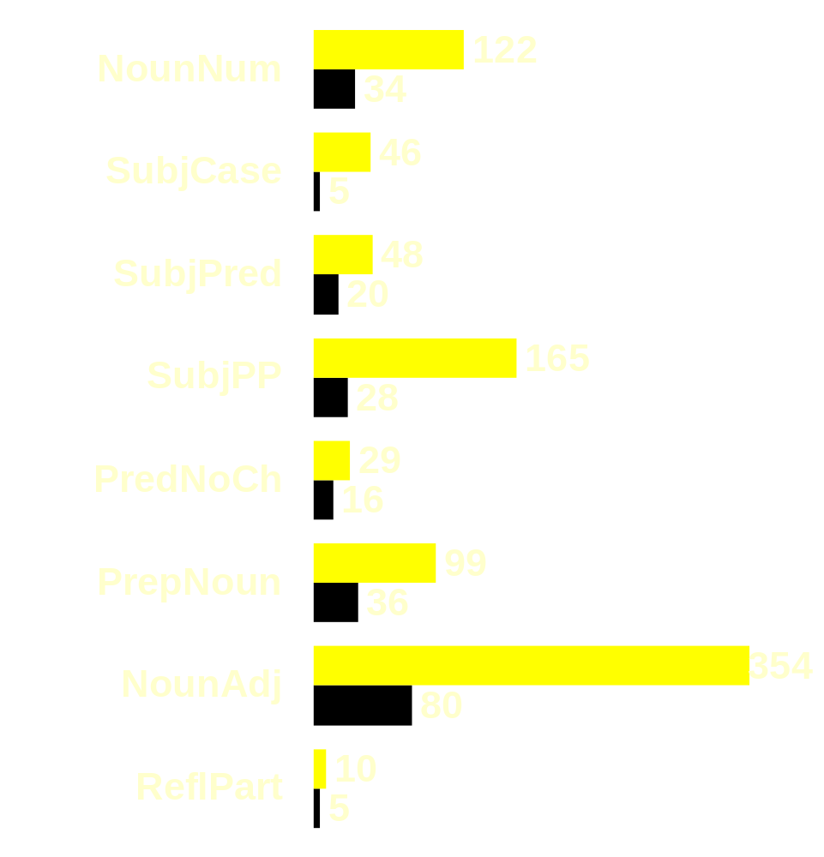
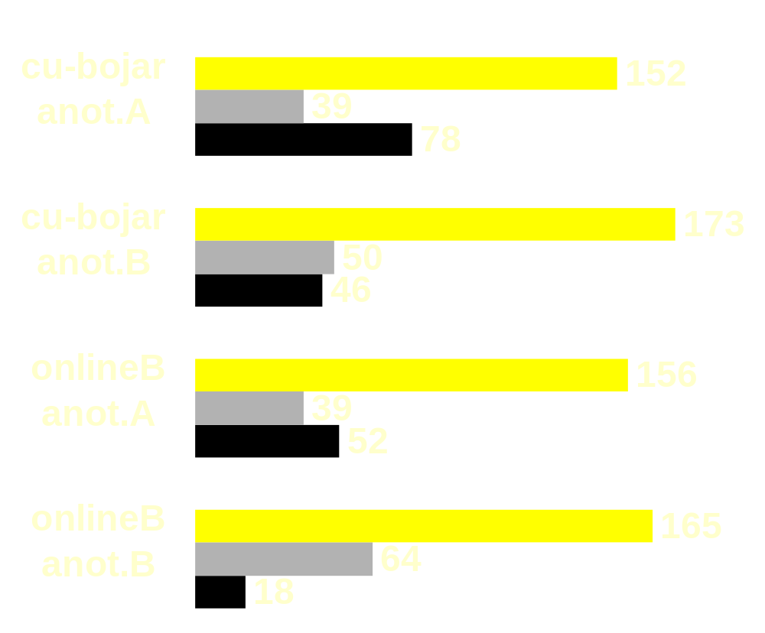
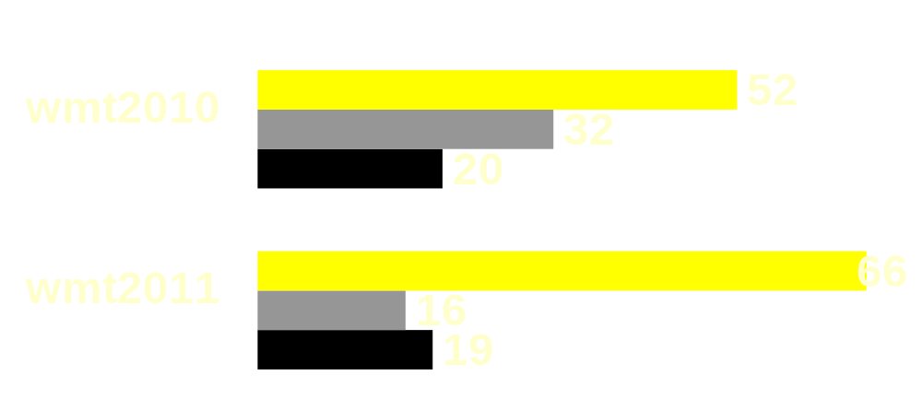
Two-step translation with grammatical post-processing
David Mareček, Rudolf Rosa, Petra Galuščáková, Ondřej Bojar; {marecek, rosa, galuscakova, bojar}@ufal.mff.cuni.cz
Charles University in Prague, Faculty of Mathematics and Physics, Institute of Formal and Applied Linguistics (ÚFAL)
Goal: Improve Czech grammar
en source
arrive.
Pred
VB
Rules
Phrase-based MT often breaks morphological agreement.
Some of the dependencies still recovered in parses of MT output.
=> We can check and fix the agreements.
did
AuxV
VB
not
AuxV
??
Noun number
number
Subj
NN
In Czech, plural has sometimes the same form as singular.
Correct nouns tagged as singular to plural if the English counterpart is in plural.
A
Det
DT
of
AuxP
IN
Depfix
people
Atr
NN
from
AuxP
IN
Subject case
A rule-based grammar correction of MT to Czech.
Applicable on top of any MT system.
Czech subject must be in nominative case.
Republic
Atr
NN
Subject-Predicate agreement
the
Det
DT
Czech
Atr
NN
Subject and predicate must agree in morphological number.
cs target en source
Our WMT11 submissions
Subject-PastParticiple agreement
cu-bojar
cs target
nedorazila.
Pred
V,fem,sg,past
Czech subject and past participle must agree in number and gender.
Simple non-factored Moses setup.
Truecasing based on lemmatizer output.
Additional parallel data include Official Journal of EU.
Large monolingual data:
  Includes Czech National Corpus, our web collection...
  Two LMs (5-gr and 6-gr) weighted by MERT.
  Each LM already interpolated from domain-specific sources.
nedorazilo.
Pred
V,neut,sg,past
SubjPP
Preposition-Noun agreement
Nouns must agree with prepositions in morphological case.
Řada
Subj
N,fem,sg,nom
Noun-Adjective agreement
lidí
Atr
N,pl,gen
Adjectives must agree with nouns in number, gender, and case.
z
AuxP
P,gen
PrepNoun
republiky
Adv
N,fem,sg,gen
Reflexive particle deletion
republika
Adv
N,fem,sg,nom
Czech reflexive verbs are accompanied by reflexive particles (‘se’, ‘si’).
Particles not belonging to any verb are deleted.
cu-marecek
NounAdj
Česká
Atr
A,fem,sg,nom
Prepositions without children
MT in three steps:
  Moses: English -> Lemmatized Czech
  Moses: Lemmatized Czech -> Czech
  Depfix: Rule-based grammar correction.
Only 1-best output passed between the steps.
The 2nd Moses trained on a large monolingual corpus.
Lemmatized Czech includes morphological features over in English.
České
Atr
A,fem,sg,gen
Prepositions cannot be leaves.
Nouns are attached to them according to English source.
English source: A number of people from Czech Republic did not arrive.
Czech translated: Řada lidí z Česká republika nedorazilo. (wrong)
improved
indefinite
worsened
Impact of rules
System Annotator Changed Improved Worsened Indefinite
cu-bojar-twostep A 269 152 56.5% 39 14.5% 78 29.0%
cu-bojar-twostep B 269 173 64.3% 50 18.6% 46 17.1%
online-B A 247 156 63.1% 39 15.9% 52 21.1%
online-B B 247 165 66.8% 64 25.9% 18 7.3%
Czech after depfix: Řada lidí z České republiky nedorazila. (correct)
System Before After Improvement
cmu-heaf. 16.95 17.04 0.09
cu-bojar 15.85 16.09 0.24
cu-zeman 12.33 12.55 0.22
dcu 13.36 13.59 0.23
dcu-combo 18.79 18.90 0.11
eurotrans 10.10 10.11 0.01
koc 11.74 11.91 0.17
koc-combo 16.60 16.86 0.26
onlineA 11.81 12.08 0.27
onlineB 16.57 16.79 0.22
potsdam 12.34 12.57 0.23
rwth-combo 17.54 17.79 0.25
sfu 11.43 11.83 0.40
uedin 15.91 16.19 0.28
upv-combo 17.51 17.73 0.22
WMT10
Depﬁx improvements in BLEU score
Interannotator agreement
Manual evaluation
WMT11
A/B Impr. Wors. Indef.
Impr. 273 20 15
Wors. 12 59 7
Indef. 53 35 42
System Before After Improvement
cu-twostep 16.57 16.60 0.03
cmu-heaf. 20.24 20.32 0.08
commerc2 09.32 09.32 0.00
cu-bojar 16.88 16.85 -0.03
cu-popel 14.12 14.11 -0.01
cu-tamch. 16.32 16.28 -0.04
cu-zeman 14.61 14.80 0.19
jhu 17.36 17.42 0.06
online-B 20.26 20.31 0.05
udein 17.80 17.88 0.08
upv-prhlt. 20.68 20.69 0.01
Rule Fired Improved Worsened % Improved
SubjCase 51 46 5 90.2
SubjPP 193 165 28 85.5
NounAdj 434 354 80 81.6
NounNum 156 122 34 78.2
PrepNoun 135 99 36 73.3
SubjPred 68 48 20 70.6
ReflTant 15 10 5 66.7
PrepNoCh 45 29 16 64.4
Manual and automatic evaluation across different datasets.
BLEU:
16.99 → 17.38
BLEU:
13.99 → 13.87
Full text, acknowledgement and the list of references in the proceedings of WMT 2011.
Test Set Changed Improved Worsened Indefinite BLEU: before after diff
newssyscombtest2010 104 52 50.0 20 19.2 32 30.8 16.99 17.38 0.39
newssyscombtest2011 101 66 65.3 19 18.8 16 15.8 13.99 13.87 -0.12

