Slide 1
Energy
SWdn
LWdn
LWup
LE = λ ET
H
SWup
G

Slide 2
ET
P
RSurf
D

Slide 3
LWdn
ET
SWdn
P
LWup
LE = λ ET
H
Rsurf
SWup
D
G

Slide 4
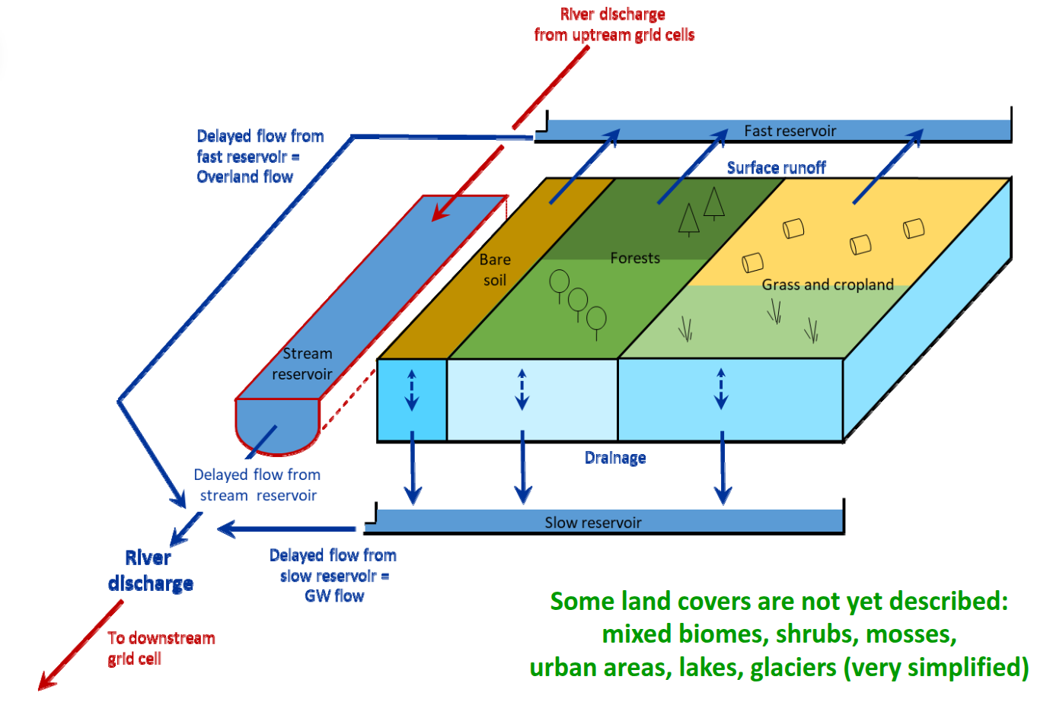

Slide 5
SLOW
SLOW
SLOW
Runoff
Runoff
Runoff
FAST
FAST
FAST
Drainage
Drainage
Drainage
STREAM
STREAM
STREAM
SLOW
SLOW
FAST
FAST
STREAM
STREAM

Slide 6
ORCHIDEE grid
Drainage
Runoff
Grid-to-grid interpolation
SLOW
SLOW
TCST_SLOW
FAST
FAST
TCST_FAST
STREAM
STREAM
TCST_STREAM
River discharge
River discharge
Routing grid

Slide 7
ORCHIDEE grid
Drainage
(kg/m²)
Stream reservoir volume (kg/m²)
Runoff
(kg/m²)
Slow reservoir volume (kg/m²)
Irrigation requirement (kg/m²)
Fast reservoir volume (kg/m²)
Irrigation(kg/m²)
Interpolation
Interpolation
Stream reservoir volume (kg)
River discharge (m³/s)
Drainage
(kg)
Slow reservoir volume (kg)
Irrigation (kg)
Runoff
(kg)
Fast reservoir volume (kg)
Irrigation requirement (kg)
Routing DEM grid

Slide 8
ORCHIDEE grid
Drainage
(kg/m²)
Runoff
(kg/m²)
3 reservoir volumes (kg/m²)
Irrigation
(kg/m²)
Irrigation requirement (kg/m²)
Grid interpolation and conversion to absolute values
Grid interpolation and conversion to areal values
River discharge (m³/s)
Drainage
(kg)
3 reservoir volumes (kg)
Runoff
(kg)
Irrigation withdrawals
Irrigation requirement (kg)
Irrigation (kg)
Routing grid

Slide 9
ORCHIDEE grid
Drainage
(kg/m²)
Infiltration
(kg/m²)
Runoff
(kg/m²)
3 reservoir volumes (kg/m²)
Irrigation
(kg/m²)
Irrigation requirement (kg/m²)
Grid interpolation and conversion to absolute values
Grid interpolation and conversion to areal values
River discharge (m³/s)
Drainage
(kg)
3 reservoir volumes (kg)
Runoff
(kg)
Irrigation withdrawals
Irrigation requirement (kg)
Irrigation (kg)
Routing DEM grid

Slide 10
subgrid_halfdeg
interp_topo
Coastal grid cell
Coastal grid cell
SLOW
SLOW
FAST
FAST
STREAM
Ocean
STREAM
River discharge
Ocean
River discharge
NB : pas de diff hydrographs sur les (4) points où il n’y a ni coastalflow ni riveflow

Slide 11
Coastal grid cell
Coastal grid cell
SLOW
SLOW
FAST
FAST
STREAM
STREAM
Ocean
Ocean
River discharge
River discharge

Slide 12
Forcing variable
Time (hours)
12UTC
18UTC

Slide 13
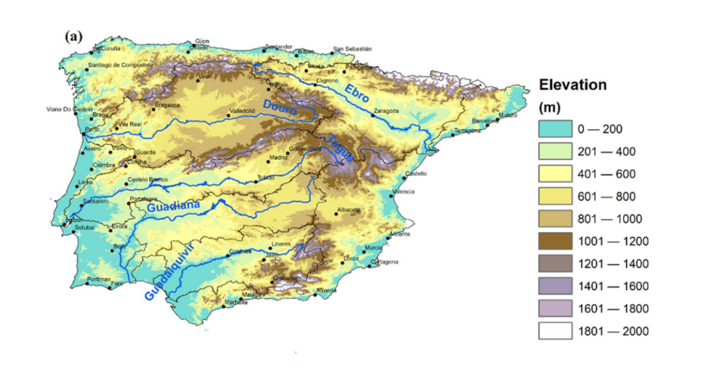
Pyrenees
Cantabrian range
Central system
Iberian system
Baetic system

