Slide 1

Banking System Using Linked Lists in C
A Simple Console-Based Banking System
This presentation will demonstrate the application of data structures. It covers the development of a console-based banking system. Our key focus will be the linked list implementation for core banking operations.

Slide 2

CRUD Operations
Create
Read
Update
Add new accounts. Collect user details: name, initial deposit. Generate a unique account number. Store the data in a new node within the linked list.
Check account balance. The user enters their account number. The system searches the linked list. It displays the balance and other relevant details.
Deposit and withdraw funds. User selects an action. System prompts for amount and account number. Validates. The system updates the stored amount within the linked list.

Slide 3
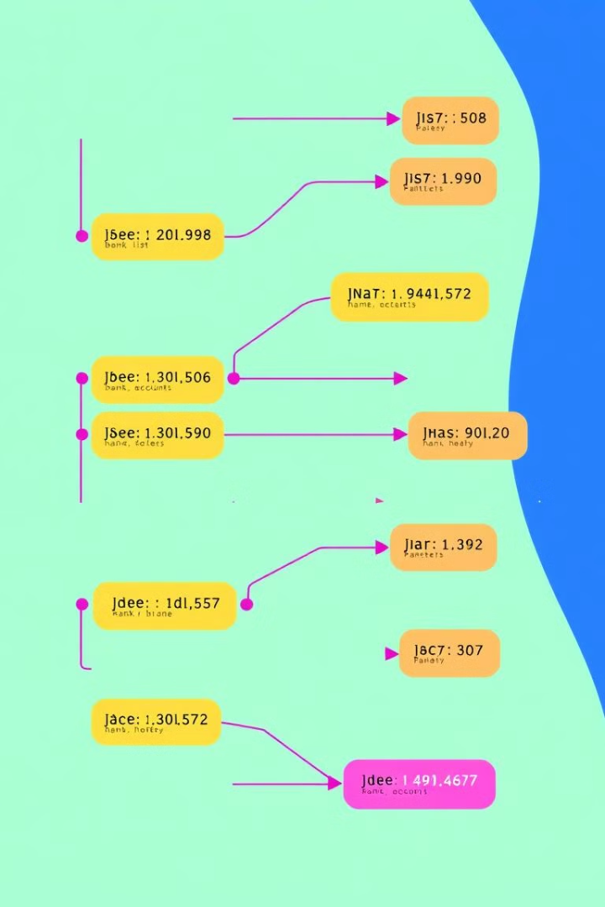
Data Structure Used: Linked List
1
Linked List Definition
2
Dynamic Size
Each account is a node. The list contains information. There is a pointer to the next account.
Accounts can be easily added or removed.
3
Efficient Insertion/Deletion
Adding or closing doesn't require shifting like an array.

