Slide 1
Vision Based Connect Four Game (Human vs Artificial Intelligence)
Nikitha Subramanian
Parameshwari Tirupari
LTU Computer Science
Faculty Adviser: Dr. CJ Chung

Slide 2
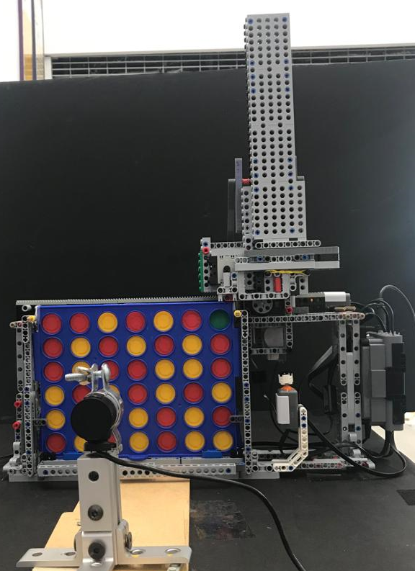
Game Objective
Connect Four is a two-player connection game, whose objective is to form a horizontal, vertical, or a diagonal line of four of one’s own discs.
Credits for assembling of the Robot : Devson Butani

Slide 3
Contd..
Incremental development approach has been used for this project.
Implementation is done using Java.
A high vision camera is used to capture the image of the board.
The library used for image processing is Sarxos webcam-capture:- https://github.com/sarxos/webcam-capture
MinMax algorithm is used to take the decision of the robot’s counter move based on the image captured by the camera.

Slide 4
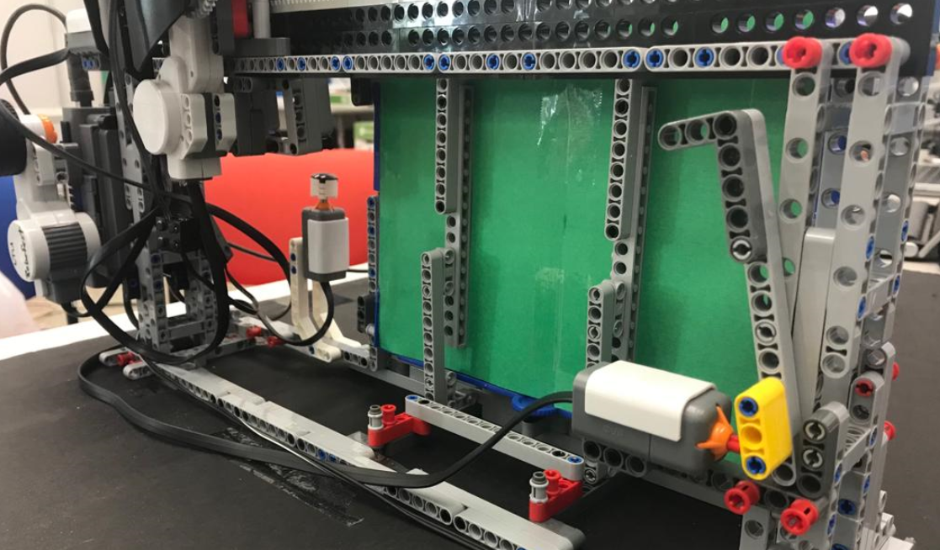
Lego NXT Mindstorm
The movement of the motor is controlled by Lego NXT.
leJOS (The firmware replacement for Lego Mindstorms programmable bricks) is used, It includes a Java virtual machine, which allows Lego Mindstorms robots to be programmed in the Java programming language.
Data transfer between the controller and the application is through serial communication.
The touch sensors(as shown in the below picture) are configured to detect the edges of the physical module.

Slide 5
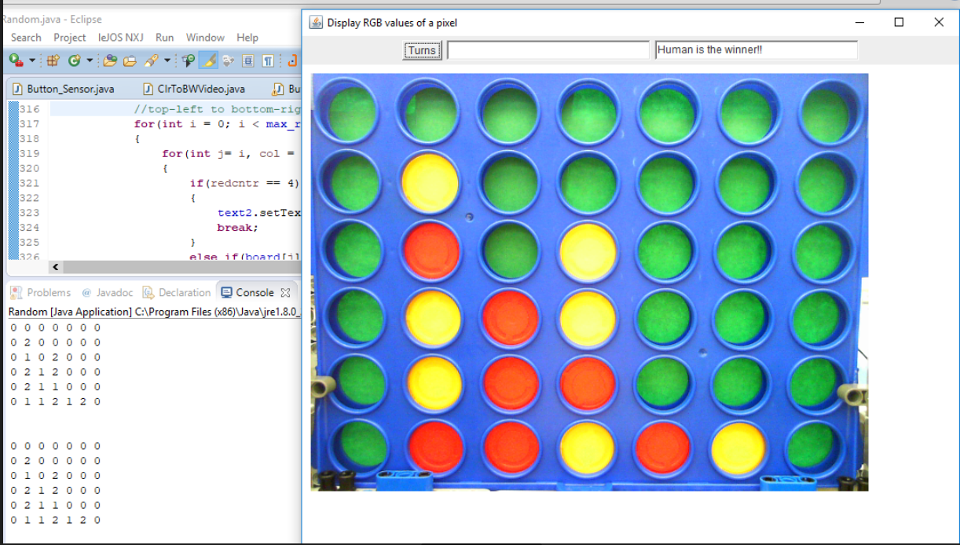
Creating a Matrix to represent the board
A 2Dimensional array of 6*7 size is created to represented 6 rows and 7 columns of the board respectively.
Average of 20 pixels (10 in vertical and 10 in horizontal from the center of the slot, are taken into consideration for each slot ) are considered to identify the slot color.
The values of the array are represented as below:
Red coin on the board --- 1
Yellow coin on the board --- 2
Green slot on the board --- 0

Slide 6
Human vs AI (Random strategy)
Robot drops a coin based on the column number(1 to 7) generated by the random function.
After every action taken by human/Robot, the camera scans the board and is read into an 2Dimensional array.
Winning conditions are checked by scanning through vertically, horizontally and diagonally.

Slide 7
Human vs AI (MinMax Algorithm)
MinMax is a backtracking algorithm which is used in decision making and game theory to find the optimal move for the player.
Credits for implementing the algorithm in java : Joon Lee
Github Link: https://github.com/jl23889/Code-Foo/tree/master/Connect%20Four
An Evaluation function is implemented, which calculates the value of the board depending on the placement of coins on the board.
Evaluation tree of a few scenarios are shown in next slide.

Slide 8
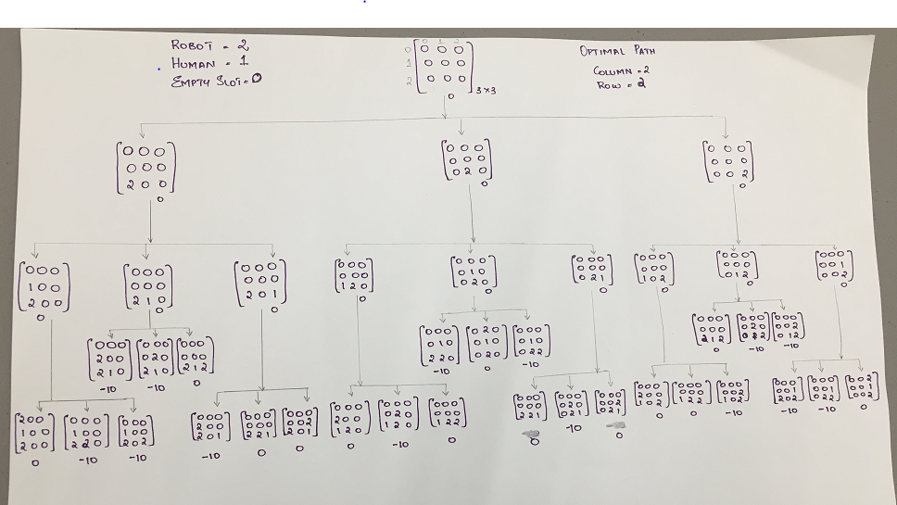

Evaluation Tree: Scenario 1:- When robot starts first for 3x3 board
The optimal path is highlighted in yellow

Slide 9
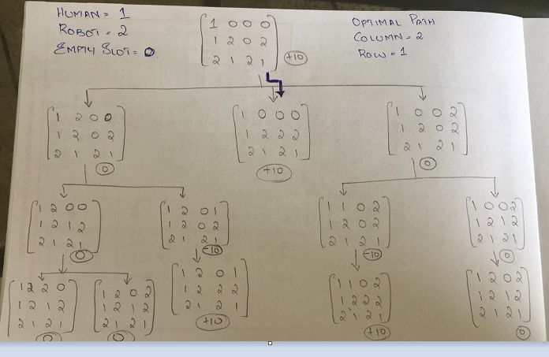
Scenario 2:- Intermediate for 3x4 board

Slide 10
Game Scenario 1: Human Starts First
HUMAN
ROBOT
BOARD
Human drops a coin
“Turn for robot to play!”
Board is checked for winner
Robot drops a coin based on evaluation function
“Turn for human to play!”
Board is checked for winner
Human drops a coin
t
t
t

Slide 11
Game Scenario 2: Robot Starts First
HUMAN
ROBOT
BOARD
Drops a coin based on evaluation function
“Turn for human to play!”
Board is checked for winner
Human drops a coin
Board is checked for winner
“Turn for robot to play!”
t
t
t

Slide 12
Game Scenario 4: Robot wins the game
HUMAN
ROBOT
BOARD
Robot drops a coin based on evaluation function
“Turn for the human to play!”
Board is checked for winner
Human drops a coin
Board is checked for winner
“Turn for the robot to play!”
Robot drops a coin based on evaluation function
Board is checked for winner
“Robot is the winner!”
t
t
t

Slide 13
Game Scenario 3: Human either wins / makes a tie
HUMAN
ROBOT
BOARD
Human drops a coin
“Turn for robot to play!”
Board is checked for winner
Robot drops a coin based on evaluation function
Board is checked for winner
“Turn for human to play!”
Human drops a coin
Human drops a coin
Board is checked for winner
“Human either makes a tie or win!”
t
t
t

Slide 14
TEST RESULTS
The game is tested for 5 times, considering both human and the Robot starting the game. And the results are as below:
Number of times Robot won the game : 4
Number of times Human won the game:0
Number of times, the game ended as a tie: 1
Robot starts the game and wins: https://youtu.be/Pwmit9kiIIM
Robo starts the game and ends in Tie:https://youtu.be/3JT8GAaUKEU

Slide 15
FUTURE WORK
Robot taking its turn soon after the human drops the coin without any human intervention.
Tie condition even when the board is not completely filled.
Recognizing the coin color using different color model (HSV), allowing the robot to play in different lighting conditions.
Different way to recognize the color, example detecting circles.
Increase the number of sample pixels, that should be considered in the process of identifying the slots on the board.
Reset the textbox, which displays the status of the game result.

Slide 16
Work Division between the Team:
Establishing serial communication between the application and the NXT - Nikitha
Working on the Image processing(to capture the board through a camera) – Parameshwari
Working on GUI part and game setup – Parameshwari and Nikitha
Combining Minimax algorithm with the existing code - Parameshwari and Nikitha
Documentation - Parameshwari and Nikitha

Slide 17
THANK YOU

