Slide 1

Forecasting Pub
One place for sales teams to call their number
Every team forecasts differently.
The Pub stops fighting that — how a team slices, measures and weights its forecast is configuration, not a separate app.
Functionality overview
Notes:
The Forecasting Pub replaces a SharePoint/PowerApp setup that had to be rebuilt for every team. The core bet: a dozen business units will never agree on how to slice a forecast, so the app has no opinion about shape.

Slide 2
THE PROBLEM
A dozen teams, a dozen shapes
Before
After
Each business unit had its own hacked-together forecast — its own SQL, its own spreadsheet, its own rebuild every time something changed.
One app. A team's levels, metric and weighting are rows in a config table, filled in through a form. Onboarding is data entry.
What a team declares — and nothing else
Levels
How rows are grouped — 1 to 8, standard dimensions or your own SQL
Metric
Orders or sales, with exceptions (e.g. software counted on sales)
Weighting
How open pipeline counts toward the suggestion
Groups & filters
Custom product rollups, and which source rows are yours
Notes:
The design response to "we can never standardise": stop trying. Standardise the contract — one fact shape, one dimension catalogue, one entry and audit model — and let shape be configuration.

Slide 3
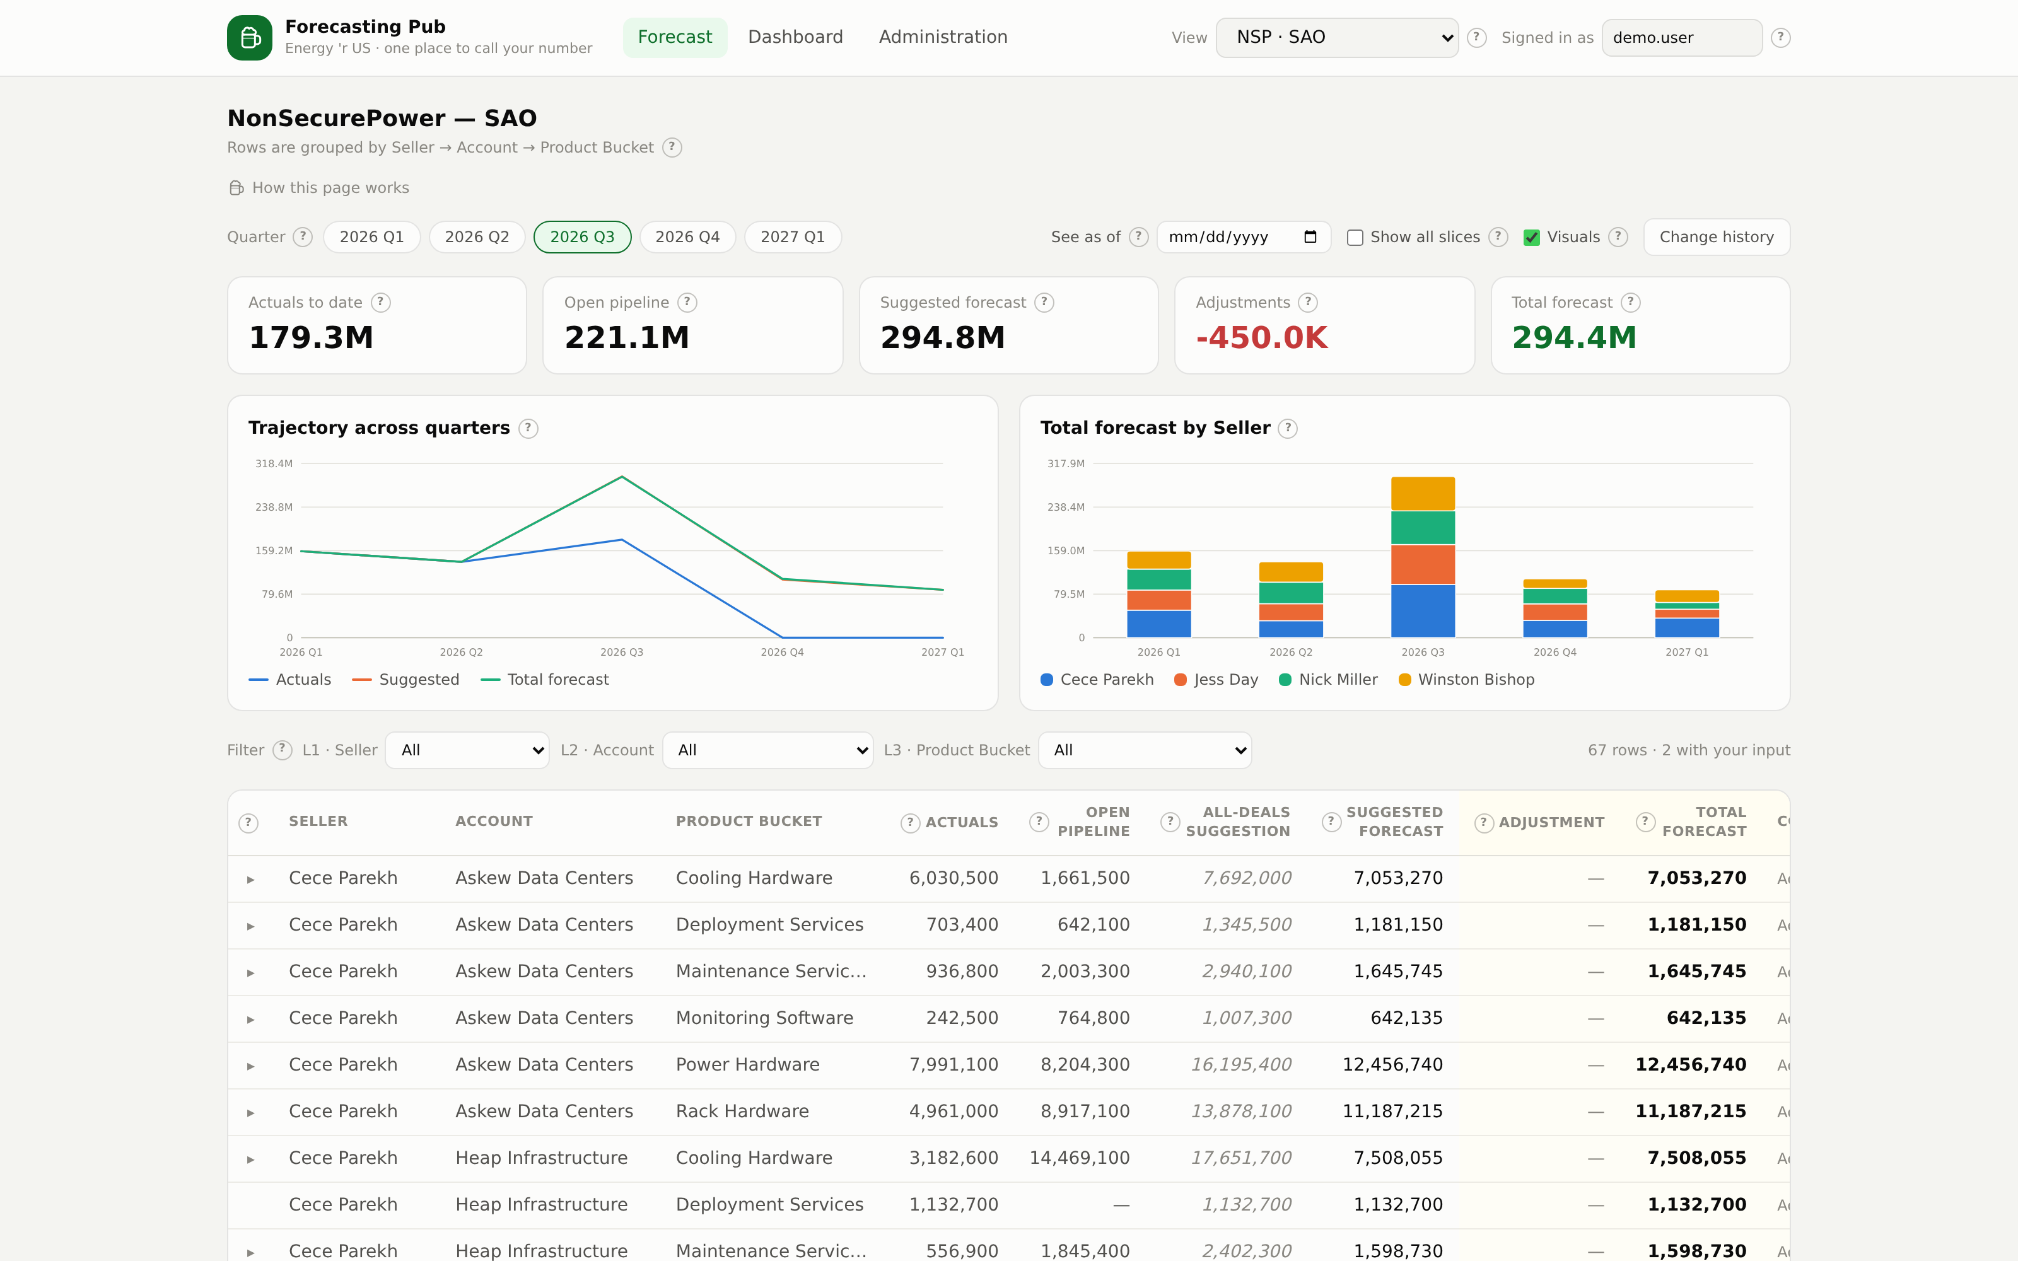
WHERE SELLERS WORK
The forecast grid
1
Actuals & pipeline
Read straight from source. Nobody types over them.
2
Two suggestions
A weighted starting number, and the "if everything lands" ceiling.
3
You enter one number
Adjustment or Total — they stay in step, last edit wins.
4
And say why
A one-line comment saves the follow-up call.
Shorthand works: 1.2M, 500K, -750K. Everything saves as you type.
Notes:
The grid is the product. Everything else supports it.

Slide 4
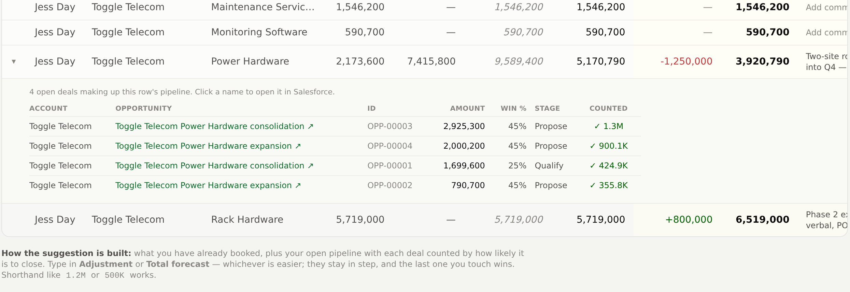
TRUST
Every number opens up
Click the arrow on any row and the actual Salesforce deals behind it appear — amount, likelihood, stage, and whether each one counts toward the suggestion. Deal names link straight into Salesforce.
The answer to "why is my suggestion so high?" is usually one deal that is not as certain as it looks.
Notes:
This is the feature that earns trust in the number. A forecast tool nobody can audit gets ignored.

Slide 5
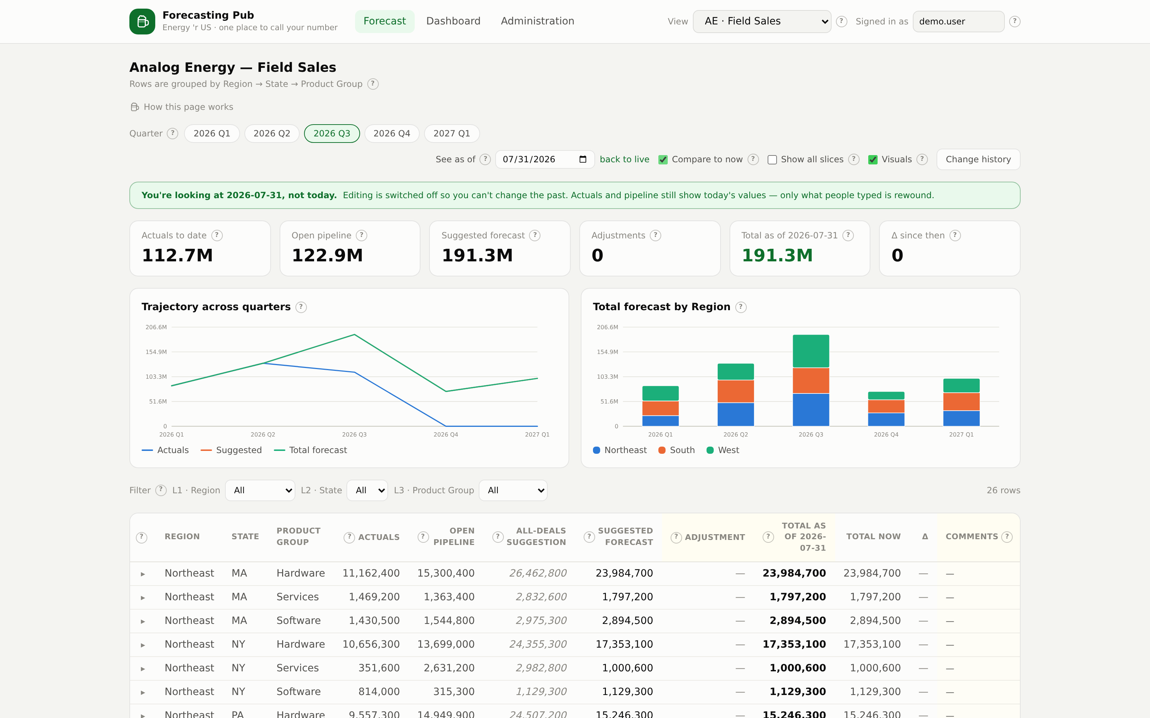
POINT IN TIME
Rewind to any date
See as of
Pick a date and the grid shows what everyone had entered then. Editing switches off so the past cannot be rewritten.
Compare to now
Adds today's number and the delta, so "what moved this week?" is one glance.
Full history
Every change ever made — field, old value, new value, who, when. Nothing is silently overwritten.
Rebuilt by replaying the audit trail — no snapshot jobs, no extra tables.
Notes:
Rep input is reconstructed from the audit log. Source facts stay live for now because the upstream tables have no snapshots yet — the UI says so rather than hiding it.

Slide 6
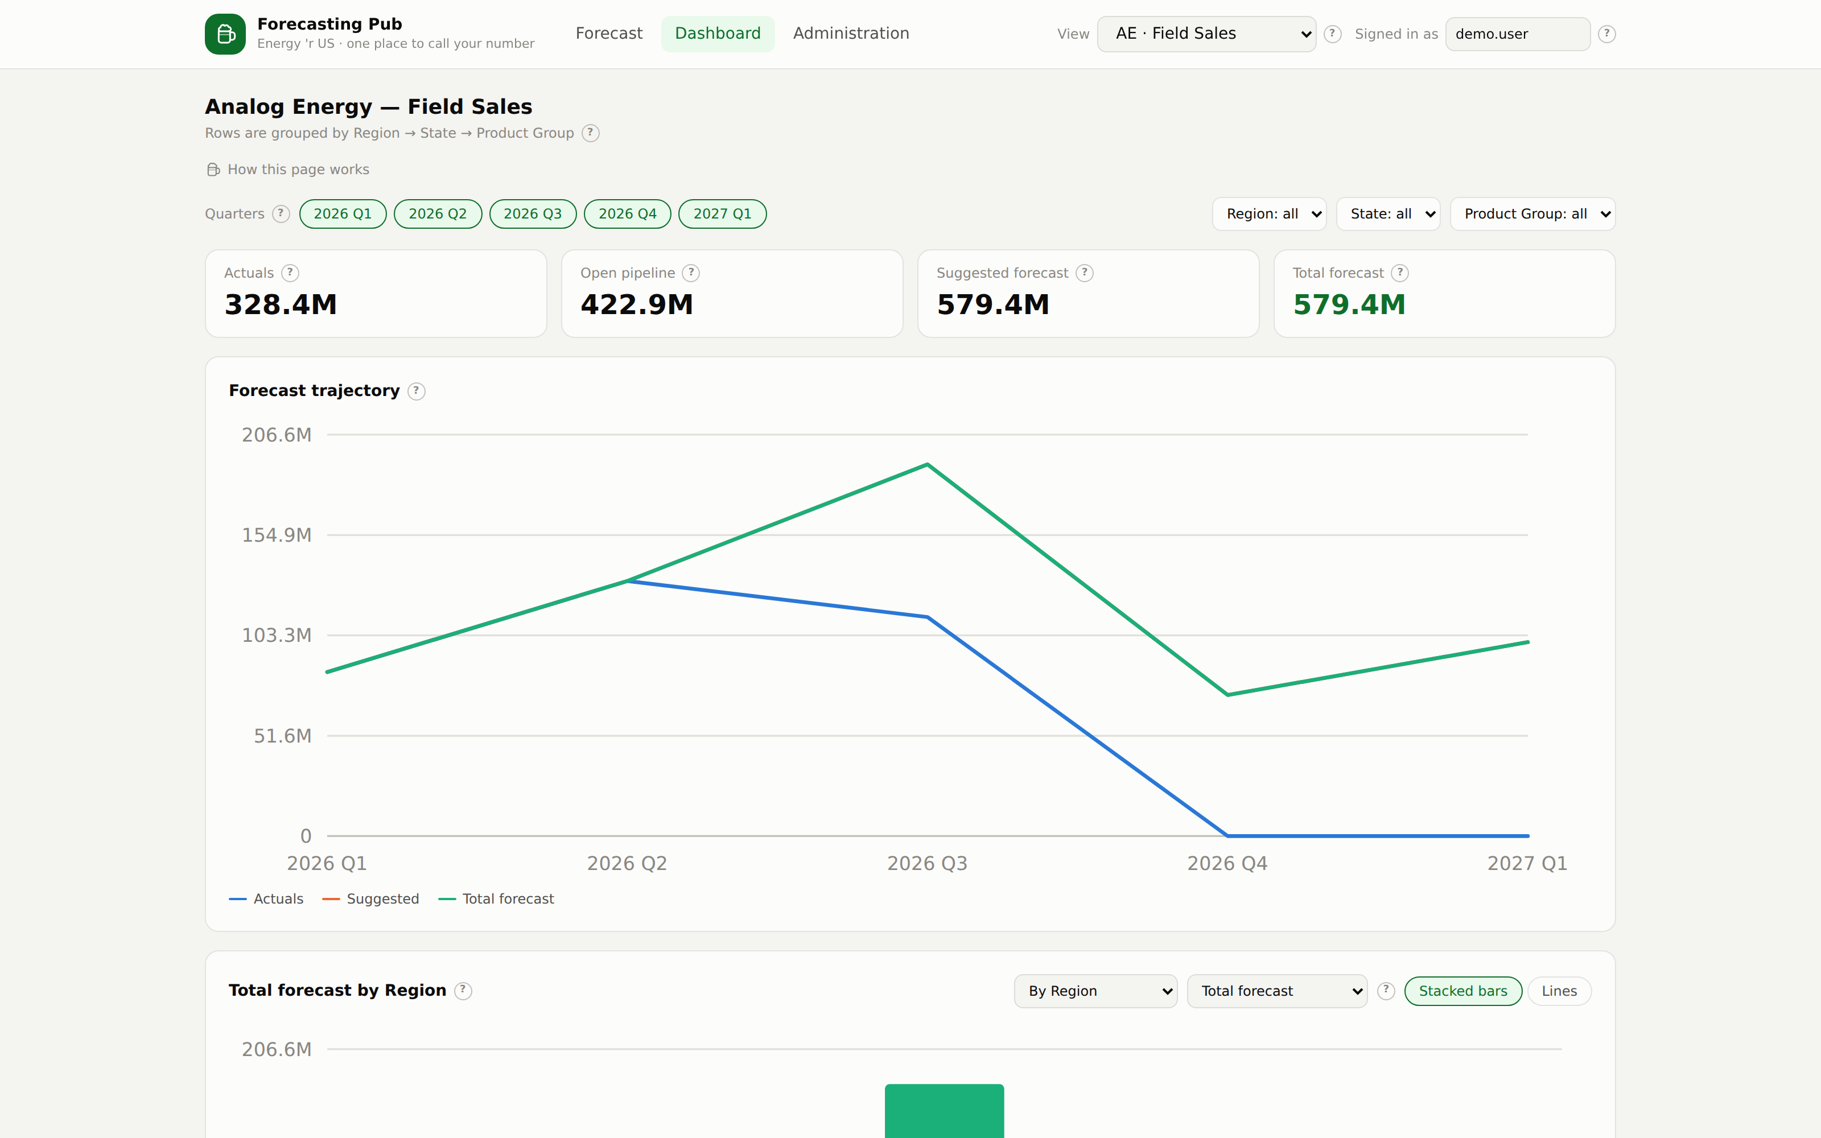
DASHBOARD
The same numbers, drawn
Trajectory
Actuals, suggestion and commitment across quarters. A wide gap means a lot still has to be won.
Breakdown
Switch what is measured and how it is grouped — any level the team forecasts by.
Bars or lines
Stacked bars for make-up, lines for movement. Same data either way.
Filters everywhere
Every tile and chart follows the same filters, so the numbers always agree.
Notes:
Charts are native SVG with a fixed, colourblind-checked palette — no chart library, no generated hues.

Slide 7
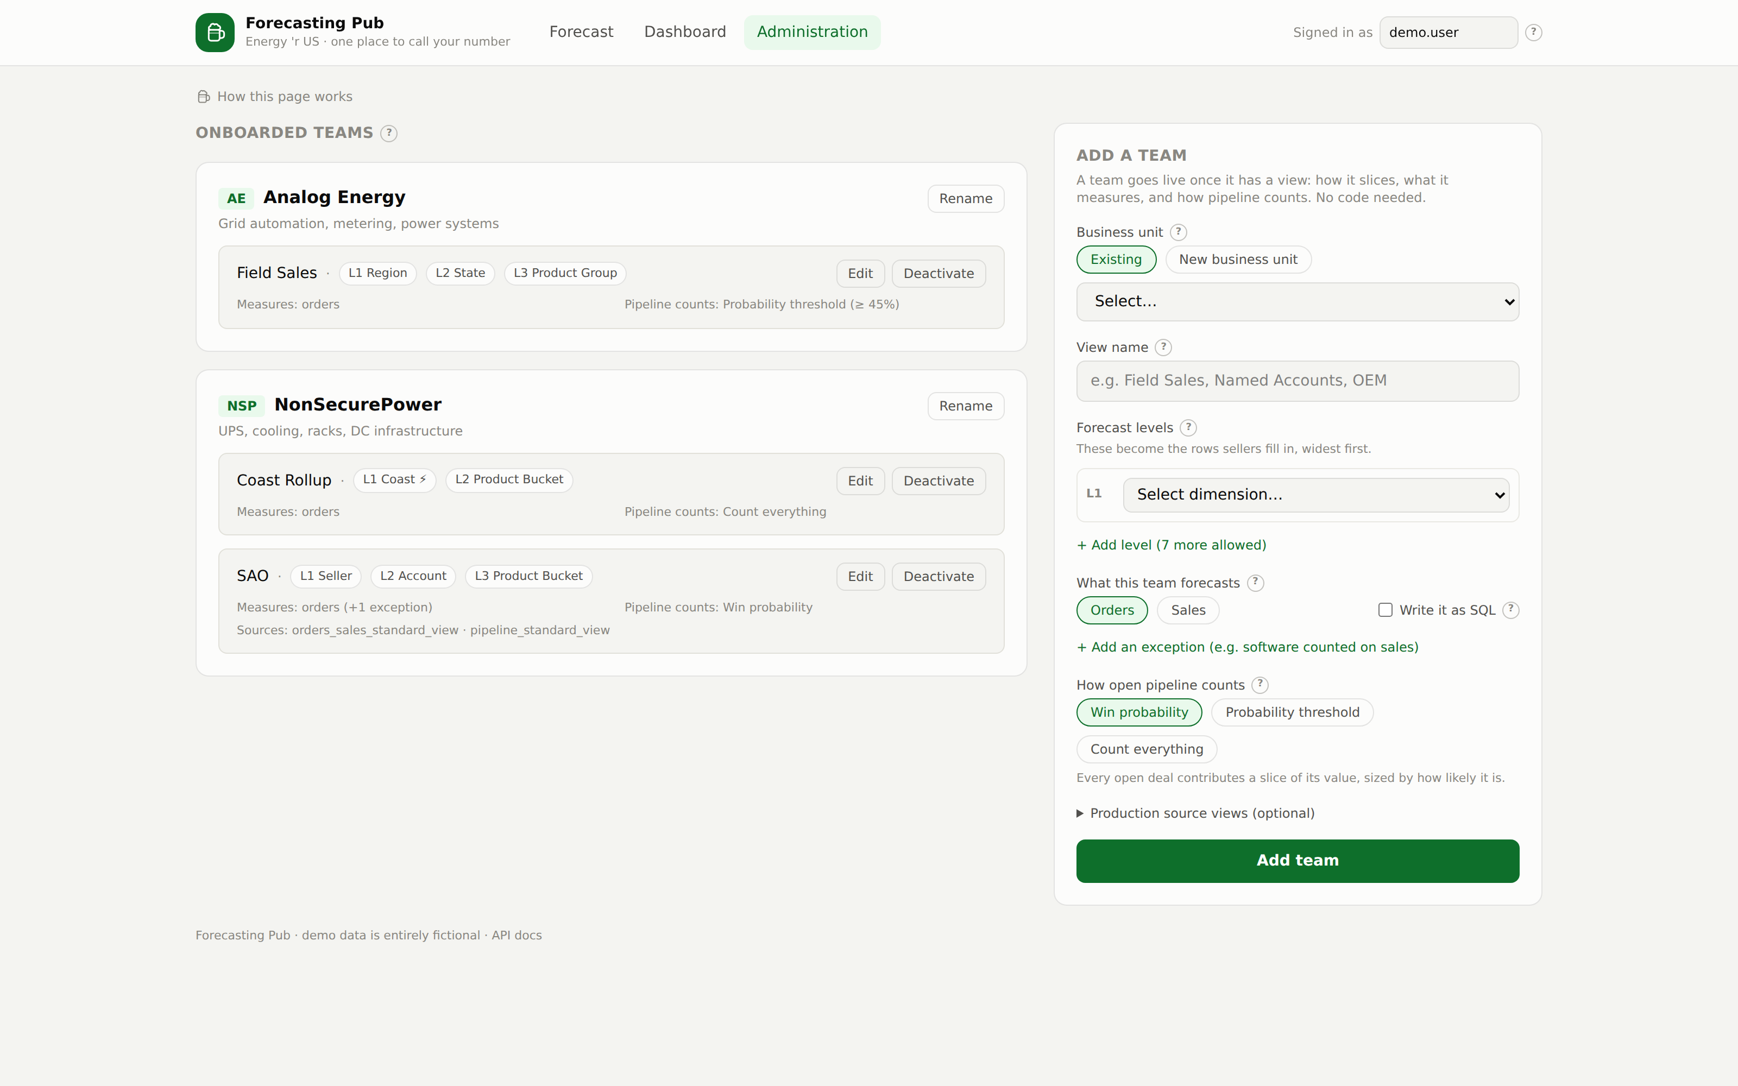
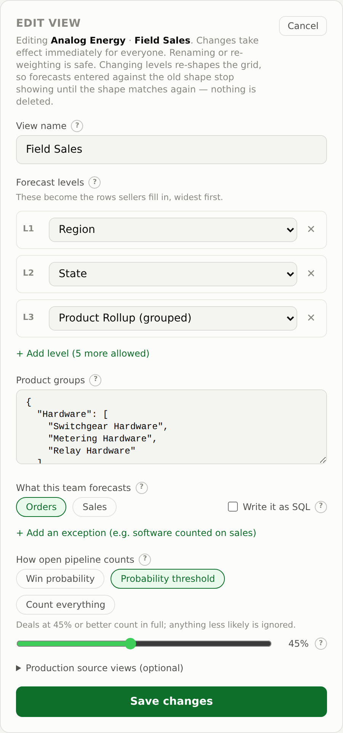
ADMINISTRATION
Onboarding is a form
Four decisions and the team is live in the picker. No schema change, no deploy, no ticket — and every setup can be edited or switched off later.
Edit anything, delete nothing
Edit loads a view's current setup. Deactivate hides it from sellers while keeping every entry and audit row — because deleting a forecast destroys the record of what someone committed to.
Custom levels take a SQL expression, compiled and checked the moment you save.
Notes:
A bad config fails for the admin who wrote it, with a reason — never for a seller opening the grid.

Slide 8
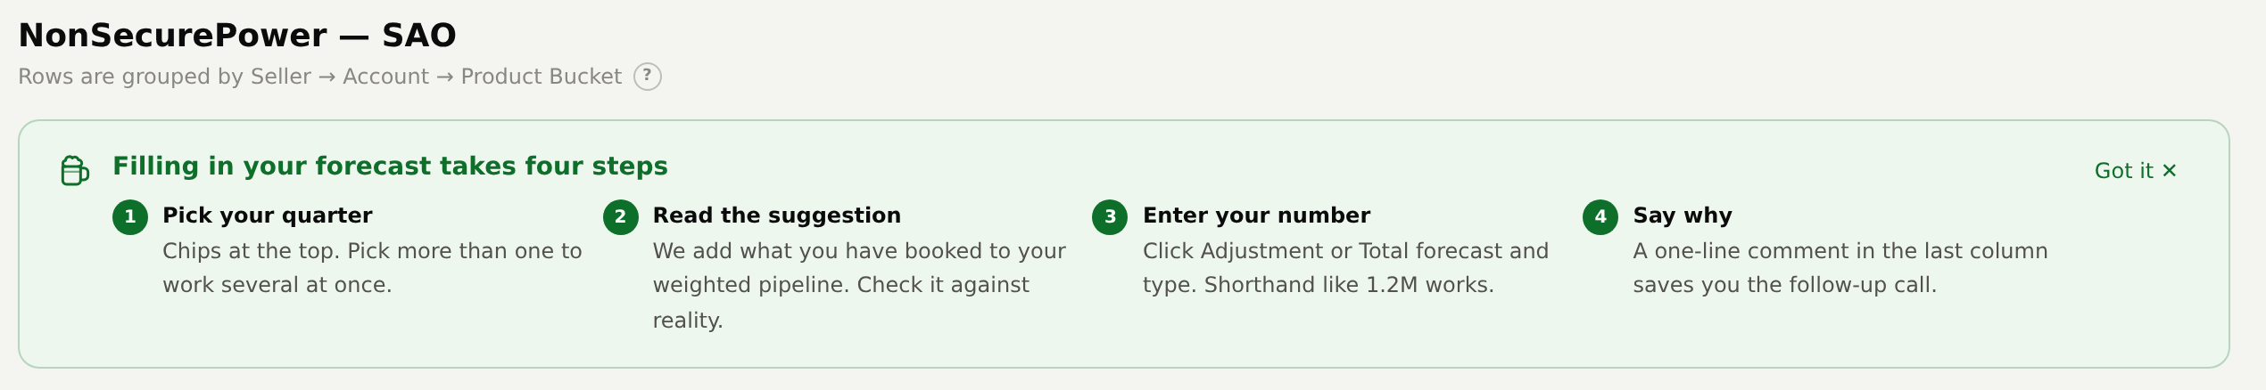
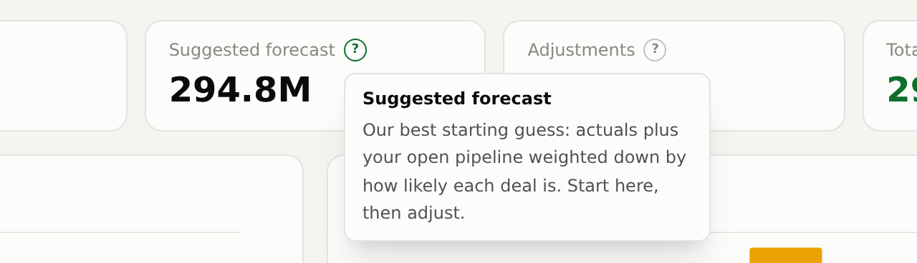
USABILITY
Built for people who sell
Our users are better at selling than at querying. Every column, control and setting explains itself in plain language — no acronyms anyone would have to look up.
1
A four-step primer
On every page, dismissable, and always retrievable.
2
A "?" on everything
Columns, controls, tiles, charts, admin fields. Keyboard reachable.
3
Plain language
Say what the number is, then what to do with it. Two sentences, no jargon.
4
Helpful failures
Empty and error states say what to do, not just what went wrong.
Notes:
All help copy lives in one file so the wording can be reviewed as prose rather than hunted through the code.

Slide 9
UNDER THE HOOD
Enterprise-friendly by construction
Logic runs as SQL
Read-only on source
Audited by design
Levels, metrics, weighting and filters compile to SQL that executes in the database — so pointing a team at the real warehouse view is a config change, not a rewrite.
The app never writes orders, sales or pipeline. It owns only its own config, entries and audit tables.
Every change writes an immutable record. That trail is also what powers point-in-time views.
One container
Agent-ready
Swap-in seams
docker compose up. The frontend compiles into the image and the API serves it — one service, one port, no reverse proxy.
Five guides plus a working contract for agents: what is safe to change, and which doc to update.
Identity is one function away from SSO; source views are named in config; the SQL layer is a single module.
Notes:
The four goals this was built against: faster onboarding, more out of the box, agents can iterate on it, and a backend that is not SharePoint.

Slide 10
STATUS
Where it stands
3
1–8
18
1
differently-shaped
teams seeded
forecast levels,
any of them SQL
tests, including an
anonymisation guard
command to
deploy it
Working today
Before production
Entry grid, drill-down and comments
Point-in-time views and full audit history
Dashboard with switchable cuts
Self-service onboarding and editing
One-command deployment, docs for every audience
Wire SSO in place of the placeholder identity
Point the fact tables at the real feeds
Add source snapshots so as-of covers actuals too
Swap the placeholder Salesforce opportunity id
All demo data is fictional — accounts, people, products and every number.
Notes:
Known limits are stated rather than buried: identity, real feeds, fact snapshots, and the placeholder opportunity link.

