Slide 1
Assessing Melbourne’s Employment and Housing Correlations
Patrick Tjahjadi

Slide 2
Presentation Outline
Question
Motivation of Research
Datasets
Data Wrangling Methodologies
Results
Reflections

Slide 3
Question
“Do the increase in employment rates contribute to the rise of house prices in Melbourne?”

Slide 4
Motivation and Purpose
Rise in employment rates and quality of life.
Concerning increase in property prices.
Assessing the future of Victoria’s economy.

Slide 5
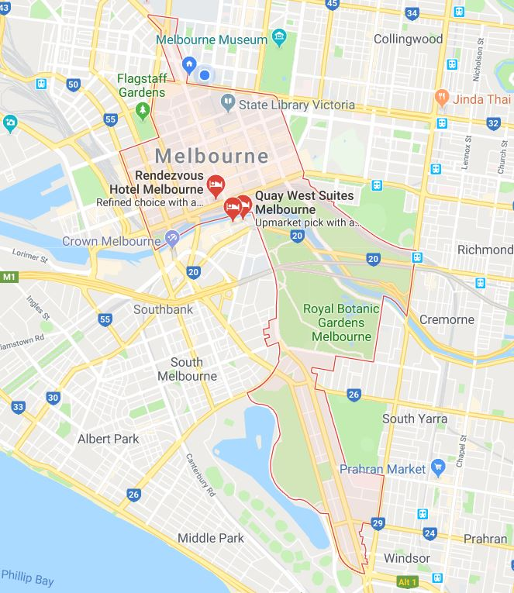

Scope
City of Melbourne
DATASETS:
‘Median House Prices – By Type and Sale Year’
‘Employment by Block by Industry’
.

Slide 6
Pre-processing Integration
Removing Unnecessary Data
Input missing values in datasets
Detecting Outliers
Type Conversion
Column Joins
DataFrames implementation using pandas.
Clustering of sectors
All done by Python
Special thanks to: Pandas, Matplotlib, Numpy, Scipy, Re, Decimal and Seaborn

Slide 7
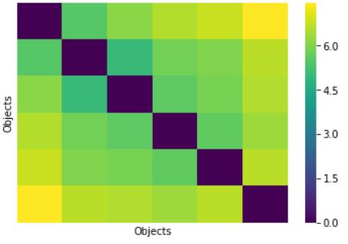
Clustering Method
Using the VAT algorithm
Normalisation is Magic
$$Normalised Value= \frac{Old Value−Minimum Value}{Maximum Value−Minimum Value}$$
Figure 1: VAT visualisation of the 6 employment sectors

Slide 8
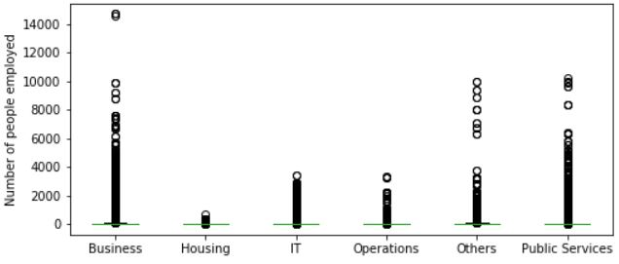
“An Outlier Speaks A Thousand Words”
Figure 2: Instances of people employed for each sector in the City of Melbourne

Slide 9
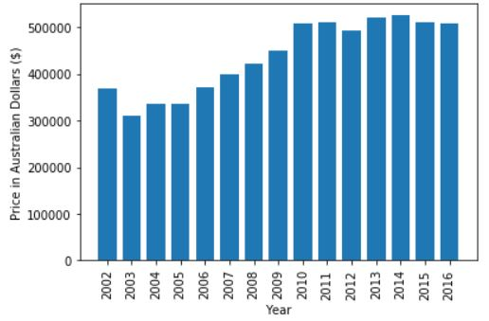
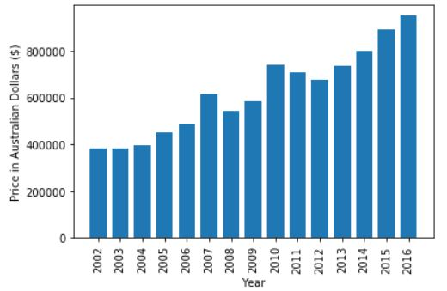
House Prices are on the Rise
Figure 3: Median Apartment Price in Melbourne
Figure 4: Median House Price in Melbourne

Slide 10
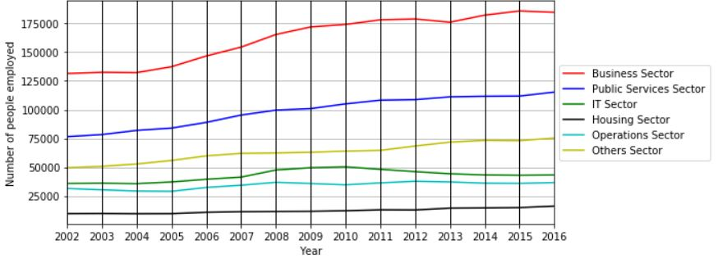
What about employment rates?
Figure 5: Number of employment per year for each sector (City of Melbourne)

Slide 11
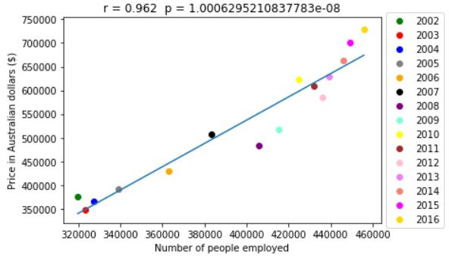
Let’s Correlate!
194.14%
Percentage increase of housing prices
142.54%
Percentage increase in number of people employed
Figure 6: Median house and apartment price averaged vs number of people employed (City of Melbourne)
0.962
Pearson Correlation Coefficient

Slide 12
Reflections
Challenge 1
Challenge 2
Challenge 3
Raw heatmap visualisation?
Too many instances!
Initial question? Too complex.
Missing values in the datasets.
INITIAL QUESTION:
Population? Poverty?
Education? Employment?
Immigration? Economy?
Crime Rate? Interest Rates?
“What are the variables that affect changing property prices?”

