Slide 1
SEMI-SUPERVISED CLASSIFICATION WITH
GRAPH CONVOLUTIONAL NETWORKS
김지완

Slide 2
Contents
Background
Laplacian, Degree, Adjacency Matrix
Why Convolution ? - Convolution on Graphs
Introduction
How Do We Convolution ? - Graph Fourier Transform (GFT)
Fast Approximate Convolutions on Graphs
Semi-Supervised Node Classification
Experiments
Implementation

Slide 3
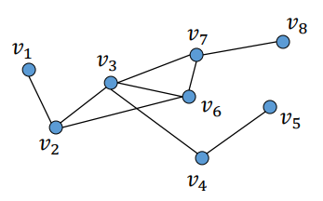
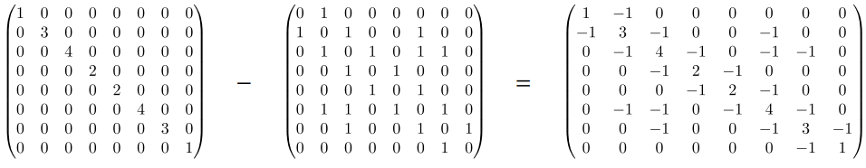
Background
Laplacian, Degree, Adjacency Matrix
Adjacency Matrix : A[i, j] = 1 if v_i is adjacent to v_j
Degree Matrix : D = Diag(degree(v_1, ... , v_n)
Laplacian Matrix : L = D - A
Degree Matrix
Adjacency Matrix
Laplacian Matrix

Slide 4
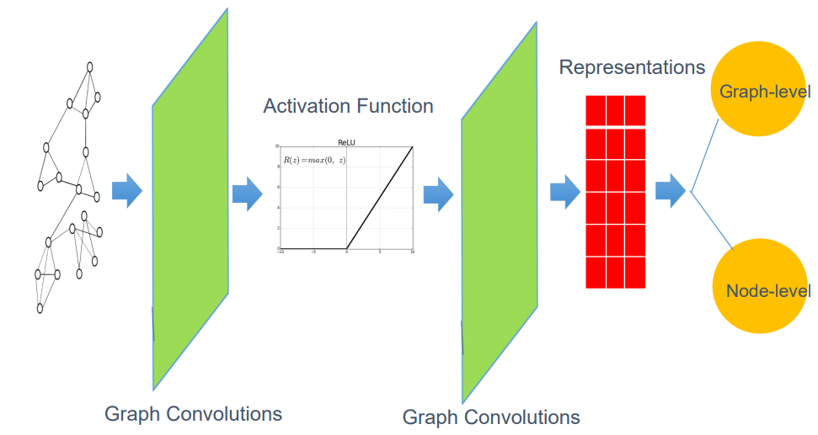
Background
Why Convolution ?
- Layer applicable to Graph Structure
Problems in Graph Structure
Complex Topological Structure
No Fixed Node Ordering
Arbitrary Neighbor size
Desirable Property of Graph Layer
Permutation Invariant or Equivariance
Capturing Locality
Naive Approach : MLP is not Working !

Slide 5
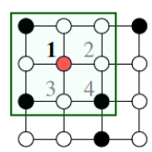
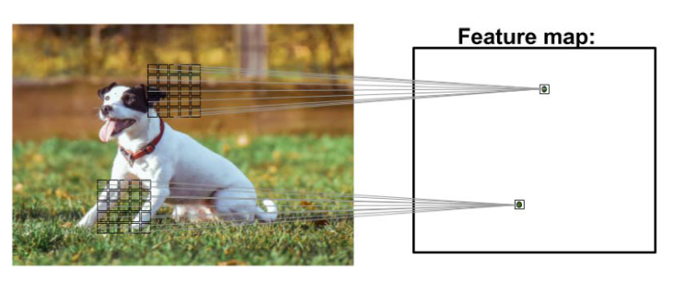
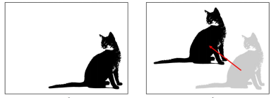
Background
Why Convolution ?
- Convolution in CNN
Locality
Transition Equivariance
Generalize Convolution of CNN to Apply on Graph !

Slide 6
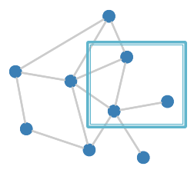
Background
Why Convolution ?
- Convolution in Image vs Graph
Image
Graph
As Image is Fixed-Grid, Applying Convolution is Easy.
There are 2 ways in applying Convolution on Graph
1. Apply Directly to Graph Structure - Spatial Filtering
2. Change Graph Structure and Apply - Spectral Filtering

Slide 7
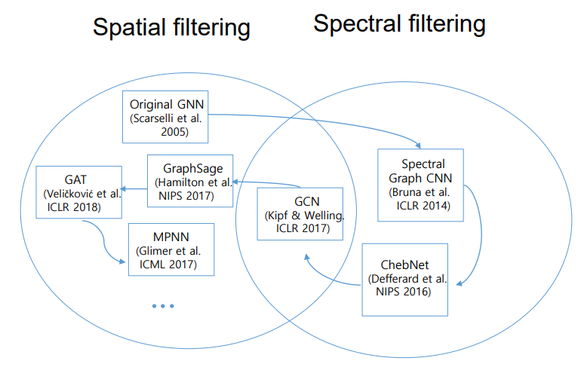
Background
Why Convolution ?
- Spatial vs Spectral Convolution
Spatial Filtering
Intuitively Applicable
Calculation is Simple
Before GCN(2017), Spatial Filtering is Unstable and Hard to Learning
Spectral Filtering
Well-Defined Theory in Signal Processing
Computational Cost is Expensive

Slide 8
Background
Why Convolution ?
- What is Spectral ?
After Failing at Spatial Convolution, Try Spectral Convolution
Spectral Filtering
Change Graph Structure to apply Convolution Easy
-> Change Domain From Spatial to Some Other ..
Fourier Transform : Time Domain -> Frequency Domain
-> Filtering Frequency Easy
Graph Fourier Transform : Spatial Domain -> Some Other Domain
-> Node Similarity (Hidden Relationship) Easy
Changing Domain (Space) is related to Spectral Theory

Slide 9
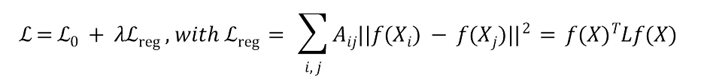
Introduction
Semi-Supervised Learning
$$ℒ=ℒ_{0} + λℒ_{reg} , with ℒ_{reg} = \sum_{i, j}{A_{ij}||f(X_{i}) - f(X_{j})||^{2} = f{(X)}^{T}Lf(X) }$$
Supervised Loss With Small Labeled Dataset + Regularization Loss
Connected Nodes by Edge is Likely to share Same Label
Edges Could Contain More Additional Information !
Two Contribution
1. Simple, Well-Behaved Layer-Wise Propagation Rule Can Directly Apply on Graphs
2. Fast and Scalable
-> First Order Approximation of Spectral Graph Convolution
Stable + Fast Learning is Possible

Slide 10
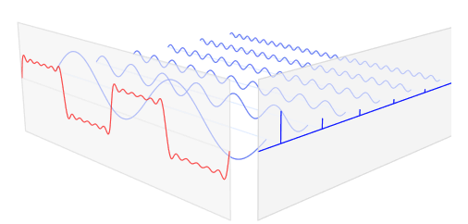
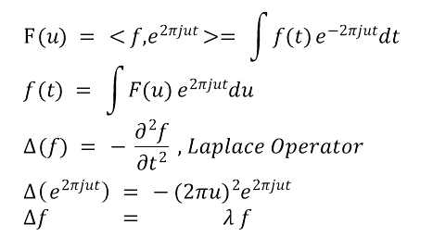

Introduction
How Do We Convolution ?
$$F\left(u\right) = <f,e^{2πjut}>= \int{f(t)}e^{-2πjut}dt$$
$$f\left(t\right) = \int{F(u)}e^{2πjut}du$$
$$∆\left(f\right) = -\frac{∂^{2}f}{∂t^{2}} , Laplace Operator$$
$$∆\left(e^{2πjut}\right) = -{(2πu)}^{2}e^{2πjut}$$
$$∆f = λ f$$
Idea : Want to Know Divergence of Gradient (Diffusion) -> Laplace Operator
Laplace Operator : Operator on Function Space
is EigenFunction(EigenVector) of Laplace Operator
Fourier Transform = Projecting Function To Other Function Space
= Representing Function With EigenFunction of Laplace Operator
$$e^{2πjut}$$
Notes:
EigenFunction 은 Not Unique 하나 해당 함수를 사용함으로써, 주기함수에 대해 표현하기 용이하고, Frequency 관련하여 해석이 쉬워짐

Slide 11
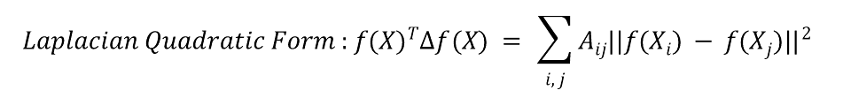
Introduction
How Do We Convolution ?
In Signal Processing,
Want to Know Divergence of Gradient (Diffusion) -> Laplace Operator
In Graph,
Want to Know Similarity Between Nodes -> Which Operator ?
Laplacian Quadratic Form
The Smaller, The Similar the Connected Nodes
Derivative of Laplacian Quadratic Form is Laplacian Matrix (Discrete Laplace Operator) !
Graph Fourier Transform = Projecting X (Feature) To Laplacian Matrix Space
= Representing X With EigenVector of Laplacian Matrix
$$Laplacian Quadratic Form : f{(X)}^{T}∆f\left(X\right) = \sum_{i, j}{A_{ij}||f(X_{i}) - f(X_{j})||^{2} }$$
Notes:
EigenFunction 은 Not Unique 하나 해당 함수를 사용함으로써, 주기함수에 대해 표현하기 용이하고, Frequency 관련하여 해석이 쉬워짐

Slide 12
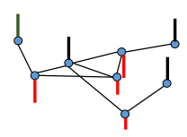
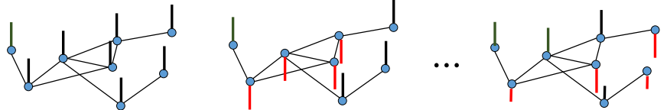
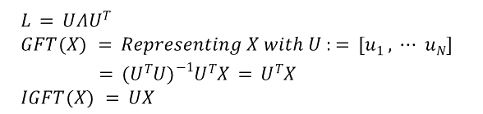
Introduction
How Do We Convolution ?
Low Frequency
High Frequency
$$L = UΛU^{T}$$
$$GFT\left(X\right) = Representing X with U := [u_{1} , ⋯ u_{N}]$$
$$= {(U^{T}U)}^{-1}U^{T}X = U^{T}X$$
$$IGFT\left(X\right) = UX$$

Slide 13
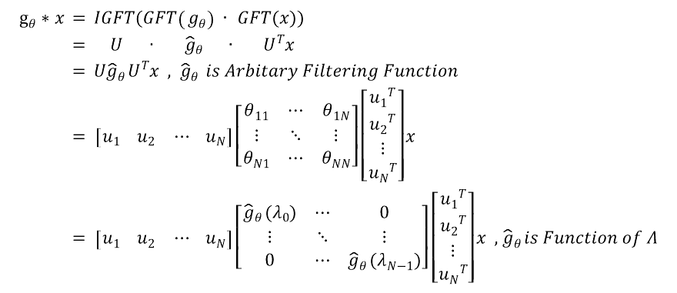
Introduction
How Do We Convolution ?
$$g_{θ}*x = IGFT(GFT\left(g_{θ}\right)∙ GFT(x))$$
$$= U ∙ {\hat{g}}_{θ } ∙ U^{T}x$$
$$= U{\hat{g}}_{θ }U^{T}x , {\hat{g}}_{θ } is Arbitary Filtering Function$$
$$= \left[u_{1} u_{2} ⋯ u_{N}\right]\left[\begin{matrix}θ_{11} & ⋯ & θ_{1N} \\ ⋮ & ⋱ & ⋮ \\ θ_{N1} & ⋯ & θ_{NN}\end{matrix}\right]\left[\begin{matrix}{u_{1}}^{T} \\ {u_{2}}^{T} \\ \begin{matrix}⋮ \\ {u_{N}}^{T}\end{matrix}\end{matrix}\right]x$$
$$= \left[u_{1} u_{2} ⋯ u_{N}\right]\left[\begin{matrix}{\hat{g}}_{θ }(λ_{0}) & ⋯ & 0 \\ ⋮ & ⋱ & ⋮ \\ 0 & ⋯ & {\hat{g}}_{θ }(λ_{N-1})\end{matrix}\right]\left[\begin{matrix}{u_{1}}^{T} \\ {u_{2}}^{T} \\ \begin{matrix}⋮ \\ {u_{N}}^{T}\end{matrix}\end{matrix}\right]x , {\hat{g}}_{θ }is Function of Λ$$

Slide 14


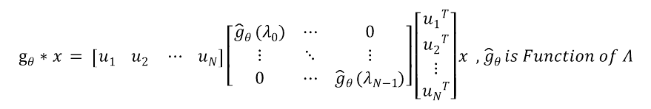
Fast Approximate Convolution on Graphs
Layer-Wise Propagation Rule
$$g_{θ}*x = \left[u_{1} u_{2} ⋯ u_{N}\right]\left[\begin{matrix}{\hat{g}}_{θ }(λ_{0}) & ⋯ & 0 \\ ⋮ & ⋱ & ⋮ \\ 0 & ⋯ & {\hat{g}}_{θ }(λ_{N-1})\end{matrix}\right]\left[\begin{matrix}{u_{1}}^{T} \\ {u_{2}}^{T} \\ \begin{matrix}⋮ \\ {u_{N}}^{T}\end{matrix}\end{matrix}\right]x , {\hat{g}}_{θ }is Function of Λ$$
Problems in Computational Resource
-> Matrix Multiplication + Eigendecomposition of L is Expensive
4 Tricks For Fast Approximate
1. Approximate to ChebyShev Polynomial
2. K = 1 Set
3. Parameter Reduce
4. Renormaliation Trick
$$H^{(l+1)} = σ({\tilde{D}}^{-\frac{1}{2}} \tilde{A} {\tilde{D}}^{-\frac{1}{2}} H^{(l)} W^{(l)})$$
$$\tilde{A} = I_{N} + A , {\tilde{D}}_{ii} = \sum{A_{ij}}$$

Slide 15

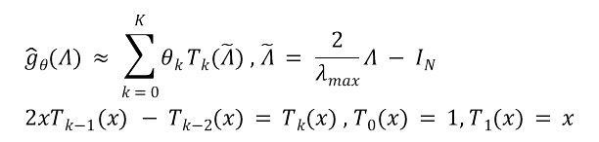
Fast Approximate Convolution on Graphs
Layer-Wise Propagation Rule
1. Approximate to ChebyShev Polynomial
$${\hat{g}}_{θ}(Λ) ≈ \sum_{k = 0}^{K}{θ_{k}}T_{k}(\tilde{Λ}) , \tilde{Λ} = \frac{2}{λ_{max}}Λ - I_{N}$$
$$2xT_{k-1}\left(x\right) - T_{k-2}(x) = T_{k}(x) , T_{0}(x) = 1, T_{1}(x) = x$$
ChebyShev Polynomial
$$g_{θ}*x = U {\hat{g}}_{θ} U^{T}x$$
$$= U \sum_{k = 0}^{K}{{θ_{k}}^{T}T_{k}(\tilde{Λ})U^{T}x }$$
$$= \sum_{k = 0}^{K}{{θ_{k}}^{T}T_{k}(U\tilde{Λ}U^{T})x }, \tilde{L} = \frac{2}{λ_{max}}L - I_{N}$$
$$= \sum_{k = 0}^{K}{{θ_{k}}^{T}T_{k}(\tilde{L})x }= {θ_{0}}^{T} I_{N}x + {θ_{1}}^{T} \tilde{L} x +{θ_{2}}^{T} (2{\tilde{L}}^{2}-I_{N} )x + ⋯$$
K-th Polynomial Capture K-step Neighborhood
No More Need Eigen Decomposition
Only Need Spatial Data, L
Computational Still Expensive - O(KE)
Non-Linear - Hard To Stack Deep Layer

Slide 16
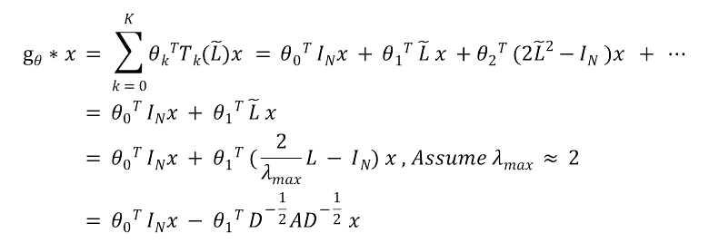
Fast Approximate Convolution on Graphs
Layer-Wise Propagation Rule
2. Setting K = 1
$$g_{θ}*x = \sum_{k = 0}^{K}{{θ_{k}}^{T}T_{k}(\tilde{L})x }= {θ_{0}}^{T} I_{N}x + {θ_{1}}^{T} \tilde{L} x +{θ_{2}}^{T} (2{\tilde{L}}^{2}-I_{N} )x + ⋯$$
$$= {θ_{0}}^{T} I_{N}x + {θ_{1}}^{T} \tilde{L} x$$
$$= {θ_{0}}^{T} I_{N}x + {θ_{1}}^{T} (\frac{2}{λ_{max}}L - I_{N}) x , Assume λ_{max} ≈ 2$$
$$= {θ_{0}}^{T} I_{N}x - {θ_{1}}^{T} D^{-\frac{1}{2}}AD^{-\frac{1}{2}} x$$
By Setting K = 1, Convolution Capture 1-Step Neighborhood
-> More Deep Neighborhood Infomation by Stacking Layer Deep
Time Efficiency - O(E) & Linear -> Stacking Deep Layer Possible

Slide 17
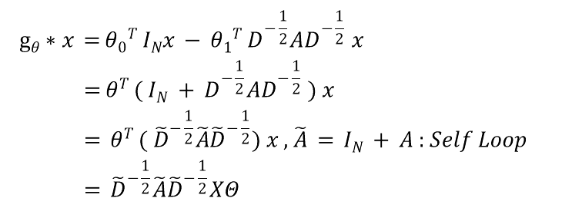
Fast Approximate Convolution on Graphs
Layer-Wise Propagation Rule
3&4. Parameter Reduce & Renormalization Trick
$$g_{θ}*x ={θ_{0}}^{T} I_{N}x - {θ_{1}}^{T} D^{-\frac{1}{2}}AD^{-\frac{1}{2}} x$$
$$=θ^{T} ( I_{N} + D^{-\frac{1}{2}}AD^{-\frac{1}{2}} ) x$$
$$= θ^{T} ( {\tilde{D}}^{-\frac{1}{2}}\tilde{A}{\tilde{D}}^{-\frac{1}{2}}) x , \tilde{A} = I_{N} + A : Self Loop$$
$$= {\tilde{D}}^{-\frac{1}{2}}\tilde{A}{\tilde{D}}^{-\frac{1}{2}}XΘ$$
Parameter Reduce
Renormalization Trick
$$H^{(l+1)} = σ({\tilde{D}}^{-\frac{1}{2}} \tilde{A} {\tilde{D}}^{-\frac{1}{2}} H^{(l)} W^{(l)})$$
By Parameter Reduce, Prevent Overfitting
By Renormalization Trick, Avoid Gradient Exploding / Vanishing

Slide 18
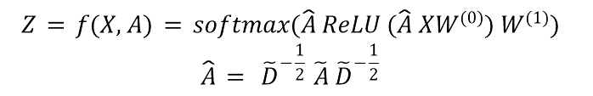
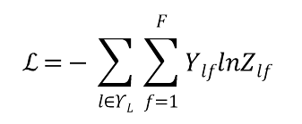
Semi-Supervised Node Classification
Two Layer GCN
$$Z = f(X, A) = softmax(\hat{A} ReLU (\hat{A} XW^{(0)}) W^{(1)})$$
$$\hat{A} = {\tilde{D}}^{-\frac{1}{2}} \tilde{A} {\tilde{D}}^{-\frac{1}{2}}$$
$$ℒ=ℒ_{0} + λℒ_{reg} , with ℒ_{reg} = \sum_{i, j}{A_{ij}||f(X_{i}) - f(X_{j})||^{2} = f{(X)}^{T}Lf(X) }$$
$$ℒ=-\sum_{l∈Υ_{L}}{\sum_{f=1}^{F}{Y_{lf}lnZ_{lf}}}$$

Slide 19
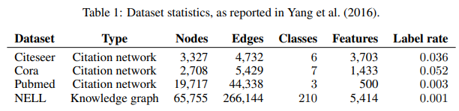
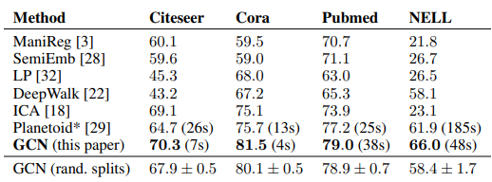
Experiments
Datasets
For Semi-Supervised Learning,
Train Set : 20 Samples Per Class,
Valid, Test Set : 500, 1000 Samples Each
Learing Rate : 0.01
Epoch : 200
Early Stopping : 10 Patience
Dropout : 0.1 (NELL) / 0.5 (Others)
L2 Regularization : 1e-5 (NELL) / 5e-4 (Others)
Hidden Dim : 64 (NELL) / 16 (Others)
(Upper) Mean Acc of 100 Random Node Ordering
(Lower) Mean Acc of 10 Dataset split
Graph, Feature : Row-wise Normalize

Slide 20
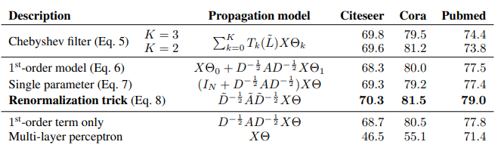




Experiments
Datasets
Method | Eigen Value Decomposition | Propagation
Spectral GCN
+ ChebyShev Filter | -
+ 1st-Order Model | -
+ Single Parameter | -
+ Renomalization Trick | -
$$O(N^{3})$$
$$O(N^{2}CF)$$
$$O(KECF)$$
$$O(ECF)$$
$$O(ECF)$$
$$O(ECF)$$

Slide 21
Limitation And Future Works
1. Memory Requirement
Full Batch Gradient Descent
2. Directed Edges and Edges Features
Only Applicable to Undirected Graphs
3. Limiting Assumptions
Importance between Self-Connection and Neighborhood Edge

Slide 22




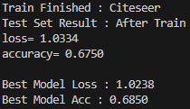
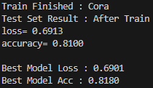
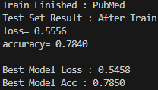
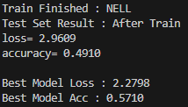
Implementation
Datasets

Slide 23
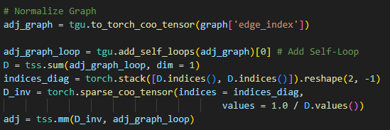
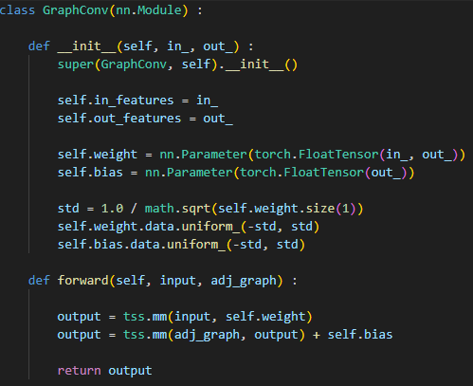


Implementation
$$H^{(l+1)} = σ(\hat{A} H^{(l)} W^{(l)})$$
$$\hat{A} = {\tilde{D}}^{-\frac{1}{2}} \tilde{A} {\tilde{D}}^{-\frac{1}{2}} = {\tilde{D}}^{-1} \tilde{A}$$
$$H^{(l+1)} = σ({\tilde{D}}^{-\frac{1}{2}} \tilde{A} {\tilde{D}}^{-\frac{1}{2}} H^{(l)} W^{(l)})$$
$$Z = f(X, A) = softmax(\hat{A} ReLU (\hat{A} XW^{(0)}) W^{(1)})$$

Slide 24
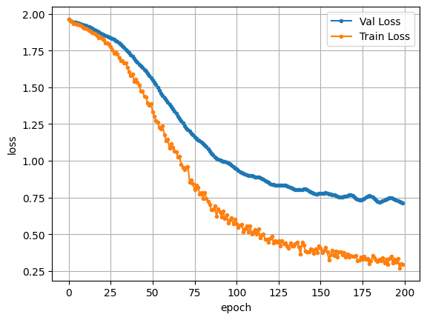
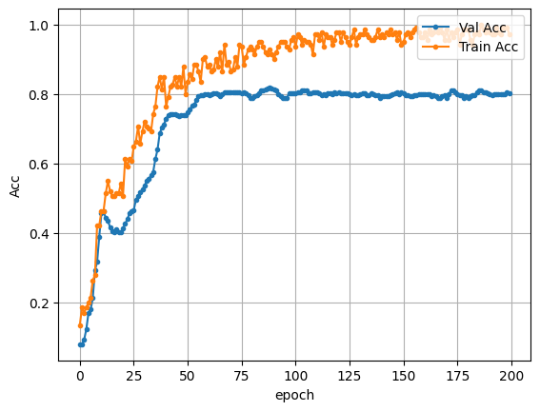
Implementation
In Paper, 20 Sample Per Class
Author Github Just 100 Sample Regardless of Classs - No Big Diffence
All Data 200 Epoch & Early Stop -> Citeseer / Cora / PubMed Stop Without Learning
For NELL Dataset, High Deviation in Accuracy

Slide 25
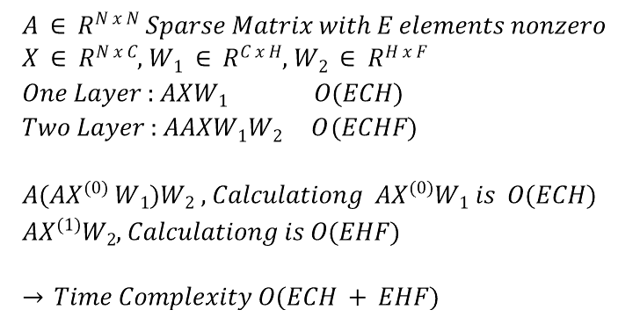
Implementation
$$A ∈ R^{N x N} Sparse Matrix with E elements nonzero$$
$$X ∈ R^{N x C}, W_{1} ∈ R^{C x H}, W_{2} ∈ R^{H x F}$$
$$One Layer : AXW_{1} O(ECH)$$
$$Two Layer : AAXW_{1}W_{2} O\left(ECHF\right)$$
$$A({AX}^{(0)} W_{1})W_{2} , Calculationg AX^{(0)}W_{1} is O(ECH)$$
$$AX^{(1)}W_{2}, Calculationg is O(EHF)$$
$$→ Time Complexity O(ECH + EHF)$$

