Slide 1
Küdo

Slide 2
Design
Management
Development
Demo
Customer

Slide 3
Design Process

Slide 4
Simplicity

Slide 5
Interactive

Slide 6
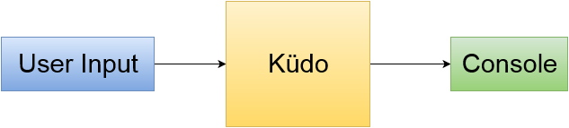

Slide 7
Model View Controller

Slide 8
Management Process

Slide 10
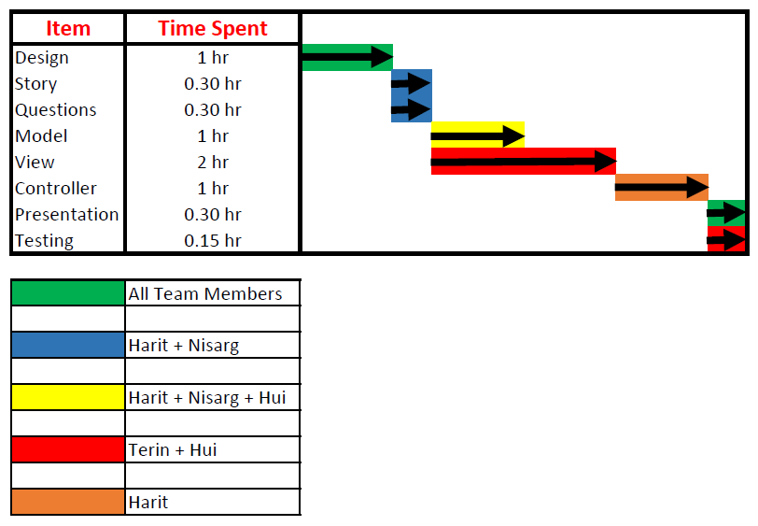

Slide 11
Development Process

Slide 12
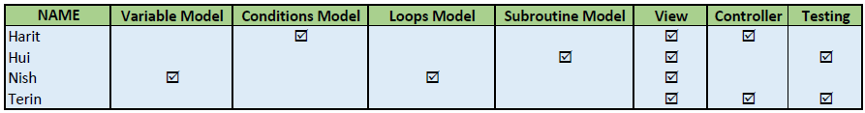

Slide 13
Live Demo

Slide 14
Potential Customers

Slide 15
That Concludes Our Presentation

