Slide 1
Küdo

Slide 2
Management
Design
Development
Demo
Customer

Slide 3
Management Process

Slide 5
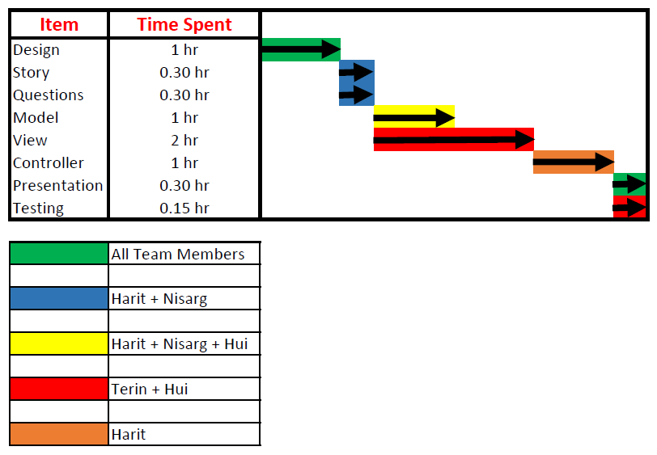

Slide 6
Design Process

Slide 7
Simplicity

Slide 8
Interactive

Slide 9
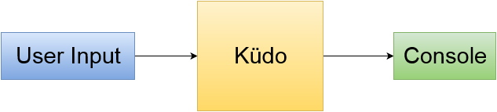

Slide 10
Model View Controller

Slide 11
Development Process

Slide 12
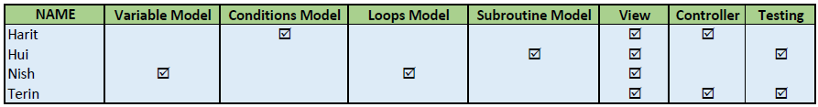

Slide 13
Live Demo

Slide 14
Potential Customers

Slide 15
That Concludes Our Presentation

