Slide 1
Micro Credit Defaulter Project

Slide 2
Contents
Problem Statement
Introduction
Exploratory Data Analysis
Models Development and Evaluation
Analysis of the output of each model
Conclusion

Slide 3
Problem Statement
Build a model which can be used to predict in terms of a probability for each loan transaction, whether the customer will be paying back the loaned amount within 5 days of insurance of loan. In this case, Label ‘1’ indicates that the loan has been payed i.e. Non- defaulter, while, Label ‘0’ indicates that the loan has not been payed i.e. defaulter.

Slide 4
INTRODUCTION
Business Problem Framing
This is a classic Business problem which helps Micro Financing Institutions and other Lending companies reduce Credit risks by recognizing potential Defaulters.
Conceptual Background of the Domain Problem
Before advancement of Data Science, loan lending companies used to risk a high rate of defaulting. Many a times a perfect candidate would display erratic financial and repayment behaviour after being approved for loan. Machine Learning can help lenders predict potential defaulters before approving their candidature using their past data. The candidates’ income, past debt and repayment behaviour can be important metrics for the same.
Review of Literature
“Microfinance” is often seen as financial services for poor and low-income clients. In practice, the term is often used more narrowly to refer to loans and other services from providers that identify themselves as “microfinance institutions”. Microfinance can also be described as a setup of a number of different operators focusing on the financially under-served people with the aim of satisfying their need for poverty alleviation, social promotion, emancipation, and inclusion. Microfinance institutions reach and serve their target market in very innovative ways

Slide 5
Exploratory Data Analysis
1.Data Exploration
2.Data cleaning
3.Data Visualization
4.Feature Selection
5.Build model

Slide 6
Models Development and Evaluation
Data Exploration and Cleaning On data exploration, I found that the dataset was imbalanced for the target feature(87.5% for Non-defaulters and 12.5% for Defaulters). Also, I found that the data had some very unrealitic values such as 999860 days which is not possible. Also, there were negative values for variables which must not have one (example:frequency,amount of recharge etc). All these unrealistic values were dropped which caused a data loss of 8% only.
Feature Selection Since there were 36 features, many of which I suspected were redundant because of the data duplication. It was imperative to select only most significant of them to make ML models more efficient and cost effective. The method used was 'Univariate Selection' using chi-square test. I selected top 20 features which were highly significant.
Data Visualization On visualizing data, there were two important insights I gathered. a. Imbalance of data b. Distribution was not normal

Slide 7
Data Normalization Since the data was not normal, I normalized all the features except the target variable which was dichotomous(Values '1' and '0').
Oversampling of Minority class Since the data was expensive, I did not want to lose out on data by under sampling the majority class. Instead, I decided to oversample the minority class using SMOTE.
Build Models Since it was a supervised classification problem, I built 5 models to evaluate performance of each of them: a. Logistic Regression b. Linear SVM c. Decision Tree d. Random forest e. Gradient Boost Classifier Since the data was imbalanced, accuracy was not the correct performance metric. Instead I focused on other metrics like precision, recall and ROC-AUC curve

Slide 8
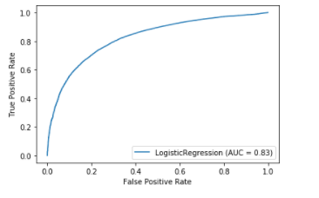
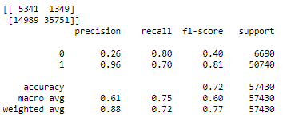
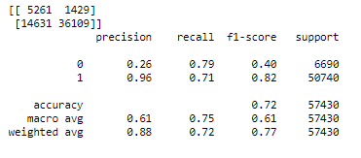
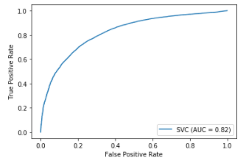
Analysis of the output of each model
Logistic Regression
2. Linear SVM

Slide 9
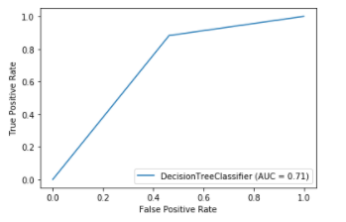
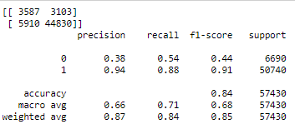
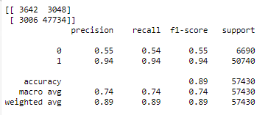
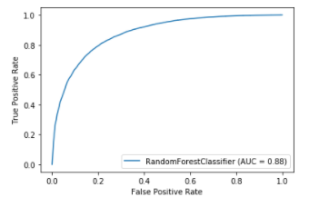
3. Decision Tree
4.Random Forest

Slide 10
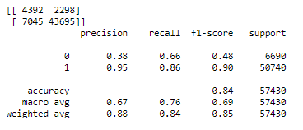
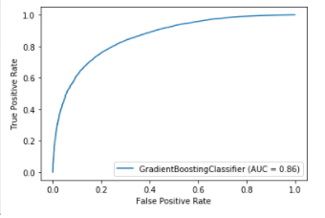
Gradient Boosting Classifier

Slide 11
Conclusion
According to the performance metrics, Random Forrest scores highest in accuracy. Also, the curve is tending towards the ideal shape. Hence, Random Forrest looks like the best fit for this data.

