Slide 1

HW
Health Web
Implementing Technology for health
Team Members
1. Aman Verma
2. Chirag Aherwar
3. Kushal Reddy
01

Slide 2

Introduction
A web App where people can write micro-blogs & request for blood.
Also Doners can promote their blood donations busting myths regarding blood donations
The platform focuses on developing a health centered community & promote blood donations in 18-35 age demographics

Slide 3
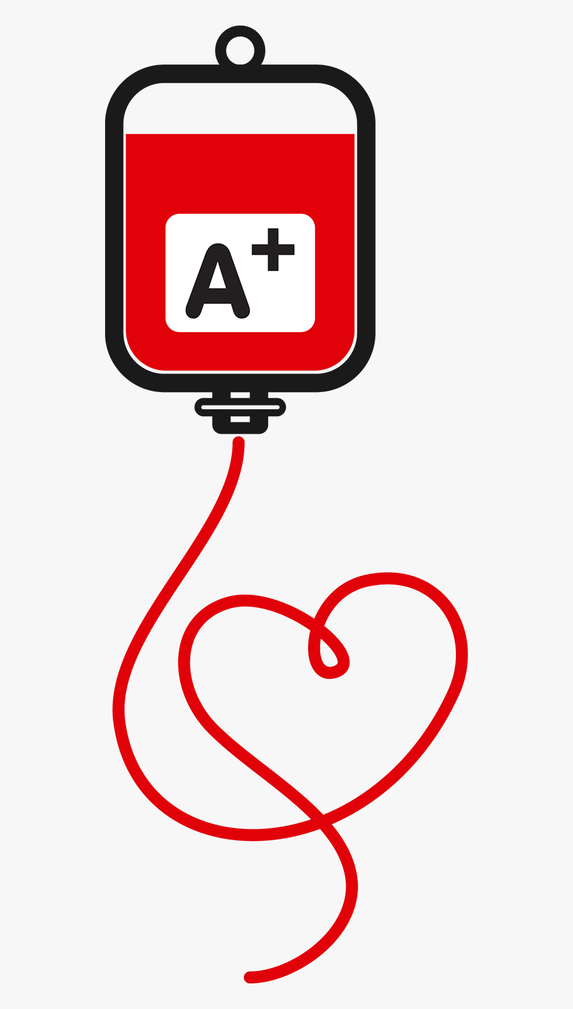
Motivation Of The
Work
Most of us have lost someone near and dear to us in this pandemic and being a student we always asked from ourselves what can we do from our side to save lives of people who are dying untimely deaths.
Meantime, we researched and came across a fact that every day 12,000 people in India die due to the sheer lack of donated blood. Hence we decided that no one in our country should die from lack of blood.
There is no denying that the blood is available at blood banks but there is vast shortage of Reliable Blood donors in the society.

Slide 4




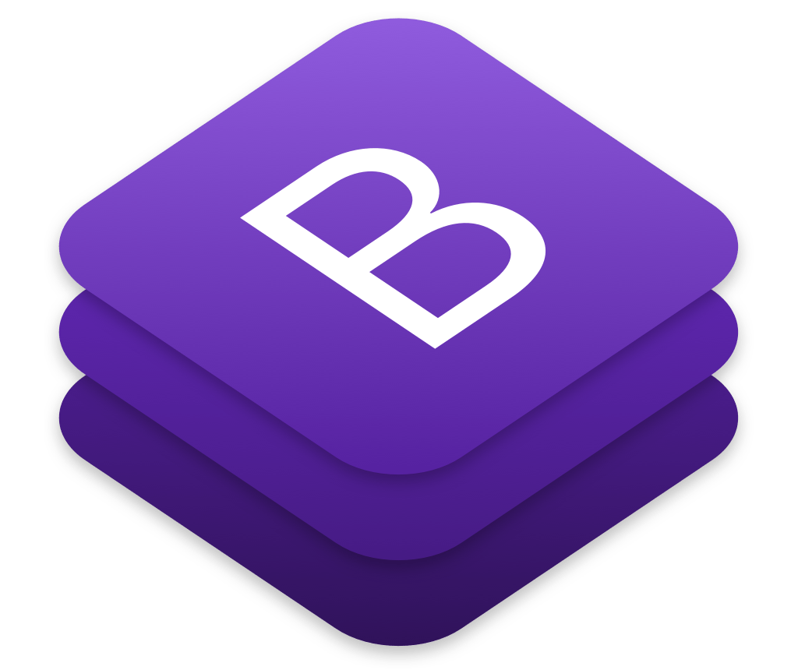

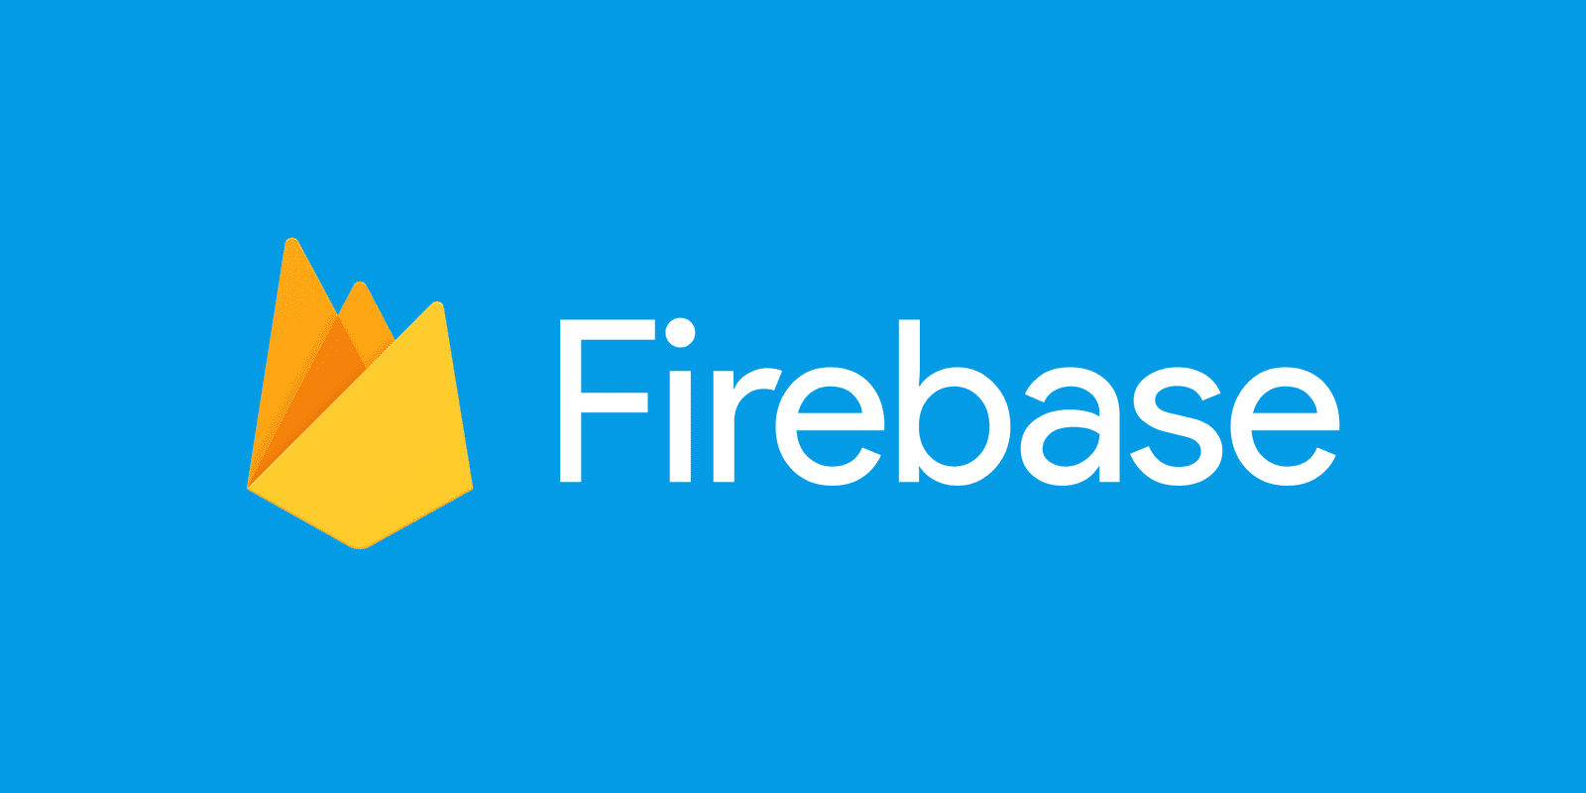

State-Of-The-Art
Techniques / Works
Technologies Used
Hosting : Firebase
API : NodeJS, AxiosJs
Backend : Firebase DB
Frontend : ReactJs, Bootstrap, CSS3, HTML5
Software Development Technique
Waterfall Method

Slide 5
TECH STACK
1.
React
A JavaScript library for building user interfaces
Firebase
Backed by Google and loved by app development
teams - from startups to global enterprises
2.
3.
Bootstrap
Compact CSS Library build by twitter for small and fast CSS Components
4.
HTML5 , CSS3 & JavaScript
The building blocks for every web-app

Slide 6


Problem Observed on the State-of-The-Art Techniques/Works
Problems Occurred :
Tech Stack was Hard To Learn and Implement because its comparatively new to rest tech Stacks
Bootstrap is not completely Compatible with ReactJS hence faced Issues regarding Component Management.
Chatbot Library was hard and Buggy to implement.

Slide 7

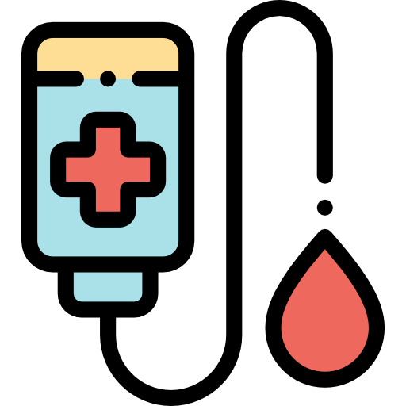
Exact Problem We Will Solve
A Platform where a person can request for blood & doner can donate blood directly to the person in need & get some cash
Blood donors can donate blood and submit a report once his/her document gets verified by admin he/she will get a live-saver (hero) rank on our community donor list. "We think that if you are a hero you should get recognition", which in turn inspires other new donors to come forward and donate for mankind.
Just like any other social media platforms the main motive of this platform is to create a community of people who care about their health as well as of others. A Micro-blog posting platform where people can share their experiences about their medical conditions, how they tackled them or any other life experiences where their health was challenged. In India there are very few Health centered community platforms.

Slide 8
Exact Problem We Will Solve
Interactive Medi-Bot which tells solves user first hand queries in no time with in-built BMI calculator and other related features.
A smart BMI-Calculator which not only calculates your BMI but also tells your recommended weight, daily calorie requirements, a complementary diet also. Moreover 3D yoga asanas and Covid support has also been provided

Slide 9


POTENTIAL
SOLUTION
The Idea is to Build an Online Health Centred Platform which promotes regular blood donations particularly in the 18-35 age demographics.
“The motive is to Create and Sustain and Increase Reliable Blood Donors in the society.”

Slide 10
POTENTIAL
SOLUTION
Creating a blood donation Centred Social Platform where a donor can join and tell everyone that he/she just donated blood and get the well deserved recognition that the blood donors should get
We have developed a web app where a donor can join by simple signup. The blood donor then can go to the blood donation section and submit their name with some required documents and other small details that he/she has donated blood.
Once the documents get verified by the admin a post appears in the home field just like a social platform showing all the people in the platform that he/she just to donated blood. Donor also gets a ranking in the hero-leaderboard of Blood donors according to the amount of blood donated

Slide 11
POTENTIAL
SOLUTION
When a blood donor donates blood he/she gets a ranking as well as automatic community post that he/she just donated blood. Other People of Platform can like and comment the community post as well as the Leader-board ranking gives a lot of recognition to the blood donors who have donated blood
This promotes other people precisely new donors to donate blood for a good cause and also breaks lot of maths related with the blood donation. It creates awareness among the people that donating blood is not a very hard task and also makes The present blood donors to sustain and donate more blood for mankind

Slide 12
Novelty Of The Work
Blood donors can donate blood and submit a report once his/her document gets verified by admin he/she will get a live-saver (`hero`) rank on our community donor list. "We think that if you are a `hero` you should get recognition", which in turn inspires other new donors to come forward and donate for mankind.
3.
1.
Interactive Medi-BoT which tells solves user first hand queries in no time with in-built BMI calculator and other related features.
Just like any other social media platforms the main motive of this platform is to create a community of people who care about thier health as well as of others. A Micro-blog posting platform where people can share thier experiences about thier medical conditions, how they tackled them or any other life experinces where their health was challenged. In India there are very few Health centered community platforms.
4.
2.
A smart BMI-Calculator which not only calculates your BMI but also tells your recommended weight, daily calorie requirements, a complementary diet also.
Moreover 3D yoga asanas and Covid support has also been provided.

Slide 13

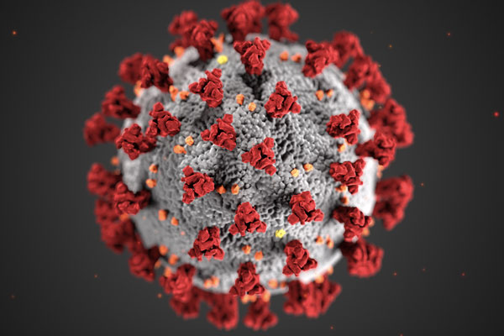

Future Work Plans
Connecting Hospitals for blood donations
Enhanced Covid Symptom Checker
Better And Faster UI & Scaling Project

Slide 14

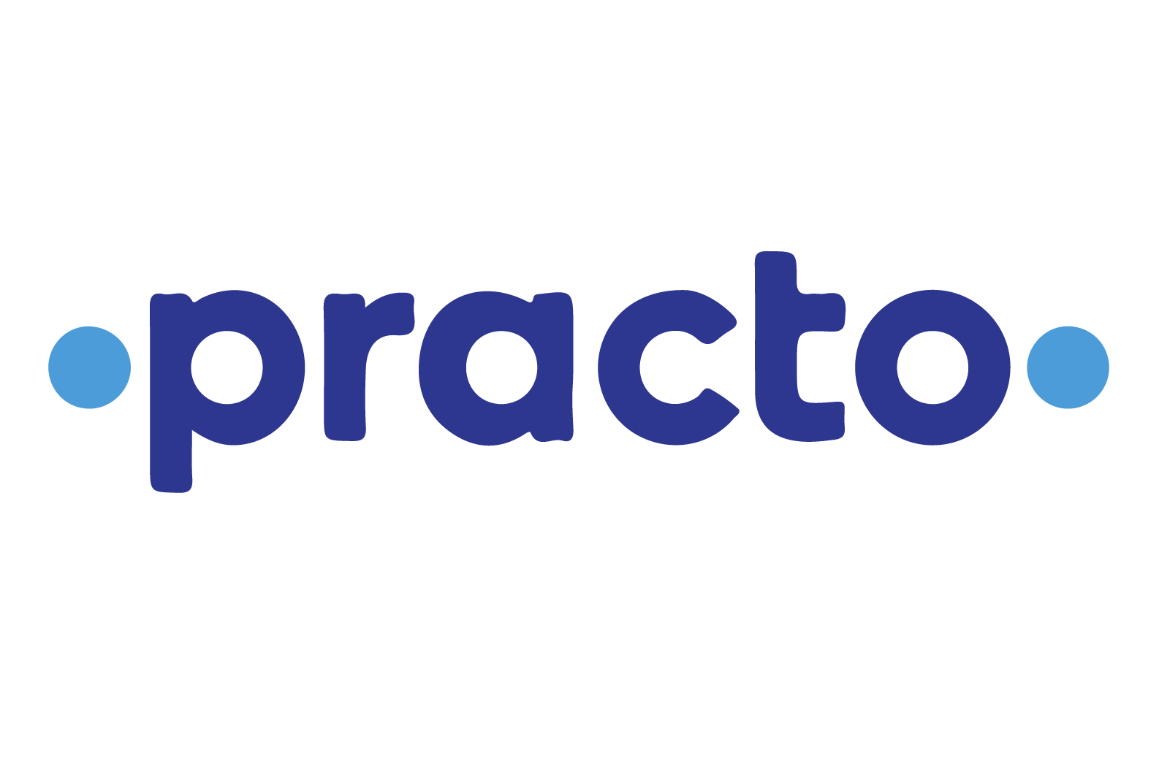


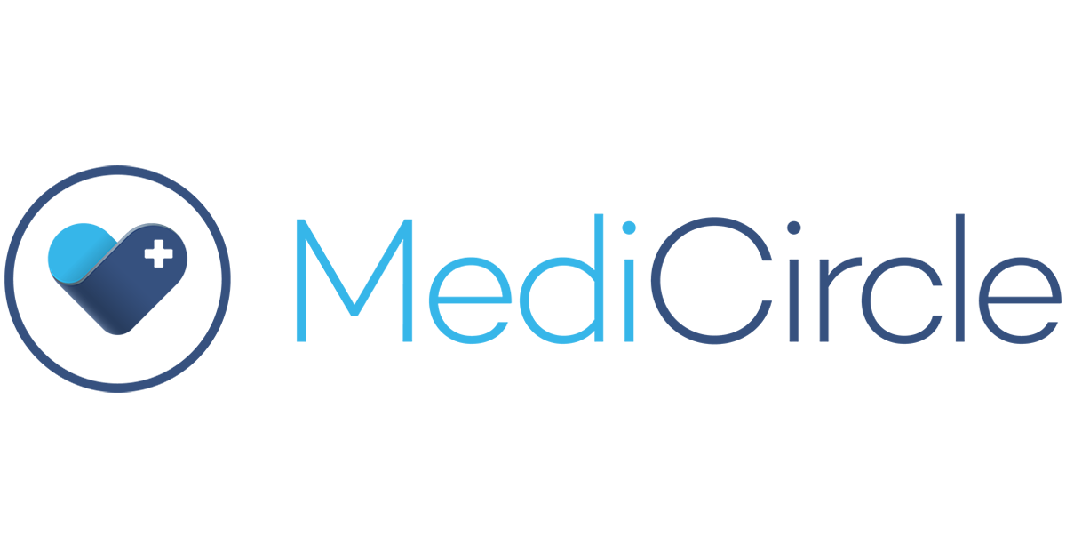
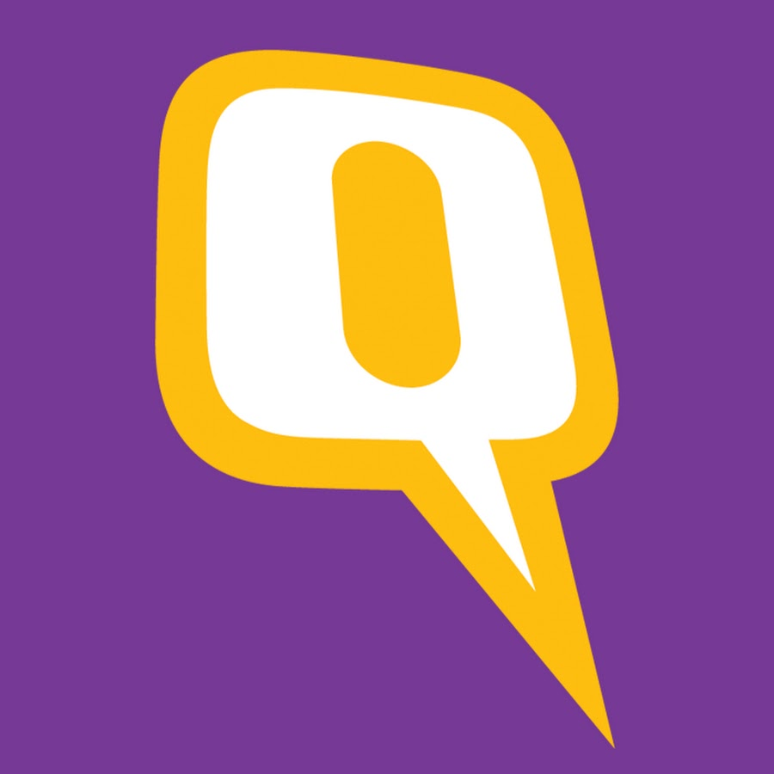
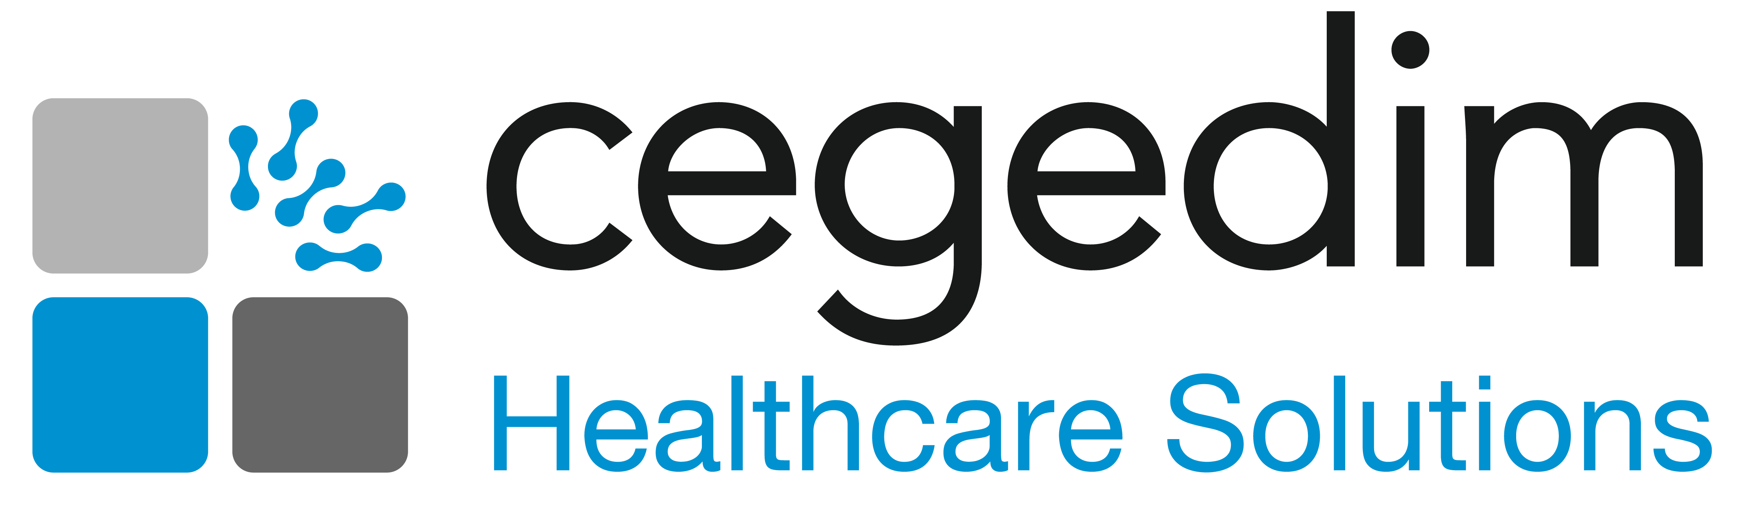
R
E
F
E
R
E
N
C
E

Slide 15

THANK YOU

